Slide 1


Slide 2
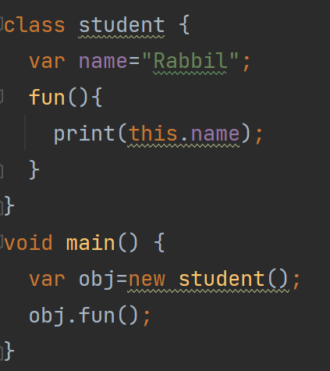
Dart this Keyword
The this keyword is used to refer the current class object. It indicates the current instance of the class, methods, or constructor.

Slide 3
Dart Inheritance
Dart inheritance is defined as the process of deriving the properties and characteristics of another class. It provides the ability to create a new class from an existing class. It is the most essential concept of the oops(Object-Oriented programming approach). We can reuse the all the behavior and characteristics of the previous class in the new class.
Parent Class:
A class which is inherited by the other class is called superclass or parent class. It is also known as a base class.
Child Class:
A class which inherits properties from other class is called the child class. It is also known as the derived class or subclass.

Slide 4
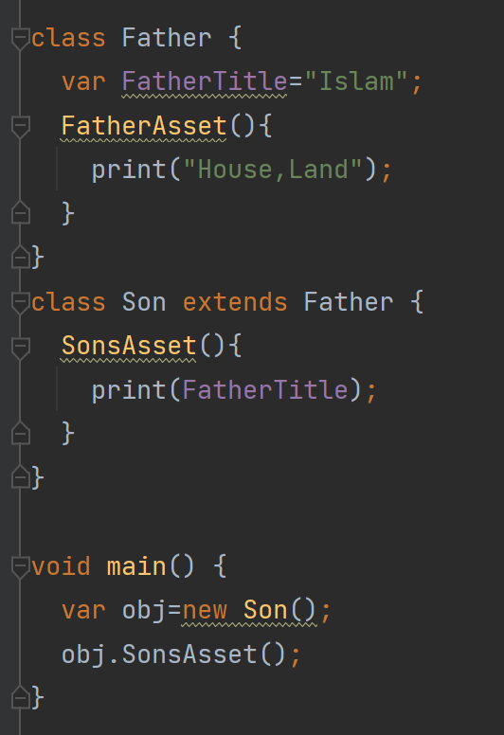
Dart Inheritance

Slide 5
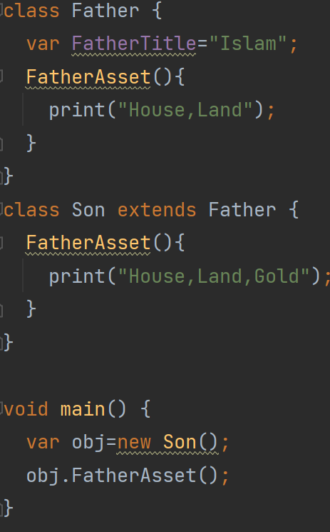
Method Overriding
When we declare the same method in the subclass, which is previously defined in the superclass is known as the method overriding. The subclass can define the same method by providing its own implementation, which is already exists in the superclass. The method in the superclass is called method overridden, and method in the subclass is called method overriding.

Slide 6
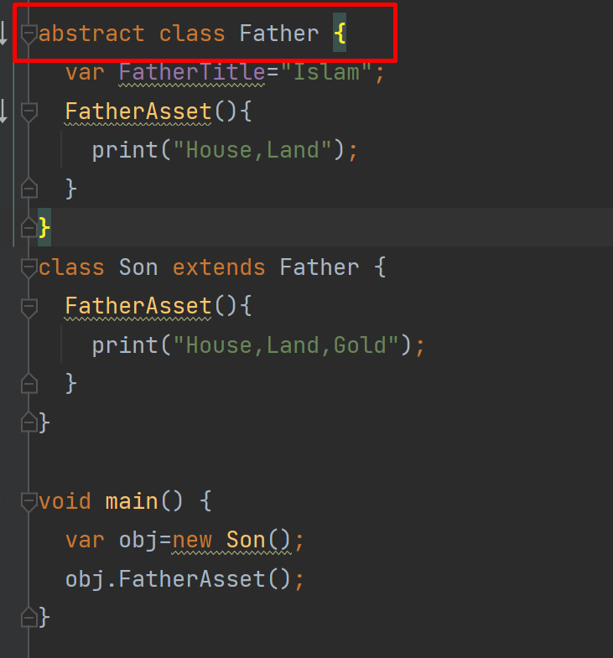
Dart Abstract Classes
Abstract classes are the classes in Dart that has one or more abstract method. Abstraction is a part of the data encapsulation where the actual internal working of the function hides from the users. They interact only with external functionality. We can declare the abstract class by using the abstract keyword. There is a possibility that an abstract class may or may not have abstract methods.

