Slide 1


Slide 2
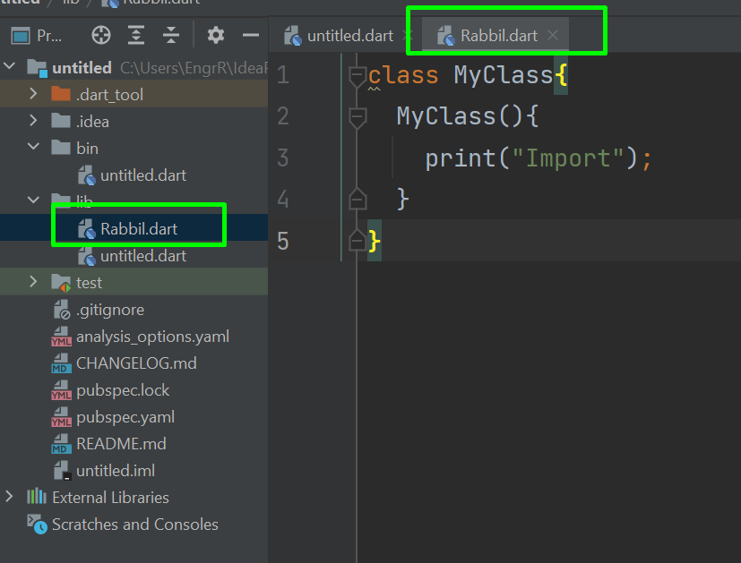
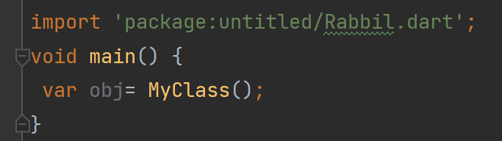
Dart Import Code Form External Files

Slide 3

Dart Debugging

