Slide 1


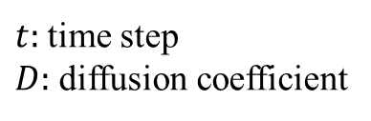


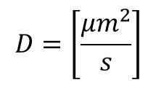
Random Brownian Motion (Free Walk)
Random walk
$$\frac{∂f}{∂t}=D\frac{∂^{2}f}{∂x^{2}}$$
$$f\left(x,t\right)= \frac{1}{\sqrt{4πDt}}e^{−\frac{x^{2}}{4Dt}}$$
g$\left(x\right)= \frac{1}{\sqrt{2π}σ}e^{−\frac{x^{2}}{σ^{2}}}$
D = 0.1
D = 0.01
$t:$time step
$D:$ diffusion coefficient
$$σ=\sqrt{2Dt}$$
$$D=\left[\frac{{μm}^{2}}{s}\right]$$
As diffusion coefficient increase, the normal distribution flattens more.
Start with some random position in (x,y) plane.
At each time step, randomly generate dx and dy from a normal distribution function for a given diffusion coefficient.
Add dx and dy to the initial position (x,y) : (x+dx, y+dy).
Repeat for all time steps.

Slide 2
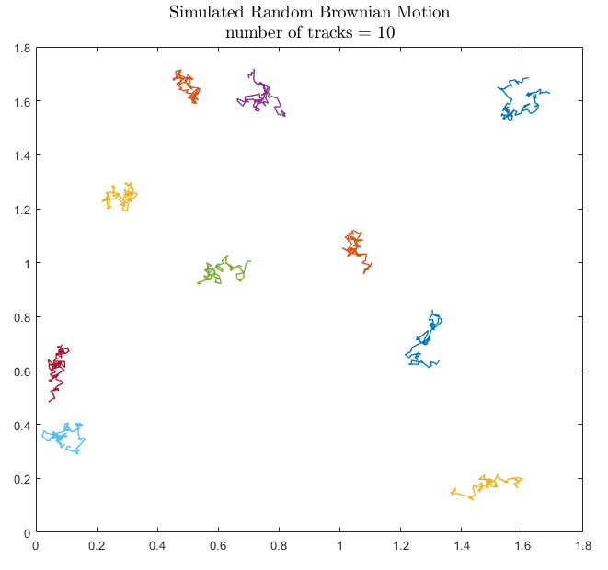
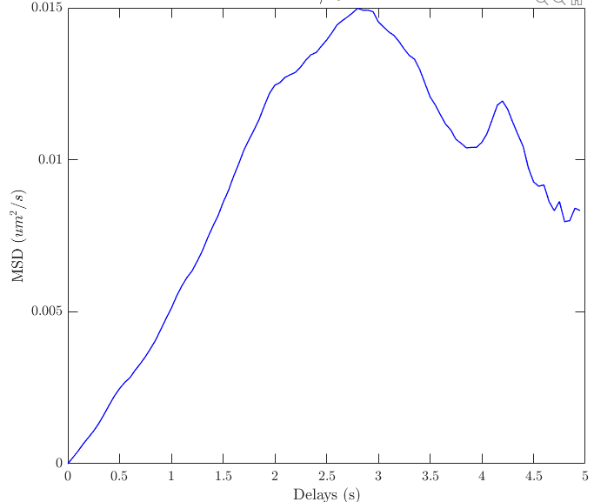
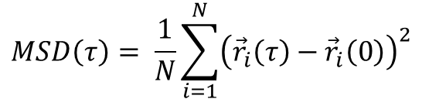
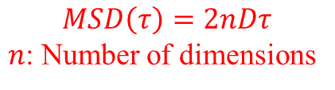

Mean Square Displacement
t x y
$$MSD\left(τ\right)= \frac{1}{N}\sum_{i=1}^{N}{{\left({\vec{r}}_{i}\left(τ\right)−{\vec{r}}_{i}\left(0\right)\right)}^{2}}$$
0 | 2.803182 | 4.52742
0.05 | 2.813882 | 4.531084
0.1 | 2.821822 | 4.550547
0.15 | 2.824778 | 4.554392
0.2 | 2.827643 | 4.556678
0.25 | 2.821854 | 4.560226
0.3 | 2.837868 | 4.566485
0.35 | 2.839508 | 4.555638
0.4 | 2.834627 | 4.542947
0.45 | 2.842142 | 4.541845
0.5 | 2.839758 | 4.527171
0.55 | 2.855968 | 4.513676
0.6 | 2.864516 | 4.514535
$N:$ number of delays at a specific delay $τ$
$$MSD\left(τ\right)=2nDτ$$
$n$: Number of dimensions
In two dimensions fit MSD curve to a linear function, slope/4 is a measure of Diffusion Coefficient.

Slide 3
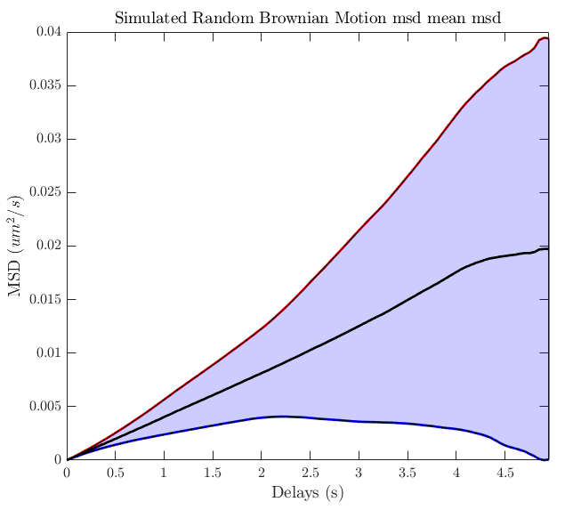
<Mean Square Displacement>
Ensemble mean, mean over all MSDs for all tracks

Slide 4
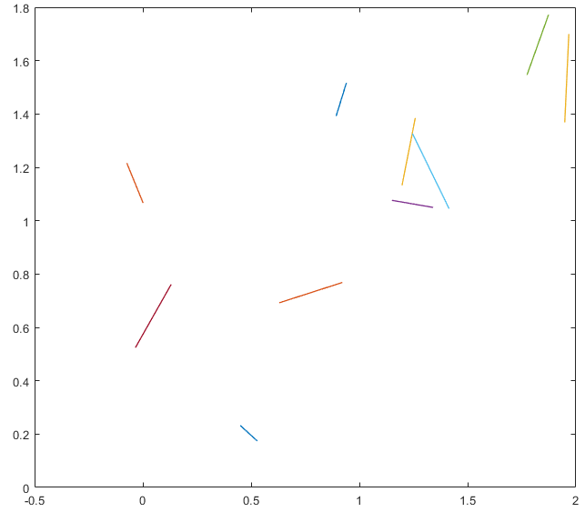
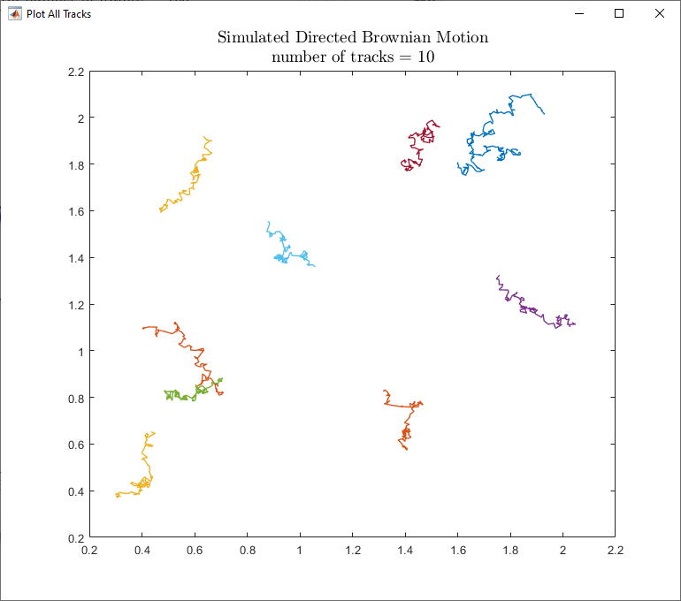
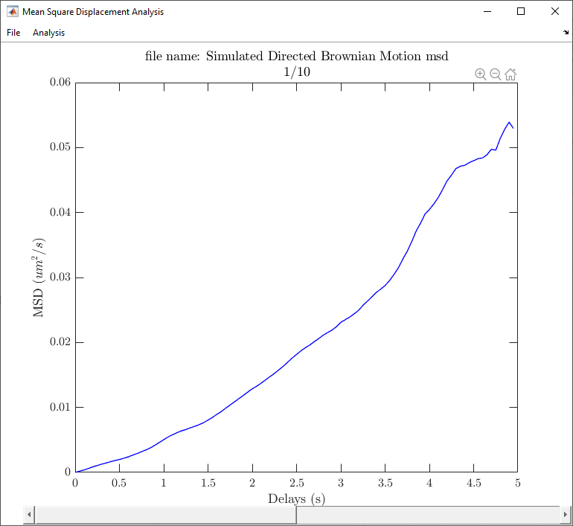

Directed Brownian Motion
Random walk
Directed Motion
Free Walk + Velocity Direction
$$+$$
If we only consider a directed motion and neglect the random walk: $x = vt$, hence: MSD = $v^{2}τ^{2}$
Now if we add the free walk motion to the directed motion, we get MSD = $2nDτ+v^{2}τ^{2}$

Slide 5
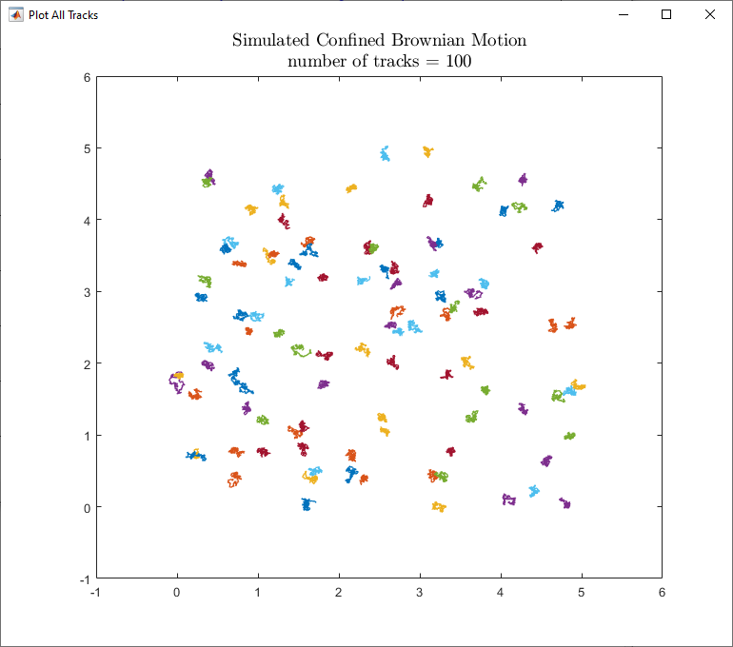
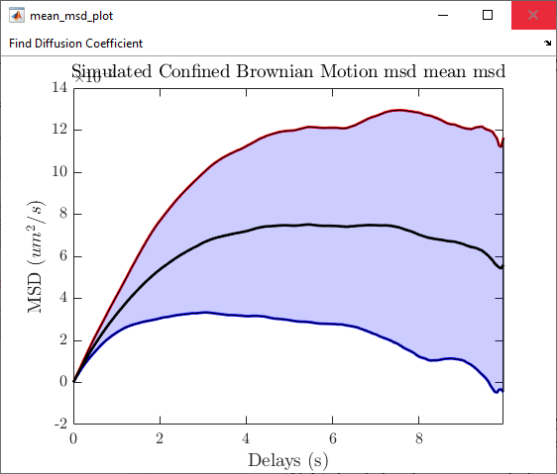


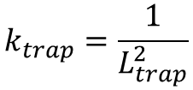
Confined Brownian Motion
Random walk
Spring Force
Free Walk + Spring Force
$$+$$
$$k_{trap}=\frac{1}{L_{trap}^{2}}$$
$$F_{trap}=−k_{trap}(x−x_{0})$$
$${dx}_{trap}=DF_{trap}dt$$
0) Start with some random position in (x,y) plane.
1) Calculate dx_{trap} and dy_{trap} from the spring force.
2) Calculate dx_{random} and dy_{random} from the normal distribution function to generate the random walk.
3) Add dx_{trap} and dx_{random} ; and dy_{trap} and dy_{random}
4) Repeat for all time steps.

