Slide 1
Microservice
Mohammad shokri

Slide 2
Introduction
Microservice architecture is an architectural method that relies on a series of independently deployable services.

Slide 3
Characteristics
An approach to software development
Small independent services
Communicate over API
Each service owned by small, self-contained teams

Slide 4
Monolith
Microservice
A traditional application has most of its functionality within a few processes that are componentized with layers and libraries.
Scales by cloning the app on multiple app on multiple servers/VMs
Segregates functionality into separate smaller services.
Scales out by deploying each service independently with multiple instances across servers/VMs

Slide 5
Dev stack

Slide 6
Use the right tool for the right job

Slide 7
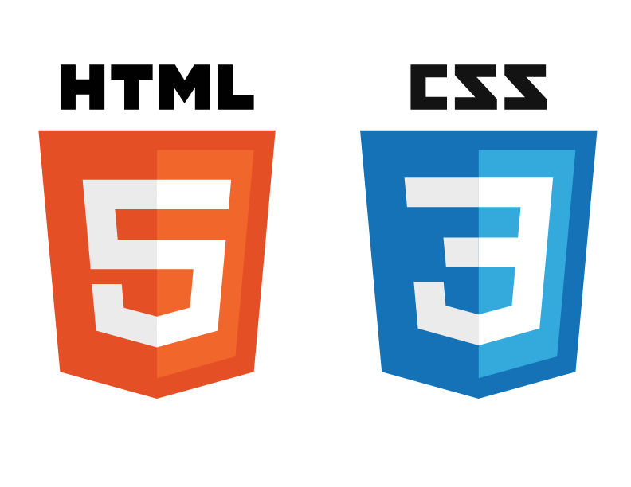









Front-end
Chat
Accounting
Game
Friend

Slide 8
Chat
Accounting
Friend
Front-end
Game

Slide 9
API gateways

Slide 10
Micro-services only rely on each other’s public API

Slide 11
Front-end
localhost:4000
Chat
Accounting
Game
localhost:3000
Friend
localhost:3000
localhost:8000

Slide 12
Chat
Accounting
Friend
Front-end
Game
localhost:8000/static
localhost:8000

Slide 13
Components

Slide 14
Do one thing, do it well

Slide 15
Front-end
Chat
Accounting
Game
Friend
Web socket Tic Tac Toe
Web socket personal chat
Authentication
Login and registration
Authentication
Web socket lobby
Chat history
Friend list and requests and connect
User Validation
User Validation

Slide 16
Front-end
Chat
Web socket personal chat
Login and registration
Web socket Tic Tac Toe
Accounting
Friend
Web socket lobby
Game
Chat history
Friend list and requests and connect

Slide 17
Deployment

Slide 18
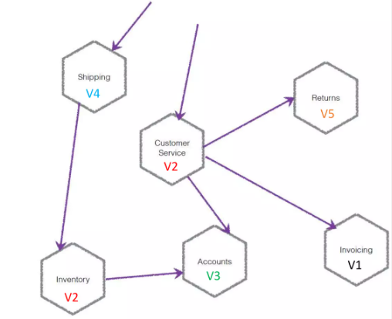
INDEPENDENTLY DEPLOYABLE
No lock-step build and deployment
Avoiding the distributed monolith

Slide 19
Front-end
Deployed on simple static nginx server
Chat
Accounting
Game
Friend
Deployed on Virtual machine
Deployed on Docker
Deployed on host OS with apache

Slide 20
Front-end
Chat
Accounting
Friend
Deployed on Virtual machine
Game

Slide 21
Management

Slide 22
Getting to production fast
Multiple and individual teams
Microservice architecture
Continuous delivery
Multiple environments

Slide 23
Front-end
Github repository x1 – team1
Chat
Accounting
Game
Friend
Gitlab repository x3 – team3
Github repository x2 – team2
Gitlab repository x4 – team4

Slide 24
Front-end
Github repository x2 – team2
Chat
Accounting
Friend
Game
Github repository x1 – team1

Slide 25
Benefits
Service independence increases an application’s resistance to failure
Agility
Each team works on their small and well understood context
Flexible scaling
Easy deployment
Any language
Software divided into small, well defined modules
Resilience
Reusable code
Each service is independently scaled
Any Database
Anywhere
Anytime
1
2
3
4
5

Slide 26
Challenges

Slide 27
Distributed transactions
Managing transactions across different microservices are hard.
Business operations that update multiple business entities are fairly common, and they are usually atomic means either all operations are applied or everything fails.
wrapping multiple operations in a single database transaction ensures atomic

Slide 28
Comprehensive testing
For example, to test the functionality of processing an order in a monolithic ecommerce service, you select items, add them to a cart, and then check out. To test the same flow in a microservices-based architecture, multiple services - such as frontend, order, and payment - call each other to complete the test run.

Slide 29
Complex deploying
A microservice application typically consists of many services, each of which has multiple runtime instances. You also need to implement a service discovery mechanism that enables a service to discover the locations of any other services it needs to communicate with.

Slide 30
Overhead
there are more services to monitor and alert on. Microservice architecture also has more points of failure due to the increased points of service-to-service communication.
The division of services in a microservice architecture allows the application to perform more functions at the same time.

Slide 31
Summary
Microservices are not the goal, are about problems at scale
Microservices are manageable units of functionality and deployability
Own the end-to-end
Require automation and maturity

