Slide 1


Slide 2
Heterogeneous Graph Attention Network
Mohammad Ebrahimi
2021

Slide 3
Heterogeneous Graph
Despite the success of attention mechanism in deep learning, it has not been considered in the graph neural network framework for heterogeneous graph.
Heterogeneity of graph:
means various types of nodes and edges.
For example, different types of nodes have different traits and their features may fall in different feature space.

Slide 4
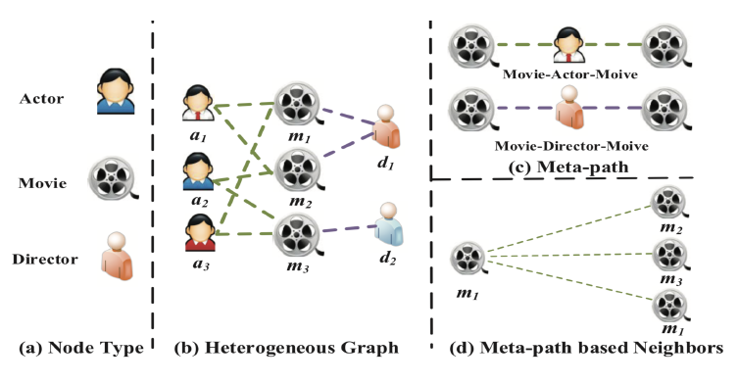
Heterogeneous Graph
Taking the movie data IMDB as an example:
it contains three types of nodes include movie, actor and director.

Slide 5
Heterogeneous Graph
Taking the movie data IMDB as an example:
the feature of an actor may involve in sex, age and nationality. On the other hand, the feature of movie may involve in plot and actors.

Slide 6
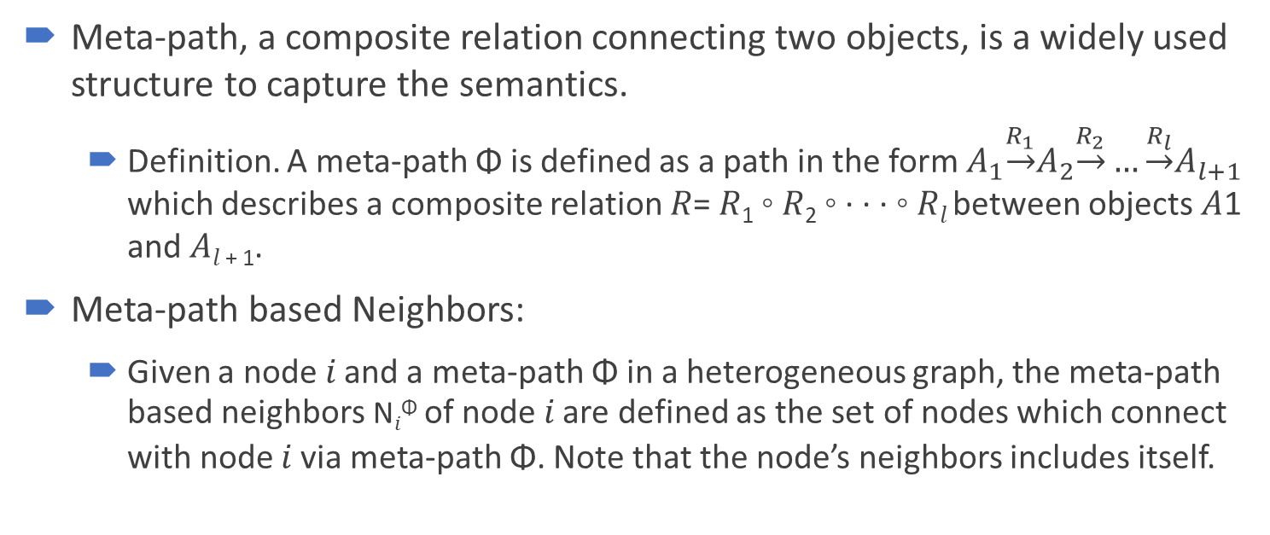
Meta-Path
Meta-path, a composite relation connecting two objects, is a widely used structure to capture the semantics.
Definition. A meta-path Φ is defined as a path in the form $A_{1}\underset{→}{R_{1}}A_{2}\underset{→}{R_{2}}…\underset{→}{R_{l}}A_{l+1}$ which describes a composite relation 𝑅= 𝑅₁ ◦ 𝑅₂ ◦ · · · ◦ 𝑅_{𝑙} between objects 𝐴1 and 𝐴_{𝑙 + 1}.
Meta-path based Neighbors:
Given a node 𝑖 and a meta-path Φ in a heterogeneous graph, the meta-path based neighbors N_{𝑖}^{Φ} of node 𝑖 are defined as the set of nodes which connect with node 𝑖 via meta-path Φ. Note that the node’s neighbors includes itself.

Slide 7
Meta-Path
Taking the movie data IMDB as an example:
two movies can be connected via multiple meta-paths:
Movie-Actor-Movie (MAM) : means the co-actor relation
Movie-Director-Movie (MDM): means they are directed by the same director

Slide 8
Meta-Path
Taking the movie data IMDB as an example:
given the meta-path Movie-Actor-Movie, the meta-path based neighbors of 𝑚1 includes 𝑚1 (itself) 𝑚2 and 𝑚3.

Slide 9
Heterogeneous Graph Attention Network
we propose a heterogeneous graph neural network based on the hierarchical attention, including:
node-level attention :
For each node, node-level attention aims to learn the importance of meta-path based neighbors and assign different attention values to them.
semantic-level attention :
Different meta-paths in heterogeneous graph may extract diverse semantic information.
Semantic-level attention aims to learn the importance of each meta-path and assign proper weights to them.

Slide 10



Node-level Attention
when using the meta-path Movie-Director-Movie ,The Terminator will connect to Titanic and The Terminator 2 via director James Cameron. To better identify the genre of The Terminator as sci-fi movie, the model should pay more attention to The Terminator 2, rather than Titanic.

Slide 11

Semantic-level Attention
The Terminator can either connect to The Terminator 2 via Movie-Actor-Movie (both starred by Schwarzenegger) or connect to Birdy via Movie-Year-Movie (both shot in 1984). However, when identifying the genre of the movie The Terminator, MAM usually plays more important role, rather than MYM.

Slide 12
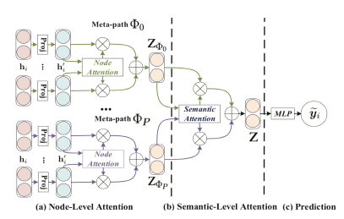
Heterogeneous Graph Attention Network
The overall framework of the proposed HAN.
(a) All types of nodes are projected into a unified feature space and the weight of meta-path based node pair can be learned via node-level attention.
(b) Joint learning the weight of each
meta-path and fuse the
semantic-specific node embedding
via semantic-level attention.
(c) Calculate the loss and end-to-end
optimization for the proposed HAN.

Slide 13
Calculation of Node-level Attention
Due to the heterogeneity of nodes, different types of nodes have different feature spaces.
Therefore, for each type of nodes (e.g., node with type 𝜙_{𝑖} ), we design the type-specific transformation matrix M_{𝜙𝑖} to project the features of different types of nodes into the same feature space.

Slide 14

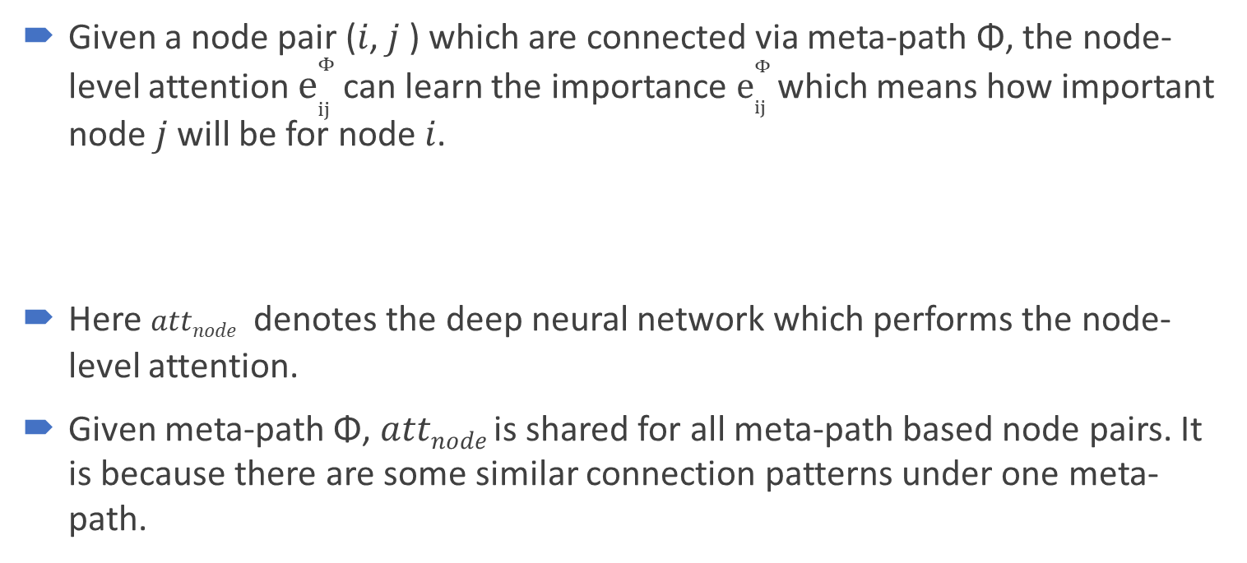
Calculation of Node-level Attention
Given a node pair (𝑖, 𝑗 ) which are connected via meta-path Φ, the node-level attention $e_{ij}^{Φ}$can learn the importance $e_{ij}^{Φ}$which means how important node 𝑗 will be for node 𝑖.
Here 𝑎𝑡𝑡_{𝑛𝑜𝑑𝑒} denotes the deep neural network which performs the node-level attention.
Given meta-path Φ, 𝑎𝑡𝑡_{𝑛𝑜𝑑𝑒} is shared for all meta-path based node pairs. It is because there are some similar connection patterns under one meta-path.

Slide 15
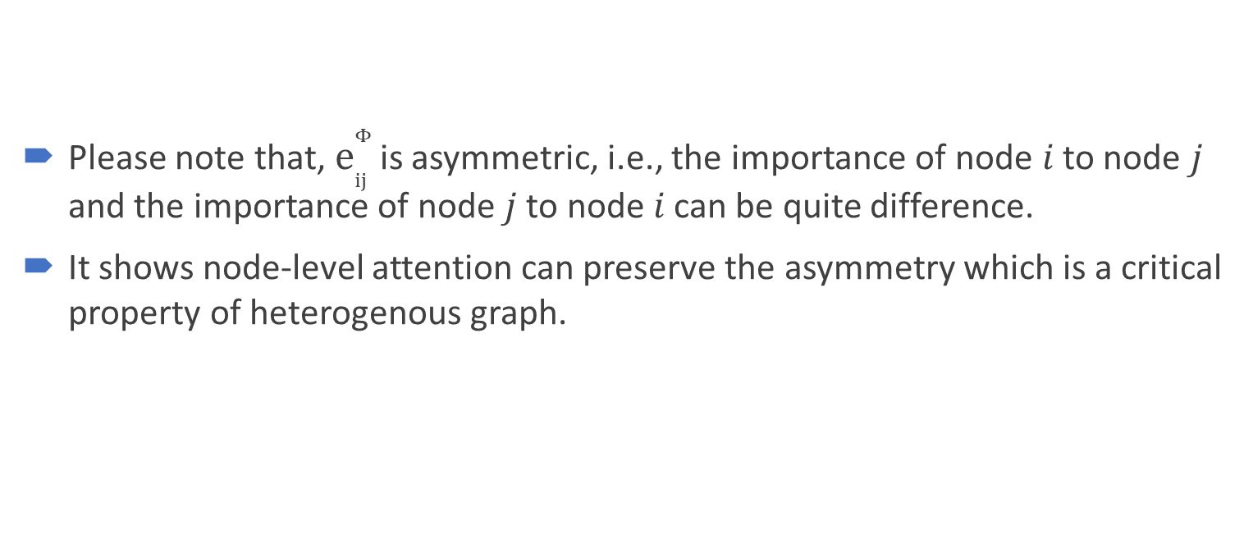
Calculation of Node-level Attention
Please note that, $e_{ij}^{Φ}$is asymmetric, i.e., the importance of node 𝑖 to node 𝑗 and the importance of node 𝑗 to node 𝑖 can be quite difference.
It shows node-level attention can preserve the asymmetry which is a critical property of heterogenous graph.

Slide 16

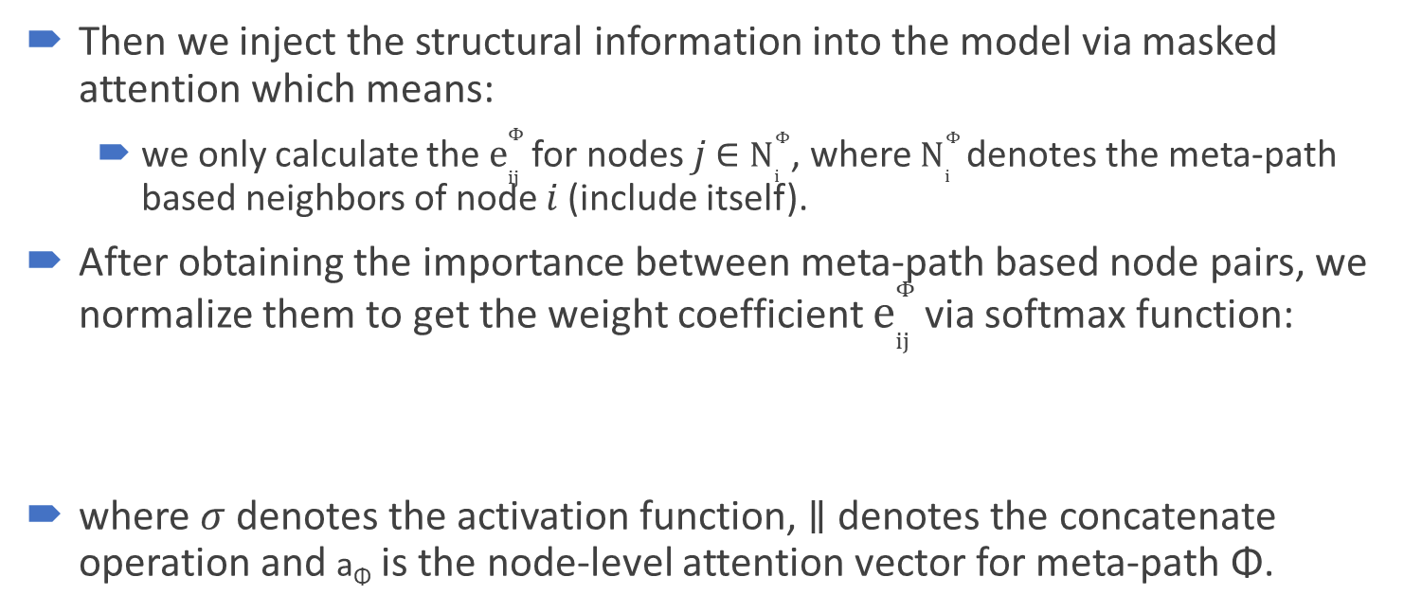
Calculation of Node-level Attention
Then we inject the structural information into the model via masked attention which means:
we only calculate the $e_{ij}^{Φ}$for nodes 𝑗 ∈ $N_{i}^{Φ}$, where $N_{i}^{Φ}$denotes the meta-path based neighbors of node 𝑖 (include itself).
After obtaining the importance between meta-path based node pairs, we normalize them to get the weight coefficient $e_{ij}^{Φ}$via softmax function:
where 𝜎 denotes the activation function, ∥ denotes the concatenate operation and a_{Φ} is the node-level attention vector for meta-path Φ.

Slide 17

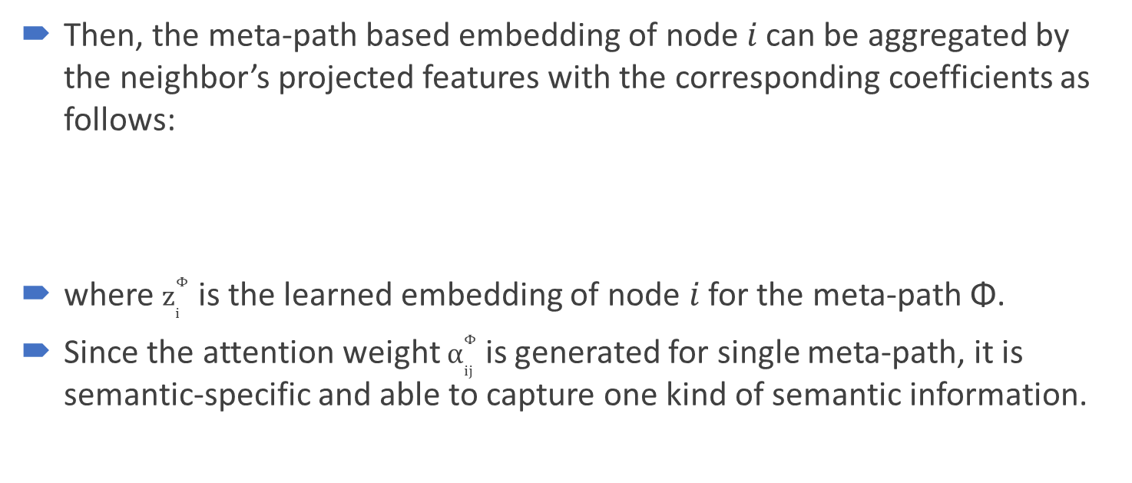
Calculation of Node-level Attention
Then, the meta-path based embedding of node 𝑖 can be aggregated by the neighbor’s projected features with the corresponding coefficients as follows:
where $z_{i}^{Φ}$ is the learned embedding of node 𝑖 for the meta-path Φ.
Since the attention weight $α_{ij}^{Φ}$ is generated for single meta-path, it is semantic-specific and able to capture one kind of semantic information.

Slide 18

Calculation of Node-level Attention
Since heterogeneous graph present the property of scale free, the variance of graph data is quite high.
To tackle the above challenge, we extend node-level attention to multihead attention so that the training process is more stable.
Specifically, we repeat the node-level attention for 𝐾 times and concatenate the learned embeddings as the semantic-specific embedding:
Given the meta-path set {Φ₁, . . . , Φ_{𝑃}}, after feeding node features into node-level attention, we can obtain 𝑃 groups of semantic-specific node embeddings, denoted as {Z_{Φ1}, . . . , Z_{Φ𝑃}} .

Slide 19
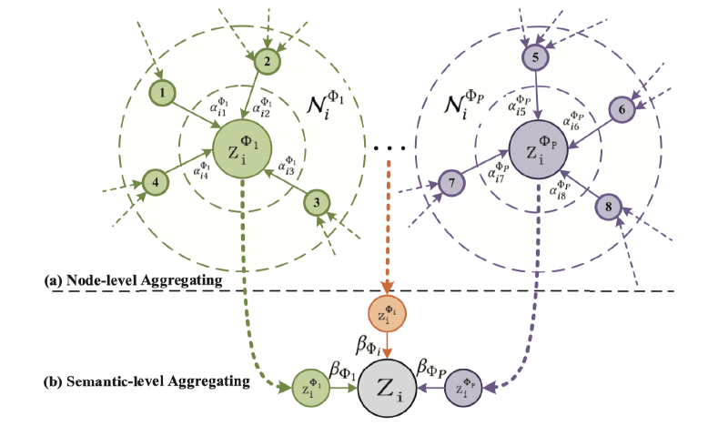
Calculation of Node-level Attention

Slide 20
Calculation of Semantic-level Attention
Generally, every node in a heterogeneous graph contains multiple types of semantic information and semantic-specific node embedding can only reflect node from one aspect.
To learn a more comprehensive node embedding, we need to fuse multiple semantics which can be revealed by meta-paths.
semantic-level attention automatically learns the importance of different meta-paths and fuse them for the specific task.

Slide 21
Calculation of Semantic-level Attention
Taking 𝑃 groups of semantic-specific node embeddings learned from node-level attention as input, the learned weights of each meta-path
(𝛽_{Φ1} , . . . , 𝛽_{Φ𝑃}) can be shown as follows:
Here 𝑎𝑡𝑡_{𝑠𝑒𝑚} denotes the deep neural network which performs the semantic-level attention.

Slide 22

Calculation of Semantic-level Attention
To learn the importance of each meta-path, we first transform semantic-specific embedding through a nonlinear transformation (e.g., one-layer MLP).
Then we measure the importance of the semantic-specific embedding as the similarity of transformed embedding with a semantic-level attention vector q.
Furthermore, we average the importance of all the semantic-specific node embedding which can be explained as the importance of each meta-path.

Slide 23


Calculation of Semantic-level Attention
The weight of meta-path Φ_{𝑝} , denoted as 𝛽_{Φ𝑝}, can be obtained by normalizing the above importance of all meta-paths using softmax function:
With the learned weights as coefficients, we can fuse these semantic-specific embeddings to obtain the final embedding Z as follows:

Slide 24
Calculation of Semantic-level Attention

Slide 25

Loss
we can apply the final embedding to specific tasks and design different loss function.
For semi-supervised node classification, we can minimize the Cross-Entropy over all labeled node between the ground-truth and the prediction:
where C is the parameter of the classifier, Y_{𝐿} is the set of node indices that have labels, Y_{𝑙} and Z_{𝑙} are the labels and embeddings of labeled nodes.
With the guide of labeled data, we can optimize the proposed model via back propagation and learn the embeddings of nodes.

