Slide 1


Slide 2
Heterogeneous Graph Attention Network
Mohammad Ebrahimi
2021
Xiao Wang, Houye Ji, Chuan Shi, Bai Wang, Peng Cui, P. Yu, & Yanfang Ye. (2021). Heterogeneous Graph Attention Network.

Slide 3
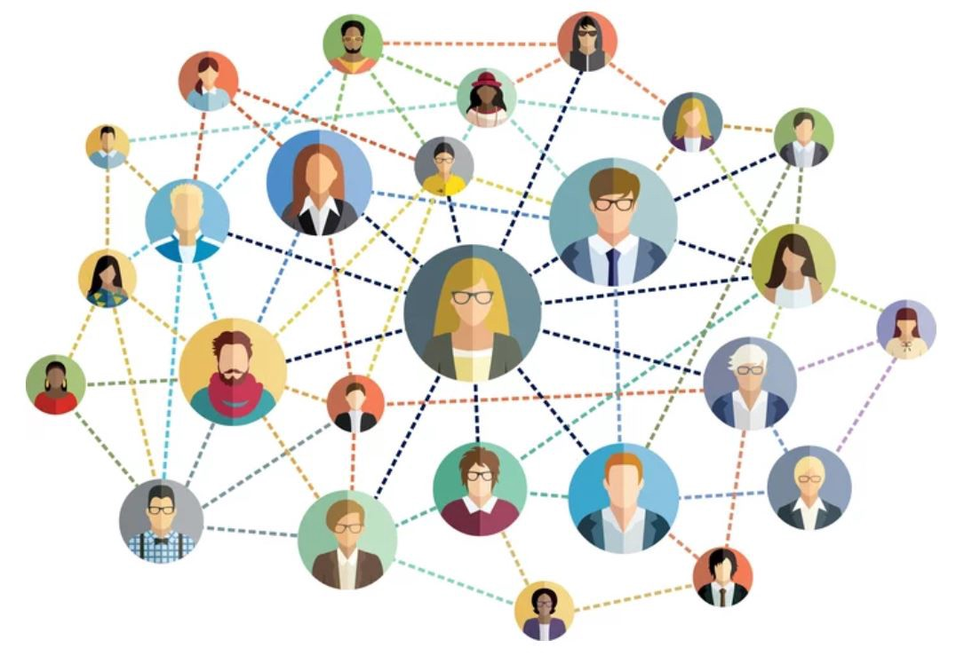

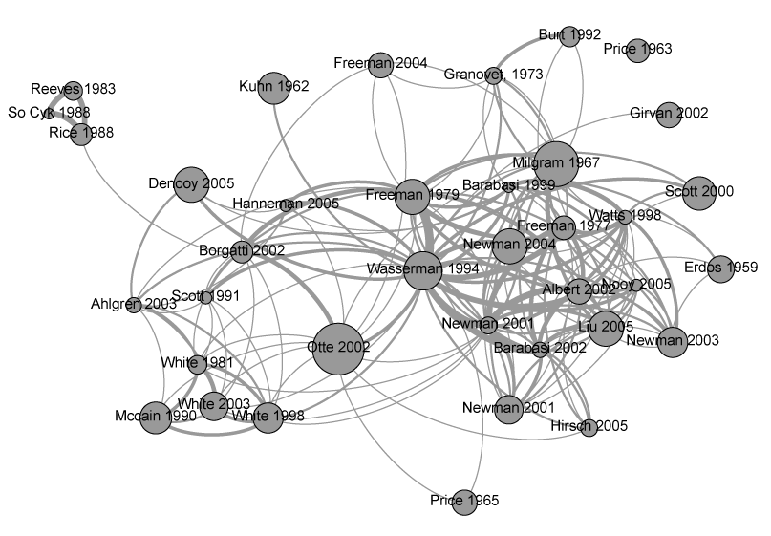
Real World Data
The real-world data usually come together with the graph structure
social networks
citation networks
world wide web

Slide 4
Graph neural network (GNN)
a powerful deep representation learning method for such graph data
has shown superior performance on network
Some works leverage deep neural network to learn node representations based on node features and the graph structure
Some works propose the graph convolutional networks by generalizing the convolutional operation to graph

Slide 5
Attention Mechanism
attention mechanism:
deals with variable sized data
encourages the model to focus on the most salient parts of data
has demonstrated the effectiveness in deep neural network framework
is widely applied to various applications, such as:
text analysis
knowledge graph
image processing

Slide 6
Attention Mechanism(in Graphs)
Graph Attention Network
a novel convolution-style graph neural network, leverages attention mechanism for the homogeneous graph which includes only one type of nodes or links.
Despite the success of attention mechanism in deep learning, it has not been considered in the graph neural network framework for heterogeneous graph.

Slide 7
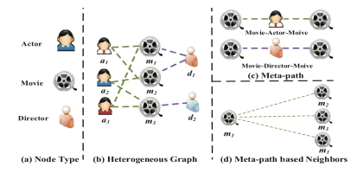
Heterogeneous Graph
Heterogeneity of graph:
means various types of nodes and edges.
For example, different types of nodes have different traits and their features may fall in different feature space.

Slide 8
Heterogeneous Graph
Taking the movie data IMDB as an example:
it contains three types of nodes include movie, actor and director.
the feature of an actor may involve in sex, age and nationality. On the other hand, the feature of movie may involve in plot and actors.

Slide 9
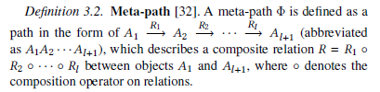
Meta-Path
Meta-path, a composite relation connecting two objects, is a widely used structure to capture the semantics.

Slide 10
Meta-Path
Taking the movie data IMDB as an example:
two movies can be connected via multiple meta-paths:
Movie-Actor-Movie (MAM) : means the co-actor relation
Movie-Director-Movie (MDM): means they are directed by the same director

Slide 11
Meta-Path
Meta-path based Neighbors:
Given a node 𝑖 and a meta-path Φ in a heterogeneous graph, the meta-path based neighbors N_{𝑖}^{Φ} of node 𝑖 are defined as the set of nodes which connect with node 𝑖 via meta-path Φ. Note that the node’s neighbors includes itself.
We can get meta-path based neighbors by the multiplication of a sequences of adjacency matrices.

Slide 12
Meta-Path
Meta-path based Neighbors:
Taking Figure (d) as an example:
given the meta-path Movie-Actor-Movie, the meta-path based neighbors of 𝑚1 includes 𝑚1 (itself), 𝑚2 and 𝑚3.
Similarly, the neighbors of 𝑚1 based on meta-path Movie-Director-Movie includes 𝑚1 and 𝑚2.

Slide 13
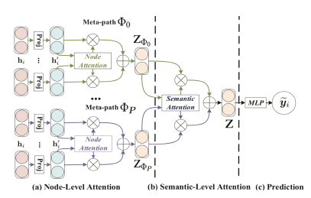
Heterogeneous Graph Attention Network
we propose a heterogeneous graph neural network based on the hierarchical attention, including:
node-level attention
semantic-level attention

Slide 14
Node-level Attention
In a heterogeneous graph, Given a meta-path, each node has lots of meta-path based neighbors.
For each node, node-level attention aims to learn the importance of meta-path based neighbors and assign different attention values to them.

Slide 15



Node-level Attention
taking IMDB as an example:
when using the meta-path Movie-Director-Movie ,The Terminator will connect to Titanic and The Terminator 2 via director James Cameron. To better identify the genre of The Terminator as sci-fi movie, the model should pay more attention to The Terminator 2, rather than Titanic.

Slide 16
Semantic-level Attention
Different meaningful and complex semantic information are involved in heterogeneous graph, which are usually reflected by meta-paths.
Different meta-paths in heterogeneous graph may extract diverse semantic information.
Semantic-level attention aims to learn the importance of each meta-path and assign proper weights to them.

Slide 17

Semantic-level Attention
Still taking IMDB as an example, The Terminator can either connect to The Terminator 2 via Movie-Actor-Movie (both starred by Schwarzenegger) or connect to Birdy via Movie-Year-Movie (both shot in 1984). However, when identifying the genre of the movie The Terminator, MAM usually plays more important role, rather than MYM.

Slide 18
Heterogeneous Graph Attention Network
The overall framework of the proposed HAN.
(a) All types of nodes are projected into a unified feature space and the weight of meta-path based node pair can be learned via node-level attention.
(b) Joint learning the weight of each
meta-path and fuse the
semantic-specific node embedding
via semantic-level attention.
(c) Calculate the loss and end-to-end
optimization for the proposed HAN.

Slide 19
Calculation of Node-level Attention
Due to the heterogeneity of nodes, different types of nodes have different feature spaces.
Therefore, for each type of nodes (e.g., node with type 𝜙_{𝑖} ), we design the type-specific transformation matrix M_{𝜙𝑖} to project the features of different types of nodes into the same feature space.

Slide 20

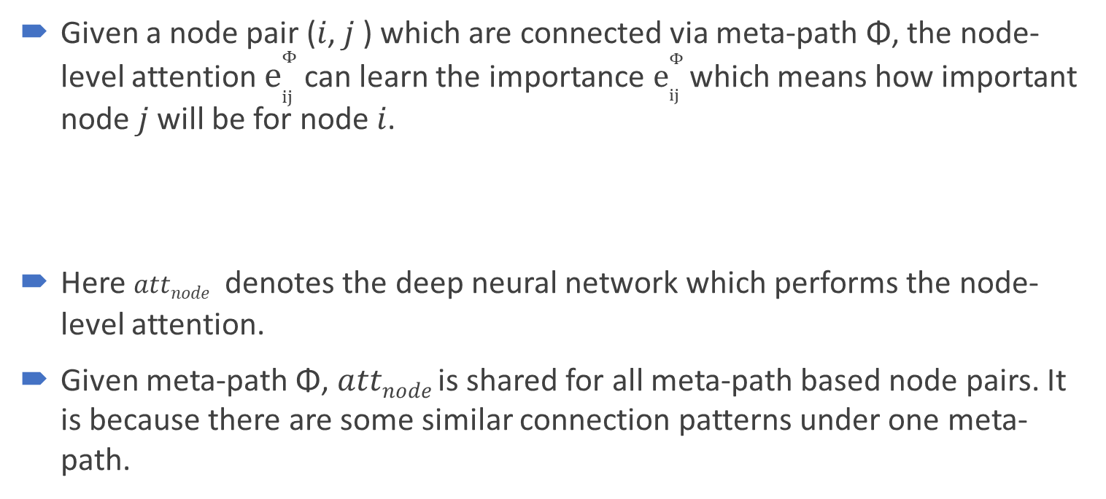
Calculation of Node-level Attention
Given a node pair (𝑖, 𝑗 ) which are connected via meta-path Φ, the node-level attention $e_{ij}^{Φ}$can learn the importance $e_{ij}^{Φ}$which means how important node 𝑗 will be for node 𝑖.
Here 𝑎𝑡𝑡_{𝑛𝑜𝑑𝑒} denotes the deep neural network which performs the node-level attention.
Given meta-path Φ, 𝑎𝑡𝑡_{𝑛𝑜𝑑𝑒} is shared for all meta-path based node pairs. It is because there are some similar connection patterns under one meta-path.

Slide 21
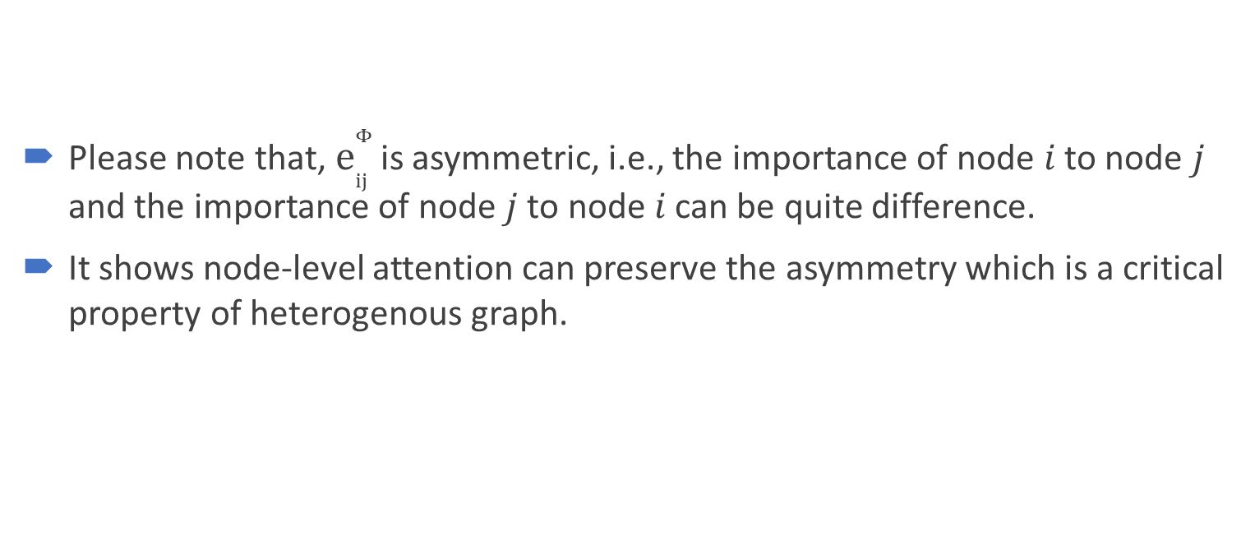
Calculation of Node-level Attention
Please note that, $e_{ij}^{Φ}$is asymmetric, i.e., the importance of node 𝑖 to node 𝑗 and the importance of node 𝑗 to node 𝑖 can be quite difference.
It shows node-level attention can preserve the asymmetry which is a critical property of heterogenous graph.

Slide 22

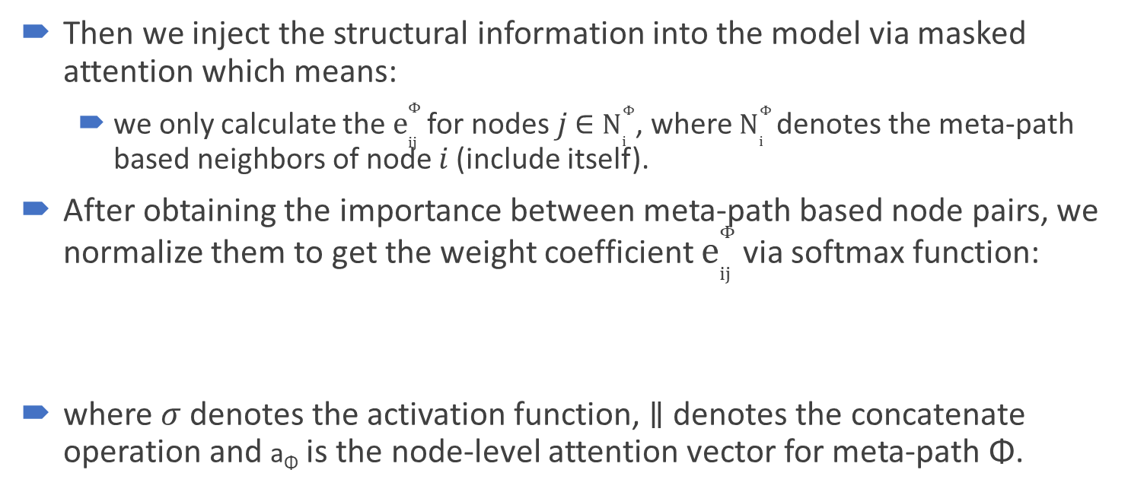
Calculation of Node-level Attention
Then we inject the structural information into the model via masked attention which means:
we only calculate the $e_{ij}^{Φ}$for nodes 𝑗 ∈ $N_{i}^{Φ}$, where $N_{i}^{Φ}$denotes the meta-path based neighbors of node 𝑖 (include itself).
After obtaining the importance between meta-path based node pairs, we normalize them to get the weight coefficient $e_{ij}^{Φ}$via softmax function:
where 𝜎 denotes the activation function, ∥ denotes the concatenate operation and a_{Φ} is the node-level attention vector for meta-path Φ.

Slide 23
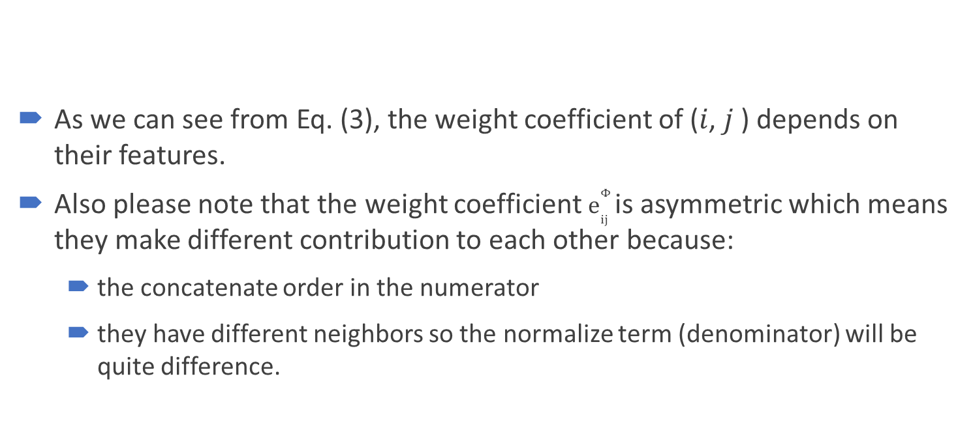
Calculation of Node-level Attention
As we can see from Eq. (3), the weight coefficient of (𝑖, 𝑗 ) depends on their features.
Also please note that the weight coefficient $e_{ij}^{Φ}$is asymmetric which means they make different contribution to each other because:
the concatenate order in the numerator
they have different neighbors so the normalize term (denominator) will be quite difference.

Slide 24

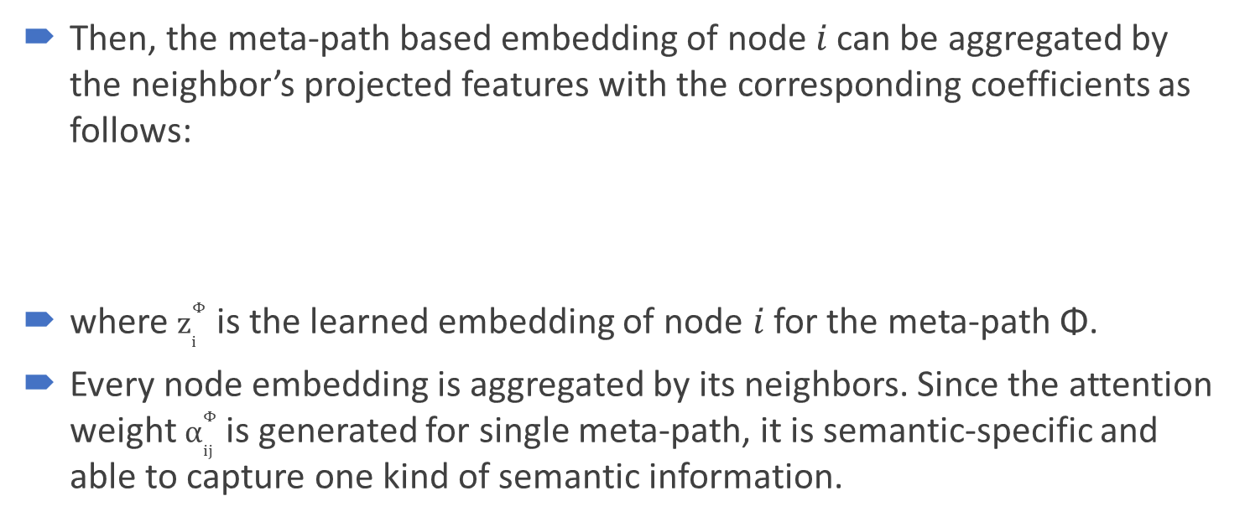
Calculation of Node-level Attention
Then, the meta-path based embedding of node 𝑖 can be aggregated by the neighbor’s projected features with the corresponding coefficients as follows:
where $z_{i}^{Φ}$ is the learned embedding of node 𝑖 for the meta-path Φ.
Every node embedding is aggregated by its neighbors. Since the attention weight $α_{ij}^{Φ}$ is generated for single meta-path, it is semantic-specific and able to capture one kind of semantic information.

Slide 25
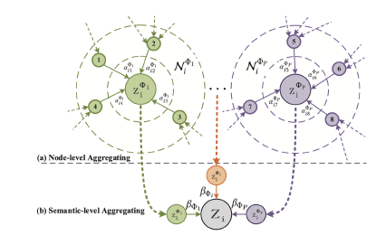

Calculation of Node-level Attention
Since heterogeneous graph present the property of scale free, the variance of graph data is quite high.
To tackle the above challenge, we extend node-level attention to multihead attention so that the training process is more stable.
Specifically, we repeat the node-level
attention for 𝐾 times and concatenate
the learned embeddings as the
semantic-specific embedding:

Slide 26
Calculation of Node-level Attention
Given the meta-path set {Φ₁, . . . , Φ_{𝑃}}, after feeding node features into node-level attention, we can obtain 𝑃 groups of semantic-specific node embeddings, denoted as {Z_{Φ1}, . . . , Z_{Φ𝑃}} .

Slide 27
Calculation of Semantic-level Attention
Generally, every node in a heterogeneous graph contains multiple types of semantic information and semantic-specific node embedding can only reflect node from one aspect.
To learn a more comprehensive node embedding, we need to fuse multiple semantics which can be revealed by meta-paths.
semantic-level attention automatically learns the importance of different meta-paths and fuse them for the specific task.

Slide 28
Calculation of Semantic-level Attention
Taking 𝑃 groups of semantic-specific node embeddings learned from node-level attention as input, the learned weights of each meta-path
(𝛽_{Φ1} , . . . , 𝛽_{Φ𝑃}) can be shown as follows:
Here 𝑎𝑡𝑡_{𝑠𝑒𝑚} denotes the deep
neural network which performs
the semantic-level attention.

Slide 29
Calculation of Semantic-level Attention
To learn the importance of each meta-path, we first transform semantic-specific embedding through a nonlinear transformation (e.g., one-layer MLP).

Slide 30

Calculation of Semantic-level Attention
Then we measure the importance of the semantic-specific embedding as the similarity of transformed embedding with a semantic-level attention vector q.
Furthermore, we average the importance of all the semantic-specific node embedding which can be explained as the importance of each meta-path.
where W is the weight matrix, b is the bias vector, q is the semantic level attention vector.

Slide 31


Calculation of Semantic-level Attention
The weight of meta-path Φ_{𝑝} , denoted as 𝛽_{Φ𝑝}, can be obtained by normalizing the above importance of all meta-paths using softmax function:
With the learned weights as coefficients,
we can fuse these semantic-specific
embeddings to obtain the final
embedding Z as follows:

Slide 32

Calculation of Semantic-level Attention
we can apply the final embedding to specific tasks and design different loss function.
For semi-supervised node classification, we can minimize the Cross-Entropy over all labeled node between the ground-truth and the prediction:
where C is the parameter of the classifier, Y_{𝐿} is the set of node indices that have labels, Y_{𝑙} and Z_{𝑙} are the labels and embeddings of labeled nodes.
With the guide of labeled data, we can optimize the proposed model via back propagation and learn the embeddings of nodes.

Slide 33
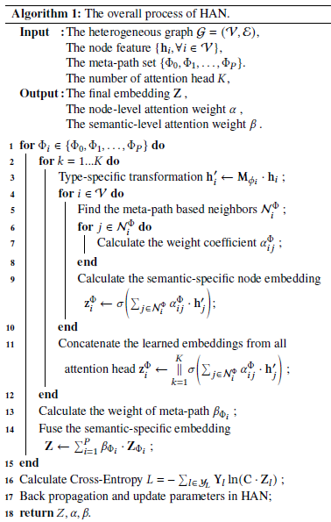
Algorithm : HAN

Slide 34
Datasets
Name | Data Source | Data | Labeling Method | Meta-paths | Classes
DBLP | DBLP | 14328 Paper (P) 4057 Author (A) 20 Conf (C) 8789 Term (T) | label each author’s research area according to the conferences they submitted | Author-Paper-Author (APA) Author-Paper-Conf-Paper-Author (APCPA) Author-Paper-Term-Paper-Author (APTPA) | database data mining machine learning information retrieval
ACM | KDD SIGMOD SIGCOMM MobiCOMM VLDB | 3025 Paper (P) 5835 Author (A) 56 Subject (S) | label the papers according to the conference they published. | Paper-Author-Paper (PAP) Paper-Subject-Paper (PSP) | Database Wireless Communication data mining
IMDB | IMDB | 4780 Movie (M) 5841 Actor (A) 2269 Director (D) | label the movies according to their genre. | Movie-Actor-Movie (MAM) Movie-Director-Movie (MDM) | Action Comedy Drama

