Slide 1
CME308 INTERACTION DESIGN
JavaScript

Slide 2

Web Development
<html>
{css}
javascript()
content
presentation
behavior
Notes:
Content: structure and semantics
Presentation: how information is presented
Behavior: Add interativity

Slide 3



What is JavaScript?
10
Notes:
Created it 10 days by Brendan Eich in May 1995 (pronounced I-ch)
Joined Netscape to create a new language that resembled Java for the Netscape browser
-- wanted a lightweight interpreted language for nonprofessional programmers – complemented Java

Slide 4

What is JavaScript?
Mocha
May 1995
LiveScript
September 1995
JavaScript
December 1995
Notes:
Created under the name Mocha
Changed to LiveScript when shipped when in beta with Netscape Navigator 2.0
Renamed to JavaScript when shipped with Netscape Browser version 2.0

Slide 5
JAVASCRIPT
≠
JAVA

Slide 6








ICONS

Slide 7
Web Development
<html>
{css}
javascript()
content
presentation
behavior
Notes:
Content: structure and semantics
Presentation: how information is presented
Behavior: Add interactivity

Slide 8
What is JavaScript?
Most popular programming language in the world
Language designed for dynamic tasks
Code interpreted by the browser’s engine when the web page is loaded

Slide 9

Normal Web Process
HTTP Request
USER COMPUTER
SERVER
HTML
Page
HTTP Response

Slide 10
Dynamic Web Page Process
HTTP Request
WEB
SERVER
APP
SERVER
DB
SERVER
USER COMPUTER
HTTP Response
App Script

Slide 11
JavaScript Process
HTTP Request
WEB
SERVER
APP
SERVER
DB
SERVER
USER COMPUTER
HTTP Response
JavaScript
App Script

Slide 12
JavaScript
ACCESS
CONTENT
REACT
TO
EVENTS
MODIFY
CONTENT
PROGRAM
RULES
Notes:
Access content: find out text entered into input element
Modify content: Add/Change content
React: button pressed, info is added to a form (validation)
Program Rules: slideshow, calculator

Slide 13
JavaScript Uses
FORM VALIDATION
CLICK RESPONSE
DYNAMIC MENUS
SLIDESHOWS
ANIMATION
DATA SORTING
CHANGE CSS
SPECIAL EFFECTS
TIMERS, CLOCKS, CALENDARS
LOAD NEW CONTENT
Notes:
HTML – elements – change content, styles, attributes
Form calculation

Slide 14
Javascript and the DOM

Slide 15
THE DOM
Document Object Model
When a web page is loaded, the browser creates a DOM of the page
Tree of objects
html
head
title
text
body
h1
text
p
text
h2
text
ul
li
text
li
text
p
text
Notes:
Is it necessary?
What is it?
Why do I need to know it?

Slide 16
Why Use The DOM?
With the DOM, JavaScript can create dynamic HTML
Change HTML elements on the page
Change HTML attributes on the page
Change CSS styles in the page
Add/Remove existing HTML elements and attributes
React to events
Create new events
Notes:
Is it necessary?
What is it?
Why do I need to know it?

Slide 17
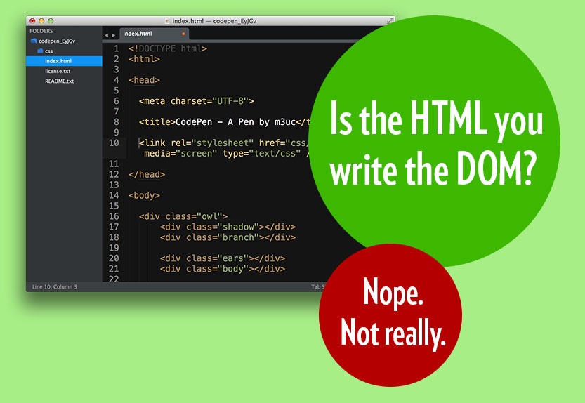
THE DOM

Slide 18
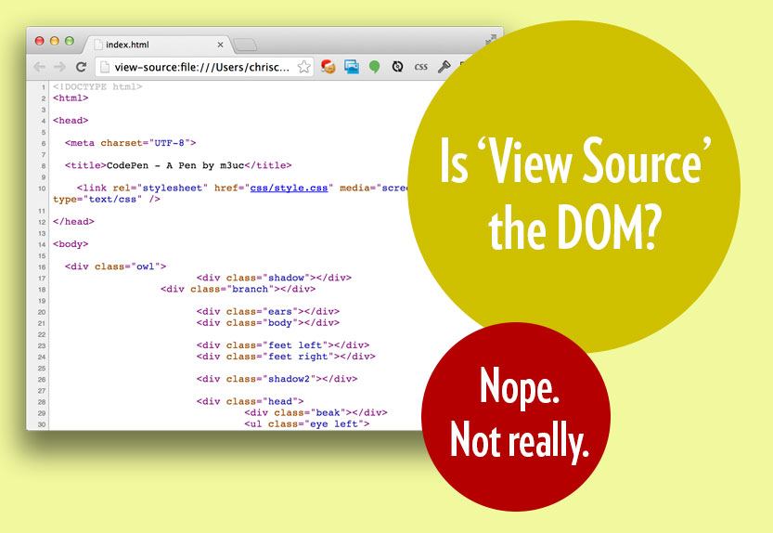
THE DOM

Slide 19
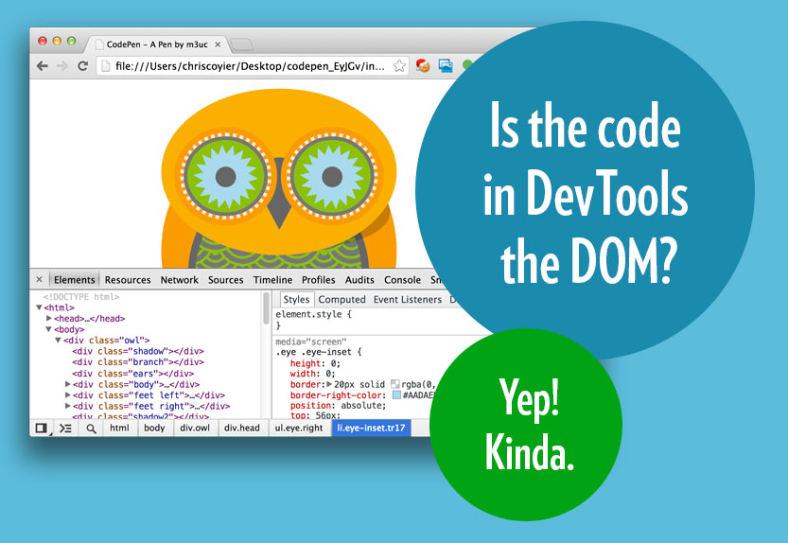
THE DOM

Slide 20
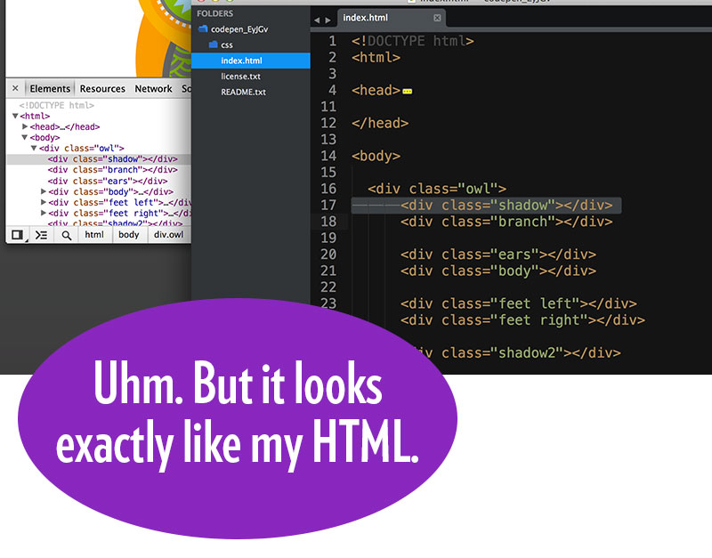
THE DOM

Slide 21
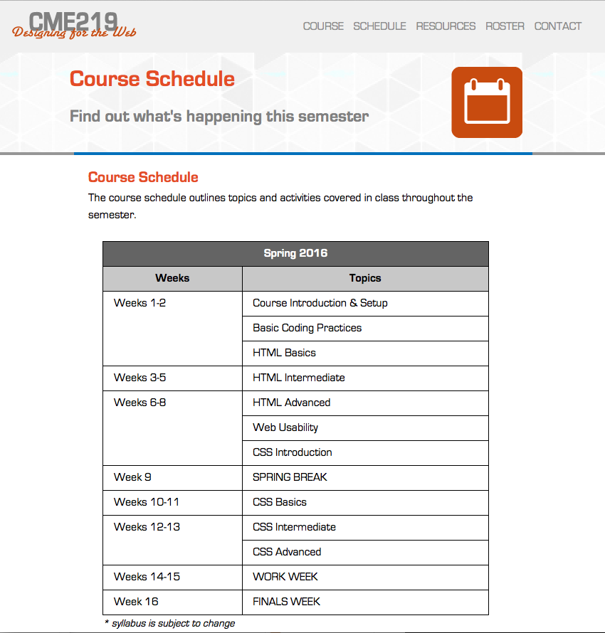
THE DOM

Slide 22
Why Do We Care?
JavaScript can manipulate the DOM to add and manipulate content as well as its CSS
JavaScript
The language that tells
The browser what stuff to do
DOM
Where
the stuff
happens

Slide 23
JavaScript DOM Manipulation
HTML
…
<div id=“container”></div>
…
HTML w/ JavaScript
<script type=“text/javascript”>
var container = document.getElementById(“container”);
container.innerHTML = “Welcome to my page!”;
HTML in DevTools
…
<div id=“container”>Welcome to my page!</div>
…

Slide 24
DOM Example
HTML
<!DOCTYPE HTML> <html>
<head>
<title>My Page </title>
</head>
<body>
<h1>CME308: Interactive Design </h1>
<p>Welcome to CME308. In this class, you will learn JavaScript and jQuery. </p>
<h2>Materials Needed</h2>
<ul>
<li>Class Book</li>
<li>USB Drive</li>
</ul>
<p>I hope you enjoy the semester!</p>
</body>
</html>

Slide 25
DOM Example
HTML
<!DOCTYPE HTML> <html>
<head>
<title>My Page </title>
</head>
<body>
<h1>CME308: Interactive Design </h1>
<p>Welcome to CME308. In this class, you will learn JavaScript and jQuery. </p>
<h2>Materials Needed</h2>
<ul>
<li>Class Book</li>
<li>USB Drive</li>
</ul>
<p>I hope you enjoy the semester!</p>
</body>
</html>
html
head
title
text
body
h1
text
p
text
h2
text
ul
li
text
li
text
p
text

