Slide 1
UNIX Tools Lecture 1
Mission: Nerdification

Slide 2
What will we cover?
UNIX history
Linux: The open-source verison
Advantages of UNIX/Linux
Operating system overview
UNIX/Linux utilities

Slide 3
Operating System
Suite of programs that run the computer.
Applications are programs that interact with the operating software.
Gedankenexperiment: How does a Spreadsheet program interact with the hardware?

Slide 4
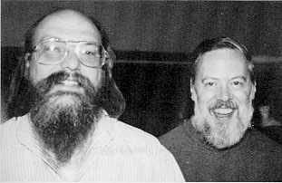

Our Heroes
Ken Thompson
Wrote first Unix Assembly language on PDP-7
Dennis Ritchie
Created C programming lang and worked on Unix

Slide 5
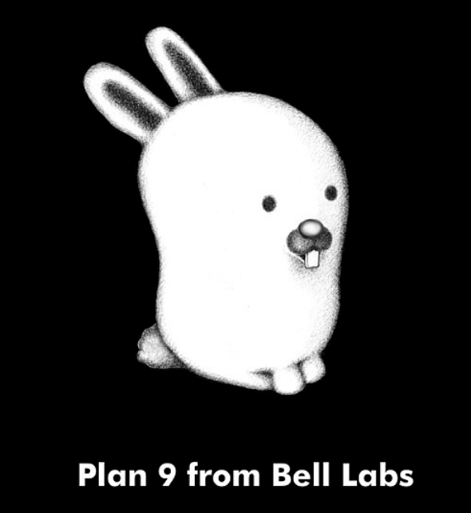

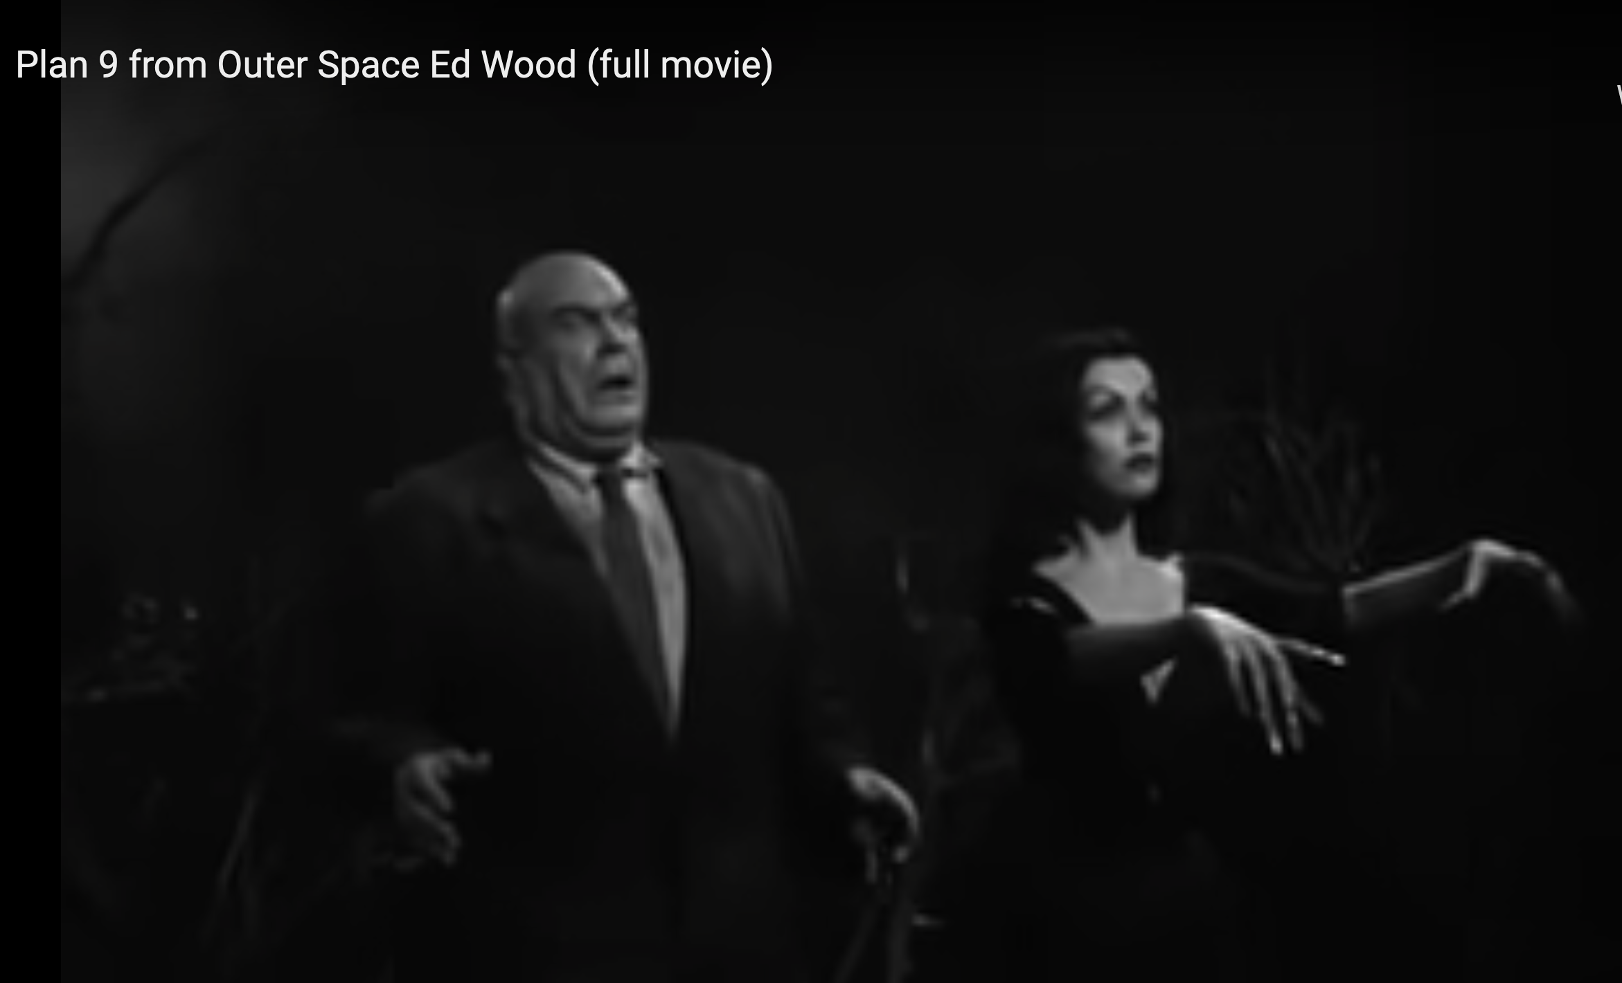

Slide 6
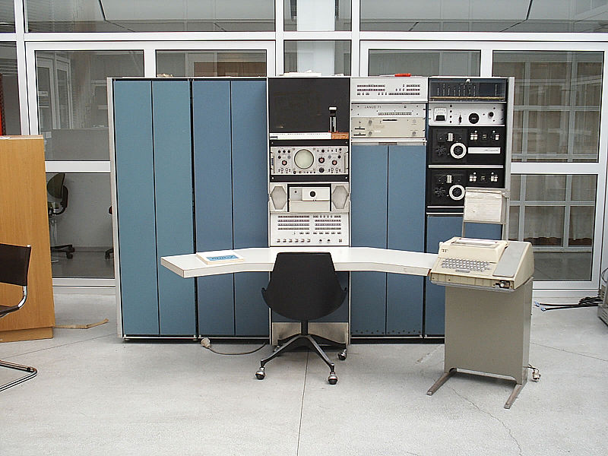
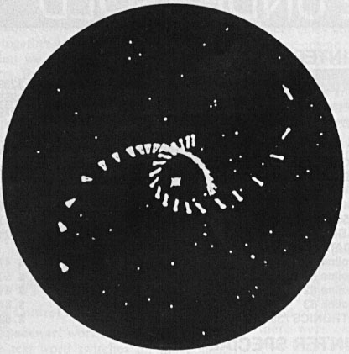
Video Games Spark Innovation
Space Travel: Ken Thompson (Bell Labs)
PDP-7 “Mini-computer”: The ORIGINAL Personal computer 1965
Notes:
Operating systems needed because without them there is inefficient use of resources.
CTSS (compatible time sharing system) was one of the first OSes, and MULTICs was to be a second generation OS.
MULTICS: Multi User file system from MIT/GE/Bell Labs, on expensive GE-645.
Introduced hierarchical file system
MULTICS died, but Thompson/Ritchie still wanted to play Space Pilot.
In order to do so, they decided to create a simplified version that would work on a PDP-7 that was laying around.
This led to a stripped down version of MULTICS called UNICS.

Slide 7
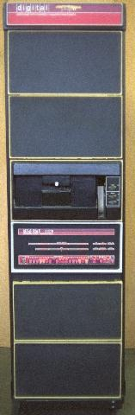
In the Beginning
UNICS*: 1969 – PDP-7 minicomputer
Changed to UNIX
PDP-7 goes away, rewritten on PDP-11 to “help patent lawyers”
V1: 1971
V3: 1973 (pipes, C language)
V6: 1976 (rewritten in C, base for BSD)
V7: 1979 (Licensed, portable)
PDP-11
*Uniplexed Information and Computing Service
Notes:
PDP7: 72K, 18 Bit, 120 made. The OS that came with it was terrible.
PDP11: 1970, $10K, 16 bit, 600K+ made
C: Also a 3rd generation system: BCPL (Basic Combined Programming Language) (similar to fortran) -> B (simplified) -> C (cleaned up, more powerful)
Up until V7 (not including), classroom use was allowed.

Slide 8
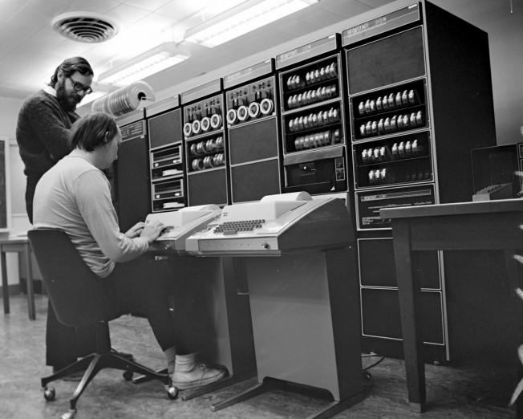

Slide 9





Commercial Success
AIX
SunOS, Solaris
Ultrix, Digital Unix
HP-UX
Irix
UnixWare -> Novell -> SCO -> Caldera ->SCO
Xenix: -> SCO
Red Hat -> IBM
Notes:
Early eighties: lots of commercial spinoffs.
XENIX: Port for microcomputers by microsoft, but inadequate. Sold to SCO after switch to QDOS (quick and dirty)
SUN: Bill Joy’s startup launched in 1982
SCO: One of the first (1978)
UnixWare: AT&T’s.

Slide 10

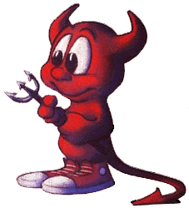
Send in the Clones
Linux
Written in 1991 by Linus Torvalds
Most popular UNIX variant
Free with GNU license
BSD Lite
FreeBSD (1993, focus on PCs)
NetBSD (1993, focus on portability)
OpenBSD (1996, focus on security)
Free with BSD license
Development less centralized
Notes:
GNU and BSD licenses have major differences.

Slide 11

Darwin
Apple abandoned old Mac OS for UNIX
Purchased NeXT in December 1996
Unveiled in 2000
Based on 4.4BSD-Lite
Open Source
YOUR MAC IS A LINUX MACHINE

Slide 12
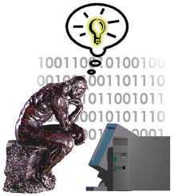
The UNIX Philosophy
Small is beautiful
Easy to understand
Easy to maintain
More efficient
Better for reuse
Make each program do one thing well
More complex functionality by combining programs
Make every program independent
Notes:
Core Idea: #1
#2 is an example of #1

Slide 13
The UNIX Philosophy
..continued
Portability over efficiency
Most efficient implementation is rarely portable
Portability better for rapidly changing hardware
Use flat ASCII files
Common, simple file format
Example of portability over efficiency
Reusable code
Good programmers write good code; great programmers borrow good code
Notes:
Example: Failure of ATARI 2600 move to ATARI 800 (hard (8K) so highly non portable)

Slide 14
The UNIX Philosophy
..continued
Avoid captive interfaces (GUIs)
The user of a program isn’t always human
Looks nice, but code is big and ugly
Problems with scale
Silence is golden
Only report if something is wrong
Think hierarchically

Slide 15
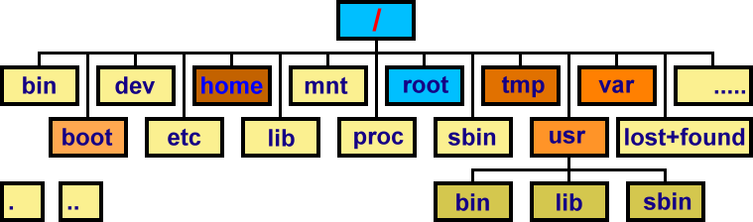
Typical Unix/Linux Structure
https://www.codepuppet.com/2012/06/08/directory-structure-in-linux/

Slide 16
The Operating System
The government of your computer
Kernel: Performs critical system functions and interacts with the hardware
Systems utilities: Programs and libraries that provide various functions through systems calls to the kernel

Slide 17
Kernel Basics
The kernel is …
a program loaded into memory during the boot process, and always stays in physical memory.
responsible for managing CPU and memory for processes, managing file systems, and interacting with devices.

Slide 18
UNIX Structural Layout
shell scripts
utilities
User Space
C programs
system calls
compilers
signal handler
scheduler
Kernel
device drivers
swapper
terminal
Devices
printer
disk
RAM

Slide 19
Kernel Subsystems
Process management
Schedule processes to run on CPU
Inter-process communication (IPC)
Memory management
Virtual memory
Paging and swapping
I/O system
File system
Device drivers
Buffer cache

