Slide 1
Outline
Overview of Unix System
Basic Commands
Relative & Absolute Path
Redirect, Append and Pipe
Wildcards * ? [ ]
Permission
Process Management
Install Software
Text Editor
Foreground and Background Jobs
Notes:
First, I’m gonna go through Unix System.

Slide 2
Overview of Unix System
Kernel & Shell
Unix/Linux is operating system (OS).
Unix system is described as kernel & shell.
Kernel is a main program of Unix system. it controls hard wares, CPU, memory, hard disk, network card etc.
Shell is an interface between user and kernel. Shell interprets your input as commands and pass them to kernel.
User
input
Shell
Kernel

Slide 3
Unix Overview (cont.)
Multi-user & Multi-process
Many people can use one machine at the same time.
File & Process
Data, directory, process, hard disk…etc (almost everything) are expressed as a file.
A “Process” is a running program identified by a unique id (PID).

Slide 4
Unix Overview (cont.)
Directory Structure
Files are put in a directory.
All directories are in a hierarchical structure (tree structure).
User can put and remove any directories on the tree.
Top directory is “/”, which is called slash or root.
Users have the own directory. (home directory)

Slide 5
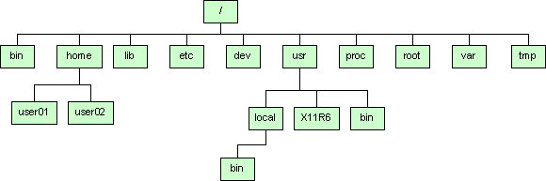
Unix Overview (cont.)
Directory Structure

Slide 6
Unix Overview (cont.)
Important Directories
/bin This contains files that are essential for correct operation of the system. These are available for use by all users.
/home This is where user home directories are stored.
/var This directory is used to store files which change frequently and must be available to be written to.
/etc Various system configuration files are stored here as are all global startup variables for all systems.
Notes:
Inside /bin
arch cut gawk ls red tar
ash date gettext mail rm tcsh
ash.static dd grep mkdir rmdir touch
aumix-minimal df gtar mknod rpm true
awk dmesg gunzip mktemp rvi umount
basename dnsdomainname gzip more rview uname
bash doexec hostname mount sed unicode_start
bash2 domainname igawk mt setfont unicode_stop
bsh dumpkeys ipcalc mv setserial unlink
cat echo kbd_mode netstat sfxload usleep
chgrp ed kill nice sh vi
chmod egrep ksh nisdomainname sleep view
chown env link pgawk sort ypdomainname
cp ex ln ping stty zcat
cpio false loadkeys ps su zsh
csh fgrep login pwd sync zsh-4.0.4

Slide 7
Unix Overview (cont.)
Important Directories
/dev This contains various devices as files, e.g., hard disk, CD-ROM drive, etc.
/sbin Binaries which are only expected to be used by the super user.
/tmp Temporary files.
Notes:
Inside /sbin
Mkfs, insmod, halt shutdown ifconfig …

Slide 8
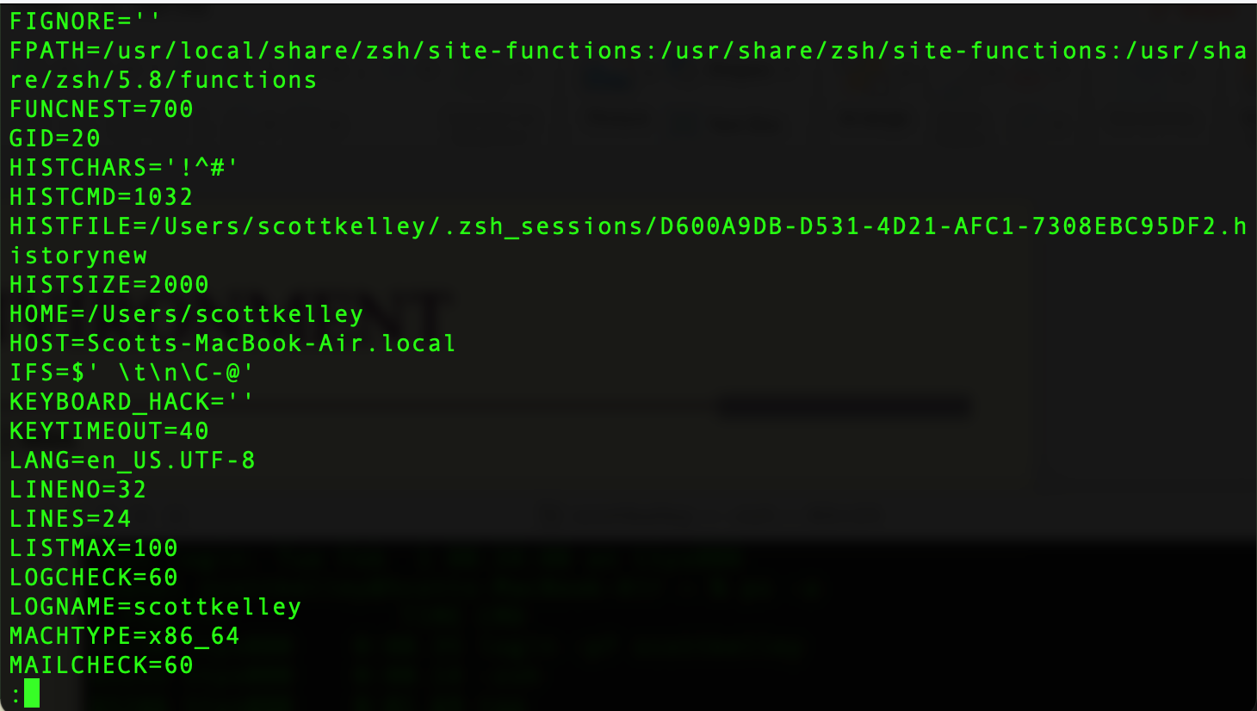
ENVIRONMENT
$set | more

Slide 9
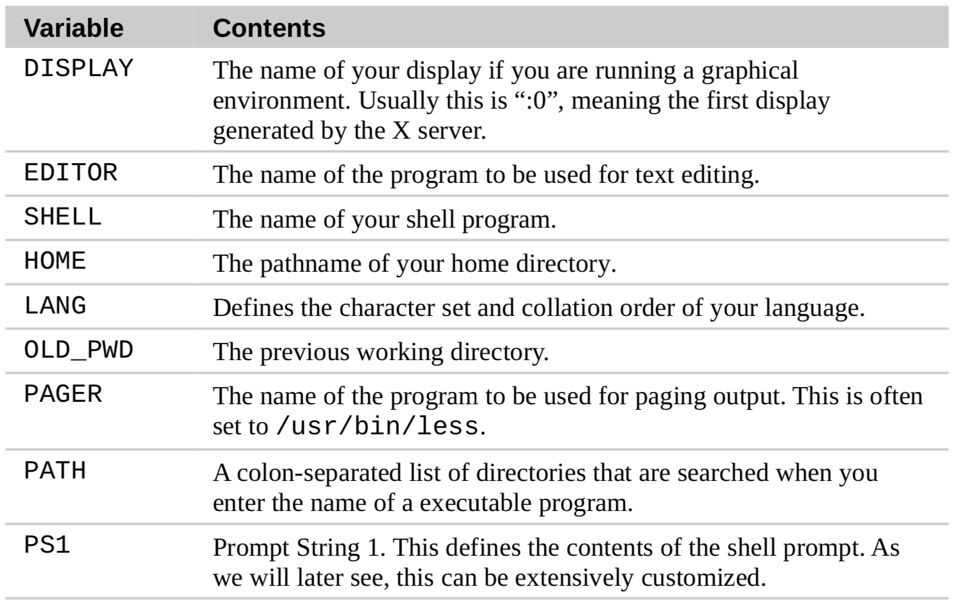
EXAMPLES

Slide 10
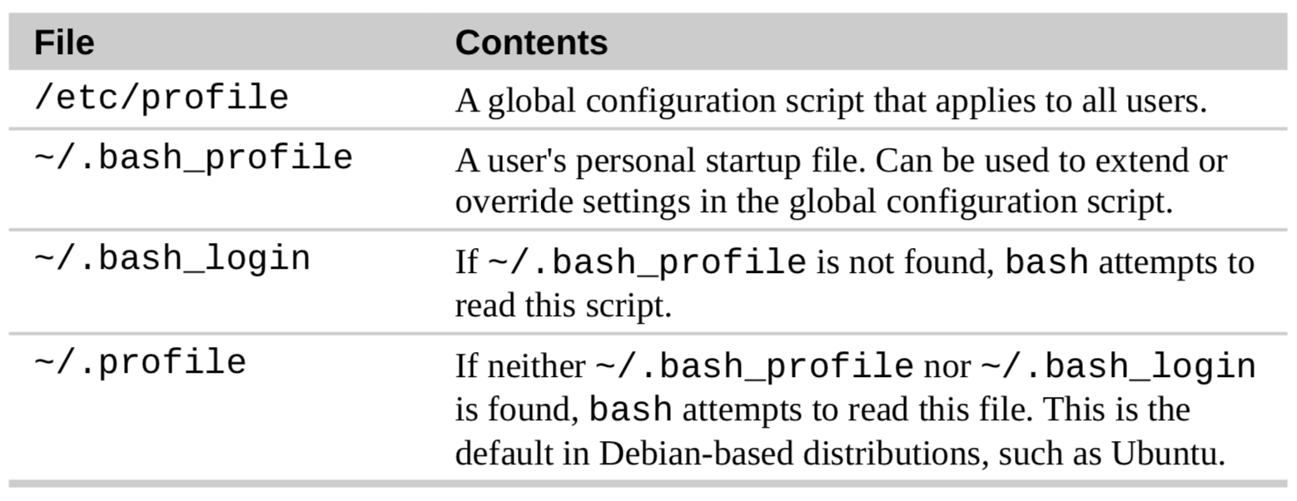
FILES EXECUTING ON STARTUP
What shell are you in? Type this at your prompt
echo $SHELL
echo $PS1
Customizing your prompt is FUN!

Slide 11
Unix Overview (cont.)
Normal user and Super user
In Unix system, there is one special user for administrator, which can do anything.
This special user is called root or superuser.
Case Sensitivity
Unix is case-sensitive.
MYFILE.doc, Myfile.doc, mYfiLe.Doc are different.
Online Manual
Unix has well-written online manuals.

Slide 12
Basic Commands
How to run commands
Finder => Application => Utilitaires => Terminal
When you log on Unix machine, you will see,
[someone]$
One command consists of three parts, i.e. command name, options, arguments.
Example)
[someone~]$ command-name optionA optionB argument1 argument2

Slide 13
Basic Commands
How to run commands
Between command name, options and arguments, space is necessary.
Opitions always start with “-”
Example:
cd ..
ls –l .bashrc
mv fileA fileB

Slide 14
Basic Commands
Commands
ls show files in current position
cd change directory
cp copy file or directory
mv move file or directory
rm remove file or directory
pwd show current position
mkdir create directory
rmdir remove directory
less, more, cat display file contents
man display online manual
Notes:
“ls” stands for list.
Pwd stands for present working directory

Slide 15
Basic Commands
Commands
su super user
passwd change password
useradd create new user account
userdel delete user account
mount mount file system
umount unmount file system
df show disk space usage
shutdown reboot or turn off machine
Notes:
“su” means switch user. When you have several user account on one machine.

Slide 16
Basic Commands
1. Type following command in your directory.
ls
ls –a
ls –la
ls -Fa
2. Make a directory
mkdir linux
pwd
cd linux
pwd
cd
pwd
rmdir linux
3. In your home directory,
ls .bash_profile
cp .bash_profile sample.txt
less sample.txt (note: to quit less, press “q”)
rm sample.txt
4. check disk space usage
df
df -h
Notes:
“ls” stands for list.

Slide 17
Relative & Absolute Path
Path means a position in the directory tree.
To express a path, you can use relative path or absolute path.
In relative path expression, the path is not defined uniquely, depends on your current path.
In absolute path expression, the path is defined uniquely, does not depend on your current path.

Slide 18
Absolute Path
Address from the root
/home/linux/
~/linux
~: ~: Alt+N
Similar to:
Lausanne University/Lausanne/Canton de Vaud/ Switzerland/Europe/Earth/Solar System/

Slide 19
Relative Path
Relative to your current location
. : your current location
.. : one directory above your current location
pwd: gives you your current location
Example
ls ./linux : lists the content of the dir linux
ls ../../ : lists everything that is two dir higer
Similar to:
Go Left/turn right/take the TSOL/go

Slide 20
Relative & Absolute Path
Relative Path
pwd
cd .
pwd
cd ..
pwd
cd ..
pwd
cd
Ablsoute Path
cd
mkdir mydir
pwd
cd /Users/invite
pwd
cd /Users
pwd
cd /
pwd
cd /Users/invite
cd ~/mydir

Slide 21
Redirect, Append and Pipe
Redirect and append
Output of command is displayed on screen.
Using “>”, you can redirect the output from screen to a file.
Using “>>” you can append the output to the bottom of the file.
Pipe
Some commands require input from a file or other commands.
Using “|”, you can use output from other command as input to the command.
On MacOSX, The Pipe sign: (Shift+Alt+N: franc, Alt+7)

Slide 22
Redirect, Append and Pipe
Commands
head show first several lines and omit other lines.
tail show last several lines and omit other lines.
grep XXX File show lines matching pattern XXX in File

Slide 23
Redirect, Append and Pipe
In home directory, type
ls -1 > sample.txt
less sample.txt
Use redirect.
head -3 sample.txt
head -3 sample.txt > redirect.txt
Use append.
tail -3 sample.txt
tail -3 sample.txt >> redirect.txt
less redirect.txt
Use pipe.
less redirect.txt
grep Desk redirect.txt
grep –n Desk redirect.txt
man grep
tail redirect.txt | grep Desk
rm sample.txt
rm redirect.txt

Slide 24
Sorting
Commands
sort Sorts using the first field of each line.
-n Sorts considering the numeric value of the strings
-k3 Sorts using the third field of each line
-rnk3 Sorts in reverse order, using the numeric value of the third field

Slide 25
Redirect, Append and Pipe
Identify the largest file in a directory:
ls –la /bin/ | sort –nk5 | tail -1

Slide 26
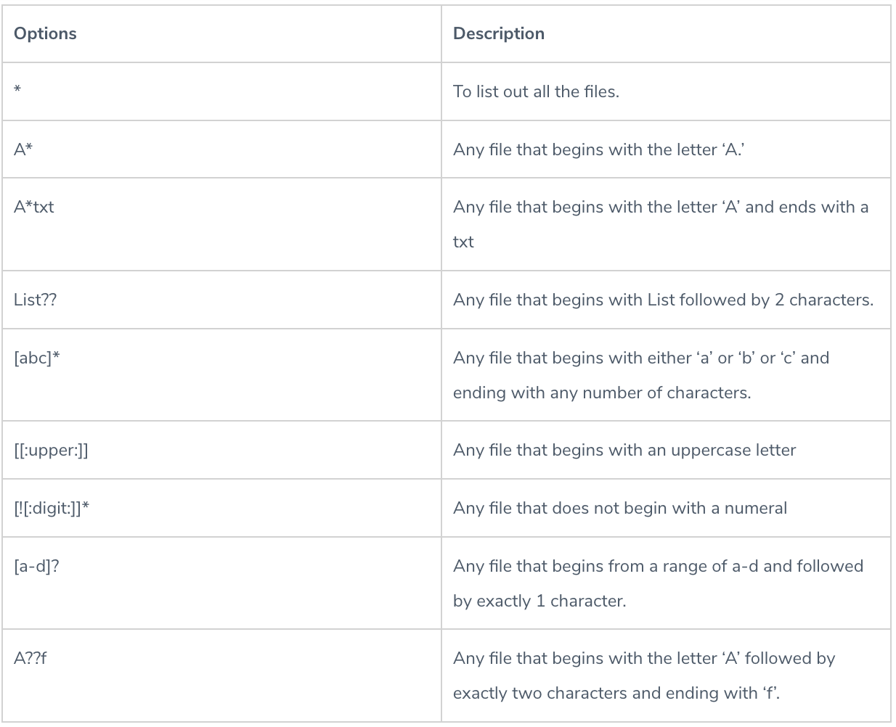
Wildcards
The * wild card – This wildcard represents all the characters
The ? – This wildcard represents a single character
The [ ] – This wildcard represents a range of characters

Slide 27
Permission
All of files and directories have owner and permission.
There are three types of permission, readable, writeable and executable.
Permissions are given to three kinds of group. owner, group member and others.
Example:
ls -l .bash_profile
-rw-r--r-- 1 cnotred cnotred 191 Jan 4 13:11 .bash_profile
r:readable, w:writable, x: executable

Slide 28
Permission
Command
chmod change file mode, add or remove permission
chown change owner of the file
Example)
chmod a+w filename
add writable permission to all users
chmod o-x filename
remove executable permission from others
chmod a+x
Gives permission to the usser to execute a file
u: user (owner), g: group, o: others a: all

Slide 29
Permission
Check permission
ls –l .bash_profile
cp .bash_profile sample.txt
ls –l sample.txt
Remove readable permission from all.
chmod a-r sample.txt
ls –l sample.txt
less sample.txt
Add readable & writable premissions to file owner.
chmod u+rw sample.txt
ls –l sample.txt
less sample.txt
rm sample.txt

Slide 30
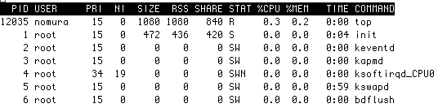
Process Management
Process is a unit of running program.
Each process has some information, like process ID, owner, priority, etc.
Example) Output of “top” command

Slide 31
Process Management
Commands
kill Stop a program. The program is specified by process ID.
killall Stop a program. The program is specified by command name.
ps Show process status
top Show system usage statistics
Notes:
These are commands related with process management. Kill is used to stop your program.

Slide 32
Process Management
Check your process.
ps
ps –u
Check process of all users.
top (To quit top, press “q”)
ps –e
ps –ef
Find your process.
ps –ef | grep cnotred
Notes:
These are commands related with process management. Kill is used to stop your program.

Slide 33
Install Software
Unix system has a “de facto standard” way to install a software.
configure, make & make install
Typical software installation procedure as following.
Download source code. Usually, it’s archived with tar command and compressed with gzip command.
configure command creates Makefile automatically which is used to compile the source.
Program compilation is written in Makefile.

Slide 34
Install Software
Commands
gzip compress a file
gunzip uncompress a file
tar archive or expand files
configure create Makefile
make compile & install software
Notes:
tar stands for “tape archive”.
“gzip” stands for zip is compression algorithm. G stands for that this software is made by GNU project. I don’t explain What GNU is here, but you might have heard about “open source project”. GNU is an open source project to create totally free UNIX.

Slide 35
Install Software
Example: parallel programming library installation
gunzip software.tar.gz
tar –xvf software.tar
cd software
./install OR make all OR …

Slide 36
Foreground and Background
Running job has two modes, “foreground” and “background”
If program is running as “background”,
the program keeps running even after your session was closed
If program is running as “foreground”,
Ctrl-C stop program
Ctrl-Z let program background

Slide 37
Foreground and Background
To run programs in background mode, use “&”
[nomura@ssc-1]$ command &
To get background job back into foreground mode, use “fg” command.
[nomura@ssc-1]$ fg

Slide 38
Remote Login & File Transfer
rshd, telnetd, ftpd, sshd are server program and provide similar services, remote login & file transfer.
The major difference is security level.
rshd < telnetd + ftpd < sshd
Commands
Client
rsh & rcp
telnet & ftp
ssh & scp
Server
rshd
telnetd & ftpd
sshd

Slide 39
Remote Login & File Transfer
Remote login & file transfer system are based on server and client model. client program on your machine ask sever program certain service remote machine.
For example, telnet server provides remote login service. ftp server provides file transfer service.
Sample client programs;
WS FTP FTP client
Internet Exploror HTTP client
Eudora POP, SMTP client

Slide 40
Tutorial of Unix/Linux
END

