Slide 1
Grep, sed and awk: command line power
The differences between them
grep: only good for simple text matching and printing
Comes from g/re/p globally search for a regular expression and print matching lines
sed: offers additional text transformation commands like substitution
Sed stands for “stream editor”
awk: a scripting language that offers a multitude of features
derived from the surnames of its authors: Alfred Aho, Peter Weinberger, and Brian Kernighan.
https://www.baeldung.com/linux/grep-sed-awk-differences
Awk cheat sheet

Slide 2
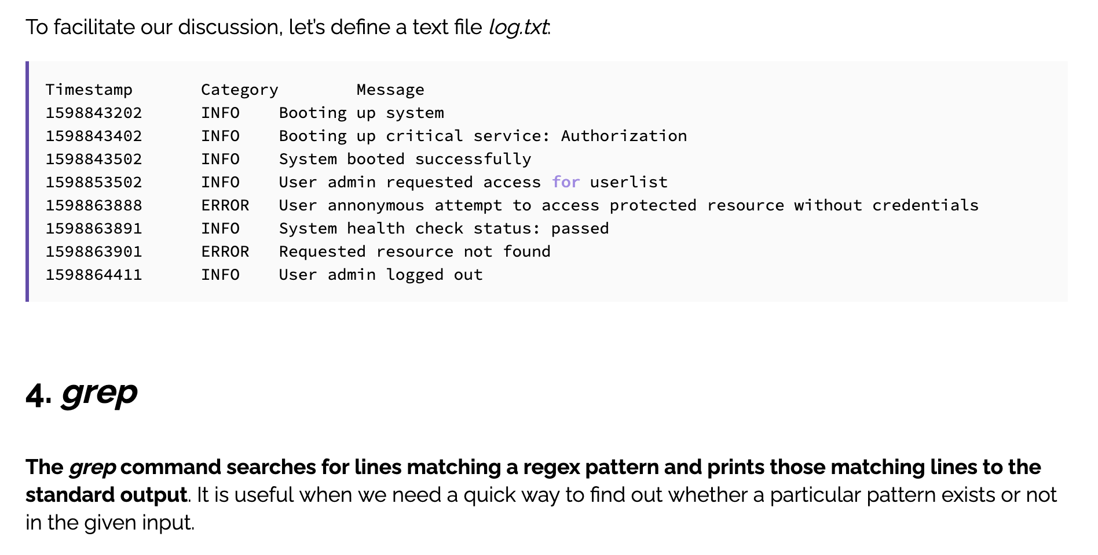
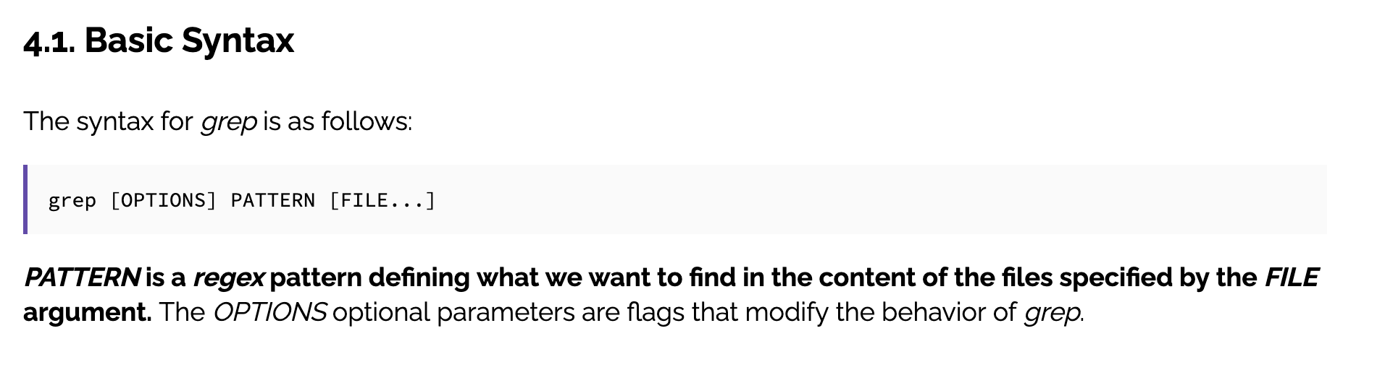
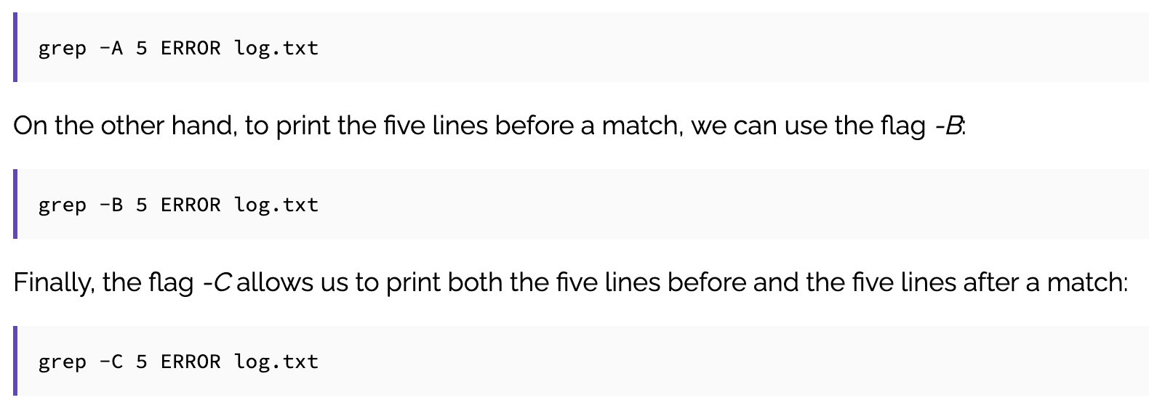
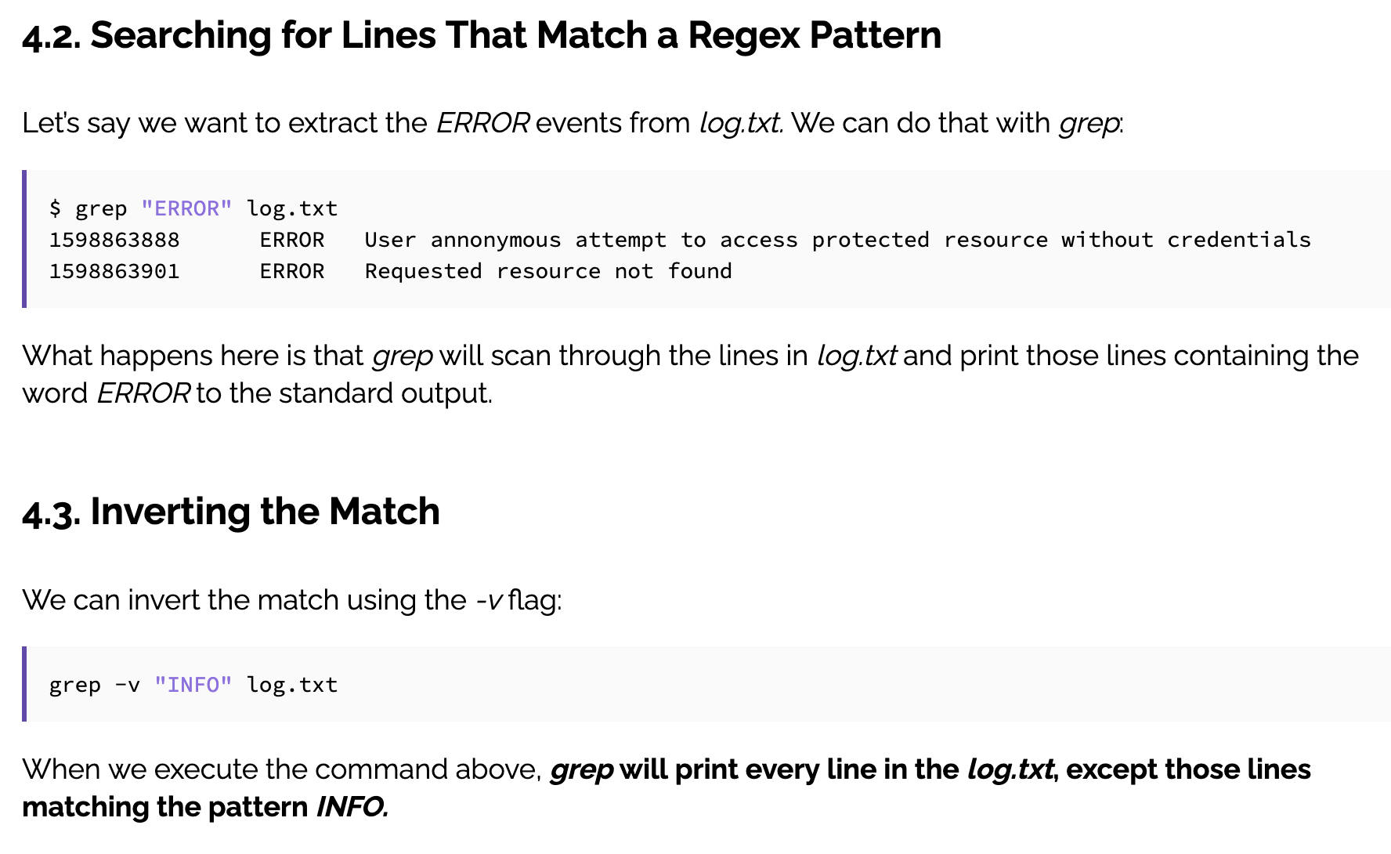
grep

Slide 3
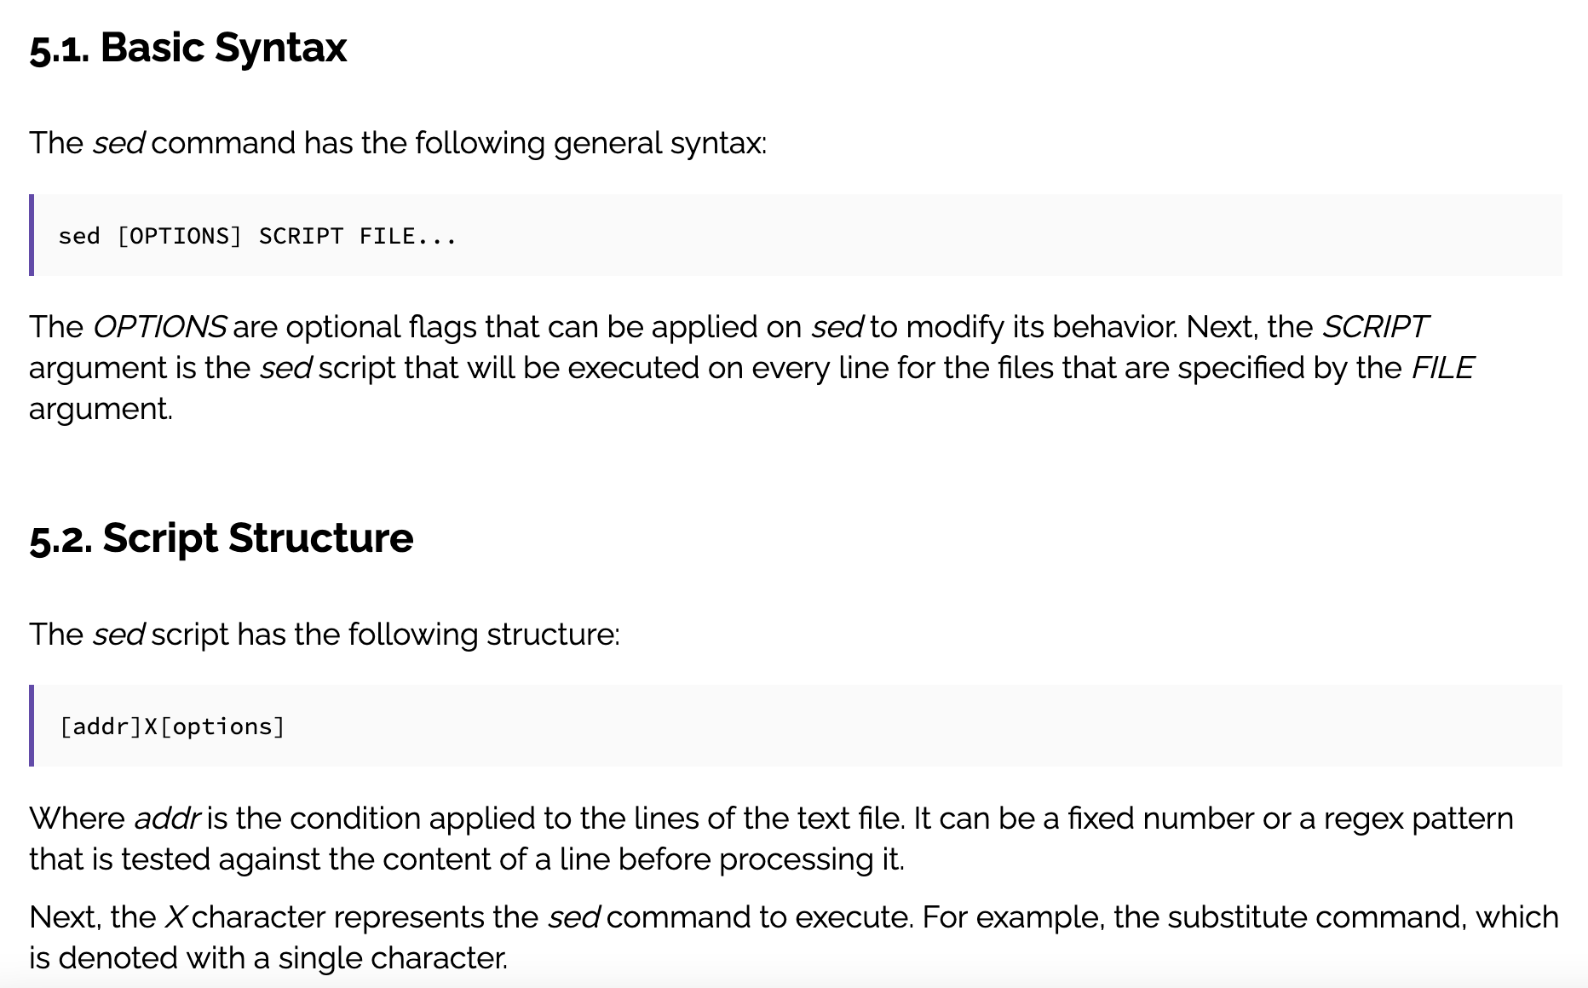
sed

Slide 4
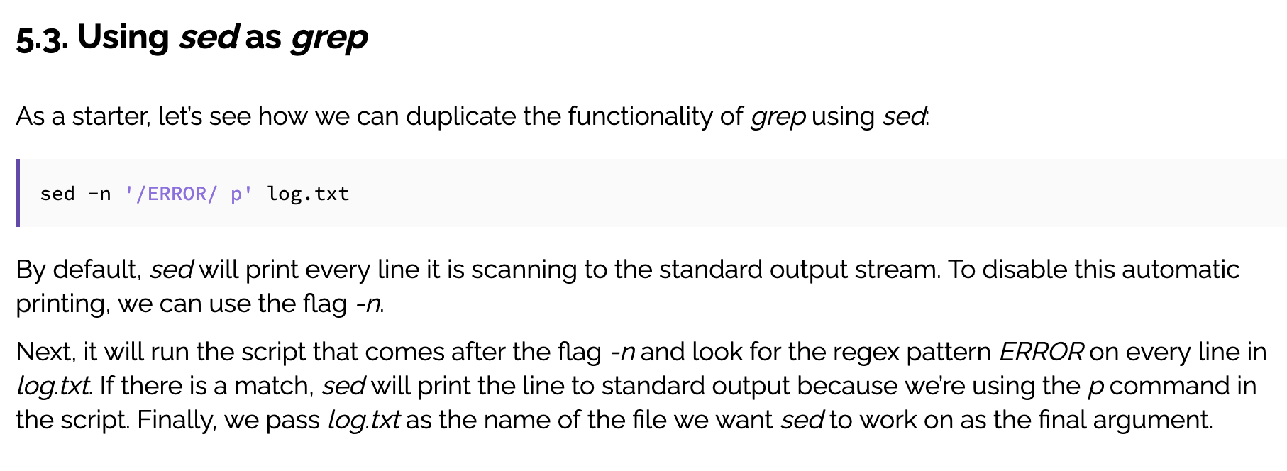
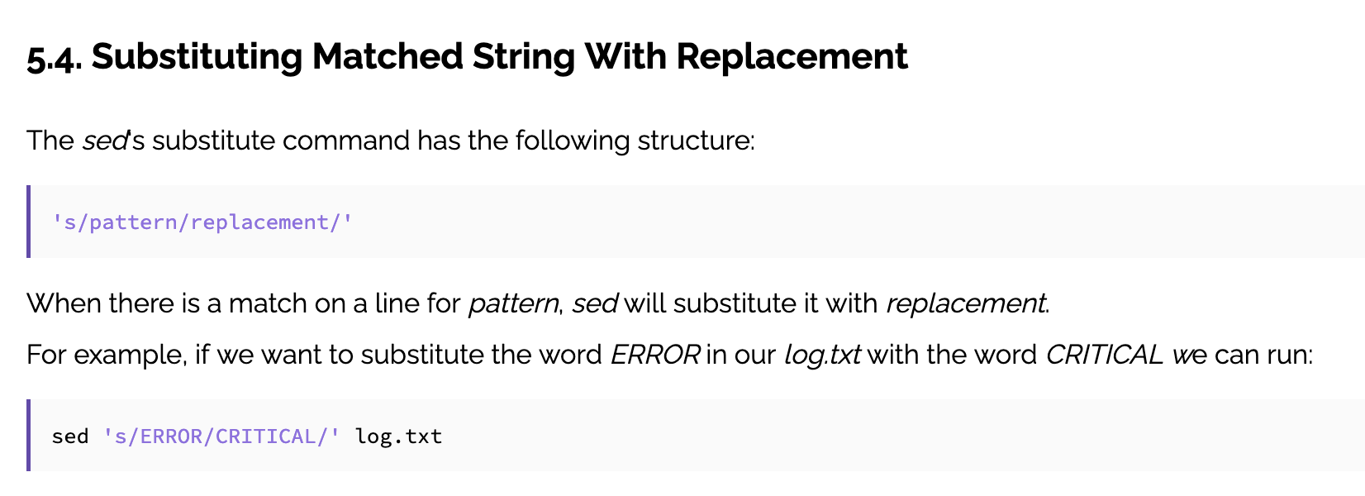
sed

Slide 5
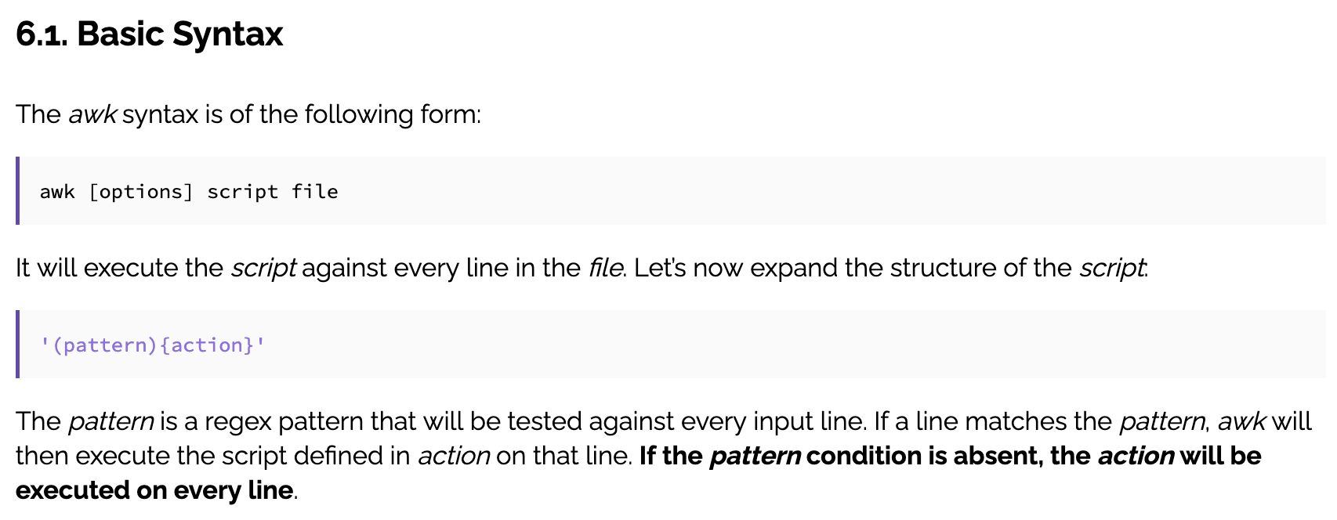
awk

Slide 6
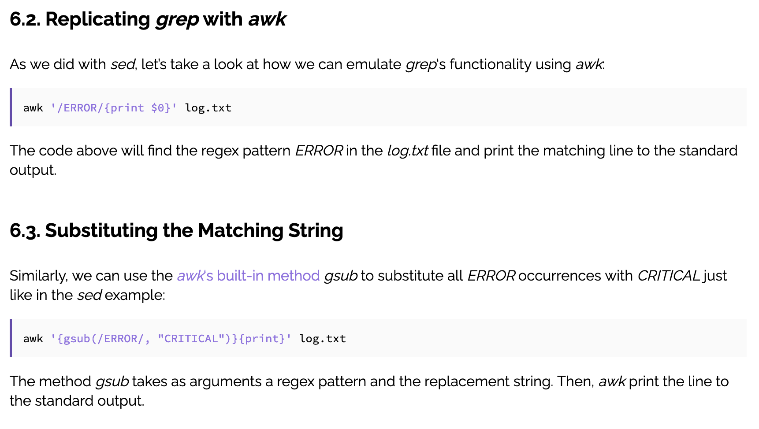
awk

Slide 7
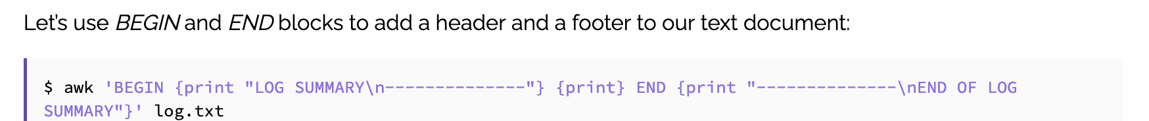
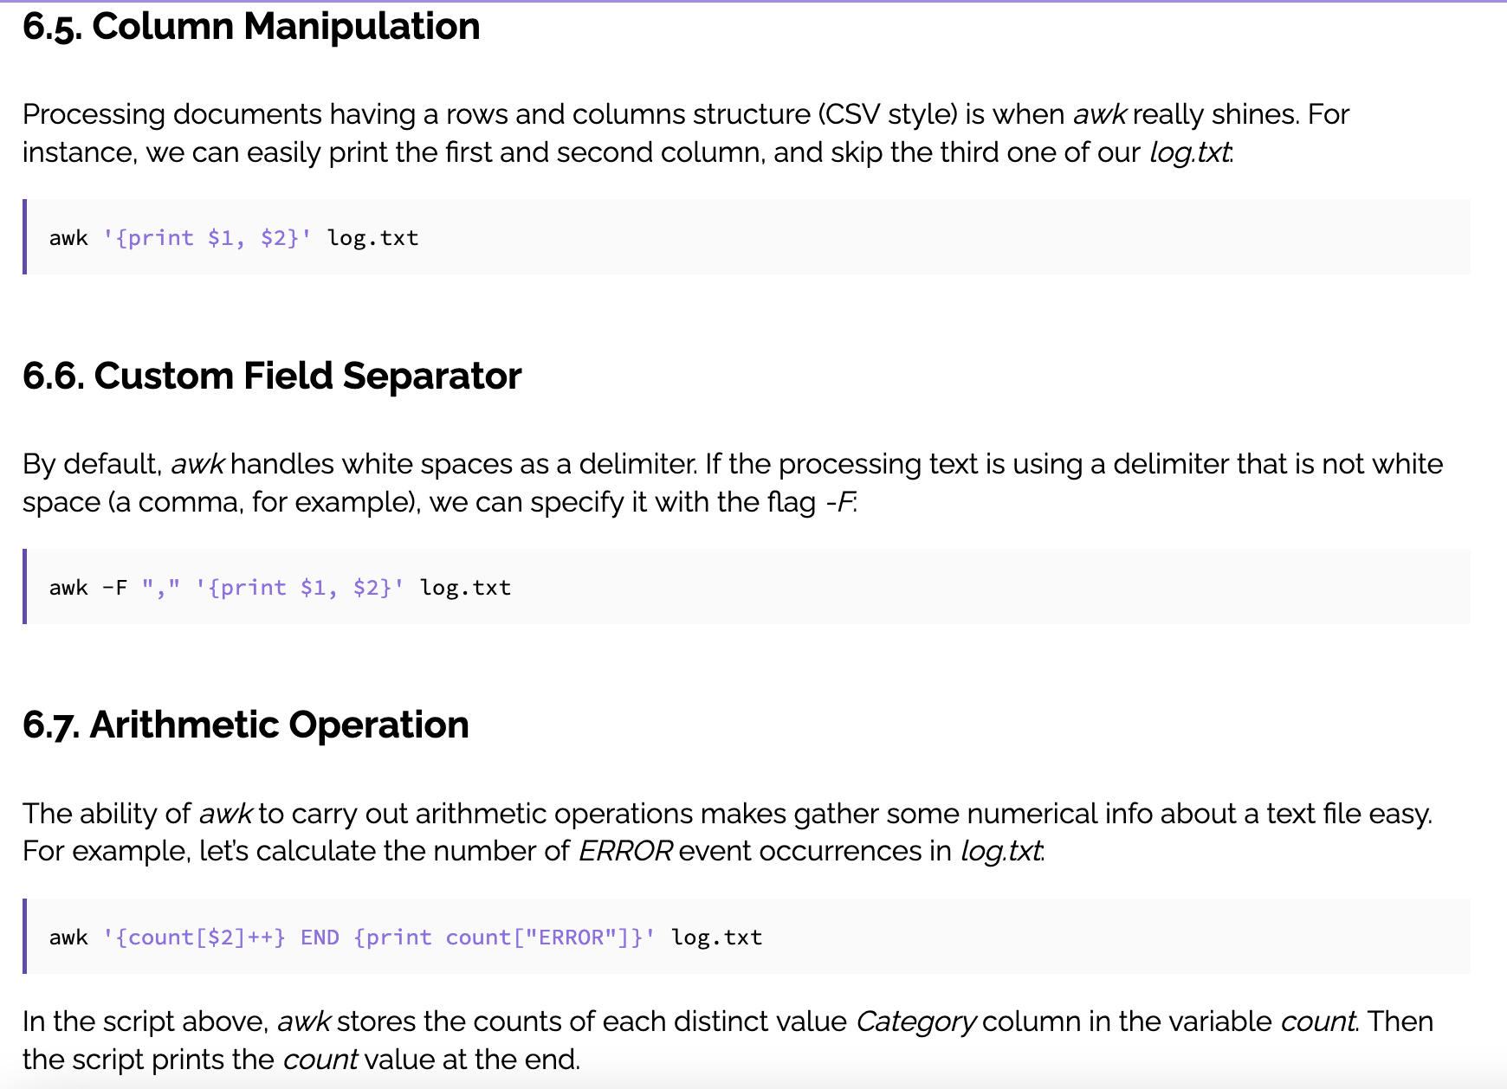
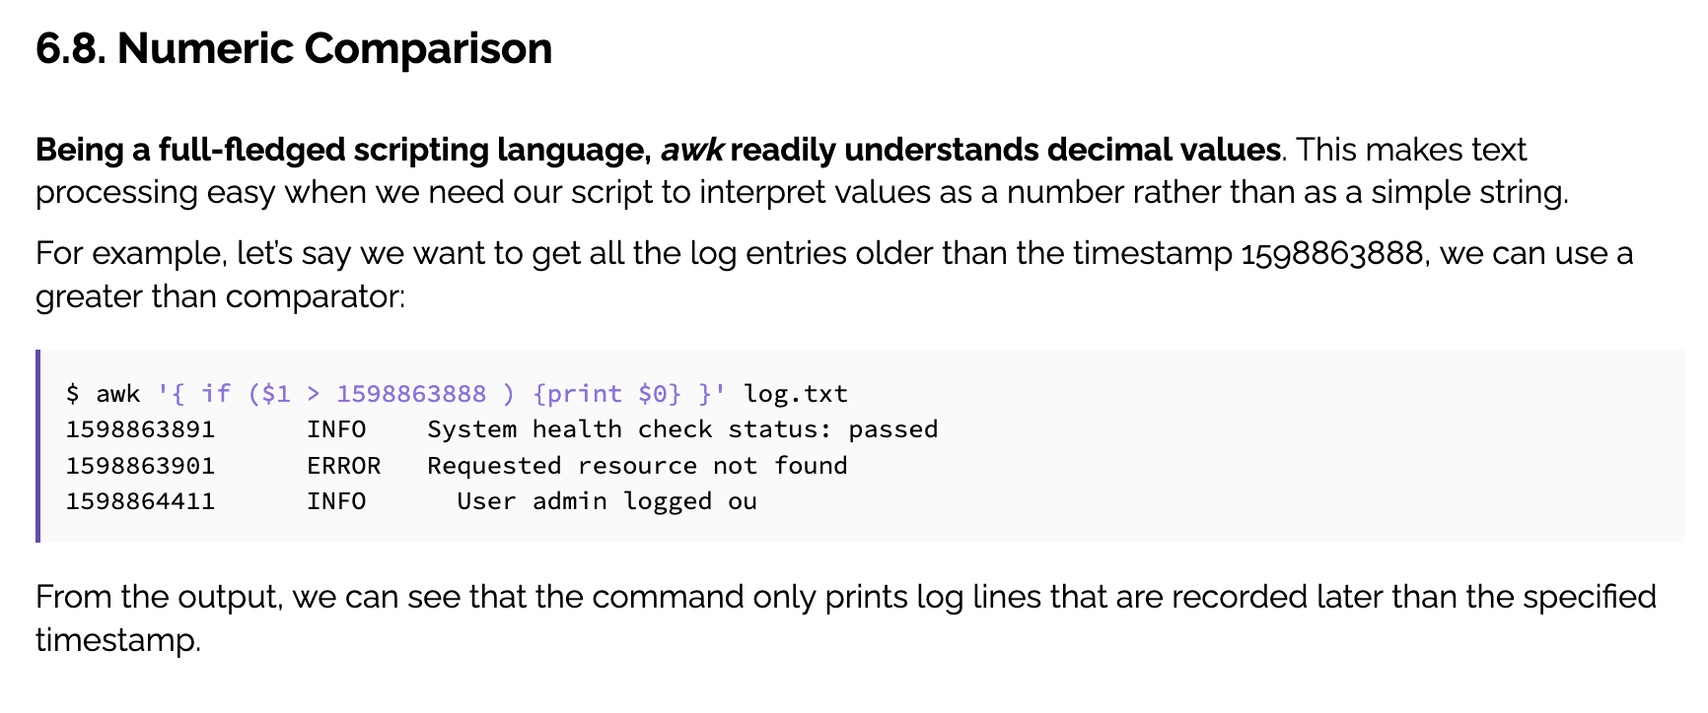
awk
GO TO AWK REFERENCE SHEET

