Slide 1
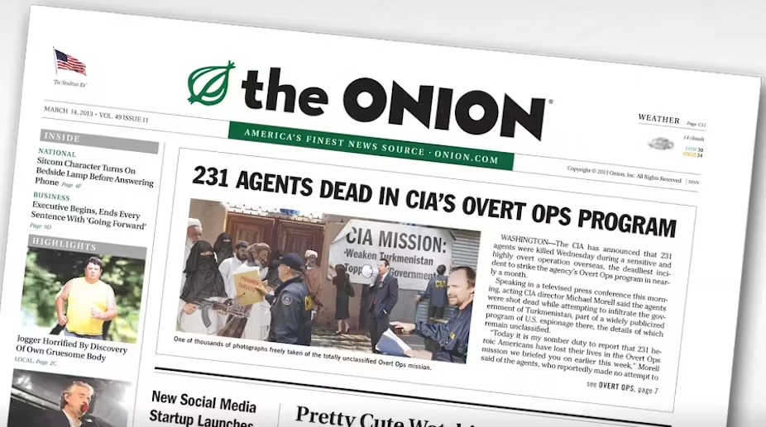
Sarcasm Detection in News Headlines
Group 16 - Snack Overflow
Terezia Olsiakova - 12331438
Arian Etemadihaghighi - 12242985
Viktoriia Ovsianik - 12217985
Maximilian Scheiblauer - 11776651

Slide 2
Contents
Task & Data
1
2
Preprocessing and Baselines
Error Analysis and Insights
3
4
Advanced Approaches
Challenges and Conclusion
5

Slide 3
Task
Goals of our project are:
Develop an approach to classify headlines as sarcastic & non-sarcastic (not fake news!)
Explore misclassified cases and understand reasons for incorrect classification
Understand if there are any patterns that “The Onion” website follows to create sarcastic headlines
Notes:
Victoria

Slide 4
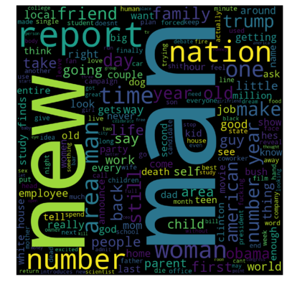
Data
News Headlines Dataset for Sarcasm Detection*
28,619 annotated headlines
sarcastic from “The Onion”
non-sarcastic from “The Huffington Post”
Balanced data
13,635 sarcastic, 14,984 non-sarcastic
Headlines Generated by ChatGPT (Additional data)
Using ChatGPT we generated 1000 news headlines (sarcastic & non-sarcastic) and 1000 news headlines in a style similar to “The Onion” and “The Huffington Post”
Sarcasm headlines word cloud
* Data and Diagram Source: News-Headlines-Dataset-For-Sarcasm-Detection
Notes:
Victoria

Slide 5
Contents
Task & Data
1
2
Preprocessing and Baselines
Error Analysis and Insights
3
4
Advanced Approaches
Challenges and Conclusion
5

Slide 6
Preprocessing
The quality of the dataset is quite good:
No missing values, just a few duplicates
Balanced classes
Not much of a preprocessing + did not exclude stopwords
Exported dataset in CoNLL-U & JSON format
Notes:
Victoria

Slide 7
Baselines
Deep learning-based:
DistilBERT
Neural Network
Non-deep learning based:
Bag of Words (Naive Bayes)
Logistic regression
Results:
Model | Precision | Recall | F1-score
Naive Bayes | 0.85 | 0.85 | 0.85
Neural Network | 0.84 | 0.83 | 0.83
Logistic Regression | 0.83 | 0.83 | 0.83
DistilBERT | 0.82 | 0.75 | 0.78
Notes:
Terezia
Why did we choose these baselines

Slide 8
Contents
Task & Data
1
2
Preprocessing and Baselines
Error Analysis and Insights
3
4
Advanced Approaches
Challenges and Conclusion
5

Slide 9
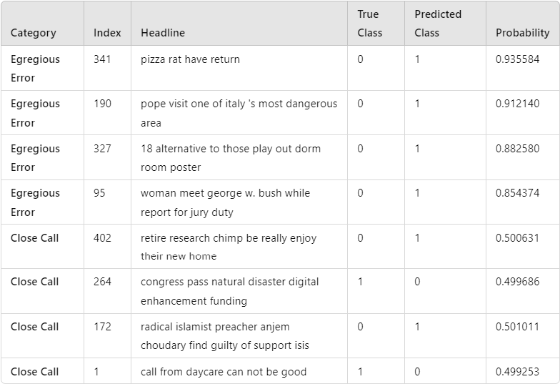
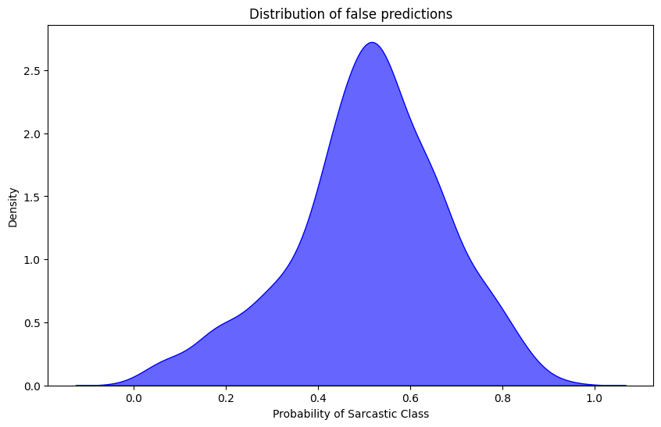
Error Analysis
Wrong Classifications
Examples of baseline failures
Error Distribution
Patterns in misclassified headlines
Notes:
Max

Slide 10



Insights from Error Analysis and Baselines
Key Takeaways
Performance Patterns
Areas for Improvement
Class not obvious without real knowledge
Some words have unintuitive weights
Recognizable patterns
BoW Methods perform very good
Errors are well distributed
Balanced predictions
Include more information than just words
Are the found patterns writing style or ‘real’ sarcasm?
Choice of Advanced Approaches
Syntactic Analysis
New Data
POS-tags, dependency trees
Transitional probabilities
Onion Headlines, tweets, other sarcastic headlines
See if models learned sarcastic patterns or Onion writing style
Notes:
Max

Slide 11
Pattern Analysis
Onion often parodies the tone and structure of serious journalism and traditional news outlets, while delivering over-the-top or ironic statements:
“7.1 Billion Demonstrate in Favor of Global Warming.”
“Area Man Nervously Asks Girlfriend if She'll Settle.”
“Guard in Video Game under Strict Orders to Repeatedly Pace Same Stretch of Hallway.”
There are certain patterns that are used often:
area man puts on some nice pants for once in his life
nation demands more slow-motion footage of syrup cascading onto pancakes
local woman has story about how she got these shoes
hillary clinton to nation: 'do not fuck this up for me'
study finds employees most productive when they can set their own salaries
Local
Dad
Area
Nation
Study
[Curse words]
But these are a minority, Onion has a diverse style:
edge of table victorious over toddler
And anyway HuffPost headlines can have similar patterns:
local officials grapple with trump's fearmongering on 'sanctuary city' policies
Notes:
[Arian]

Slide 12
Pattern Analysis
Onion’s style hinders non-semantic pattern classification
For instance:
“7.1 Billion Demonstrate in Favor of Global Warming.”
and
“U.S. Upset After Aliens Land in Italy.”
can become
“70,000 Demonstrate in Favor of [some cause].”
and
“U.S. Upset After [some politician] Lands in Italy.”
and be actual non-sarcastic headlines, or
“Must-See TV Shows You Can't Miss This Fall.”
can become sarcastic by removing a “not”:
“Must-See TV Shows You Can Miss This Fall.”
So classification methods must take advantage of semantics
And common patterns of Onion (like ‘local man…’) are already mostly captured by the Naive Bayes Bag of Words approach
Notes:
[Arian]

Slide 13
Contents
Task & Data
1
2
Preprocessing and Baselines
Error Analysis and Insights
3
4
Advanced Approaches
Challenges and Conclusion
5

Slide 14
Testing on New Data: ChatGPT
1000 headlines:
500 similar to Onion
500 similar to HuffPost
"Area Man Claims He’s 'Listening' By Repeating Last Three Words You Said."
“New Study Finds Majority Of Clouds Prefer To Rain Over Picnics.”
“Ghost Refuses To Haunt House With Open Floor Plan.”
"The Incredible Story of a Librarian Who Saved Hundreds of Books From Destruction."
"How to Actually Make Your New Year’s Resolutions Stick."
Our Naive Bayes model from before, performs even better on this fake dataset!
"How I Found Myself After Losing My Job."
Dataset | Precision (Sarcastic) | Recall (Sarcastic) | F1-score (Sarcastic)
Original | 0.85 | 0.85 | 0.85
ChatGPT (faking Onion and HuffPost) | 0.95 | 0.89 | 0.92
Notes:
[Arian]
We asked ChatGPT to generate headlines similar to the style of our two news sources, Onion and HuffPost.
We gathered 510 fake headlines for each, 1020 in total. In the process of prompting, we used prompting techniques to get better performance from the model, to make sure the model itself is considering what is the style of each news source and what are their properties. And to make sure the generated headlines are diverse.
[Here are some examples…]
In our opinion, ChatGPT did a reasonable job at faking headlines of these two sources.
Many fake headlines for Onion are genuinely funny with a deadpan tone, and many fake headlines imitating HuffPost are serious, inspirational, and practical.
Each seems to follow the style of its respective source.
As can be seen, our model that is trained on the original dataset, performs very well on classifying these fake headlines generated by ChatGPT.
In fact, it reaches a much higher value for all three metrics (precision, recall, and f1-score) on both classes than it had for our actual test set.

Slide 15
Testing on New Data: ChatGPT
1000 headlines:
500 similar to Onion
500 similar to HuffPost
"Area Man Claims He’s 'Listening' By Repeating Last Three Words You Said."
“New Study Finds Majority Of Clouds Prefer To Rain Over Picnics.”
“Ghost Refuses To Haunt House With Open Floor Plan.”
"The Incredible Story of a Librarian Who Saved Hundreds of Books From Destruction."
"How to Actually Make Your New Year’s Resolutions Stick."
"How I Found Myself After Losing My Job."
This happens because ChatGPT exaggerates their styles even further!
Four common patterns including words like “nation”, “area man”, “local”, and “study” cover the headlines with much higher recall
Dataset | Precision (Sarcastic) | Recall (Sarcastic)
Original | 0.79 | 0.08
ChatGPT (faking Onion and HuffPost) | 0.94 | 0.37
Notes:
[Arian]
We believe this is because ChatGPT is utilizing the most common patterns of each source too much when generating fake headlines.
Consider some familiar patterns by Onion, the ones that include expressions like…
This happens because ChatGPT generates headlines only in the most common patterns of Onion and HuffPost!

Slide 16
Testing on New Data: ChatGPT
2. 1000 headlines:
500 sarcastic news headlines
500 news headlines
"Local Man Heroically Holds Door Open, Hopes for Medal of Honor."
"Facebook Argument Changes No Opinions, Shockingly."
"Remote Control Found in Couch Cushions After Missing for Six Years, Declared a Miracle."
"The Surprising Link Between Gut Health and Mental Wellness."
"Why Journaling Is Becoming a Morning Ritual for Millions."
"What’s Holding Back a Truly Wireless World?"
Our Naive Bayes model from before, performs worse on this generic headlines!
Dataset | Precision (Sarcastic) | Recall (Sarcastic) | F1-score (Sarcastic)
Original | 0.85 | 0.85 | 0.85
ChatGPT (faking Onion and HuffPost) | 0.95 | 0.89 | 0.92
ChatGPT (faking generic headlines) | 0.71 | 0.74 | 0.73
Notes:
[Arian]
We asked ChatGPT to generate headlines similar to the style of our two news sources, Onion and HuffPost.
We gathered 510 fake headlines for each, 1020 in total. In the process of prompting, we used prompting techniques to get better performance from the model, to make sure the model itself is considering what is the style of each news source and what are their properties. And to make sure the generated headlines are diverse.
[Here are some examples…]
In our opinion, ChatGPT did a reasonable job at faking headlines of these two sources.
Many fake headlines for Onion are genuinely funny with a deadpan tone, and many fake headlines imitating HuffPost are serious, inspirational, and practical.
Each seems to follow the style of its respective source.
As can be seen, our model that is trained on the original dataset, performs very well on classifying these fake headlines generated by ChatGPT.
In fact, it reaches a much higher value for all three metrics (precision, recall, and f1-score) on both classes than it had for our actual test set.
We believe this is because ChatGPT is utilizing the most common patterns of each source too much when generating fake headlines.
Consider some familiar patterns by Onion, the ones that include expressions like…

Slide 17
Testing on New Data: ChatGPT
2. 1000 headlines:
500 sarcastic news headlines
500 news headlines
"Local Man Heroically Holds Door Open, Hopes for Medal of Honor."
"Facebook Argument Changes No Opinions, Shockingly."
"Remote Control Found in Couch Cushions After Missing for Six Years, Declared a Miracle."
"The Surprising Link Between Gut Health and Mental Wellness."
"Why Journaling Is Becoming a Morning Ritual for Millions."
"What’s Holding Back a Truly Wireless World?"
And the patterns don’t cover such a large fraction of the headlines anymore
Dataset | Precision (Sarcastic) | Recall (Sarcastic)
Original | 0.79 | 0.08
ChatGPT (faking Onion and HuffPost) | 0.94 | 0.37
ChatGPT (faking generic headlines) | 0.71 | 0.14
Notes:
[Arian]
We asked ChatGPT to generate headlines similar to the style of our two news sources, Onion and HuffPost.
We gathered 510 fake headlines for each, 1020 in total. In the process of prompting, we used prompting techniques to get better performance from the model, to make sure the model itself is considering what is the style of each news source and what are their properties. And to make sure the generated headlines are diverse.
[Here are some examples…]
In our opinion, ChatGPT did a reasonable job at faking headlines of these two sources.
Many fake headlines for Onion are genuinely funny with a deadpan tone, and many fake headlines imitating HuffPost are serious, inspirational, and practical.
Each seems to follow the style of its respective source.
As can be seen, our model that is trained on the original dataset, performs very well on classifying these fake headlines generated by ChatGPT.
In fact, it reaches a much higher value for all three metrics (precision, recall, and f1-score) on both classes than it had for our actual test set.
We believe this is because ChatGPT is utilizing the most common patterns of each source too much when generating fake headlines.
Consider some familiar patterns by Onion, the ones that include expressions like…

Slide 18
Testing on New Data: Tweets
Tweets annotated by their
authors
Preprocessing:
removed @user tags
same as headlines data
Comparison to headlines:
short form content
more subjective, emotional
unprofessional writing
Results from Naive Bayes:
Class | Precision | Recall | F1-score
non-sarcastic | 0.5 | 0.86 | 0.63
sarcastic | 0.52 | 0.15 | 0.23
Are we training to detect sarcasm or Onion’s writing style?
Notes:
Terezia

Slide 19
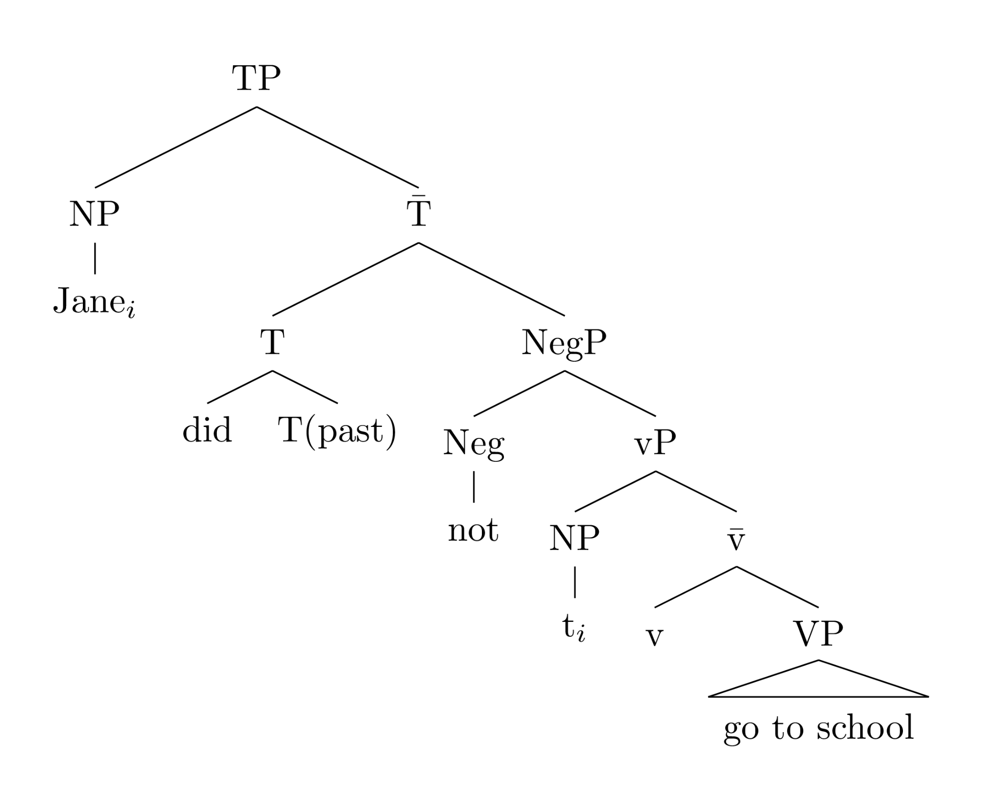
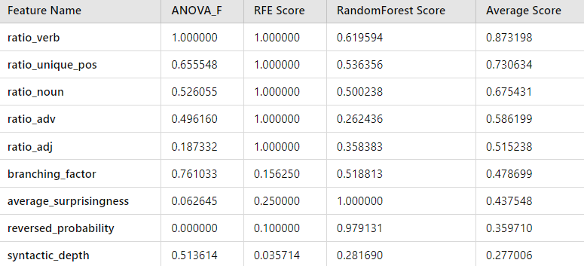
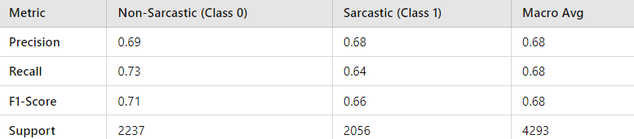
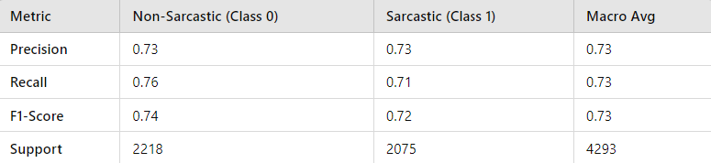
Syntactic Analysis Workflow
Dependency Parsing to get POS Tags and syntax trees
Come up with syntactic features
Do feature extraction
Recursive Feature Elimination (RFE)
Random Forest
Train Models on the top 5 features
Logistic Regression
Random Forest
Evaluate the Syntactic Models
Combine via a Voting-Rule (hard-voting)
Feature Extraction
Transitional Probability Calculation
TODO: Everything haha
Notes:
Max

Slide 20
Syntactic Analysis - Takeaways
Different models disagree on syntactic features
Voting Algorithm
Ensemble of three Classifiers
Every Classifier predicts a class
Majority wins
Does not perform as well a BoW Naive Bayes
Possible improvements:
More Classifiers (like Random Forest, XGBoost)
Weighting the classifiers (Metamodel)
Naive Bayes
Syntactic Log-Regres
Syntactic Forest
What do you guys think?
Voting Algorithm
News
Notes:
Max

Slide 21
Voting - Performance on new data
Performance on Tweets data is very bad
Syntactic Features do not apply to tweeting language
Performance on Onion-Style and Huff Post-Style Headlines
Like Naive Bayes even better than validation data
Performance on generic headlines has also worse than validation data
Dataset | Precision (Sarcastic) | Recall (Sarcastic) | F1-score (Sarcastic)
Tweets | 0.62 | 0.59 | 0.60
ChatGPT (faking Onion and HuffPost) | 0.88 | 0.87 | 0.87
ChatGPT (faking generic headlines) | 0.68 | 0.68 | 0.68
Notes:
Max

Slide 22
Contents
Task & Data
1
2
Preprocessing and Baselines
Error Analysis and Insights
3
4
Advanced Approaches
Challenges and Conclusion
5

Slide 23
Challenges and Insights
Challenges
Bag of Words models like Naive Bayes are very powerful and it is hard to come up with something better
Sarcasm is not well defined and very hard to generalize over multiple data sources
Insights
When working on sarcasm detection topic including encoded real world information might be beneficial to improve the quality of classification
Including sarcastic data from multiple sources would help to improve generalization of the model since websites and newspapers might have their unique style of headlines
Notes:
Terezia

Slide 24
Thank You!
Questions?

