Slide 1
What’s for dinner?
Ariani Herrera

Slide 2
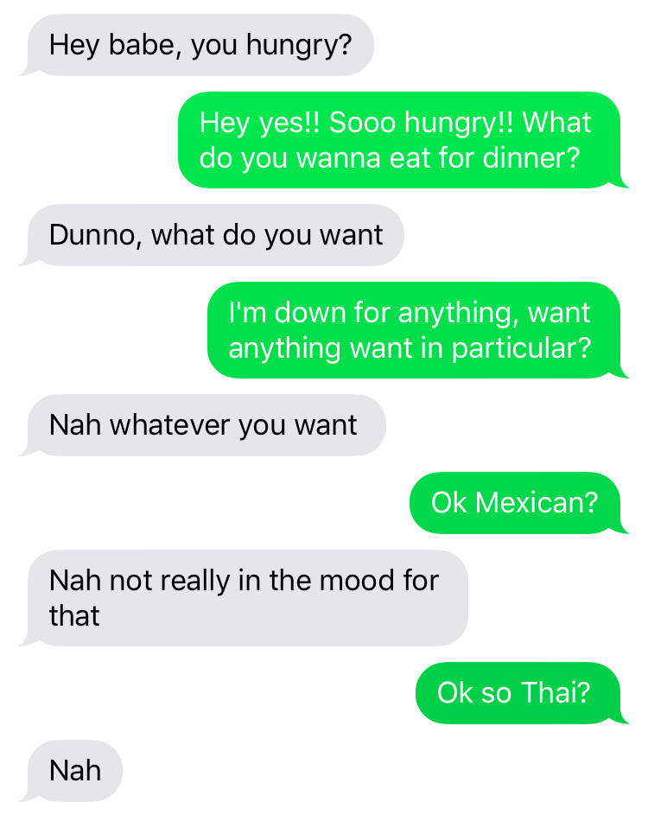

Slide 3
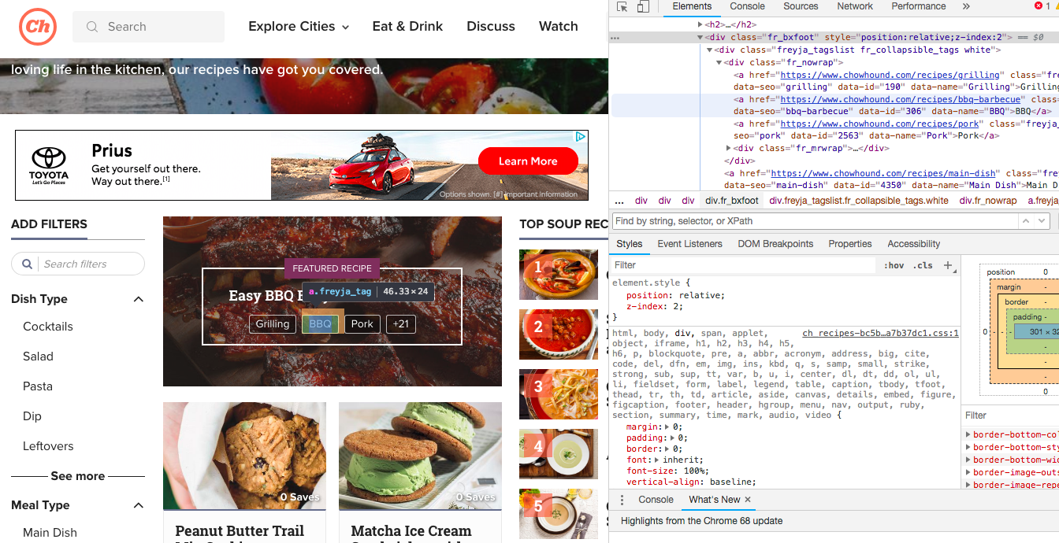
Scrapping Chowhound
On chowhound.com/recipe I found the class = fr_bxfoot , then found the ‘href’ to
get the topics page

Slide 4
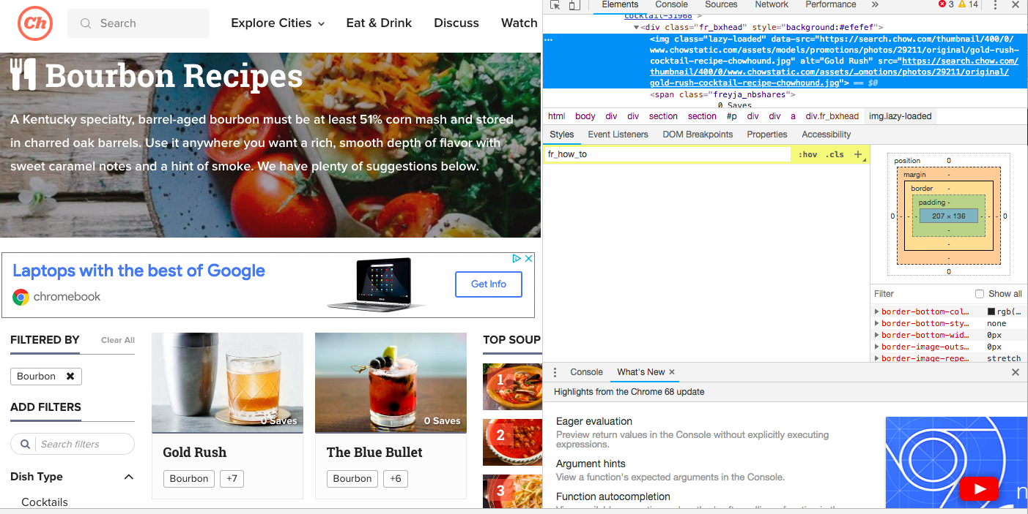
From my base pages then I would once again use beautiful soup from to find the class for
Specific recipes

Slide 5
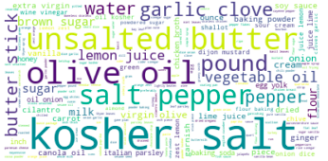

Slide 6
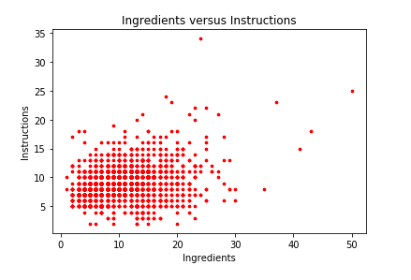

Slide 7
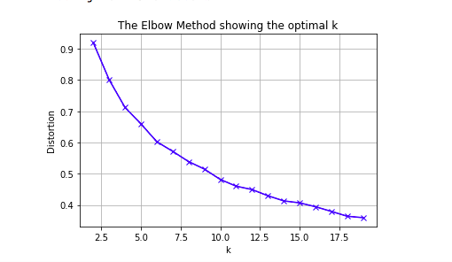

Slide 8
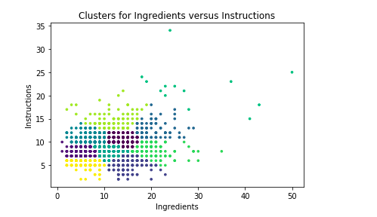
Each color represents which dots belong to certain clusters

Slide 9
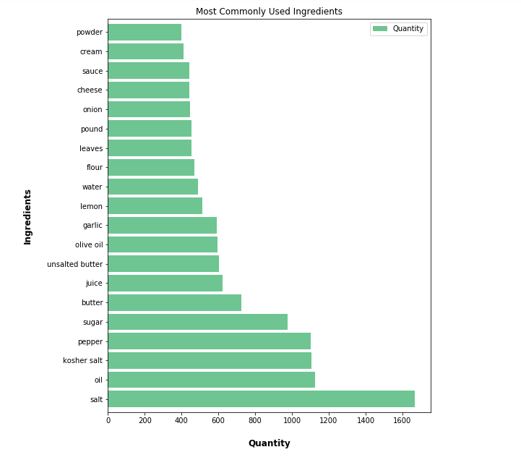

Slide 10
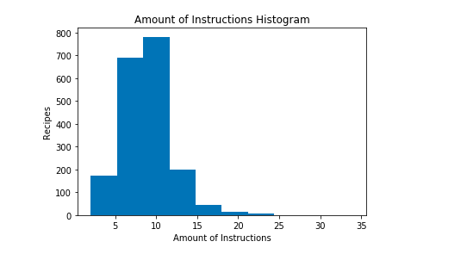

Slide 11
