Slide 1
Autoencoders, VAE & LSTM AE
Deep Learning for Anomaly Detection
From architecture to reconstruction-error scoring
Data Engineering · Year 5 · Anomaly Detection Lecture Series

Slide 2
What We'll Cover Today
01
Autoencoder Fundamentals
Architecture, training loop, anomaly scoring
02
Variational Autoencoder (VAE)
Probabilistic latent space, reparametrisation trick
03
ELBO — The VAE Objective
Reconstruction + KL divergence, β-VAE
04
LSTM Autoencoder
Temporal modelling, windowed reconstruction
05
Anomaly Detection in Practice
Thresholding, multivariate TS, root-cause

Slide 3
01
Autoencoder Fundamentals
Architecture · Training · Anomaly scoring

Slide 4
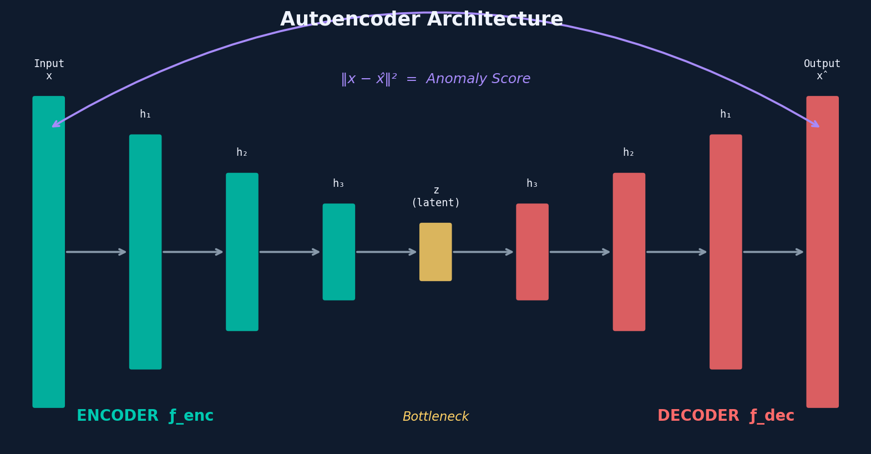
What is an Autoencoder?
Definition
An AE learns to compress data into a low-dimensional latent code z, then reconstruct the original input x̂ from z. Trained to minimise reconstruction error.
Key insight for AD
Trained only on normal data, the AE reconstructs normal samples well but struggles with anomalies — yielding high reconstruction error as the anomaly score.
Key Formulae
Unsupervised
Encoder: z = f_enc(x)
Decoder: x̂ = f_dec(z)
Loss: L = ||x - x̂||² (MSE)
AD Score: s(x) = ||x - f_dec(f_enc(x))||²
No anomaly labels needed. Only normal samples are required at training time (semi-supervised setting).

Slide 5
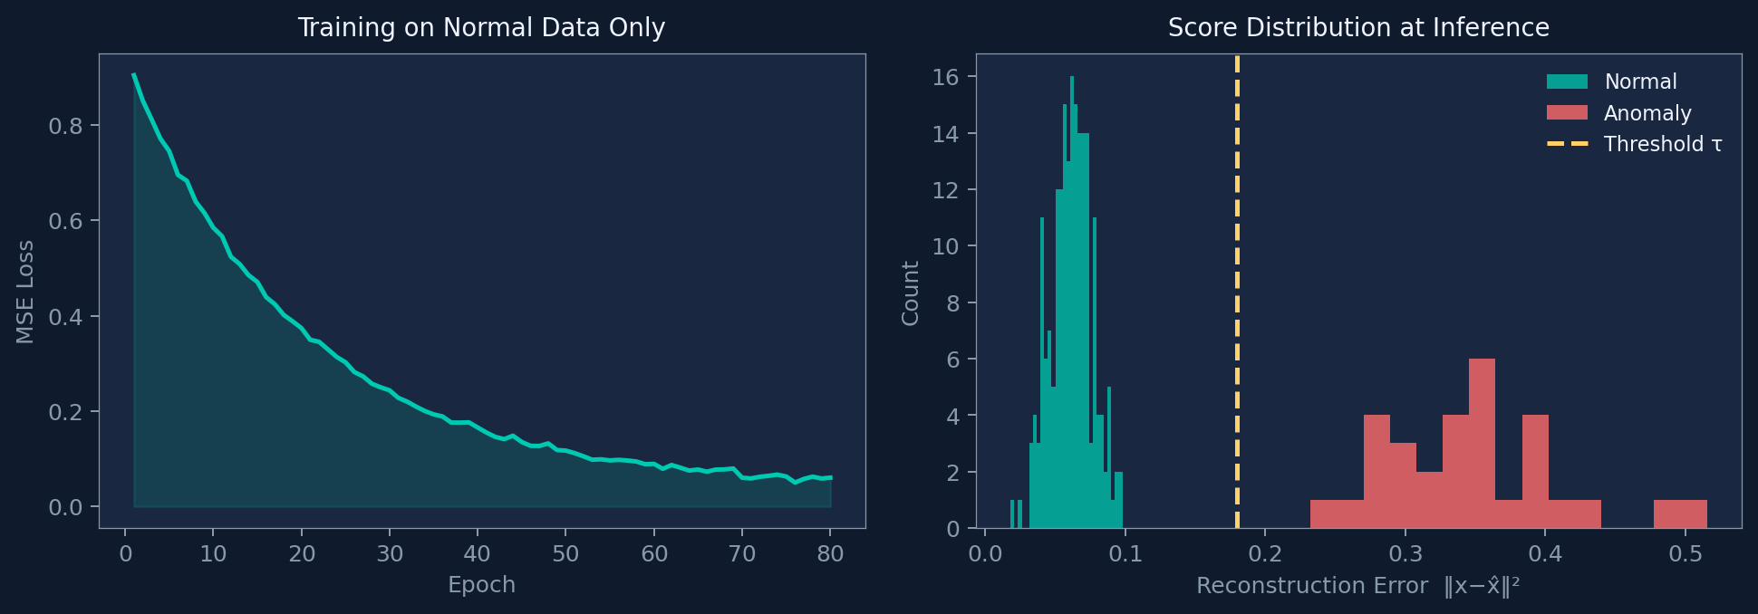
Training and Anomaly Scoring

Slide 6
The Bottleneck: Why It Works
Compression forces generalisation
The bottleneck z has dim k << d. The network must learn the principal structure of normal data, not memorise individual samples.
Normal data fits the manifold
After training, normal x maps to z and back with low error — it lies on the learned manifold.
Anomalies are off-manifold
Unusual x cannot be faithfully reconstructed from z because the AE has no representation for it.
Choosing bottleneck size k
Too small: even normal data reconstructs poorly. Too large: anomalies also reconstruct well (over-capacity). Tune via validation set.

Slide 7
02
Variational Autoencoder (VAE)
Probabilistic latent space & reparametrisation trick

Slide 8
From AE to VAE — Why Probabilistic?
Problem with Plain AE
VAE Solution
No structure in latent space
Each z is just a point — nearby z values may decode to completely different outputs.
Holes in latent space
Anomaly scores are unreliable — a normal point may accidentally land in an empty region.
No uncertainty estimate
We cannot tell whether a high reconstruction error is due to anomaly or just a rare-but-normal sample.
Probabilistic encoder
Outputs q(z|x) = N(mu_z, sigma_z^2) instead of a point.
Prior regularisation
KL term pushes q(z|x) towards N(0,I), filling latent space uniformly.
Principled anomaly score
-ELBO(x) = reconstruction error + KL divergence gives a proper log-probability estimate.

Slide 9
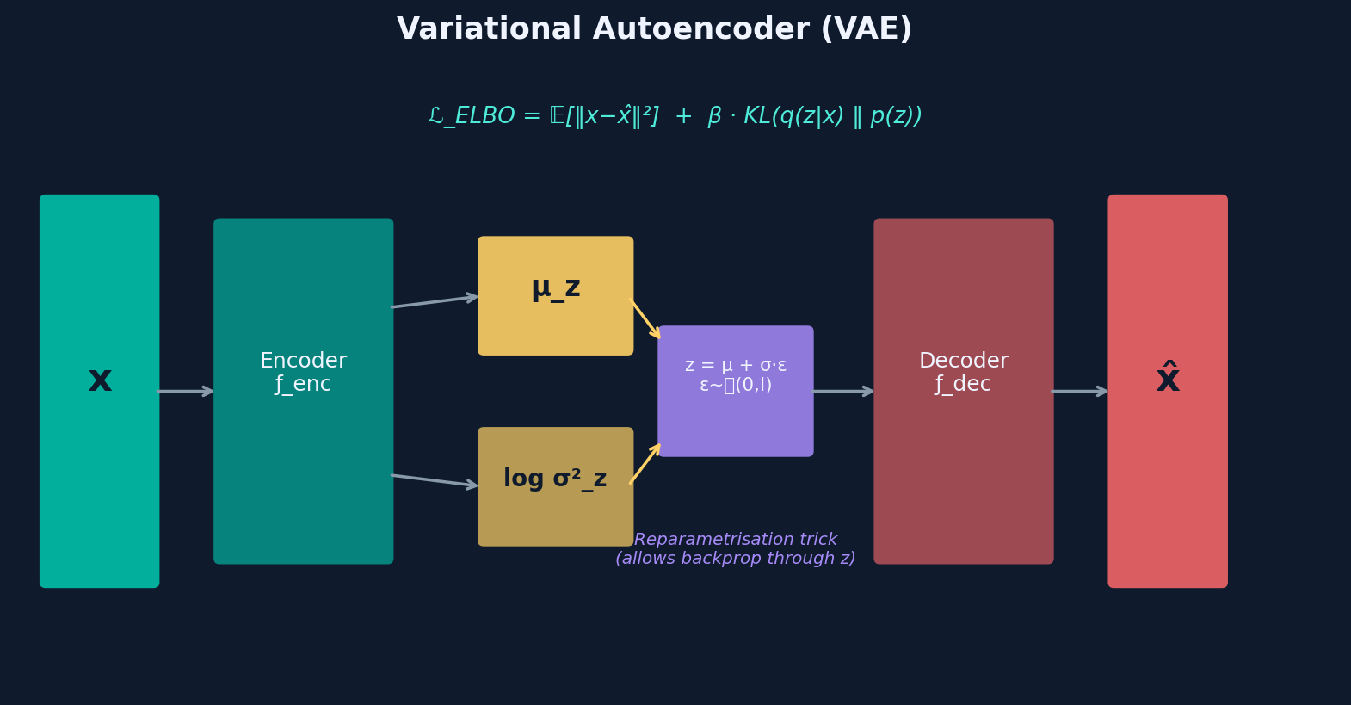
VAE Architecture & Reparametrisation Trick
Reparametrisation trick: z = mu_z + sigma_z * epsilon, epsilon ~ N(0,I) — allows gradients to flow through the sampling operation

Slide 10
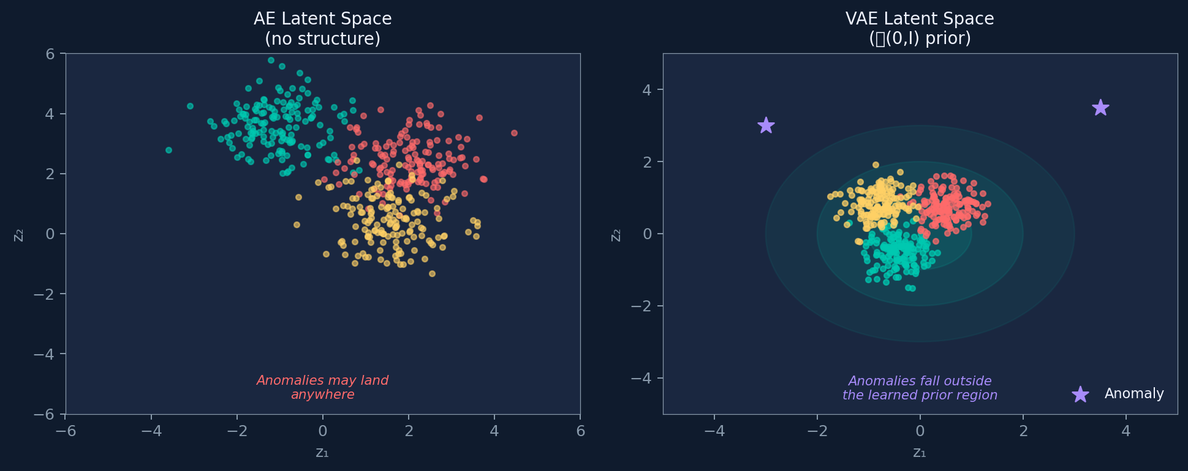
VAE Latent Space — Anomaly Detection

Slide 11
03
ELBO — The VAE Objective
Evidence Lower BOund · Reconstruction vs Regularisation

Slide 12
The ELBO Objective
ELBO = E_q(z|x)[ log p(x|z) ] - KL( q(z|x) || p(z) )
Maximising ELBO = maximising a lower bound on log p(x) (the log-likelihood of the data)
Reconstruction Term
E[ log p(x|z) ]
KL Regularisation
-KL( q(z|x) || p(z) )
Measures how well the decoder reconstructs x from a sampled z.
In practice: -MSE(x, x_hat) or -BCE(x, x_hat).
Forces the decoder to be faithful.
Measures how much the approximate posterior q(z|x) deviates from the prior p(z)=N(0,I).
For Gaussian: -1/2 * sum(1 + log(sigma^2) - mu^2 - sigma^2)
Prevents posterior collapse and fills latent space.

Slide 13
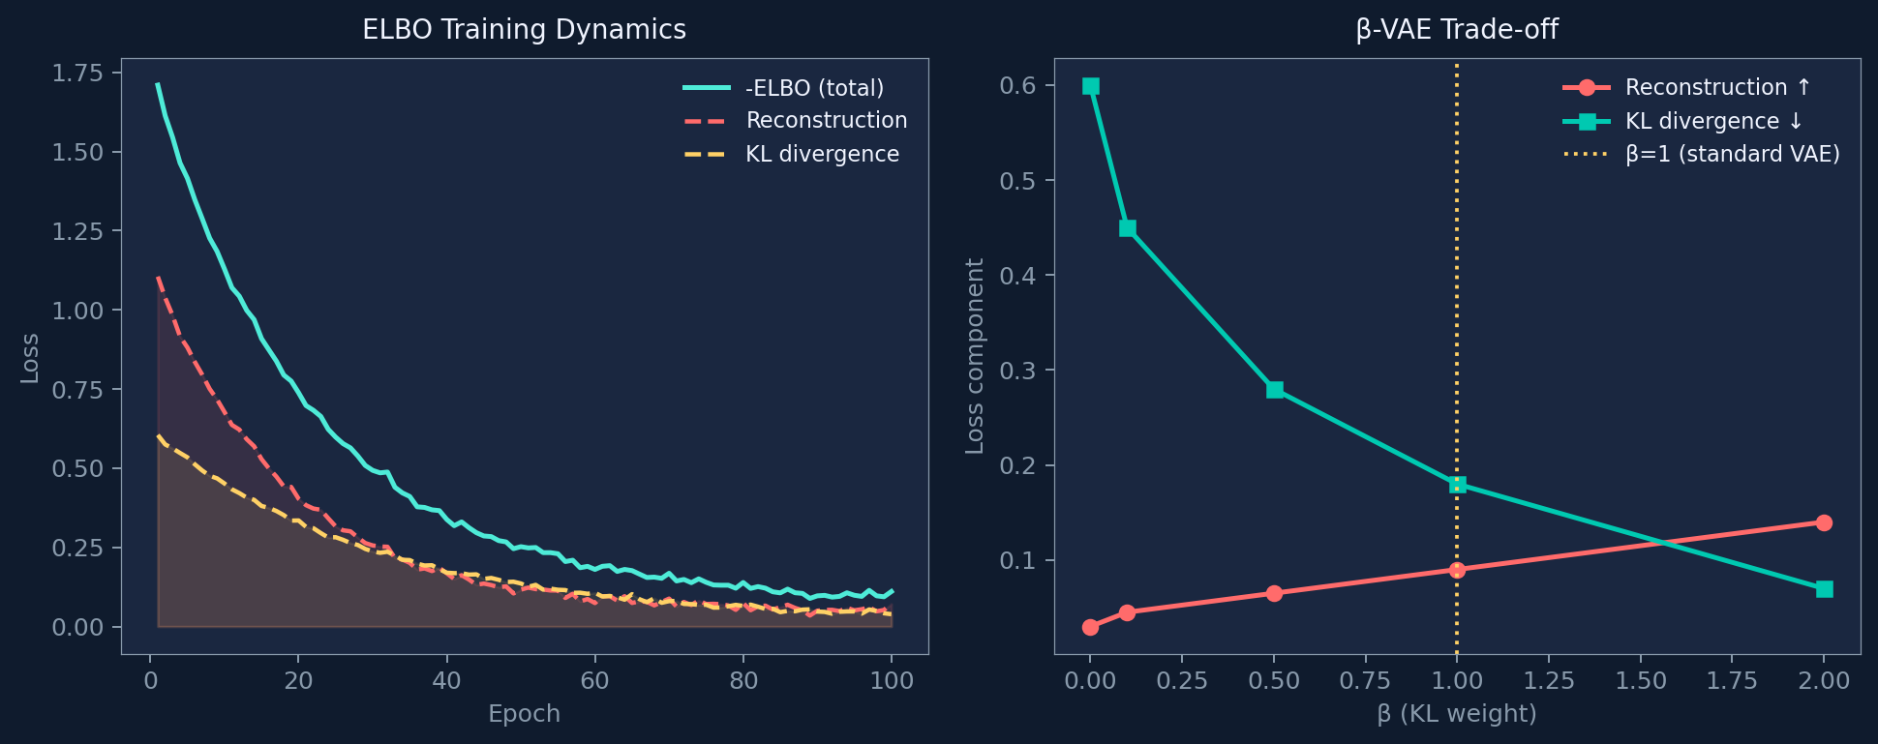
ELBO Training Dynamics & Beta-VAE Trade-off

Slide 14
Using ELBO as an Anomaly Score
s(x) = -ELBO(x) = ||x - x_hat||^2 + KL( q(z|x) || N(0,I) )
Why better than plain AE?
AE score only measures reconstruction error. ELBO score also penalises points whose posterior q(z|x) is far from the prior — catching anomalies that happen to reconstruct well by chance.
Monte Carlo estimation
Draw K samples z_k ~ q(z|x), compute E[||x - f_dec(z_k)||^2]. Use K=10-50 for a stable estimate. Higher K = lower variance but more compute.
Practical tip: importance weighting (IWAE)
Use importance-weighted ELBO for tighter bound: log(1/K * sum_k p(x|z_k)*p(z_k) / q(z_k|x)). Gives a better anomaly score at inference time.

Slide 15
04
LSTM Autoencoder
Temporal modelling of sequential data

Slide 16
Why LSTM for Time Series Anomaly Detection?
Temporal dependencies matter
LSTM gates control memory
In a time series, x_t is correlated with x_{t-1}, x_{t-2}, ... A dense AE treats each timestep independently and misses these patterns.
Forget gate discards irrelevant past. Input gate controls new information. Output gate controls what influences the hidden state. Together they capture long-range temporal patterns.
Sequence-to-sequence reconstruction
Dense AE vs LSTM AE
Encode window [x_1,...,x_W] into a single context vector z, then decode back to [x_hat_1,...,x_hat_W]. Anomaly score = mean MSE over the window.
Dense AE: ignores ordering, fast, great for tabular snapshots. LSTM AE: models ordering, slower, better for sequences, temporal patterns, sensor streams.

Slide 17
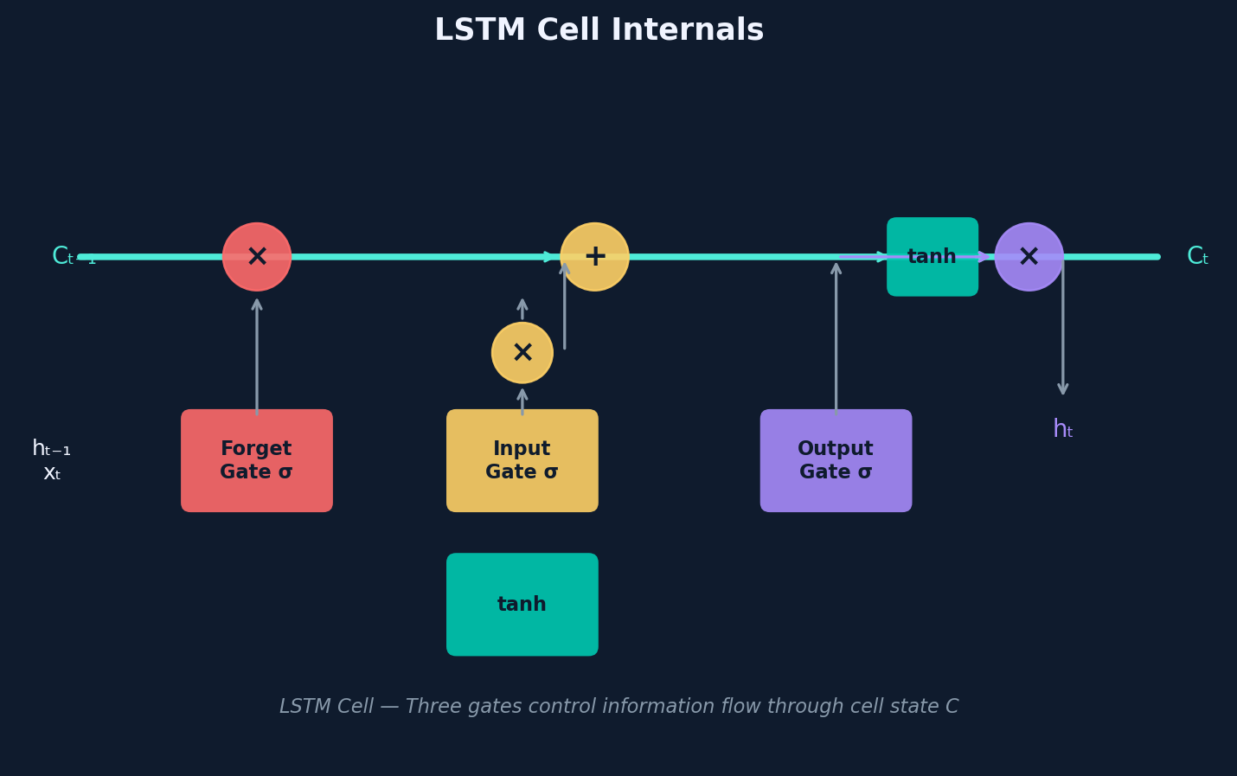
LSTM Cell — How It Works
Forget gate
f_t = sigmoid(W_f [h_{t-1}, x_t] + b_f)
Input gate
i_t = sigmoid(W_i [h_{t-1}, x_t] + b_i)
Cell update
C_t = f_t * C_{t-1} + i_t * tanh(...)
Output gate
h_t = o_t * tanh(C_t)

Slide 18
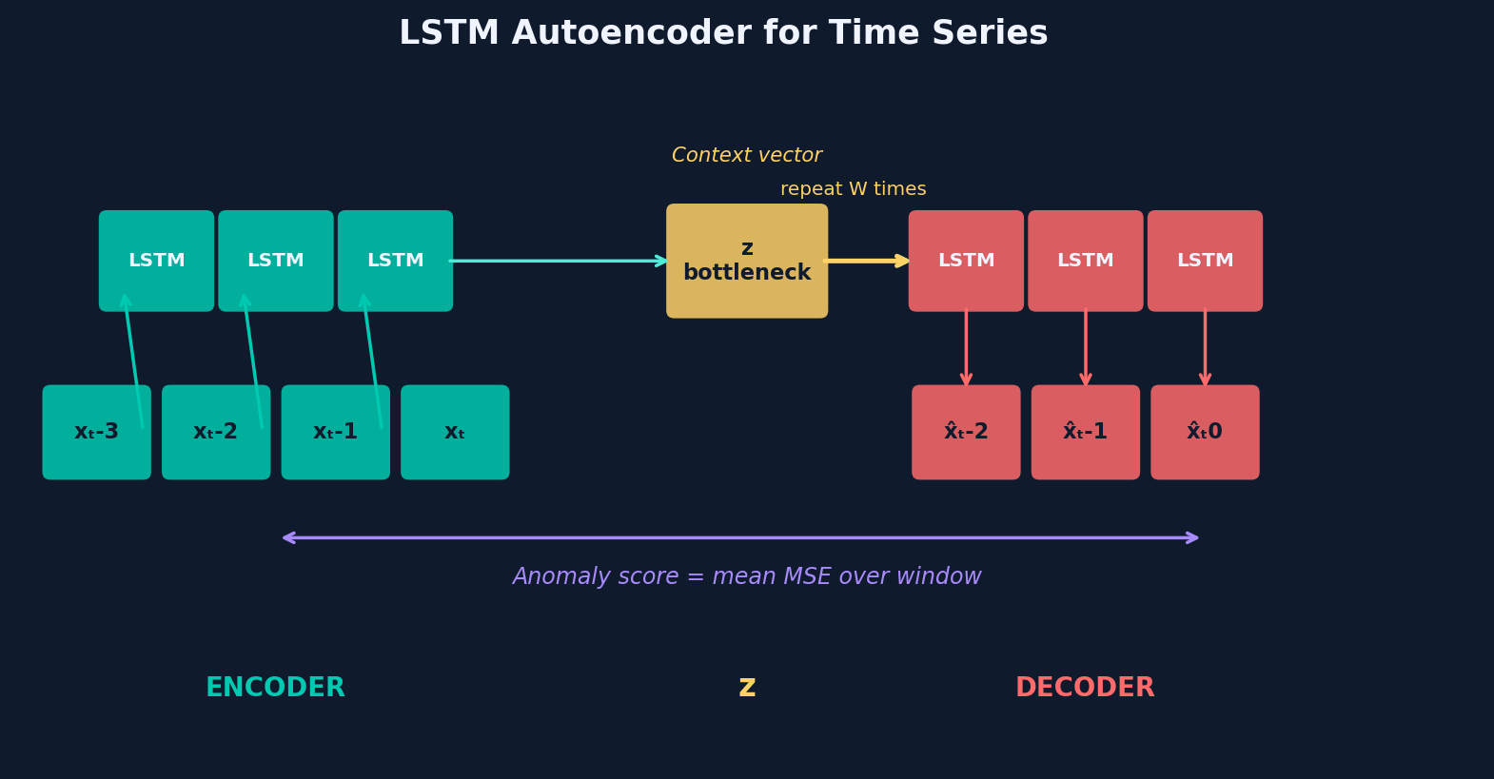
LSTM Autoencoder Architecture
Step 1: Slice TS into overlapping windows [x_t,...,x_{t+W}]. Step 2: Encoder LSTM → context z. Step 3: Decoder LSTM reconstructs x_hat from z (repeated W times). Step 4: Score = mean MSE over window, mapped back to timestep level.

Slide 19
05
Anomaly Detection in Practice
Thresholding · Multivariate TS · System design

Slide 20
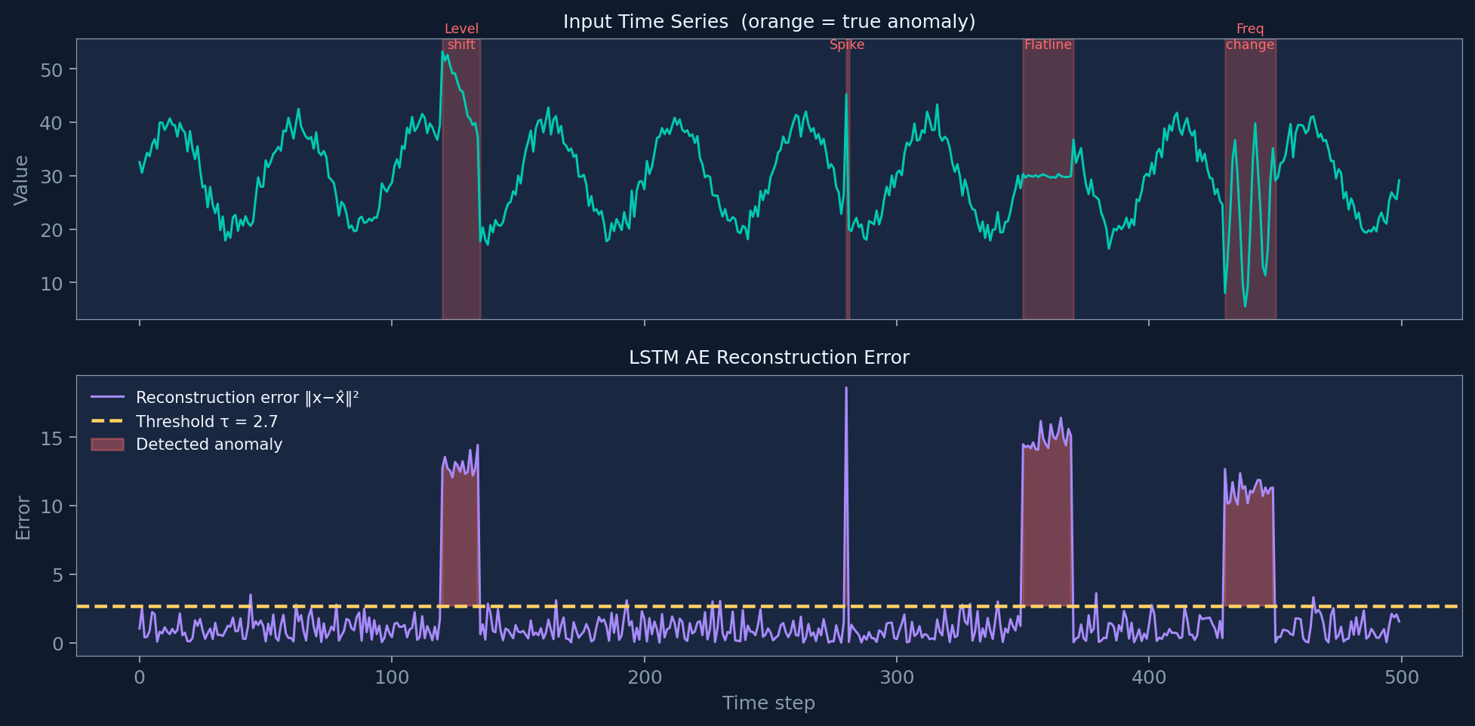
LSTM AE — Reconstruction Error on Real-World TS

Slide 21
Choosing the Anomaly Threshold tau
Percentile of training scores
Set tau = 99th percentile of reconstruction errors on training (normal) data. Simple, no labels needed. Works well if contamination is low.
Statistical test (chi-squared)
For Gaussian residuals: score ~ chi^2(d). Set tau = chi^2_{0.99}(d). Principled but assumes normality of residuals.
ROC-optimal (if labels available)
Compute AUROC curve, select threshold that maximises F1 or achieves target precision/recall. Best accuracy, requires at least some labelled anomalies.
Dynamic thresholding
Compute rolling mean/std of scores. Flag points > mu + k*sigma using a sliding window. Adapts to slow drift in the data distribution.

Slide 22
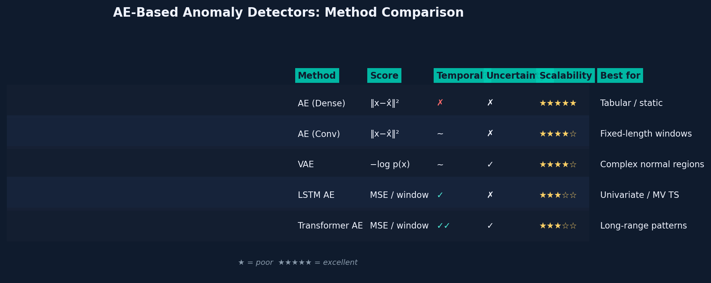
Comparison: AE, VAE, LSTM AE

Slide 23
End-to-End Anomaly Detection Pipeline
1 Ingest & Preprocess
Collect sensor/log data · Handle missing values · Normalise per channel (StandardScaler on training set)
2 Window & Feature
Sliding window W · Optionally: FFT features, rolling stats · Train/test split (no leakage!)
3 Train on Normal Data
Fit AE / VAE / LSTM AE only on confirmed normal data · Monitor validation reconstruction loss · Early stopping
4 Score & Threshold
Compute reconstruction error for all windows · Set threshold on training error distribution · Map window scores back to timesteps
5 Root-Cause & Alert
Per-channel error identifies affected sensor · Deduplicate overlapping detections · Alert with severity rank and channel attribution

Slide 24
Key Takeaways
AE
Compress to bottleneck z, reconstruct x_hat. High ||x-x_hat||^2 = anomaly. Train on normal data only.
VAE
Probabilistic AE: z ~ N(mu_z, sigma_z^2). ELBO = reconstruction + KL. Structured latent space improves AD.
ELBO
Maximise ELBO = maximise log-likelihood lower bound. beta controls reconstruction vs regularisation trade-off.
LSTM AE
Models temporal dependencies via encoder/decoder LSTMs. Score = MSE over reconstructed window. Best for time series.
Practice
Threshold = 99th pct of training errors. Per-channel error enables root-cause analysis. Ensembles improve robustness.

