Slide 1
How US comedies fare worldwide
Metis Bootcamp, Fall 2018
Arianna Breslauer

Slide 2


Past US comedies may have travelled less well overseas

Slide 3


Now we have a more globalized movie marketplace
Web connected foreign consumers
Purpose-built comedies

Slide 4
Initial hypotheses on worldwide gross
Opening US domestic gross a strong predictor
Starry actors play a large role
Budget also important

Slide 5
Setting up the model
IMDB
MPAA Rating
BOX
OFFICE
MOJO
Opening # Theaters
THE
NUMBERS
Runtime
Budget
IMDB Rating
Opening Gross
Worldwide Gross
Release Date
Actors
Genre
Budget
Highest grossing actors
Scraped with BeautifulSoup
Generated an Actor Score based on highest grossing actors
Limited data set to movies showing in 100+ theaters
Target variable:
Worldwide gross ex US
Notes:
Comedy data set only

Slide 6
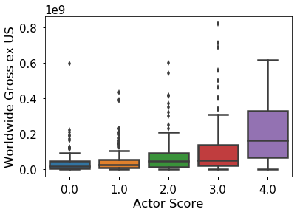
Initial EDA: high actor scores appear to be correlated with worldwide gross ex US

Slide 7
R² is 0.625 for linear regression model
Notes:
Y, ypred, y-ypred on dataframe to get films predicted well or not
# sequels or not
# which ones did model overpredict for or underpredict

Slide 8
Ridge performs best across linear regression features
Train/Validation/Test | R²
Linear Regression | 0.62477
Ridge Regression | 0.62481
Lasso Regularization | 0.62472
Polynomial Features | 0.44392
Cross-Validation/Test | R²
Linear Regression | 0.44575
Ridge Regression | 0.44613
Lasso Regularization | 0.44573
Polynomial Features | 0.44575
Ridgecv Array
[0.61579173
-0.32579784 0.59130861 0.69818528 0.65115842]
Notes:
# data set was quite small so that was bringing the average down in the CV scores
Whats causing these outliers
Hold out test for CV – run cv on 80% and hold out for the 20%

Slide 9
Scaled Relative Feature Strength – Ridge; initial hypotheses seem to hold
Notes:
# genre break down would have been interesting

Slide 10
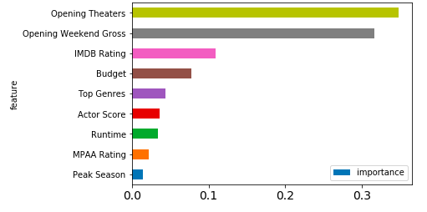
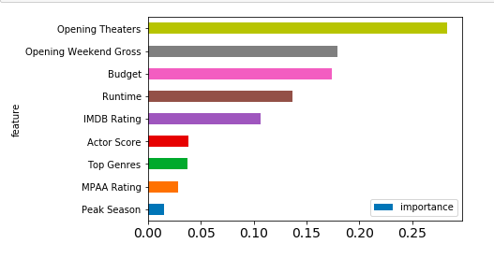
Tree based methods outperform previous models; RMSE reduced by half
RandomForest
GradientBoosting
R² = 0.66044
RMSE = 81,411,737
R² = 0.69044
RMSE = 77,732,225
Notes:
# almost half the amount of the RMSE so we lose interpretability but we see a massive drop in rmse from the ridge

Slide 11
Closing remarks
Today’s big hits earn ~80% of their box office revenue internationally
Thinking about foreign audiences has become de rigueur
Next steps to improve prediction model:
Location of filming (filmed ex US?)
Plot (high-concept, universal appeal?)
Production company (large distribution network worldwide?)
Notes:
# tie back to business problem, we can do a good job of extrapolating – here are the main factors what a movie studio should consider

