Slide 1

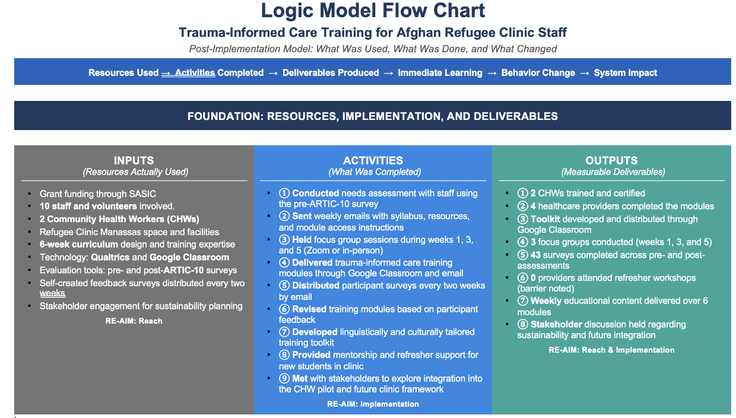

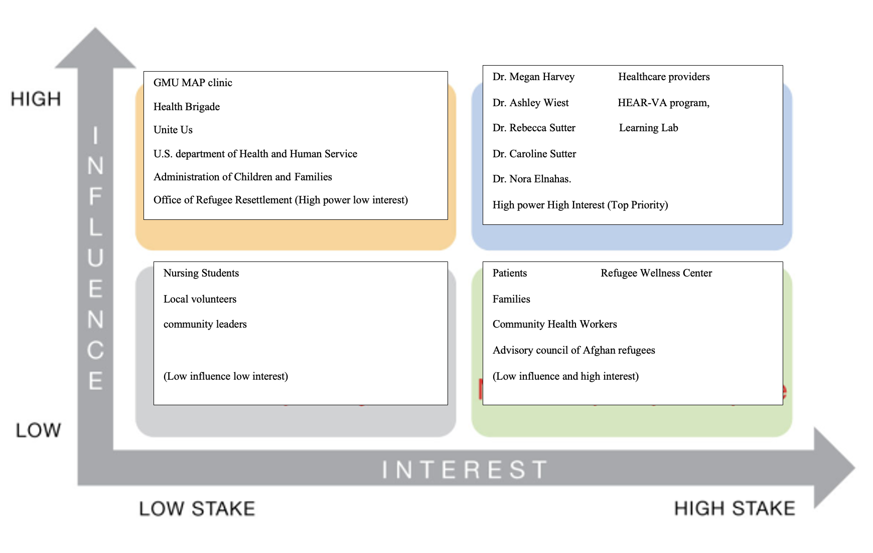
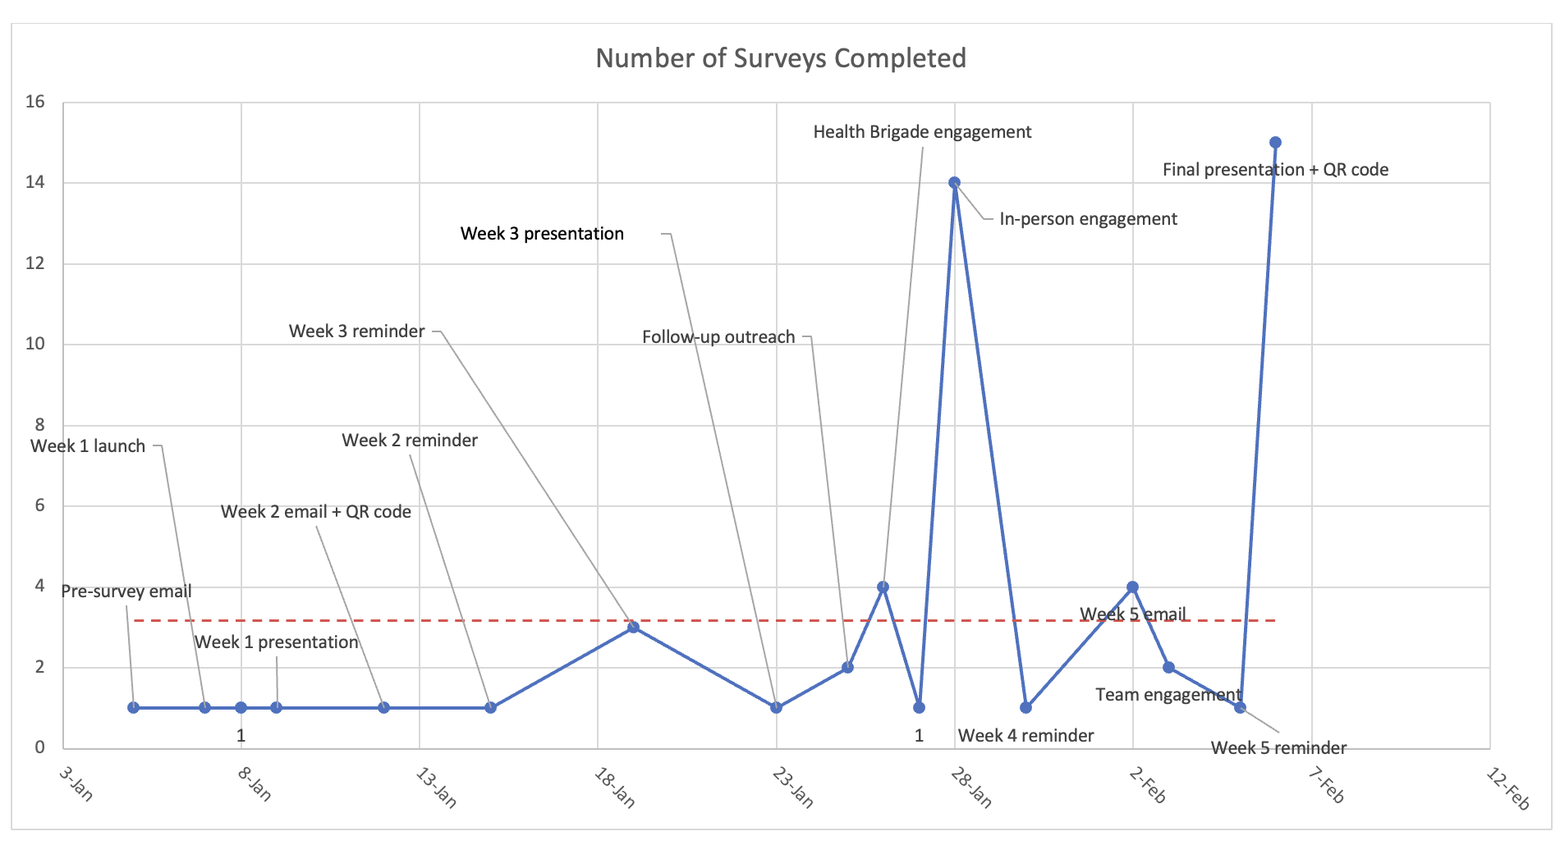
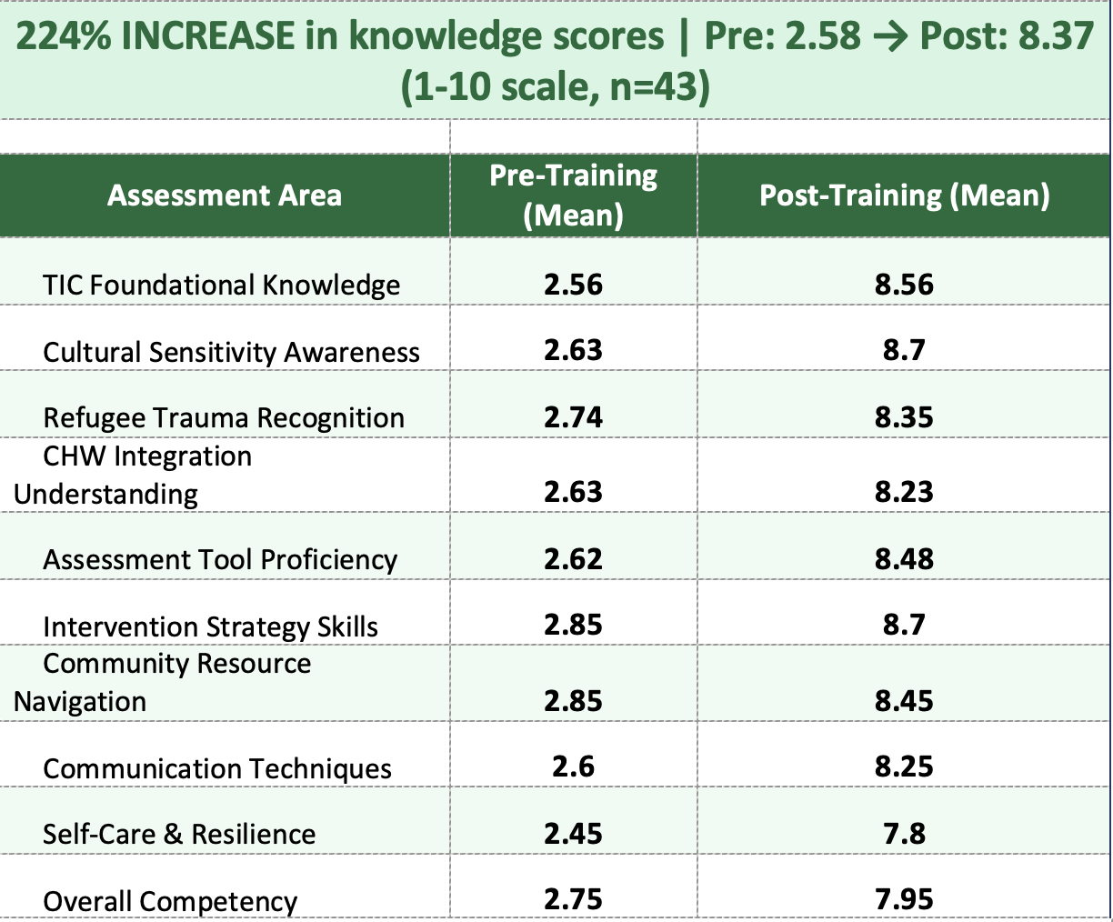
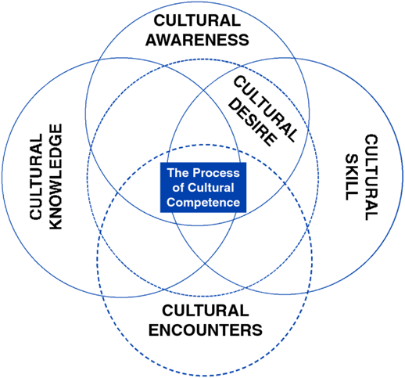
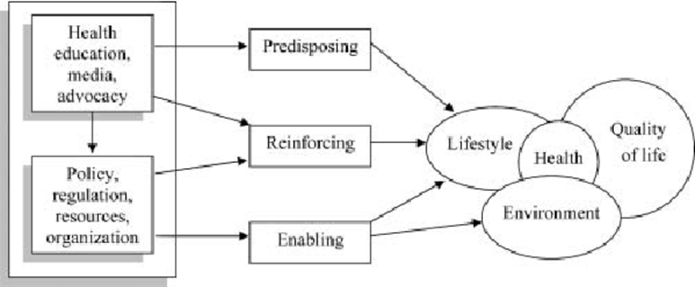
Developing Trauma-Informed Care In Refugee Health: A Six-Week Training for Afghan Refugee Care Through Community Health Worker Integration
Arianna Castro, MSN, RN, DNP-FNP Student
COMMITTEE: Dr. Caroline Sutter DNP, APRN, FNP-BC, PMHNP-C
BACKGROUND - Evidence & Literature Review
PROJECT DESIGN
PROJECT ANALYSIS
Afghan refugees who resettle in Virginia often experience significant trauma across the pre-migration, migration, and post-migration journey.
There is a growing body of evidence that shows traumatic events can increase an individual’s risk of long-term physical and behavioral health issues. The Philadelphia Urban ACEs study has linked trauma with lifelong health problems such as heart disease, liver disease, lung disease, and mental health conditions.
Partnering clinics within Virginia serve this population but lack a standardized trauma-informed care framework.
Evidence demonstrates that community health workers improve communication, trust, patient safety, and care coordination.
Project Design: Quality Improvement design to implement and evaluate a 6-week trauma-informed training module focusing on culturally responsive care for Afghan refugees. Integrating community health workers into the trainings to strengthen trust, communication, and trauma-responsive practices.
Methodology: Guided by the Precede-Proceed model and Campinha-Bacote’s cultural competence framework. The training modules were delivered in person at the clinic site and via Google Classroom.
Subjects: Clinic staff, nurses, providers, case workers, students, volunteers, and pharmacists.
Setting: Virginia partner clinics participating in the SASCI grant.
Tools/Measures: Pre/post ARTIC-10, bi-weekly reflections, and staff engagement.
The culturally tailored training modules increased provider readiness, confidence, and recognition of trauma-related needs among the Afghan refugee population.
While participant engagement and several ARTIC domains improved, post-ARTIC scores decreased, particularly in organizational and administrative support, suggesting that long-term success will require stronger leadership engagement and system-level infrastructure.
PROJECT PURPOSE, GOALS, and/or AIMS
RECOMMENDATIONS
Project Aim: develop, implement, and evaluate a CHW-integrated trauma-informed care training module to improve culturally and linguistically responsive care for Afghan refugees in Virginia.
Goal #1: Design a trauma-informed training curriculum that incorporates CHW expertise and addresses key refugee-care competencies.
Goal #2: Improve providers’ knowledge, clinical skills, and confidence in delivering culturally and trauma-informed refugee care, through the CHW-integrated training module.
Objectives:
Prepare Afghan CHWs to co-facilitate trainings
Use feedback to refine trainings
Support adoption across partner clinics
IMPLEMENTATION STRATEGY
Future Direction: Longitudinal follow-up to assess sustained knowledge retention over 6-12 months.
Measure patient outcomes directly linked to CHW TIC trainings.
Integrate training into the CHW workflow.
Policy advocacy for TIC integration into refugee resettlement programs
REFERENCES
SETTING & POPULATION
The population: Afghan Refugees resettling in Virginia
Facility: Mason and Partners Refugee Clinic, participating in the Services to Afghan Survivors Impacted by Combat grant.
Stakeholders:
ACKNOWLEDGEMENTS
Chair: Dr. Caroline Sutter, DNP, APRN, FNP-BC, PMHNP-C
George Mason University School of Nursing
OUTCOMES & FINDINGS
Number of Surveys: Formative Evaluation- Survey completion was monitored throughout implementation to assess participation in real time. Peaks in responses followed by reminders, presentations, QR code sharing, and in-person engagement.
ARTIC Scale Pre vs. Post Training Attitudes: Summative Evaluation- Reflect improved readiness and confidence in trauma-informed care. Lower post-test scores related to organizational and administrative support, indicating ongoing barriers to full implementation and sustainability.
Increased Knowledge and Skills: All ten areas showed significant improvement after the training.
FRAMEWORKS
Campinha-Bacote’s Model
“ASKED” model framework,
PRECEDE-PROCEED model
Assessing the needs of healthcare providers,
Highlighting predisposing knowledge and attitudes that affect access to resources and policies that hinder the Afghan population.

