Slide 1

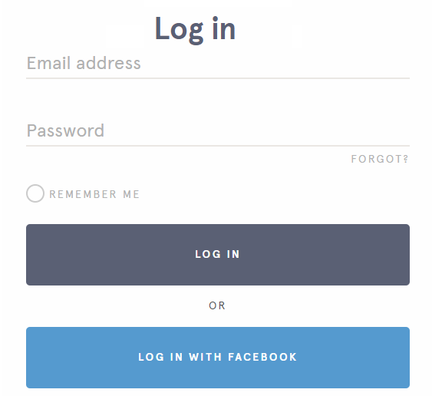
Stochastica
Start a game!
Join a game:
Your User Name
Room Code
How to Play
Get the App
Notes:
The login window is pulled from Headspace
Play Now begins a game with the Starter Pack (only).
Login expands on hover-over?
Other ideas:
Video of play on the landing page somewhere?

Slide 2
Stochastica
Start a game!
Join a game:
Your User Name
Room Code
How to Play
Get the App
Notes:
The login window is pulled from Headspace
Play Now begins a game with the Starter Pack (only).
Login expands on hover-over?
Other ideas:
Video of play on the landing page somewhere?

Slide 3

2:30
I’m done!
Notes:
Maybe timer goes red at 30 seconds or something, and starts blinking at 0:00?

Slide 4

Pick your packs:
Room ID: LDDCFD
Get more packs
Select all
Rules
Starter Pack
Pack 1
Animal Pack
Timer:
2 minutes
Break between presentations:
Yes
Submit topics by:
Phone
Presentation Title Slides:
Yes
Pack 2
NSFW Pack
Start the Game!
Notes:
You can select packs and they highlight, then click the game
Arrows to scroll if needed
Share by text or email or something?

Slide 5
Pick your packs:
Get more packs
Select all
Rules
Starter Pack
Pack 1
Animal Pack
Timer:
2 minutes
Break between presentations:
Yes
Submit topics by:
Phone
Presentation Title Slides:
Yes
Pack 2
NSFW Pack
Start the Game!
Notes:
You can select packs and they highlight, then click the game
Arrows to scroll if needed

