Slide 1

Analysis of Maryland Small Businesses Success
UMD Data Challenge 2019
Team DC19004
Based on Maryland Small Business Development Center (SBDC) data
Team DC19004:
Aria Shahverdi
Amin Aria
Raymond
Bruce
Mentor:
Dr. G. Yakubova

Slide 2
Outline
Data Explanation and Goals (1min)
Impacts to Be Analyzed
Successful Start (3 min)
Socio-demographic Analysis
Most Important Features
Logistic Regression
Secured Capital Investment (1 min)
Increased Revenue (1 min)
New Jobs Created(1 min)
General Analytics and Regression (2 min)
Conclusion ( 1 min)

Slide 3
Data Explanation
No 6928
Not applicable: Already in Business 8484
Yes 1667

Slide 4
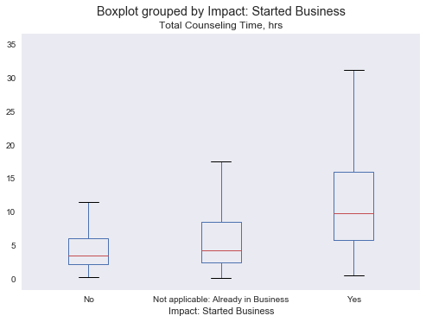
Consulting Hours
Impact: Started Business | Total Counseling hours(Mean, Median)
No | (6.0, 3.5)
Not applicable: Already in Business | (11.0, 4.5)
Yes | (20.4, 11.0)
Counseling:
Almost %13 for all three groups
sought group training at first

Slide 5
Successful Business Start per Race
Asian
Black or
African American
White/
Caucasian
Race | Success Rate
Asian | 0.17
Black or African American | 0.15
Choose not to respond | 0.20
Native American | 0.18
Native Hawaiian or Pacific | 0.27
White/Caucasian | 0.22
Choose not to
respond
Native American
Native Hawaiian or Pacific

Slide 6
Impacts: Started Business Counseling Hours, Revenue Increase, Capital Investments
Revenue Increase:
Capital Investments
Impact: Started Business | Revenue Increase(Mean, Median)
No | ($28, $0)
Not Applicable | ($57,342,$0)
Yes | ($63,995,$0)
Impact: Started Business | Mean(Capital Investments)
No | ($3,147,$0)
Not Applicable | ($46,171,$0)
Yes | ($94,064,$5000)

Slide 7
Industry

Slide 8
Gender
Race | Success Rate
Choose not to respond | 0.10
Male-Owned | 0.25
Male/Female-Owned | 0.20
Woman-Owned | 0.31
Woman-Owned (WOSB) Certified | 1.00
Choose not to respond | 0.10
Women-Owned Certified
Highest Success rate
(0.31)
Woman
Owned
Male
Owned
Male-Female
Owned

Slide 9
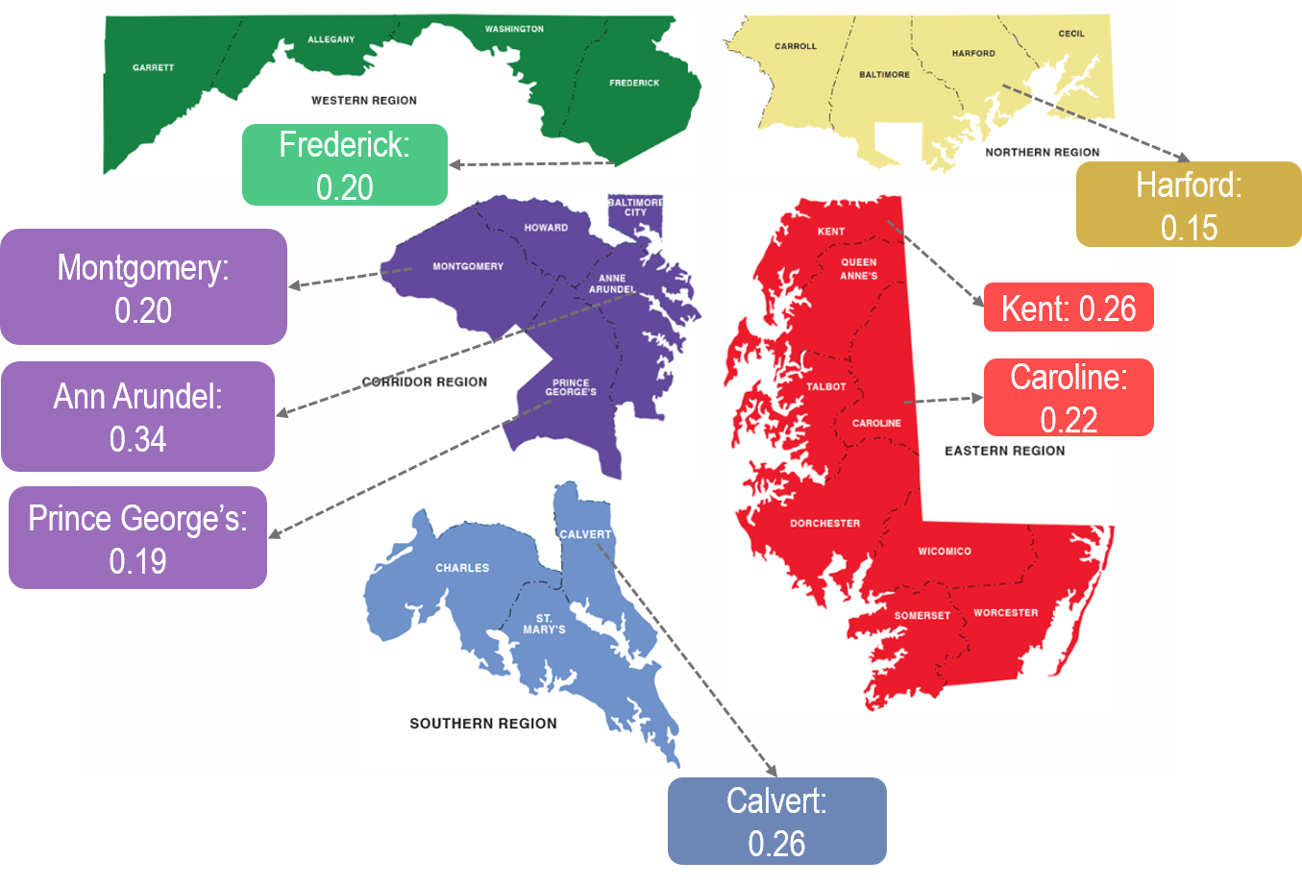
Demo Graphics of Success Rate

Slide 10
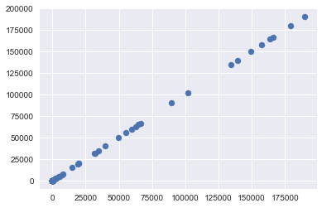

Slide 11
 | feature | score
38 | Business Status_Started with SBDC | 5992.907
36 | Business Status_Pre-venture/Nascent | 1667
37 | Business Status_Start-up (in bus. < 1 year) | 490.4043
35 | Business Status_In Business (> 1 year) | 444.6887
59 | Ownership Gender_Choose not to respond | 184.6948
2 | Impact: Created New Jobs | 160.3256
64 | Ownership Gender_Woman-Owned | 148.5571
34 | Attended Group Training?_Yes | 70.23632
6 | County_Anne Arundel | 67.64344
0 | Total Counseling Time, hrs | 66.08251
1 | Impact: Capital Investments | 63.62773
65 | Ownership Gender_Woman-Owned (WOSB) Certified | 54.02759
3 | Impact: Revenue Increase | 52.44993
4 | Company's Gross Revenue, $ | 37.93604
52 | Industry Title_Professional, Scientific, and T... | 36.56331
68 | Owner's Race_Black or African American | 33.20103

Slide 12
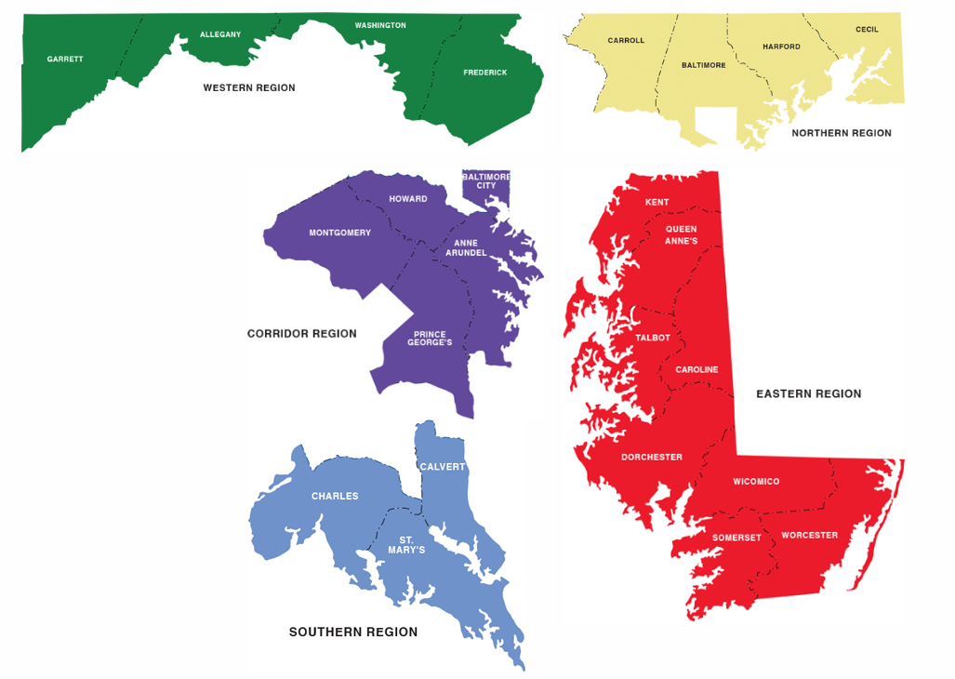
Demographics, Success Rate
Frederick:
0.20
Harford:
0.15
 |  | Success Rate
Allegany | 0.002518 | 0.189452
Anne Arundel | 0.009544 | 0.343161
Baltimore | 0.004977 | 0.166022
Baltimore City | 0.005504 | 0.256836
Calvert | 0.005153 | 0.264284
Caroline | 0.001464 | 0.221248
Carroll | 0.002401 | 0.114541
Cecil | 0.002342 | 0.173161
Charles | 0.004274 | 0.182494
Dorchester | 0.001757 | 0.123994
Frederick | 0.006031 | 0.203564
Garrett | 0.000703 | 0.26095
Harford | 0.005679 | 0.148993
Howard | 0.005445 | 0.184152
Kent | 0.000644 | 0.255759
Montgomery | 0.01376 | 0.205963
Montgomery:
0.20
Kent: 0.26
Ann Arundel:
0.34
Caroline:0.22
Prince George’s:
0.19
Calvert:
0.26

