Slide 1

✦ technica2026
TerpWhisper
Understand your professor or class with just a whisper of knowledge.
Team: Aria, Martin, Abigail
✧ ✦ ✧

Slide 2
01
02
Choosing a professor or class on PlanetTerp shouldn't feel like guesswork.
THE PROBLEM
Our Project
In PlanetTerp, reviews of professors and classes are usually very scattered
A chrome extension that helps users turn scattered reviews into a neat summary of the professor or class.
Students have limited time to read every review.
Just search by name, and it gives you clear sectioned summaries from Gemini API
Important patterns can get buried
A rating alone doesn't explain the classroom experience.

Slide 3
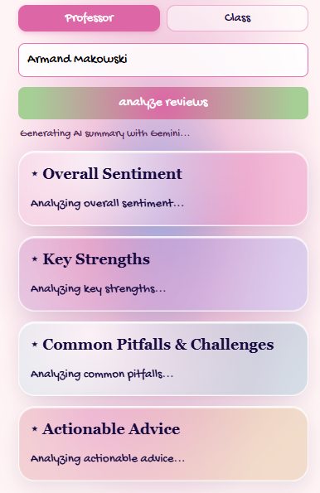
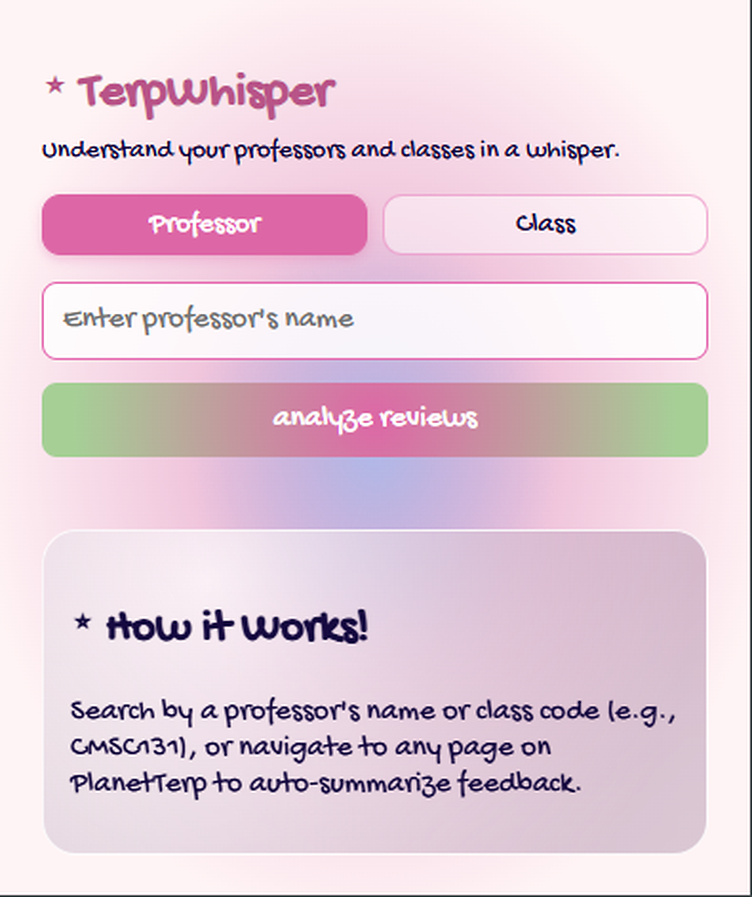
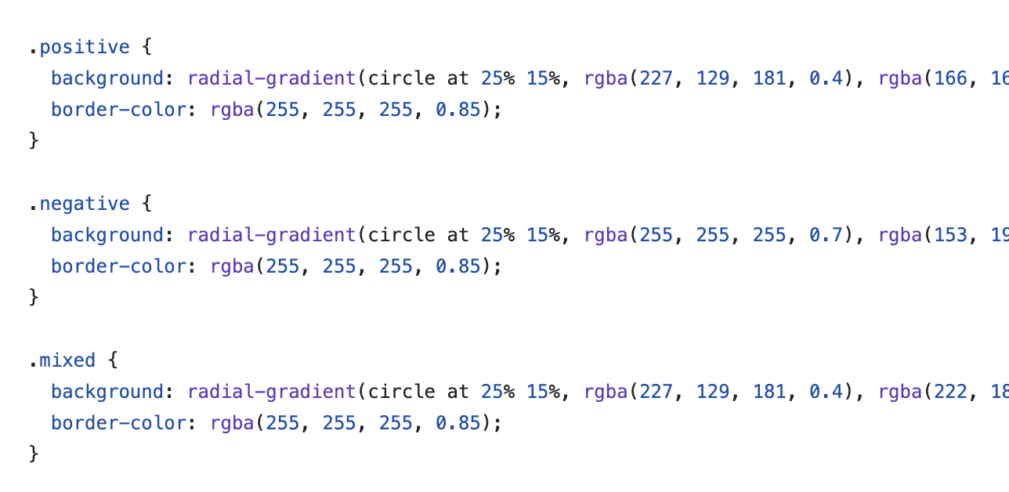
02 / THE SOLUTION
03
Our UI
Code using .html, CSS
Colors, gradient and hues, soft palette
Glassy effect on cards, with multiple different colors
Fun fonts

Slide 4
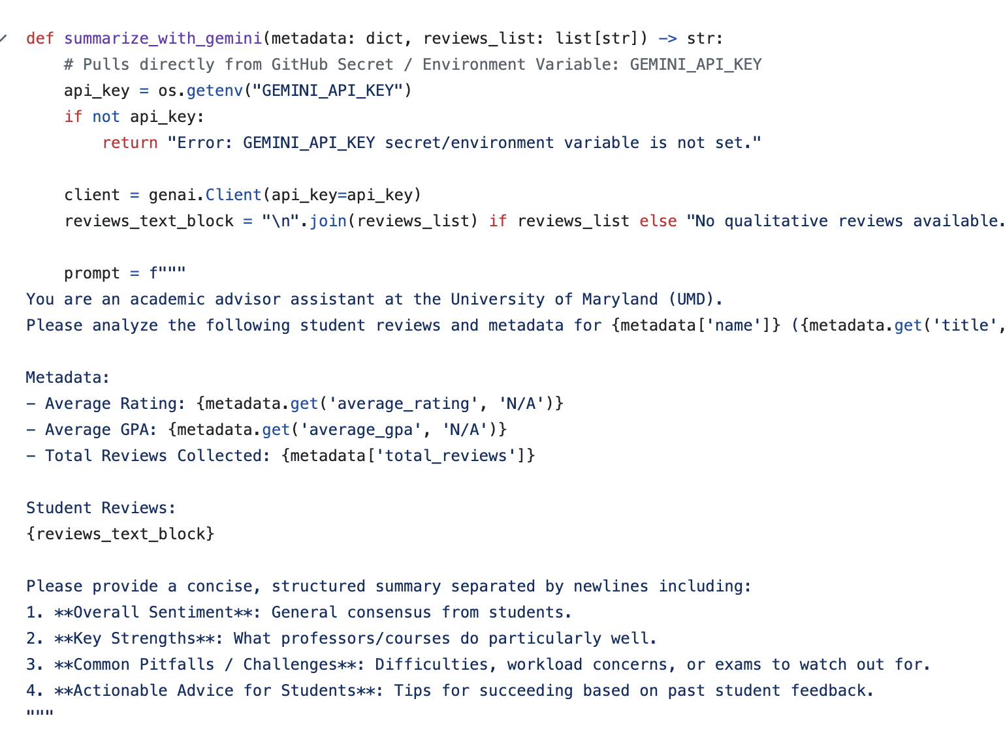
02 / THE SOLUTION
Using Gemini API
processing.py handles parsing raw JSON
data into Pandas DataFrame
Used Gemini 3.8 Flash and prompt
engineering to summarize reviews
Input: DataFrame of professor
Review data
Output: text file to be parsed in JavaScript

Slide 5
✦ TERPWHISPER
TerpWhisper
Thank you!
Aria, Martin, Abigail
✧ ♡ ✦

