Slide 1
Aria Templates Page Engine
Olaf Kappes
Benoît Charbonnier
Francesco Longo

Slide 2
Overview & Agenda
Training objectives
Introduction
The Page Engine in 6 steps

Slide 3
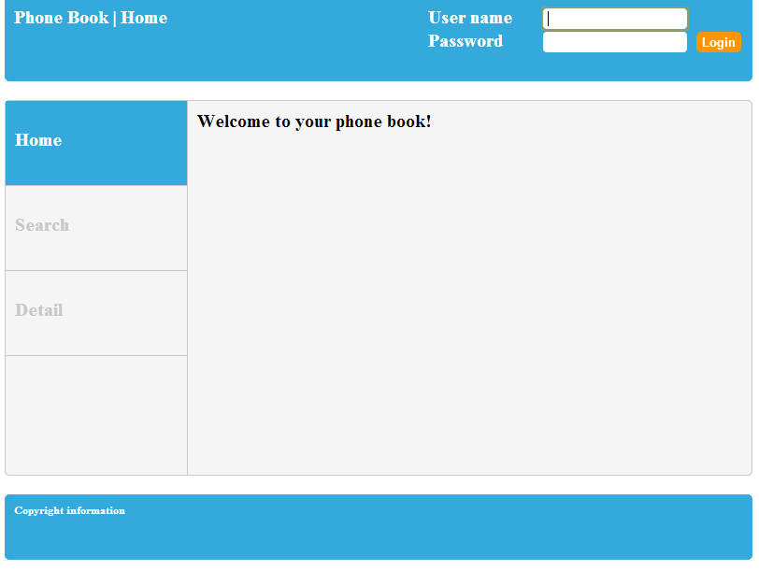
Training objectives
Design and code a very simple application using the Page Engine

Slide 4

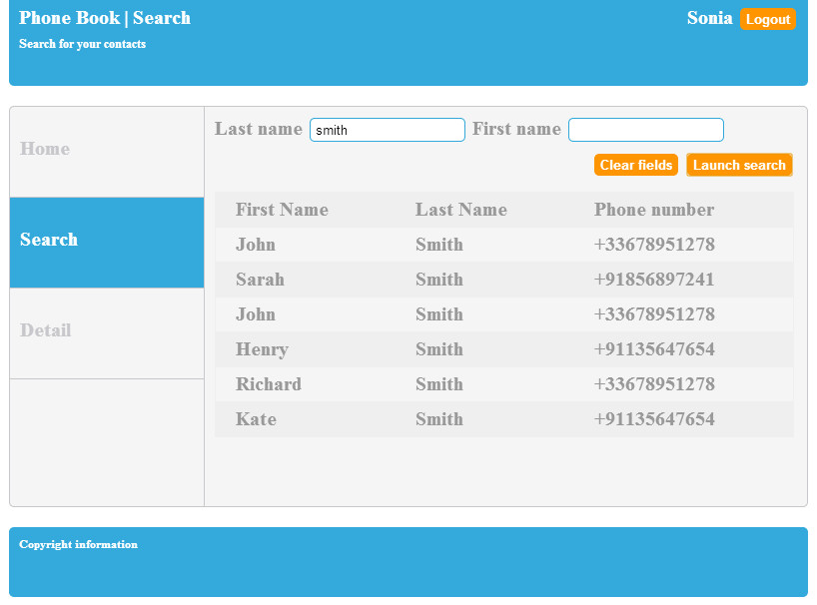
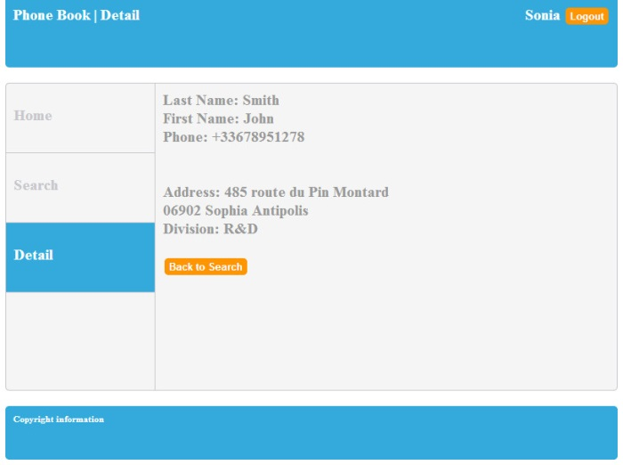
Introduction
What is the page engine?

Slide 5
Introduction
What is the page engine?
  layer of the Aria Templates framework
  For page-oriented applications
  For desktop and mobile

Slide 6
Functional modules
Navigation
Content

Slide 7
Functional modules
Navigation
Content

Slide 8

Functional modules
Navigation
Content

Slide 9
The page engine in 6 steps
Setup
Embedding templates
Embedding modules
Navigation
Data model and events
Custom page provider

Slide 10
1 - Setup
Page engine and page provider
Site configuration
Page definition
Placeholders with pure content

Slide 11
1 - Setup
Page Engine
Page Provider
.start(...)

Slide 12
1 - Setup
site config ?
Page Engine
Page Provider
{…}

Slide 13
1 - Setup
page HOME ?
Page Engine
Page Provider
{…}

Slide 14
2 - Embedding Templates
Layout templates

Slide 15
3 - Embedding Modules
Common modules
Page-specific modules

Slide 16
3 - Embedding Modules
Page Engine
root module
Login
Search

Slide 17
4 - Navigation
From templates
From modules
Titles and urls
back, forward, refresh
Animations

Slide 18
5 - Data model and events
Application data
Page data
Page information
Bindings
Access to the page engine
Listen to the page engine events

Slide 19
6 - Custom page provider
How to define one

Slide 20
Examples
Address book
Kitchen sink (for desktop/mobile/tablet)
  http://ariatemplates.com/mobile/kitchensink/
  https://github.com/ariatemplates/kitchensink

Slide 21
Find help
Official website: http://ariatemplates.com/
Page engine documentation: http://www.ariatemplates.com/usermanual/latest/page_engine
Api documentation: http://ariatemplates.com/aria/guide/apps/apidocs/
Github: https://github.com/ariatemplates/ariatemplates
Demo site (old): http://aria/aria-templates/
Topspot: http://topspot/index.php/Aria_Templates
Teams:
R&D-AQG-DUI-PRE-AFW (framework development NCE)
R&D/ALB/AQG/DUI/PRE/AFW (framework development BLR)
R&D-AQG-DUI-PRE-UAS (user interface architecture and support)

Slide 22
Any question?

