Slide 1

PYD411 · Mid-term evaluation · Bachelor's Thesis Project
Phase-Field Modelling
of Crawling Cells
Towards a Tractable Two-Dimensional Model
Siddharth Kumar · 2023PH10741
Soumik Roy · 2023PH10756
Adviser: Prof. Sujin B. Babu
Department of Physics, IIT Delhi · 2026 - 27, Semester I
8 minutes · 8 slides · 2 minutes for discussion
Notes:
We are modelling crawling cells using a phase-field description coupled to actin polarization, with the longer-term goal of extending the model from one cell to many interacting cells.

Slide 2
What makes a crawling cell move?
PHYSICAL MECHANISMS
MODEL REPRESENTATION
Actin treadmilling
• Polymerises at the front, depolymerises at the rear
• Produces protrusive transport
Phase field φ(x, t)
φ ≈ 1 inside cell, φ ≈ 0 outside
Actin polarization P(x, t)
Myosin contractility
• Generates active contractile stress
• Helps retract the cell rear
u = v + w₀P
w₀P: treadmilling transport v: friction/active-stress velocity
Adhesion
• Focal adhesions couple the cell to the substrate
• Coarse-grained as friction
σ_{act} = −ζ φ PP
convention: ζ < 0 is contractile
−ξ v
strong adhesion → larger ξ
Keratocyte fragments without a nucleus can still polarise and crawl — mechanics provides a major part of the behaviour.
Tjhung et al., Nat. Commun. 2015 · Leoni & Sens, PRL 2017
PYD411 · Mid-term · Dept of Physics, IIT Delhi · Siddharth Kumar & Soumik Roy
2 / 8
Notes:
We represent the cell by its shape field phi and the actin organisation by P. Treadmilling gives w0 P, active myosin stress gives the force that contributes to v, and substrate adhesion is coarse-grained as friction.

Slide 3
The model: shape, polarity and mechanics
F = F_{interface} + F_{polar} + F_{Frank} + F_{anchor} + F_{area/volume}
Double-well: separates cell (φ≈1) from outside (φ≈0)
Surface tension: gives the cell boundary an energetic cost
Polar order: favours |P| inside the cell
Frank elasticity: penalises strong spatial variation of P
Anchoring β: couples P to the cell edge and controls morphology
0 = −∇p + η∇²v − ξv + f
Re ∼ 10−5
Stokes force balance — inertia is negligible at the cell scale
Ver. | Geometry | Force balance | Area / volume
1 | Plane | v = 0 | drifts 4.5%
2 | Vertical slice + wall | Brinkman / screened in z | fixed
3 | Plane | incompressible Stokes | fixed
4 | Plane | friction-dominated v = f/ξ | soft volume
One ingredient at a time → identify what controls the behaviour. Goal: many interacting cells → avoid a global Stokes solve.
PYD411 · Mid-term · Dept of Physics, IIT Delhi · Siddharth Kumar & Soumik Roy
3 / 8
Notes:
The free energy controls the shape and polarisation, while the force balance determines motion. We progressively added physics so we could identify what was essential before simplifying the model for many-cell simulations.

Slide 4
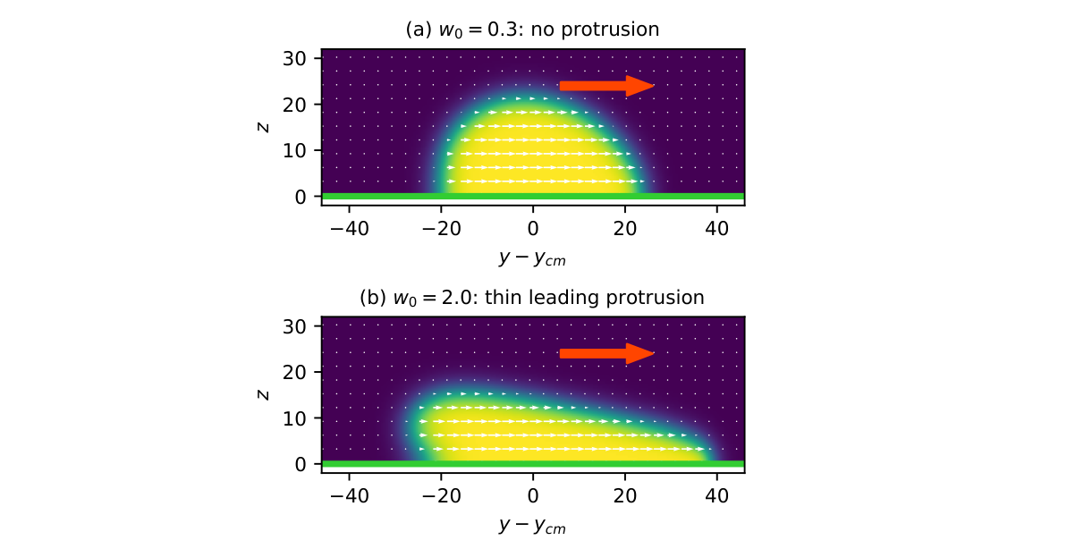
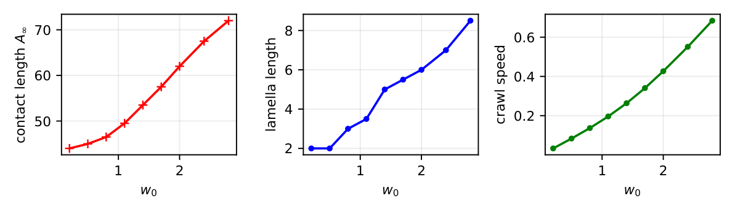
From a translating disc to a leading protrusion
Version 1
v = 0, ζ = β = 0
• Uniform P → uniform u — cell translates
• Shape cannot change
• Area falls 4.5% (non-conservative advection)
Version 2
Vertical y–z slice; substrate at z = 0. Treadmilling restricted to a layer of thickness λ:
w(z) = w₀/2 · [1−tanh((z−λ)/wτ)]
Near-wall material moves ahead → tension pulls the interface back → protrusion emerges.
w₀ | Shape | Contact | Speed
0.3 | cap | 44.0 | 0.050
2.0 | protrusion | 63.0 | 0.432
w₀* ≈ 0.8
Mε²/λ ≈ 0.75
Volume error 10⁻¹⁶
PYD411 · Mid-term · Dept of Physics, IIT Delhi · Siddharth Kumar & Soumik Roy
4 / 8
Notes:
Version 1 showed that uniform polarity can translate a cell but cannot deform it. Introducing a spatial gradient in treadmilling near the substrate produces the leading protrusion, with a transition near w0 approximately 0.8.

Slide 5
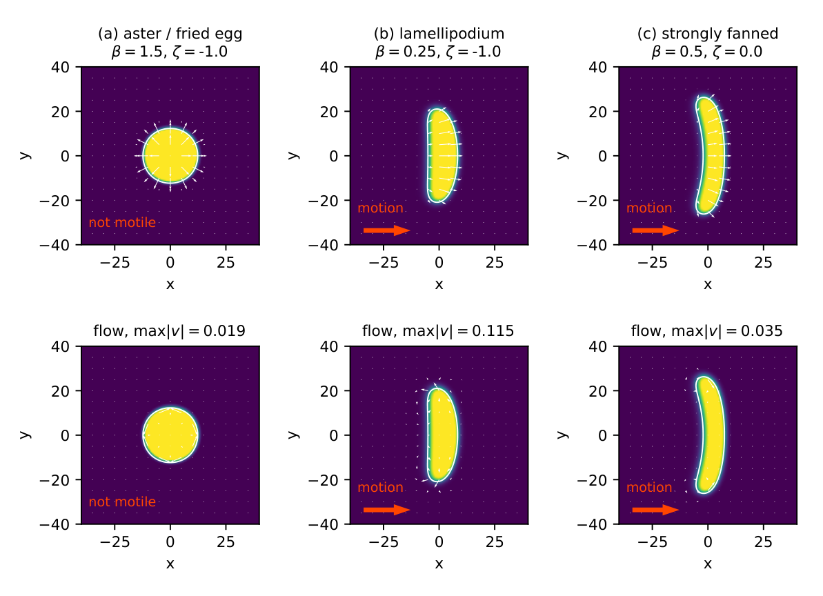
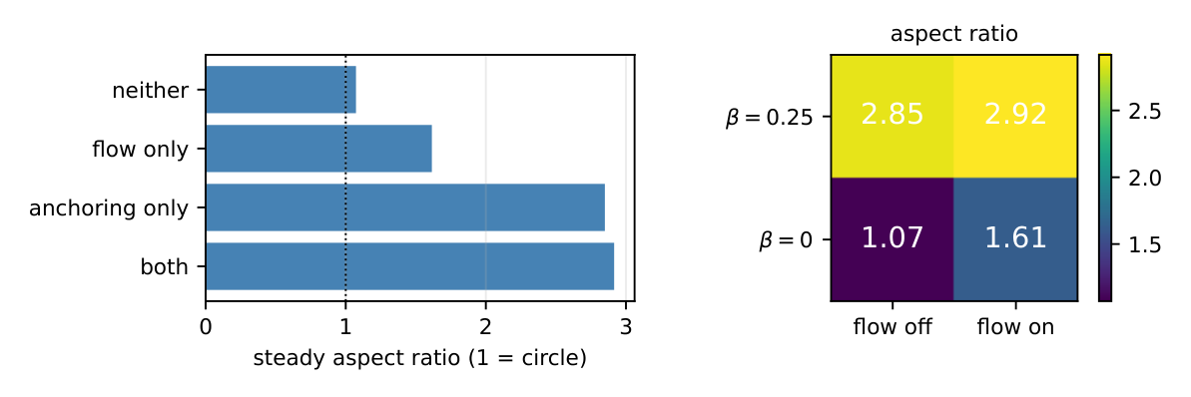
Full Stokes model: anchoring controls shape
Passive check
• Ellipse → circle
• Energy decreases
• Flow vanishes
• Volume error = 0
Strong anchoring
Radial actin aster, |⟨P⟩| = 0, speed = 0
Symmetry must break for motility
Two active morphologies at w₀ = 1
aspect ratio
Flow added on top of anchoring changes aspect ratio by only ~2%.
Moderate anchoring
Lamellipodial fan
Aspect ratio = 2.91, speed = 0.843 ≈ w₀
 | flow off | flow on
β = 0 | 1.07 | 1.61
β = 0.25 | 2.85 | 2.92
No planar pseudopod / phagocytic cup: these require 3D structure.
Constant ξ cannot reproduce the biphasic adhesion–speed mechanism of Leoni & Sens.
PYD411 · Mid-term · Dept of Physics, IIT Delhi · Siddharth Kumar & Soumik Roy
5 / 8
Notes:
The full model shows that anchoring of the polarization at the boundary is the dominant control on planar shape. Adding hydrodynamic flow changes the elongated shape by only about two percent, motivating a friction-dominated reduction.

Slide 6
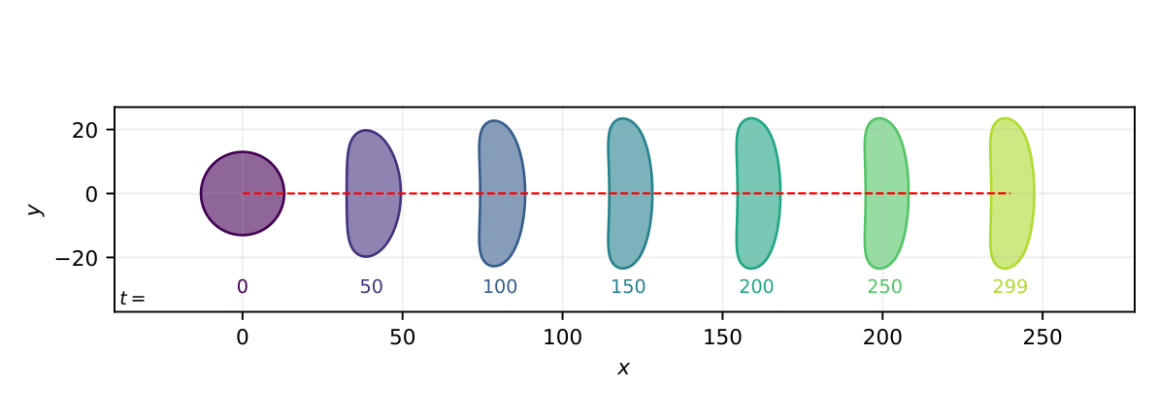
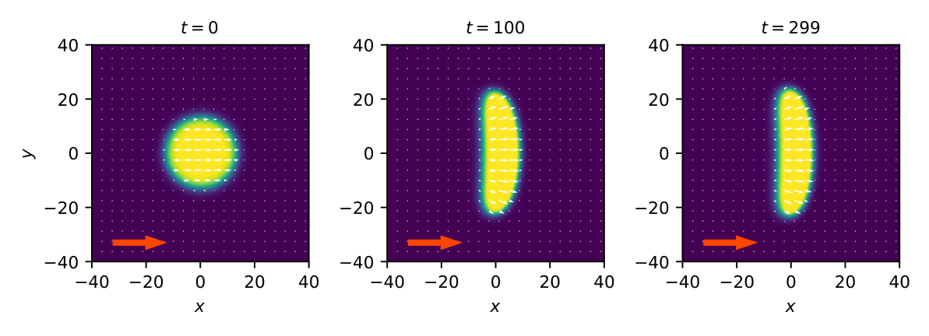
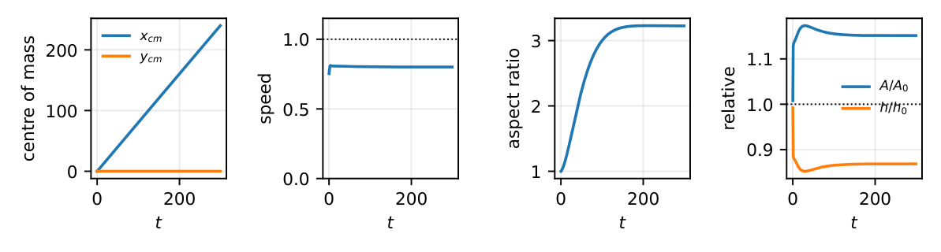
Version 4 — crawling without a Stokes solve
η / (ξ R²) ≈ 0.006
friction dominates viscosity at the cell scale
0 = −∇p + η∇²v − ξv + f
⇓
v = f / ξ
⇓
f_{act} = −ζ ∇·(φPP)
⇓
v = −(ζ/ξ) ∇·(φPP)
Travel 239.9 · Time 299 (model units) · Speed 0.801 · Aspect ∼ 3.2
yᴄᴍ = 0 · Area +15% · h/h₀ ≈ 0.87 (≈ 13% thinning)
Volume conserved; projected area is allowed to change.
k_{A} = 0 ⇒ unbounded spreading / inflation
V3 and V4 agree to within 0.2% in the comparable (flow-off, rigid-area) limit.
Cost/step: 2.70 → 1.10 ms · stable dt: 0.01 → 0.03
Overall runtime ≈ 5× faster, including the larger stable time-step.
Local formulation — a practical starting point for many cells.
u = v + w₀P
No global Stokes / pressure solve — only local finite-difference stencils.
PYD411 · Mid-term · Dept of Physics, IIT Delhi · Siddharth Kumar & Soumik Roy
6 / 8
Notes:
At the cell scale the viscous contribution is only about zero point six percent of friction, so we use a friction-dominated force balance. The active stress gives a local velocity, eliminating the global Stokes solve. The resulting cell crawls steadily, reproduces the comparable full-model result, and is substantially cheaper.

Slide 7
What the simulations establish
01
A spatial gradient in treadmilling can generate a leading protrusion.
V2
02
Planar morphology is controlled mainly by polarization anchoring.
V3 · flow adds ~2%
03
The friction-dominated model retains crawling behaviour.
V4 · speed 0.801 · 0.2% agreement · ~5× faster · local
04
Volume conservation is more appropriate than rigid projected-area conservation.
kₐ = 5: area +15% kₐ = 0: inflation, crawling lost
Take-home: a verified local single-cell model now reproduces crawling without a global Stokes solve — providing a computational base for many-cell simulations.
PYD411 · Mid-term · Dept of Physics, IIT Delhi · Siddharth Kumar & Soumik Roy
7 / 8
Notes:
The main outcome is not simply a faster simulation. We identified which mechanisms control the observed behaviour and reduced the model while retaining the essential single-cell crawling dynamics.

Slide 8
From one cell to many
1 Two cells
One field pair per cell + repulsive overlap.
2 Collisions
Head-on and glancing interactions.
3 Polarity
Allow cells to choose their own direction.
4 Adhesion
Load-dependent friction ξ.
5 Collectives
Tens of cells: jamming and neighbour alignment.
Thank you — Questions
Siddharth Kumar (2023PH10741) · Soumik Roy (2023PH10756)
Adviser: Prof. Sujin B. Babu · Department of Physics, IIT Delhi
PYD411 · Mid-term · Dept of Physics, IIT Delhi · Siddharth Kumar & Soumik Roy
8 / 8
Notes:
The immediate next step is two-cell interaction, followed by collisions and dynamic polarity. The ultimate goal is to study collective behaviour using the local formulation.

