Slide 1
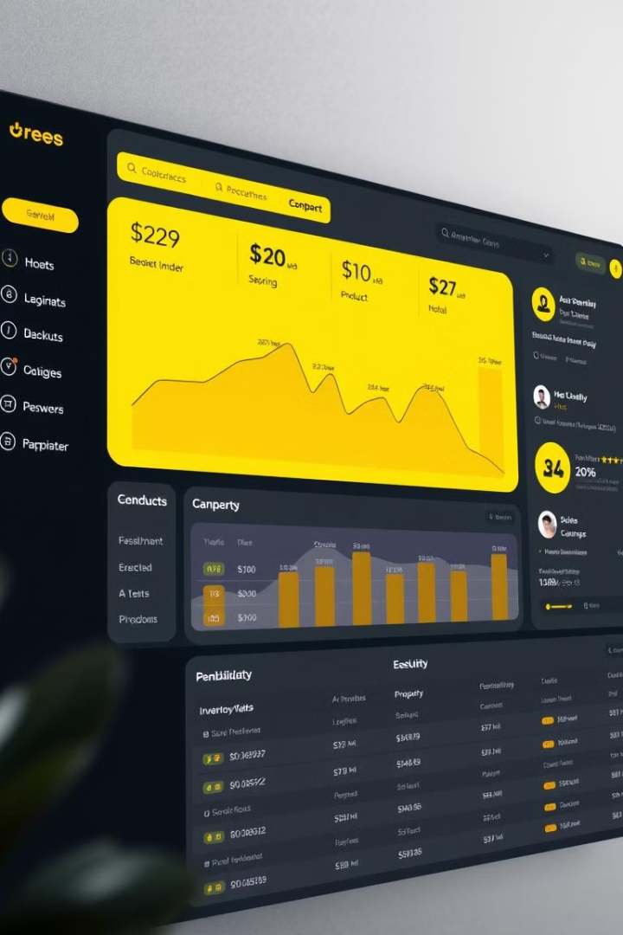
Angular Product Inventory Management
Technical Design Document for an Angular-based product inventory management system. This document outlines the system's architecture, dependencies, file structure, and functionalities. It serves as a reference for developers and stakeholders involved in the project.

Slide 2
Project Scope
Included
Not Included
Environment Specification, System Requirements, Folder Structure, Module & Component Breakdown, API Services, Authentication Flow, Issues & Risks.
Business Requirements, Production Deployment Strategy, Real Backend API Integration.
The scope defines what aspects of the project are covered in this document. It includes the environment, system requirements, folder structure, modules, API services, authentication, and risks. It excludes business requirements, deployment strategy, and real backend API integration.

Slide 3
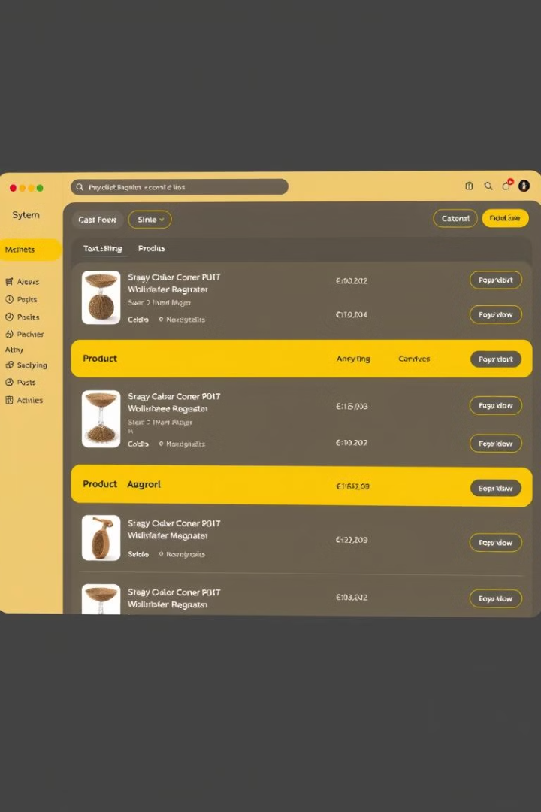
Functional Requirements
1
Welcome Page
Default landing page with navigation links: Products, About, Sign In, and Register. Persistent footer displaying "© 2024 Products Inventory" on all pages.
2
Logged-in User Actions
Authenticated users can perform CRUD operations (Create, Read, Update, Delete) on products. Navigation updates to show Products, About, and Logout links.
The system provides functionalities for adding, updating, viewing, and deleting products. The project is built using Angular 15, Bootstrap, and JSON Server for mock API handling.

Slide 4
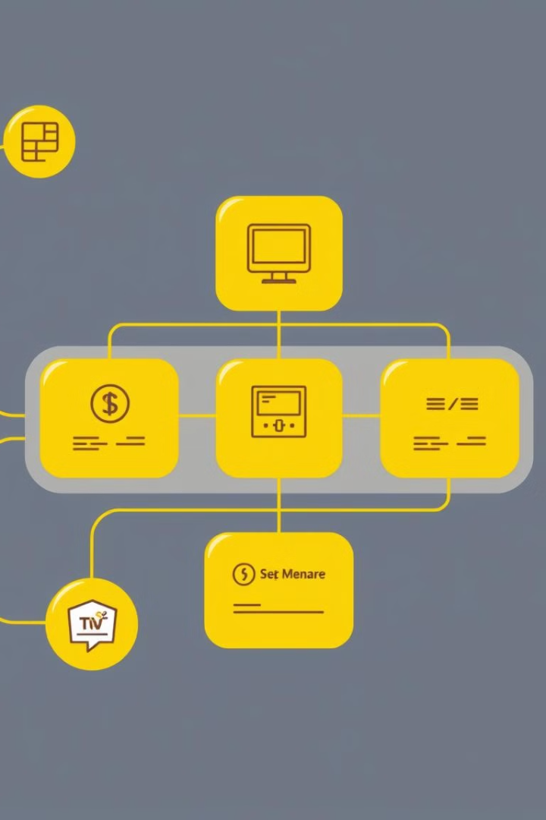


System Requirements
Development System
Software
Operating System: Windows / Linux / macOS. Processor: Intel Core i5 or higher. RAM: 8GB minimum. Storage: 500MB minimum.
Node.js (v14 or later), Angular CLI (v15.0.0), JSON Server (for mock API), Jest (for unit testing).
The development system requires a modern operating system, a decent processor, sufficient RAM, and storage. Software requirements include Node.js, Angular CLI, JSON Server, and Jest.

Slide 5

Folder Structure
Core
Features
Contains global services like DataService and AuthService.
Feature modules: inventory/ (Product Management), auth/ (Authentication), about/ (Informational pages).
Shared
Assets
Contains reusable components.
Stores images, styles, and static files.
The folder structure is organized into core, features, shared, and assets. Core contains global services, features contain feature modules, shared contains reusable components, and assets store static files.

Slide 6
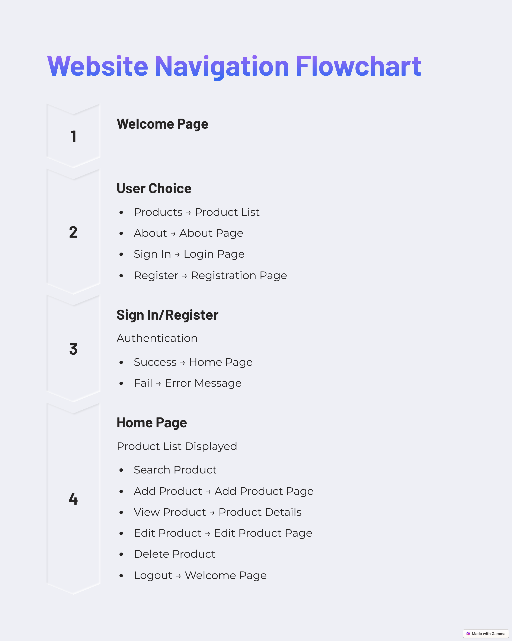
Application Navigation Flow
The flowchart illustrates the user journey, starting from the Welcome Page and navigating through authentication, product management, and logout functionalities.

Slide 7

Application Design: Modules & Components
1
Inventory Module
Product List, Product Detail, Add Product, Update Product.
2
Authentication Module
Handles login/logout operations and access control.
The system follows a modular approach with Lazy Loading for better performance. The Inventory Module manages product-related functionalities, while the Authentication Module handles user authentication and access control.

Slide 8

Database Structure
The application uses JSON Server to mock a database. Products contain an 'id', 'name', 'price', and 'category'. The API supports CRUD operations.
{ " users ": [ { " id ": 1 , " name ": " John Doe ", " role ": " admin " } ], " products ": [ { " id ": 1 , " name ": " Laptop ", " price ": 1000 , " category ": " Electronics " } ] }

Slide 9
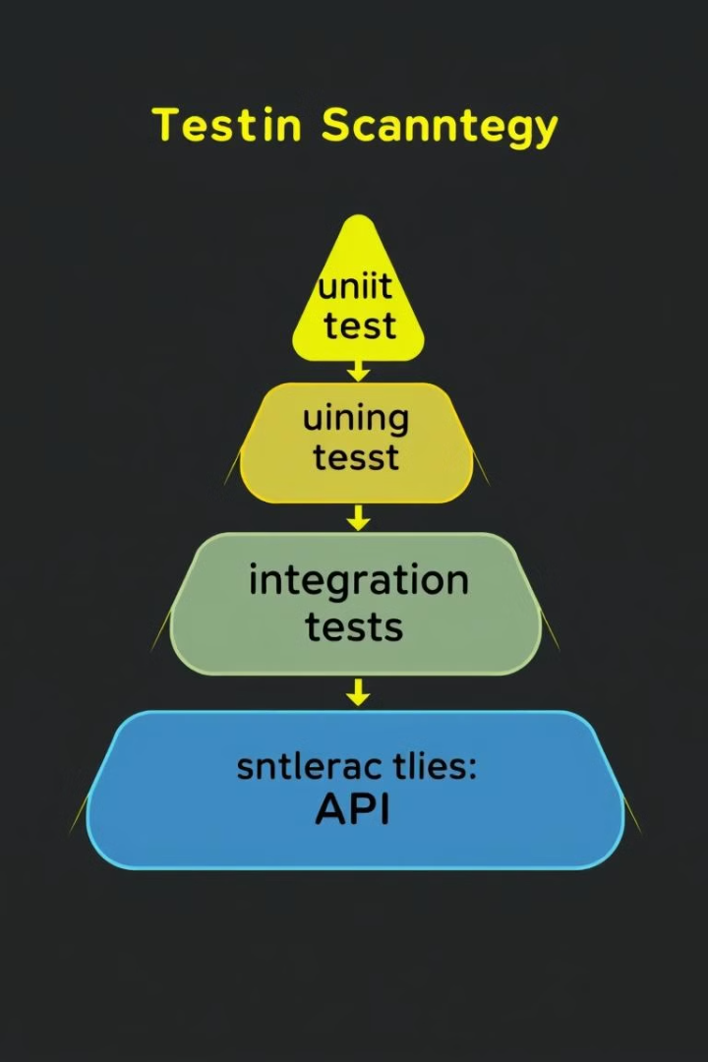
Testing Strategy
The project uses Jest for unit testing. Tests verify functionality and API interactions.
describe ( ' DataService ', () => { it (' should fetch products ' , () => { const service = new DataService () ; service . getProducts () . subscribe ( products => { expect ( products . length ). toBeGreaterThan (0) ; }) ; }) ; }) ;

Slide 10




Issues & Risks
Security
Performance
Future Improvements
No actual authentication backend. We are using Mock API.
Large product lists may affect frontend performance.
Integrate with a real database (e.g., Firebase, MongoDB, SQL). Implement role-based access control.
Potential issues include security vulnerabilities due to the mock API and performance issues with large product lists. Future improvements include integrating with a real database and implementing role-based access control.

