Slide 1
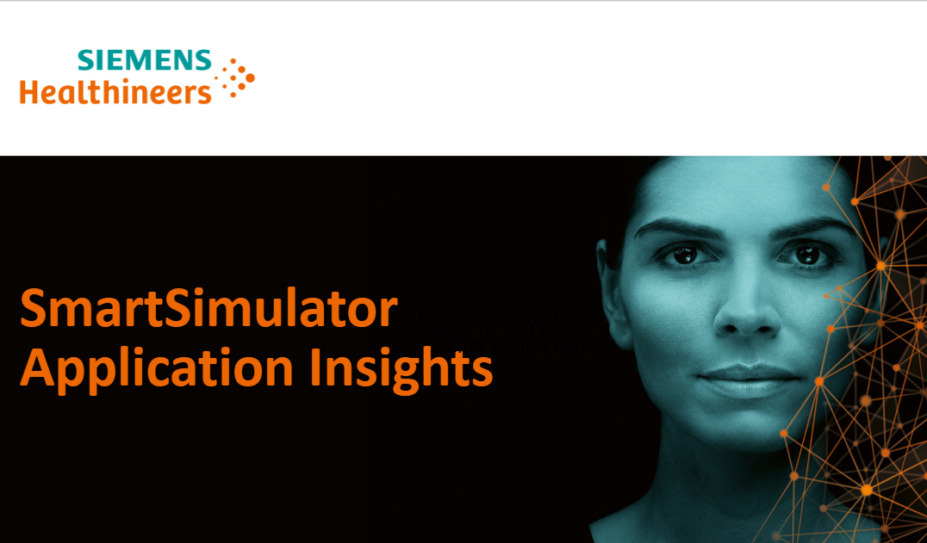

Slide 2
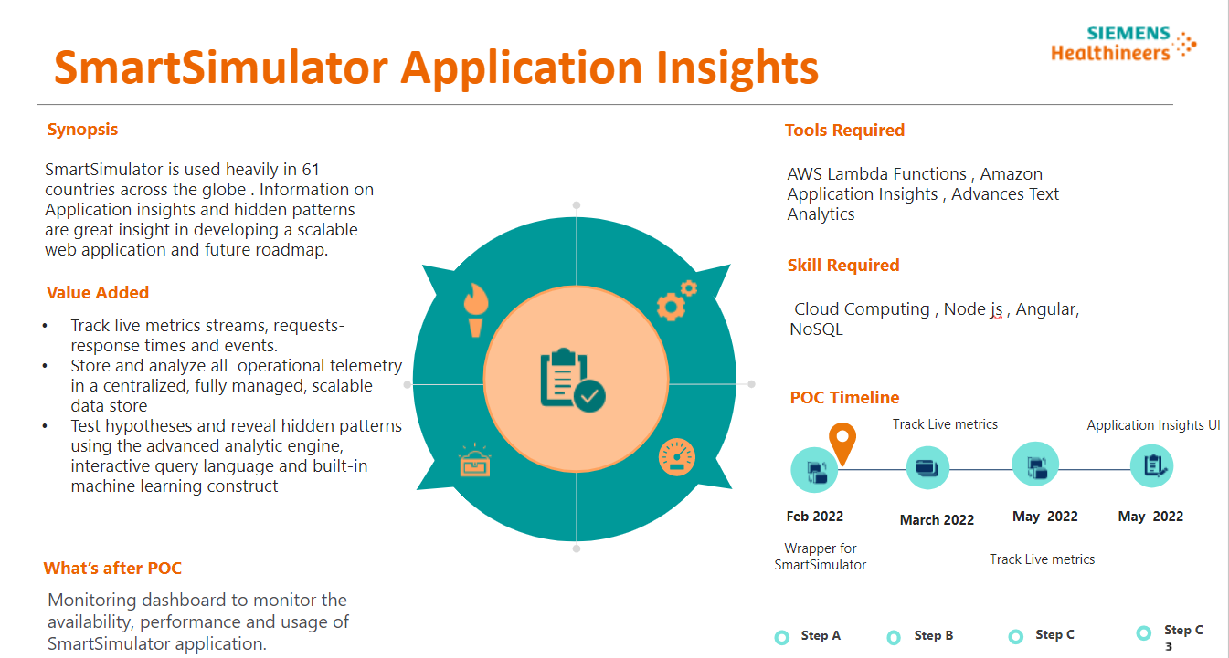

Slide 3
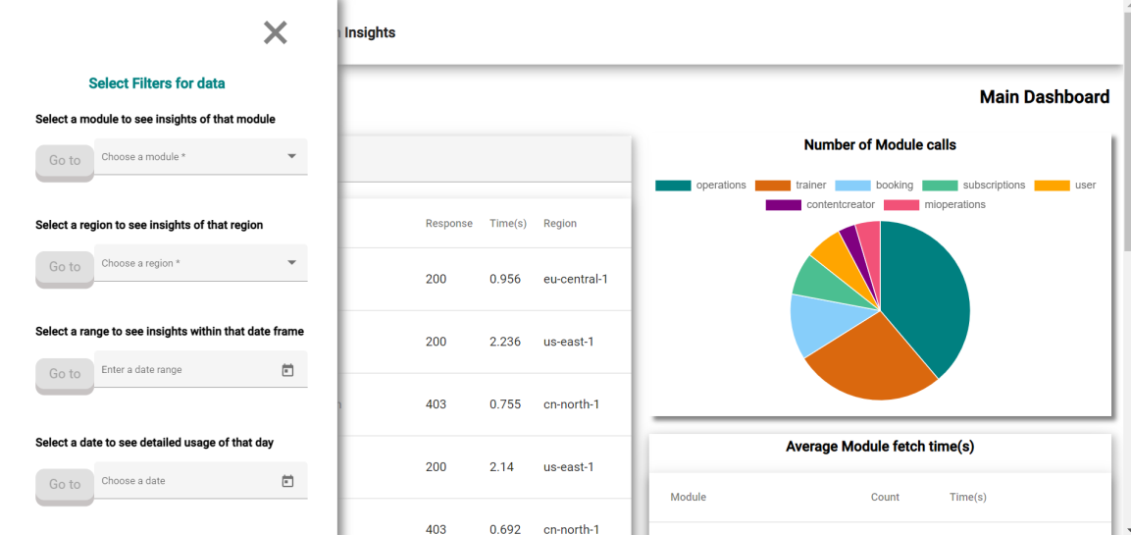
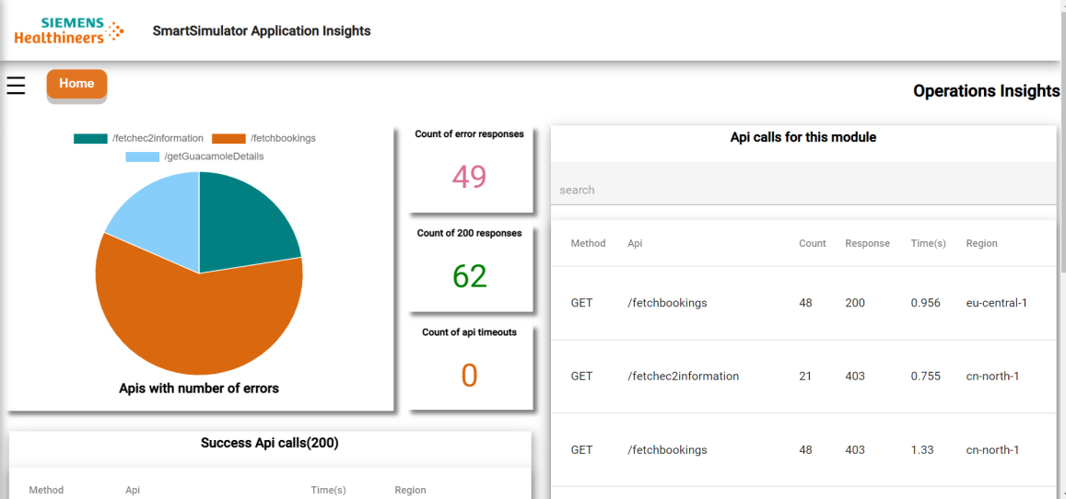
SmartSimulator Application Insights is used to track live metrics, response times and events occurring in the SmartSimulator App to be aware as a developer of what our users/customers are liking, using more and what are they missing out on.
We store and analyze all operational telemetry in a centralized , fully managed ,scalable data store and visualize the data using Angular.js graphs and charts .
For the backend we use cloud computing comprising of AWS S3, Lambda, Dynamo DB and API gateway to control and manage the insights app.
We also have various filters to filter out data and view data according to our region , date and module preferences.
We test hypotheses and reveal hidden patterns in the usage of the app to find out the reach and security level of the application using the advanced analytic engine.

Slide 4
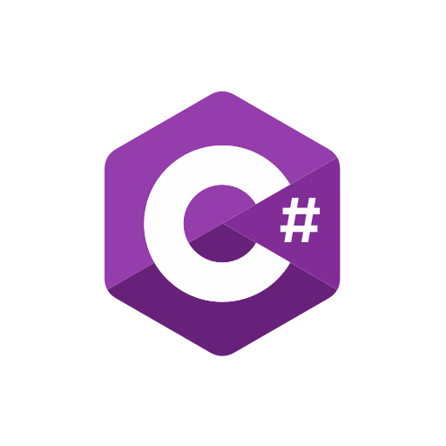
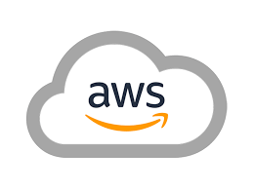

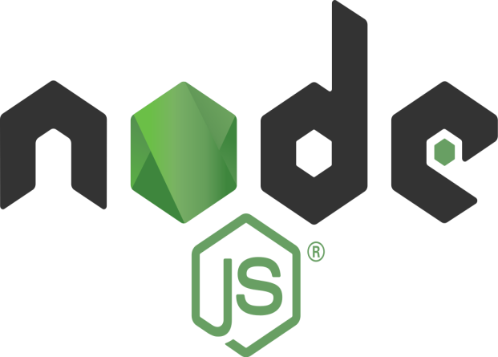
We will track the Month wise progress-:
January-
The first month started with finding the best tools for developing the insights app so we finalized Angular for frontend ,C# for backend, AWS for deployment and storage purpose and Node.js for lambda functions.
I studied more about the structure of the SmartSimulator app and how and what data we want from it to derive metrics and insights.
Testing and Validations were done on how could we get to see the usage , performance, errors ,distributions from the App and display it on the insights app.
I also learnt about Angular , C# and AWS before proceeding with the actual project.

Slide 5
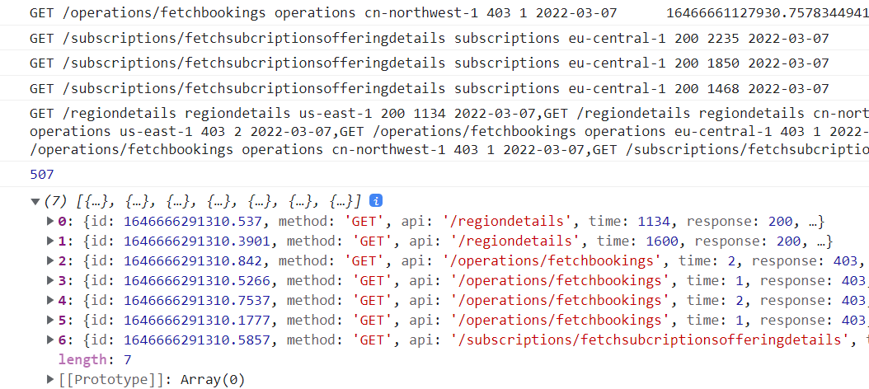
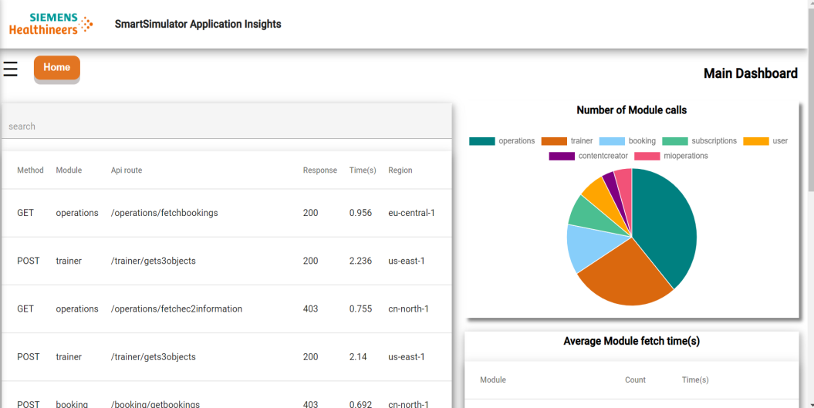
February –
Logged the necessary data from the SmartSimulator app in the console and then saved it to AWS Dynamo DB.
Then wrote the lambda algorithm for connecting the backend database to the frontend using the AWS API Gateway.
We could now see the data on frontend now so I started modeling and grouping the data to visualize and display it so that we start tracking the metrics.
The tracked metrics helped reveal many patterns and usage of the application which the developers didn’t probably knew.

Slide 6
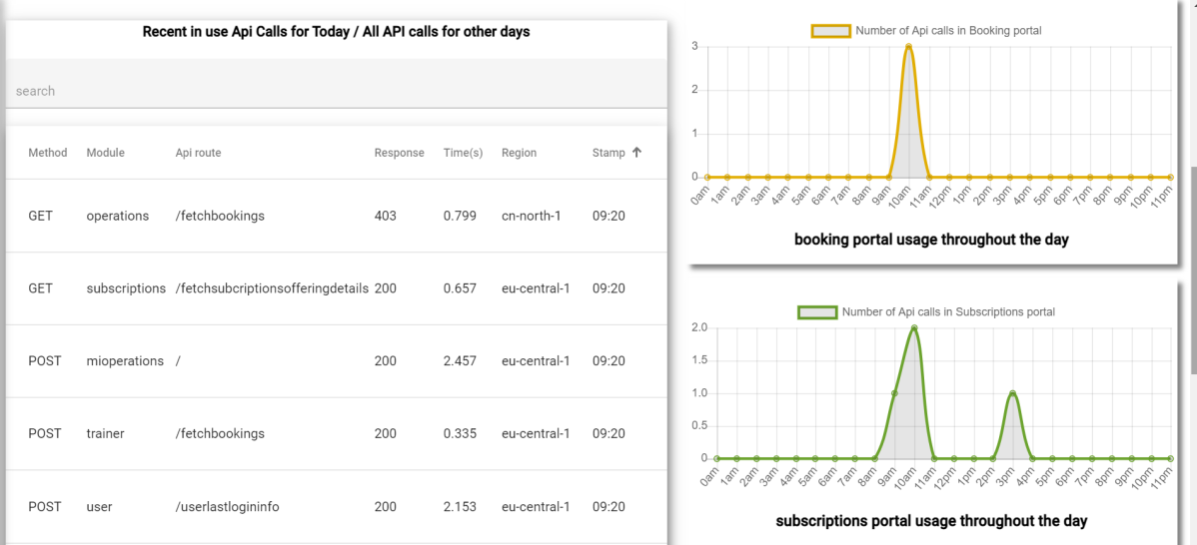
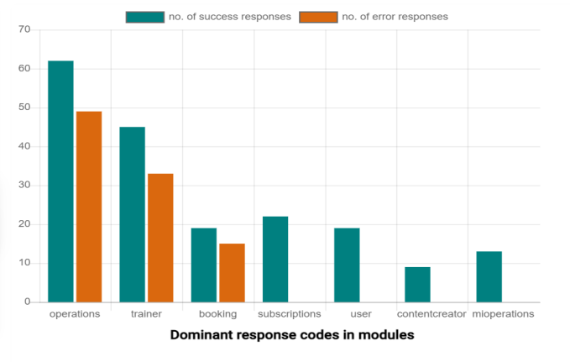
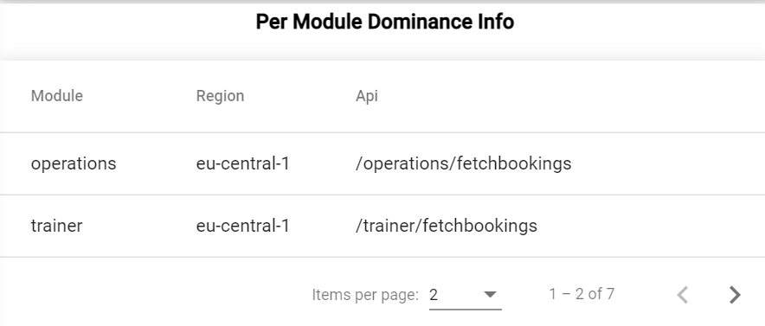
March-
Started deriving more and more useful information from the data and using it we could see the errors in modules , api ,their load times ,dominant regions ,time slots, usage ,performance and distribution of the feature usage in the application.
We also applied filter options to data such that developers could see data according to their preferences of particular module, date range and region.
We also started tracking daily usage of the application and particular portals in the SmartSimulator such as Booking, operations etc to know which is the peak time for user traffic throughout the day.
We could track the recent in use features which are being called in the near 1 hour timespan.

Slide 7
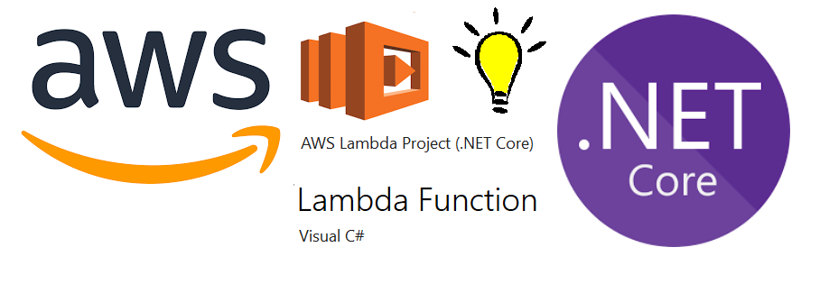
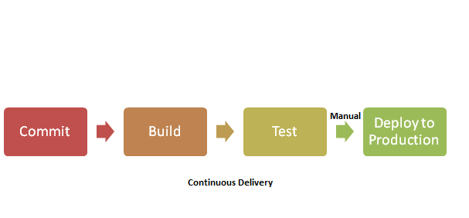
April-
I learnt about C# lambda functions which can be deployed to AWS and be connected to our application to perform queries.
We saw about the possibilities of including backend part of Smart Simulator but due to some access issues we had to restrict our application to frontend.
Performed tests on already existing application to check the accuracy of the metrics.
Learning about how can we trace the backend logs from the smart simulator code.

Slide 8
CONCLUSION
I have concluded that there are many ways in which we can improve our software but if we reduce the tiring work and focus on doing smart work
We do need a smart dashboard where we can see the insights ,errors ,usage, performance easily and in a visualized format so we know where to work on and where not to.
With the help of this dashboard we are not only decreasing debugging time but also making sure the customers are consuming whatever they like without facing any issues.
So such an application insights can be used for all the developed software not only SmartSimulator because the data we log from all the websites will be the same.

Slide 9
THANK YOU
Presentation By - Ariba Ahmad(Siemens Healthineers Intern)

