Slide 1

Rent A Car System
CS3009 Software Engineering
Made by:
K190252 Ariba
K190254 Anjiya

Slide 2
Problem Statement
The system provides car rental services, where the car owner will lend his car and the customer will lease his car. This system will aid the person who wants to commute and is ready to make earning by lending his car; he can lend it to a person who wants to lease it. The system will work as a moderator between the customer and the car owner.

Slide 3
Project Scope
The scope of this project is as follows:
The system will keep detail records of cars, car owner, customers, duration they car the car as well as the type of the car they rent.
By using this system, there will be different capabilities provided to different systems such as car owners and customers.

Slide 4

Process Model
For this we are employing agile methodology:
Teams can quickly adapt to requirements changes without deadlines
Agile helps reduce technical debt
Improves customer satisfaction
Delivers a higher quality product

Slide 5

WIDEBAND DELPHI PROCESS

Slide 6

THE TEAM
STEP 1
The team includes:
K190252 Ariba
K190254 Anjiya

Slide 7
THE KICKOFF MEETING; Work Breakdown Structure
STEP 2
The work breakdown structure of the system includes:
Car Rental Web Site
Project Management
Requirement Gathering
Analysis and Design
Site Software Development
Testing and Production

Slide 8
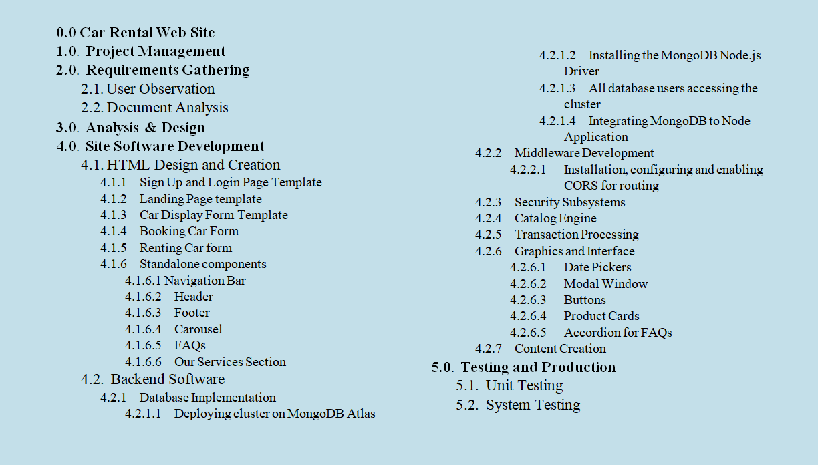

Slide 9
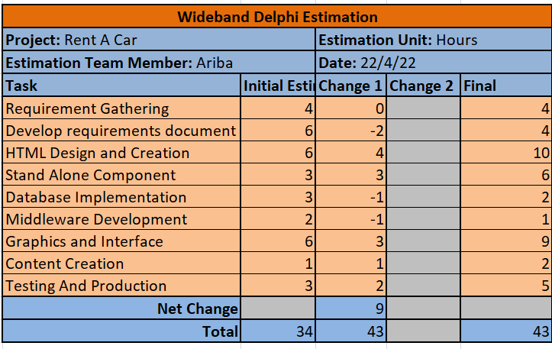
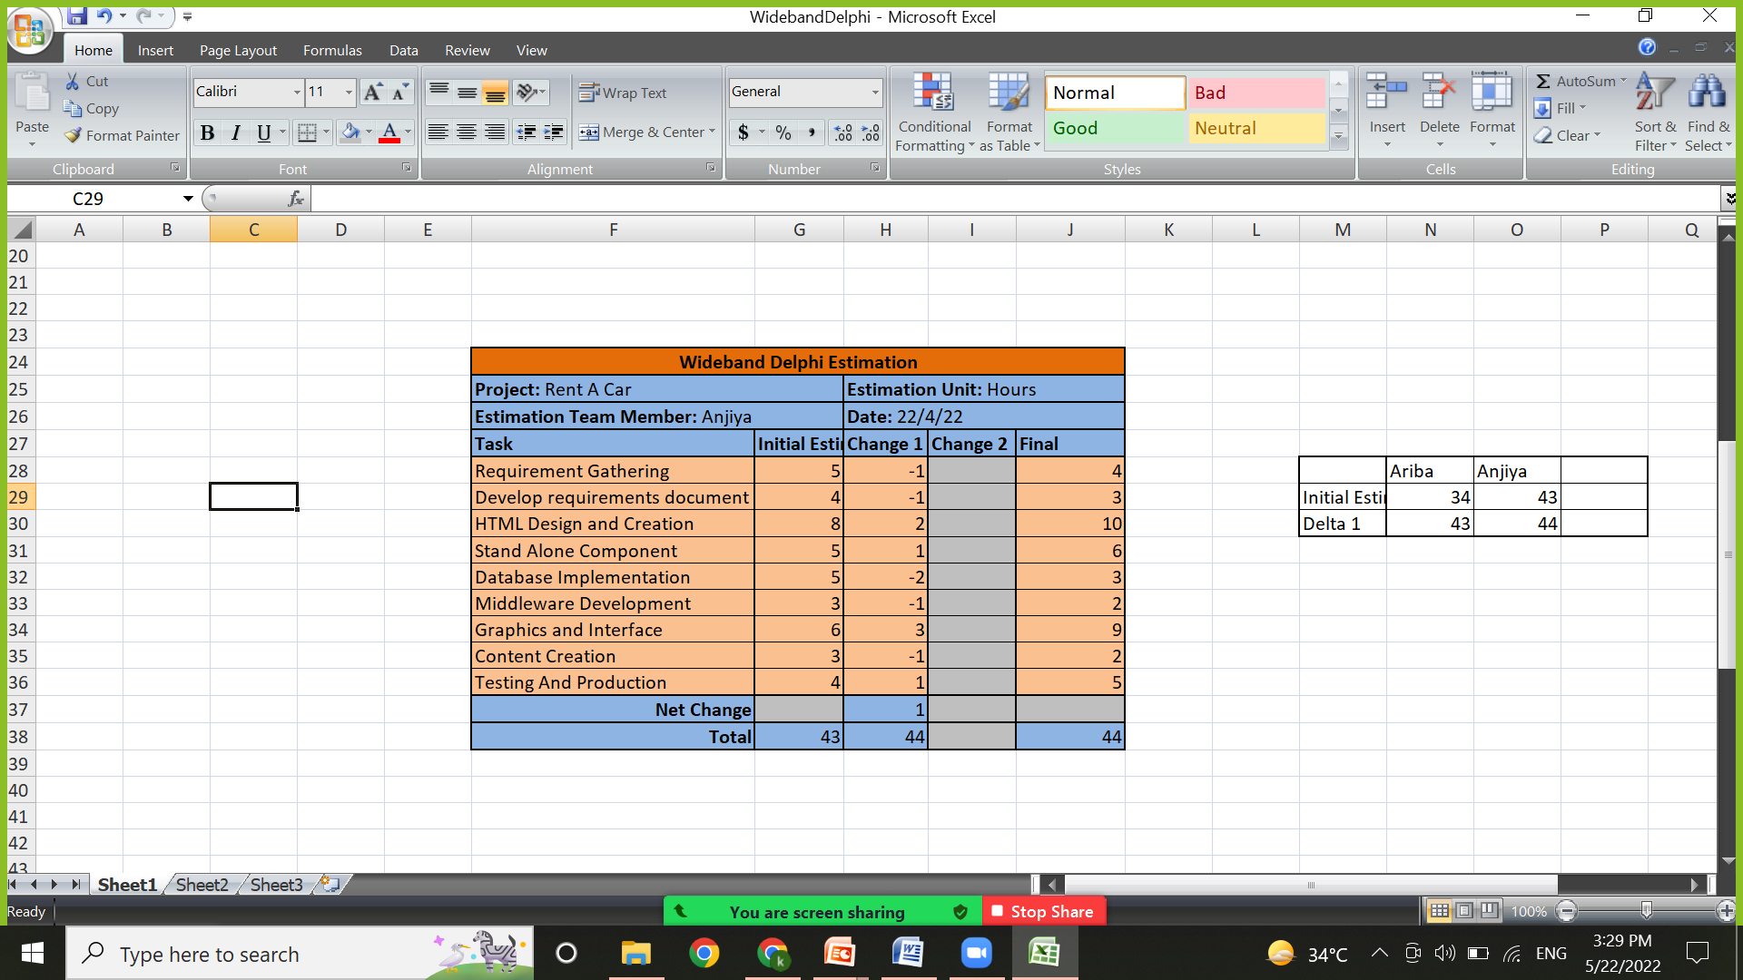
INDIVIDUAL PREPARATION
STEP 3

Slide 10
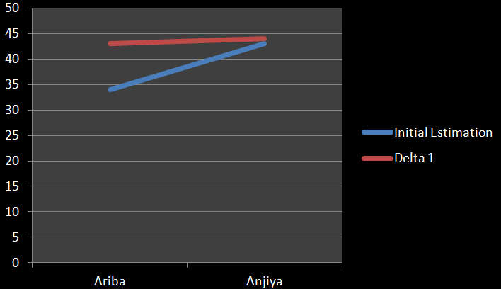
ESTIMATION SESSION
STEP 4

Slide 11
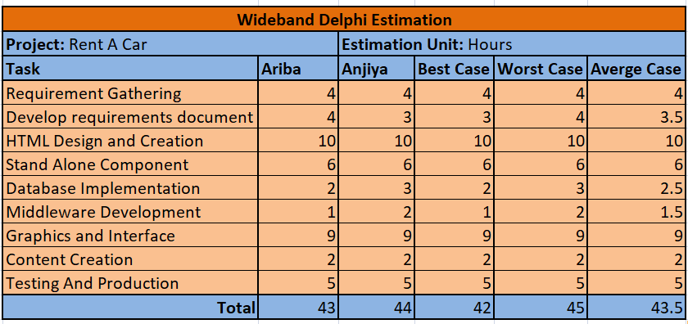
ASSEMBLE TASKS AND REVIEW RESULTS
STEP 5

Slide 12
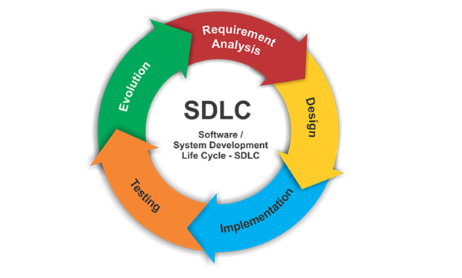
TASK ANALYSIS AND MODELING

Slide 13
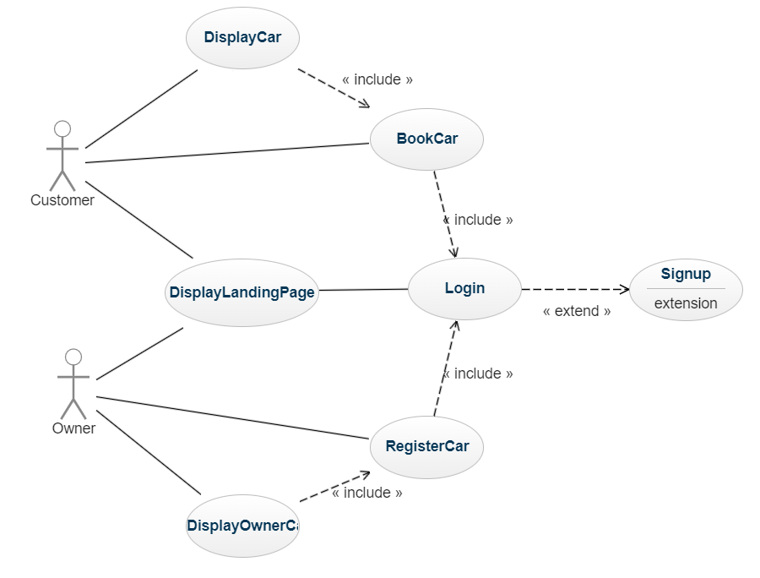
USE CASE DIAGRAM

Slide 14
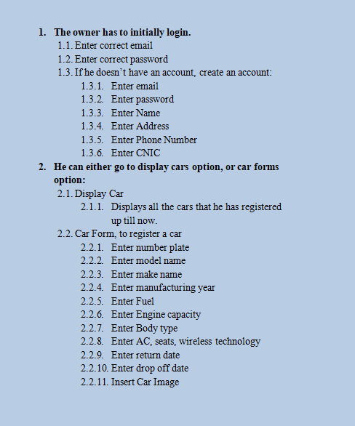
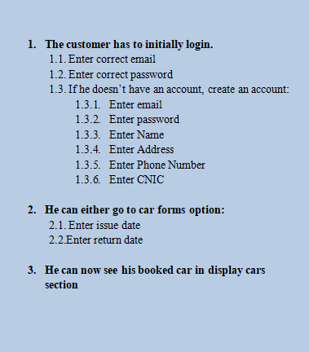
TASK ELABORATION
After browsing the website, the user will see a landing page.
He will choose to either drop his car to earn (owner) or book a car (customer).
OWNER CUSTOMER

Slide 15
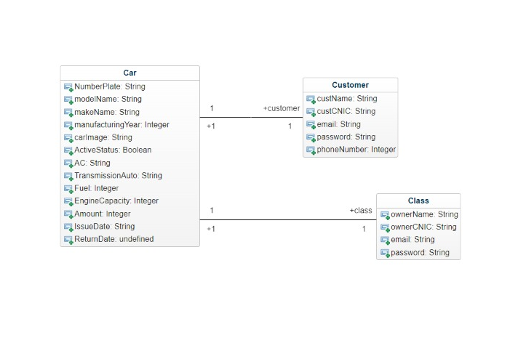
OBJECT ELABORATION

Slide 16
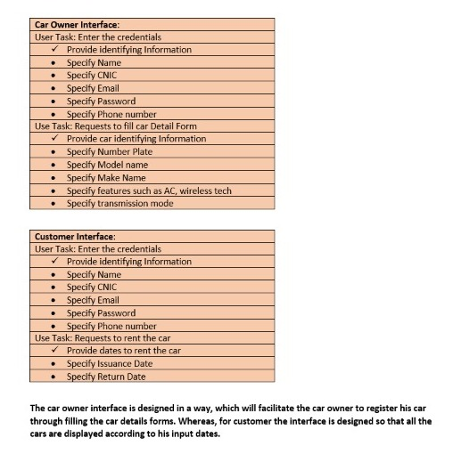
WORKFLOW ANALYSIS
The car owner interface is designed in a way, which will facilitate the car owner to register his car details through filling the car details form. Whereas for customers ,the interface is designed so that all the cars are displayed according to customers input dates.

Slide 17

MANUAL TESTING

Slide 18
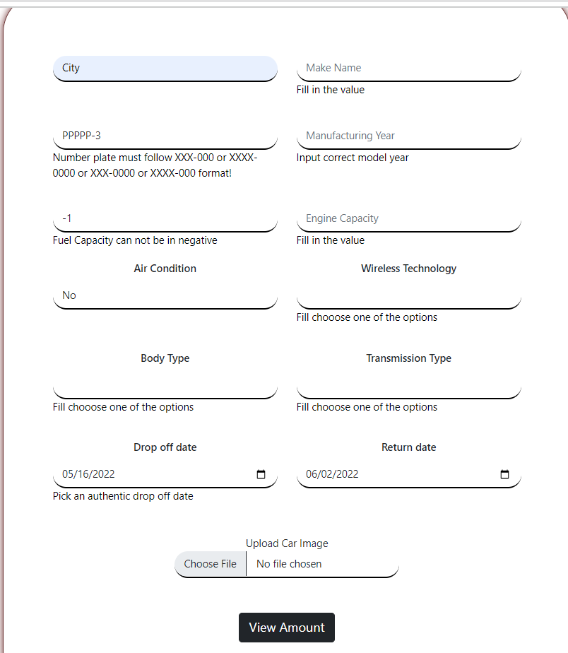
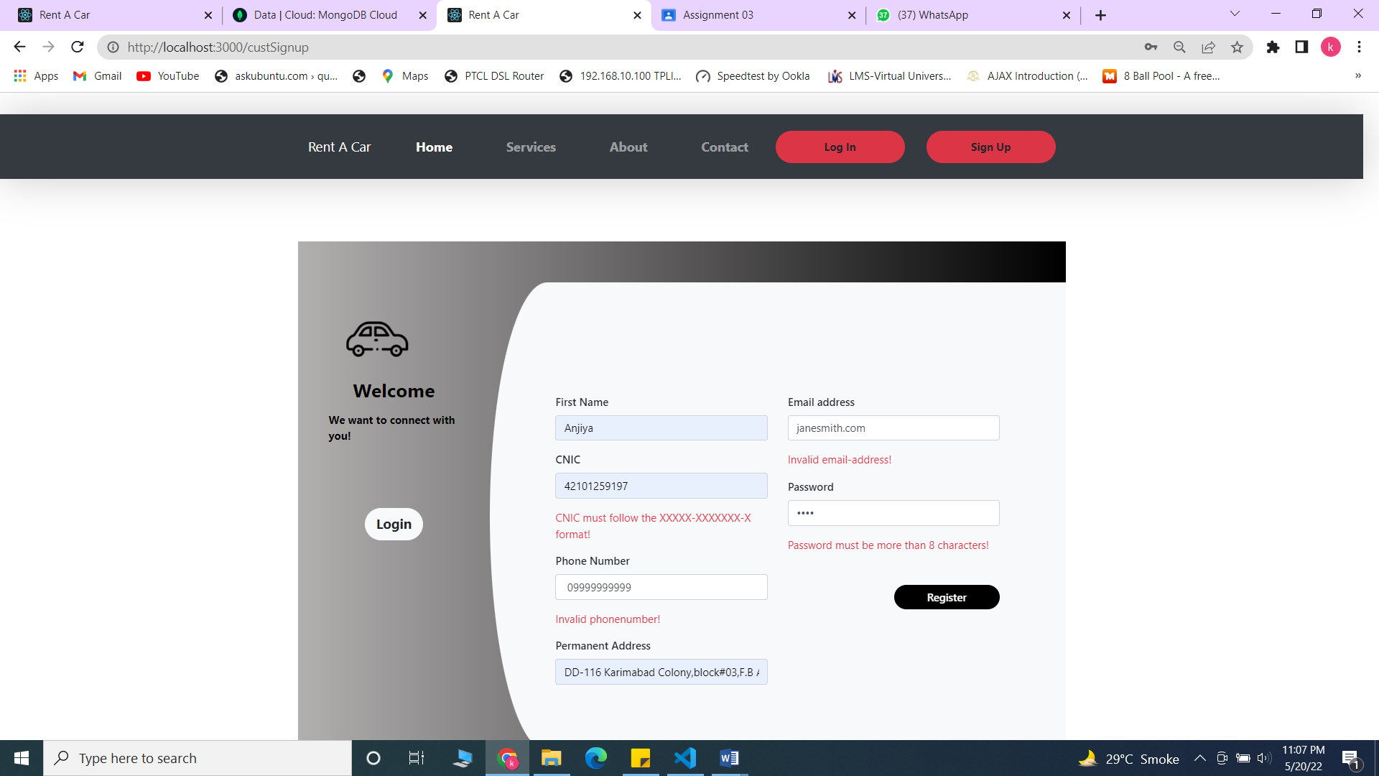

Slide 19


