Slide 1
DaVinci Group
April/30th/2018 – Group 07
Andre Ribeiro
acardoso@andrew.cmu.edu
Sumanth Sridhar
ssridha2@andrew.cmu.edu

Slide 2
Summary
Objectives
Problem Statement
Additional Enhancements
Main Lessons Learned
Team work

Slide 3
Objectives
Provide a specific, data-driven, preliminary analysis to help with Antitrust cases in the Health Market
Focus on Brazilian health care system
Compilation of on-line available data for Brazil health care market
Data cleaning according to Antitrust standard criteria
Market share analysis

Slide 4
Problem Statement
Any antitrust case (merger and acquisitions, anti-competitive processes, etc) requires a preliminary analysis of each relevant market, before further investigations
This preliminary analysis usually involve understanding each product and delimit each player’s influence, recognition of possible market power and the effective level of market competition (actual market structure)
Market share analysis in cases of health care presents the additional issue of being composed by several local markets (usually lower level than some municipality boundaries), comprising of a few neighborhood, or sometimes delimited by a defined metric radius.

Slide 5
Problem Statement – usual approach
Usual approach done by most Antitrust Offices start with market share analysis. For health care markets, Brazilian Antitrust Office usually analyses:
Share of health care equipment owned, in case of hospital and laboratories mergers
Share of physicians per specialization in case of clinics mergers
Brazilian Health Care National Agency (ANS) obliges every health care institution to provide some information, including number of equipment owned, and then make these data available online

Slide 6
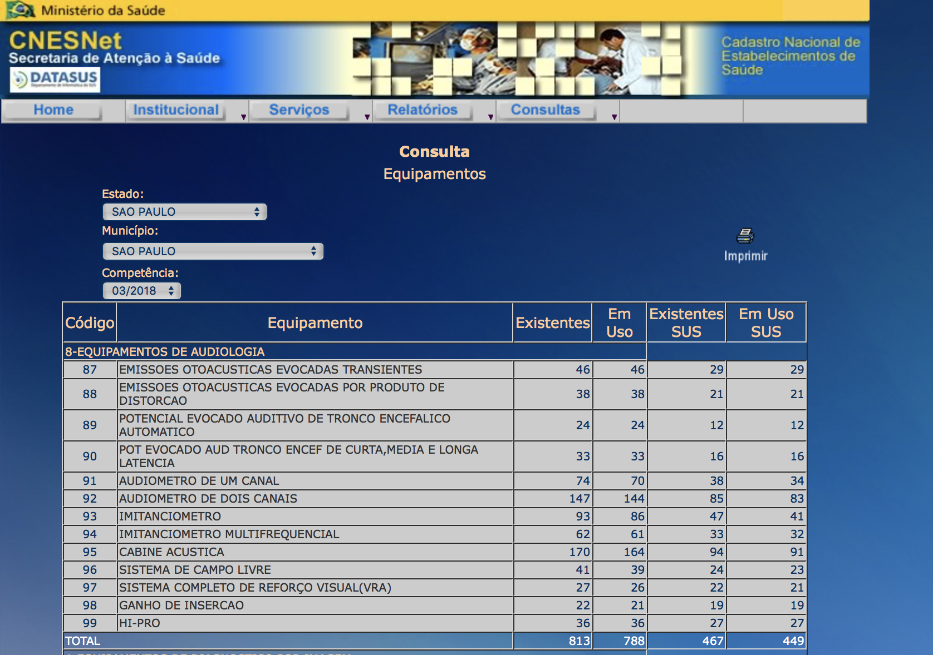
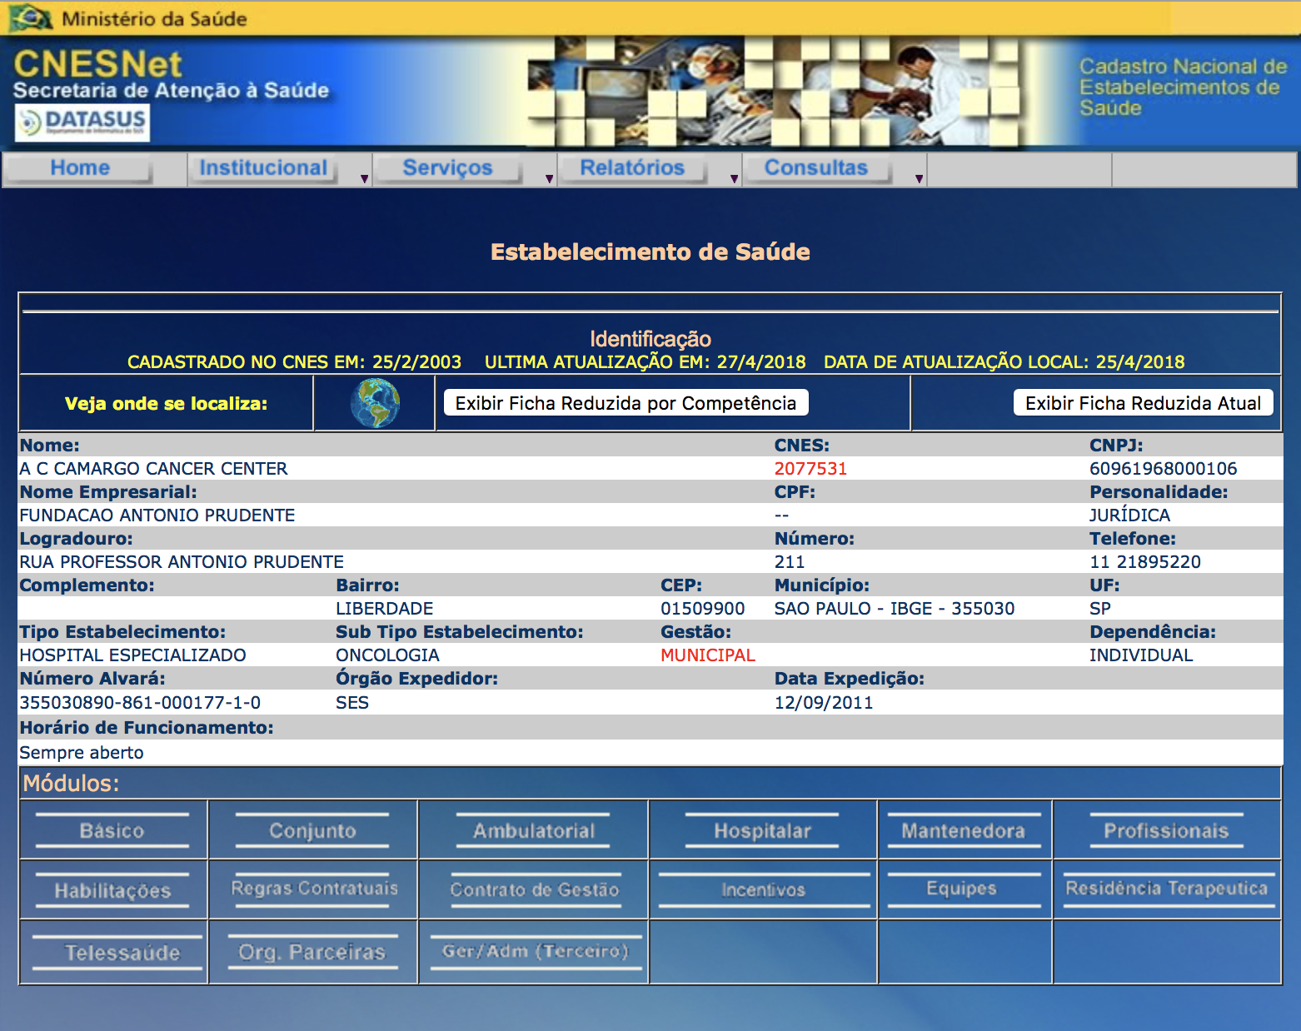
Problem Statement – main challenges (1)
Understand the HTML page and how to select values in the visible and hidden dropdown list to select:
Specific States, City, Period and Type of Equipment
Scrap information from selected tables, moving between pages back and forth, and retrieve multiple choices of equipment, identifying user misspelling names

Slide 7
Problem Statement – main challenges (2)
Interact with Google Earth (Maps) to retrieve information about Latitude, Longitude and Distance between each health care institution
Set up an API key for different services from Google Earth
Limit on the number of API queries per day = 2500
Though it might not be a problem for IT companies (which may have the premium unlimited service), we’re still working on possible ways to overcome this limitation

Slide 8
Additional Enhancements
Adjusted code to accept case insensitive user input words
(’all lowercase’, ‘ALL UPPERCASE’, ‘MiXeD CaSeS’)
Adjusted code to identify misspelling words when user inputs State names, City names or Equipment types
Adjusted code to allow to search info of more than one equipment per execution (limited to the number of equipment available online)
Adjusted google earth script to extract latitude and longitude coordinates for each institution to reduce the number of API queries required
Generate a distance matrix for analysis

Slide 9
Main Lessons Learned
Lessons from scrapping data work:
How to interact with different webpages
Work with Selenium library, sending requests
Change HTML attributes (visible/hidden)
How to think about possible input mistakes and prevent them ex-ante
Lessons from interaction with google earth API:
How to send requests and retrieve info
Extracting the required fields from the packet
Calculating distance between 2 locations using coordinates is better than using the API to query the distance due to the limit on number of requests per day

Slide 10
TEAM
Andre Ribeiro (Linkedin)
Economist, PhD Candidate in Public Policy, Carnegie Mellon University
8 years experience in Consulting, 3 years in Antitrust field
Sumanth Sridhar (Linkedin)
Computer Engineer, Master Student in Computer Architecture, Carnegie Mellon University
THANKS

