Slide 1
Feral Concurrency
Replacing database native primitives with feral mechanisms may improve maintainability of the application, but does it really work? Are the feral invariants correctly enforced in Rails? Do they work in practice? This paper performs theoretical analysis and emperical studies to answer these questions.

Slide 2
Background
MVC frameworks
Ruby on Rails
ORM-based programming
ActiveRecord

Slide 3
get the database out of the way and let the application do the work.

Slide 4
What happens when you create a user in Rails?
What happens when you create a user in Rails?

Slide 5
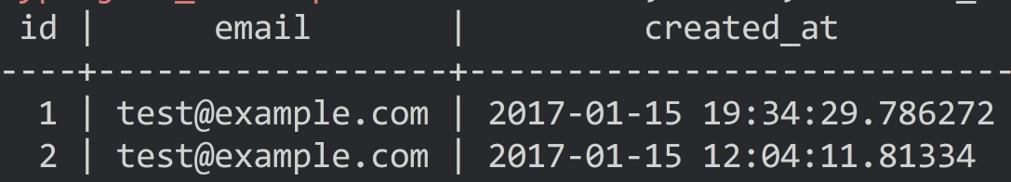
Four queries
BEGIN
SELECT * FROM users WHERE email=’foo@bar.com’
INSERT INTO users …
COMMIT
This is slow
This is also incorrect!

Slide 6
The motivation behind this apparent irrationality
Enhance maintainability of the system
The set of available integrity and concurrency control mechanisms at the database layer depends on the data model employed by the database
(e.g: PostgresSQL) support foreign key constraints, while some other (e.g: MySQL’s MyISAM and NDB storage engines) do not.
the CHECK constraint used to check domain-specific integrity constraints, is supported by PostgresSQL, but not supported by MySQL
Facilitate testing
In many cases, developers want to simply dump the sample data (known to be consistent) into the database and get along with testing their application.

Slide 7
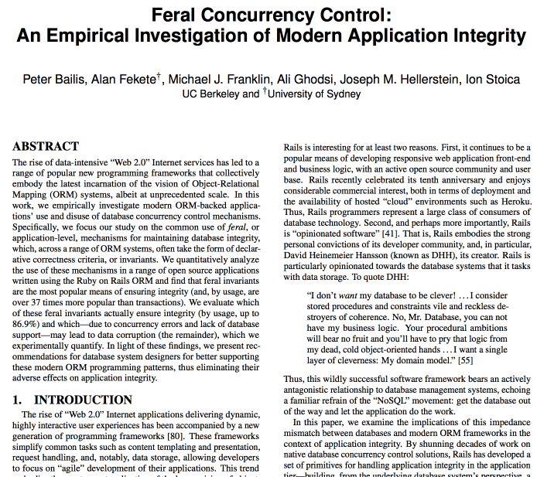

Slide 8
BEGIN/SELECT/INSERT/COMMIT is not safe at READ COMMITTED
Most databases default to READ COMMITTED

Slide 9
Why do ORM authors prefer the slow way?
One vs Four Queries !

Slide 10
The right way
try
return User.create(:email => $1)
rescue SqliteError { ... }
rescue MysqlError { ... }
rescue PostgresError { ... }
Requiers O(n) error handling

Slide 11
The Rails way
user = User.find.where(:email => $1)
if user?
throw DuplicateError('User with that key already exists')
User.create(:email => $1)
tx.commit()
DataBase agnostic

Slide 12
Another bad ORM pattern
Read - Check - Update - Save

Slide 13
Article suggestion : Don’t use save()
Cars.update().where(
:id => 'car_1',
:state => 'FREE',
).set(
:state => 'ASSIGNED',
:driver_id => 'drv_1',
)
# Check for 0 or 1 rows

Slide 14
Back to the paper

Slide 15
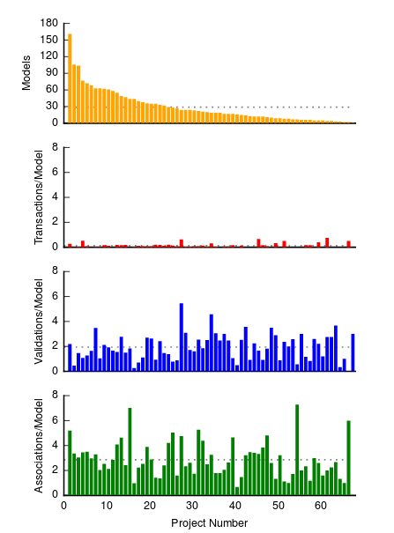
Article Results
67 Rails project surveyed
used just 3.8 transactions against 52.4 validations and 92.8 associations
Most consistency checks are in the application

Slide 16
Learn to evaluate ORM’s Use ORM’s better
What SQL does User.create() run?
Check FK behavior
Check error handling on constraint failures
Use database constraints
UPDATE with a WHERE clause, not .save()
Give up on same ORM, different database

Slide 17
Conclusion
DATABASE EXPERTS:
(do 30 years of research on consistency and locking)
RAILS: Nah, we're good

Slide 18
What can be done about the anomalies?
The paper concludes that there is currently no database-backed solution that “respects and assists with application programmer desires for a clean way of expressing correctness criteria in domain logic
Authors believe that “there is an opportunity and pressing need to build systems that provide all three criteria: performance, correctness, and programmability.”

Slide 19
Application users and framework authors need a new database interface that will enable them to
Cross-DB flexibility
Common interfaces for error handling, CRUD
Make it easier for ORM developers to use your database

Slide 20
Thanks !
These slides are available at
github.com/aribyassine/slides

