Slide 1
Image server with REST API

Slide 2
Endpoints: users
List: [GET] /users *
Add: [POST] /users
Details: [GET] /users/{username} *
Remove: [DELETE] /users/{username} *
Example: user creation
{
"id": "3b4d09899e9d405c",
"username": "user1",
"_links": {
"images": {
"href": "http://localhost:4567/users/user1/images"
},
"oauth2_clients": {
"href": "http://localhost:4567/users/user1/oauth2/clients"
},
"self": {
"href": "http://localhost:4567/users/user1"
}
}
}
POST /users
{
“username”: “user1”,
“password”: “test”
}
* requires authentication

Slide 3
Endpoints: sessions
Login: [POST] /sessions
Returns a token (= session ID) to be used for authentication (Bearer token authentication)
Logout: [DELETE] /sessions/{session-id} *
Example: login
POST /sessions
Authorization: Basic dXNlcjE6dGVzdA==
{
"id": "839ddc65d3934064",
"expiration": "2020-05-29T14:24:38.213+02:00",
"_links": {
"self": {
"href": "http://localhost:4567/sessions/839ddc65d3934064"
}
}
}
* requires authentication

Slide 4
Endpoints: images
List: [GET] /users/{username}/images *
Add: [POST] /users/{username}/images *
Details: [GET] /users/{username}/images/{image-id} *
Raw data: [GET] /users/{username/images/{image-id}/raw *
Remove: [DELETE] /users/{username}/images/{image-id} *
* requires authentication

Slide 5
Endpoints: OAuth2 clients
OAuth2 clients needs to be created, before they can be used by third party applications. Clients are assumed to be created directly by the users (e.g. such as in Facebook Developers platform).
List: [GET] /users/{username}/oauth2/clients *
Add: [POST] /users/{username}/oauth2/clients *
Details: [GET] /users/{username}/oauth2/clients/{client-id} *
Remove: [DELETE] /users/{username}/oauth2/clients/{client-id} *
* requires authentication

Slide 6
OAuth2
Compliant to RFC 6749
Authorization code request: [GET] /oauth2/authorize
Access token request / refresh: [POST] /oauth2/token
Permissions that can be requested by an OAuth client:
read_user: read user details
read_images: read images list and download them
* requires authentication

Slide 7
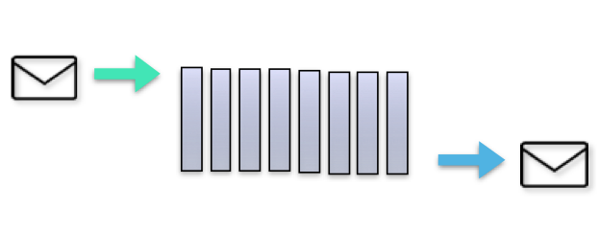
Message flow
Resource server (REST endpoint)
Responder (Route)
Token extractor
token
process
JSON
transformer
request
deserialization
request parameters
response
Responder
Responder

Slide 8

Data flow (process phase)
Request parameters
Token
Sessions Manager
Data provider
(logical layer)
Secure data provider
(security layer)
Data (or permission error)
Storage
(physical layer)
Token
Authorization table

Slide 9
Permissions
Permissions are managed by means of an authorization table (discretionary access control). Each entry of the table is a triple composed by:
Object to be secured
Subject that has access to the object
Permission level of subject on the object

