Slide 1


What's new in Microsoft Visual C++ 2013
Marc Grégoire
marc.gregoire@nuonsoft.com
http://www.nuonsoft.com/
http://www.nuonsoft.com/blog/

Slide 2
Agenda
Desktop UI
SpeedCop
Visual C++ 2013 RTM
Visual C++ 2013 November CTP
Visual C++ Update 2 CTP2
Rename Refactoring in VC++ 2013
Debugging in Visual C++ 2013
C++ Future

Slide 3
Desktop UI

Slide 4
Desktop UI
Silverlight?
Dead
WPF?
Kind of dead
Winforms?
Kind of dead
MFC?
Not dead, but on life-support
Microsoft will keep supporting it in future version of VC++
But no significant investment in new features

Slide 5
Desktop UI
Good news?
Microsoft confirmed that the Desktop is not dead
Acknowledges that it remains important
However, also acknowledges that their current desktop UI story is virtually non existent

Slide 6
SpeedCop

Slide 7
SpeedCop
Visual Studio 2013 add-in
Provides advice on how to make your code run faster
Only when building a release build
Highlights loops that were not vectorized
Gives advice with examples on how to tweak your loop to make it vectorizable
Download from: http://visualstudiogallery.msdn.microsoft.com/2f679f81-5154-4bd7-9907-adafde05a428
All messages: http://msdn.microsoft.com/en-us/library/vstudio/jj658585.aspx

Slide 8
Visual C++ 2013 RTM

Slide 9
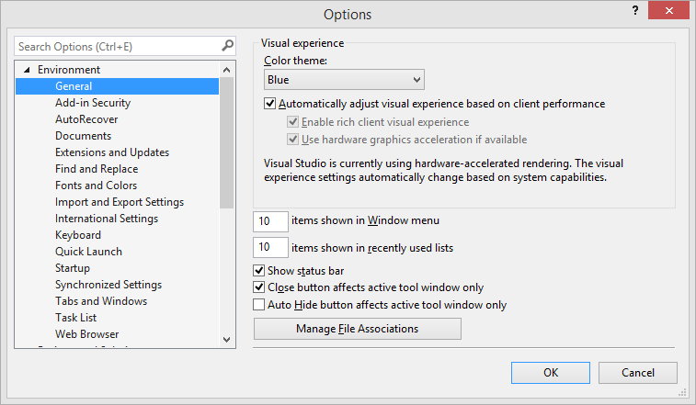
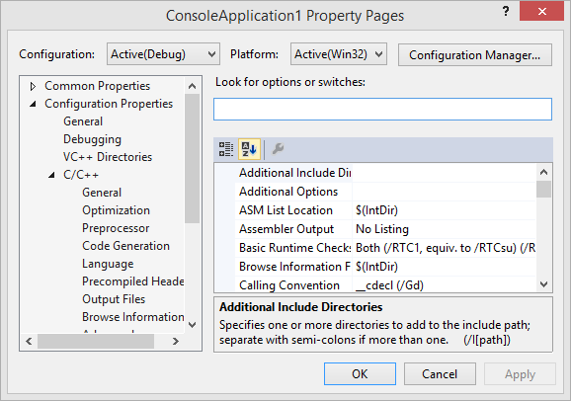
IDE
Resizable and searchable options window!

Slide 10
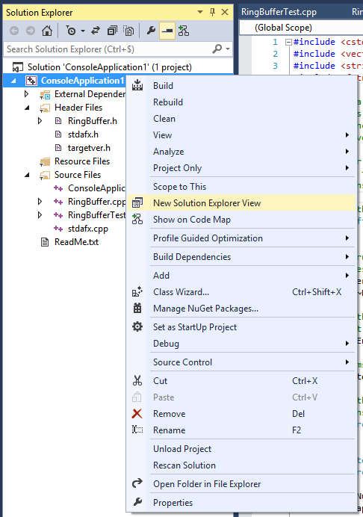
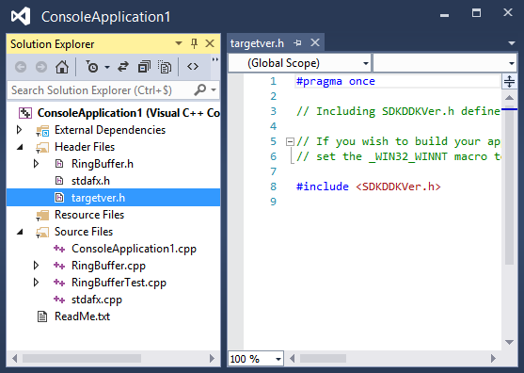
IDE
Multiple solution explorers
With their own source editor
Notes:
Not new in VS2013, but I don’t think a lot of people know about it.

Slide 11
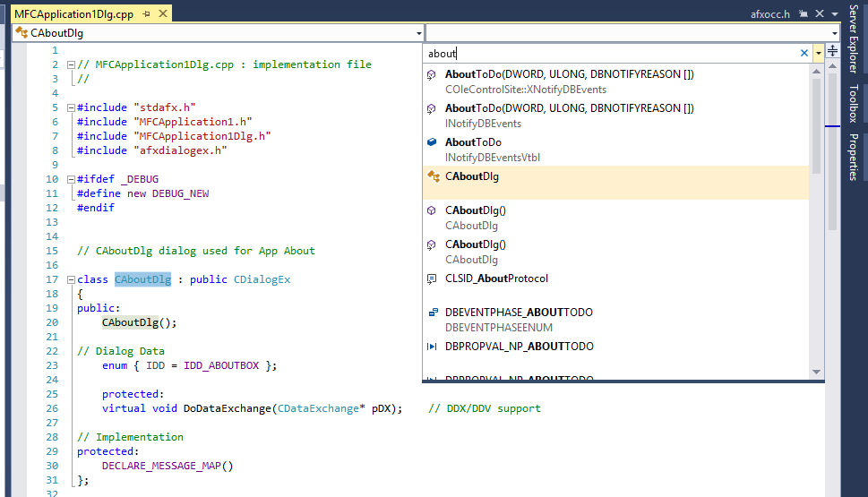
IDE
Inline Navigate To: Ctrl+,

Slide 12
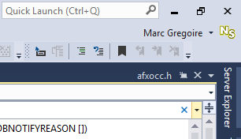
IDE
Connected IDE
Sign in with your Microsoft account
Synchronize settings across devices

Slide 13
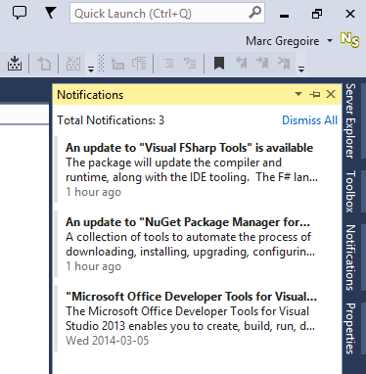
IDE
Notifications of updates in 1 place

Slide 14
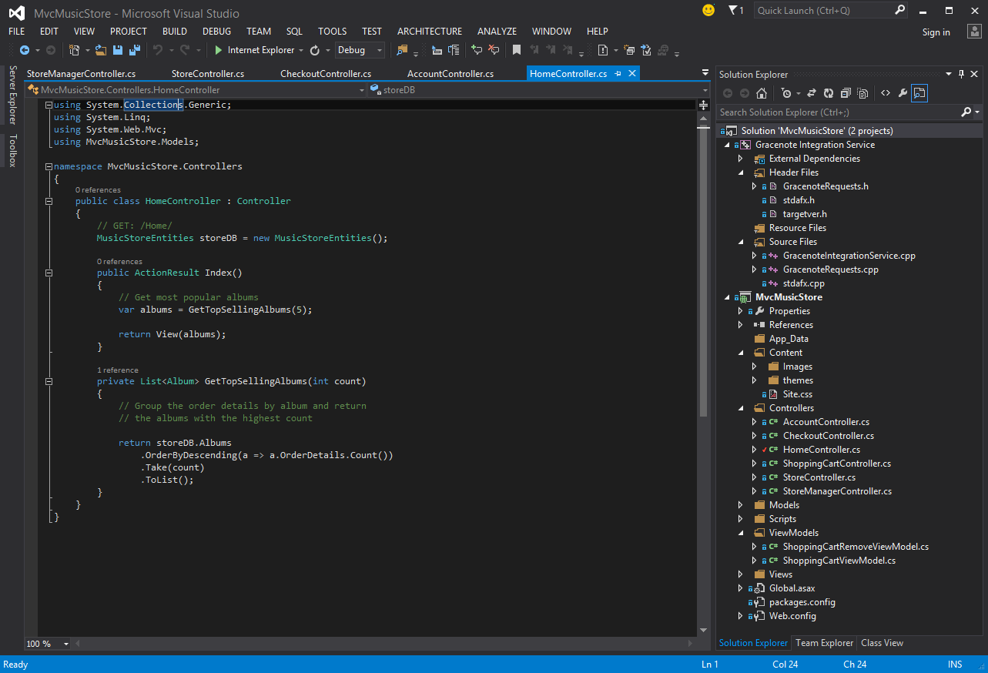
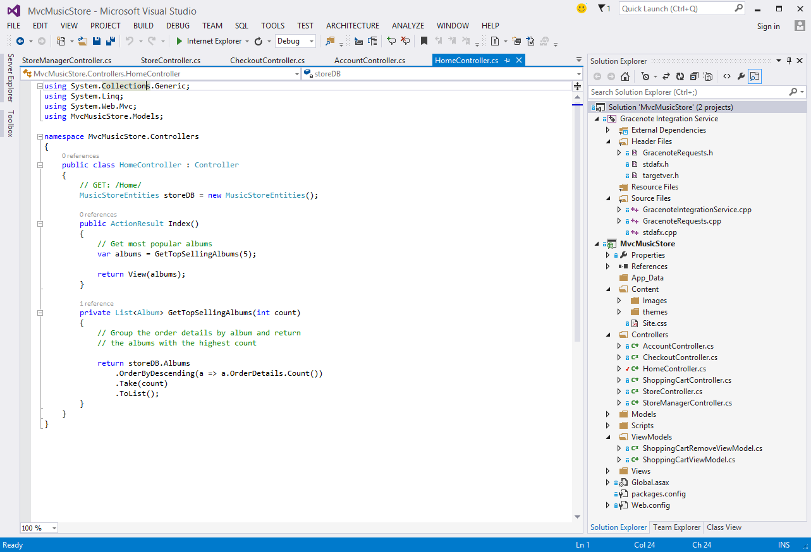
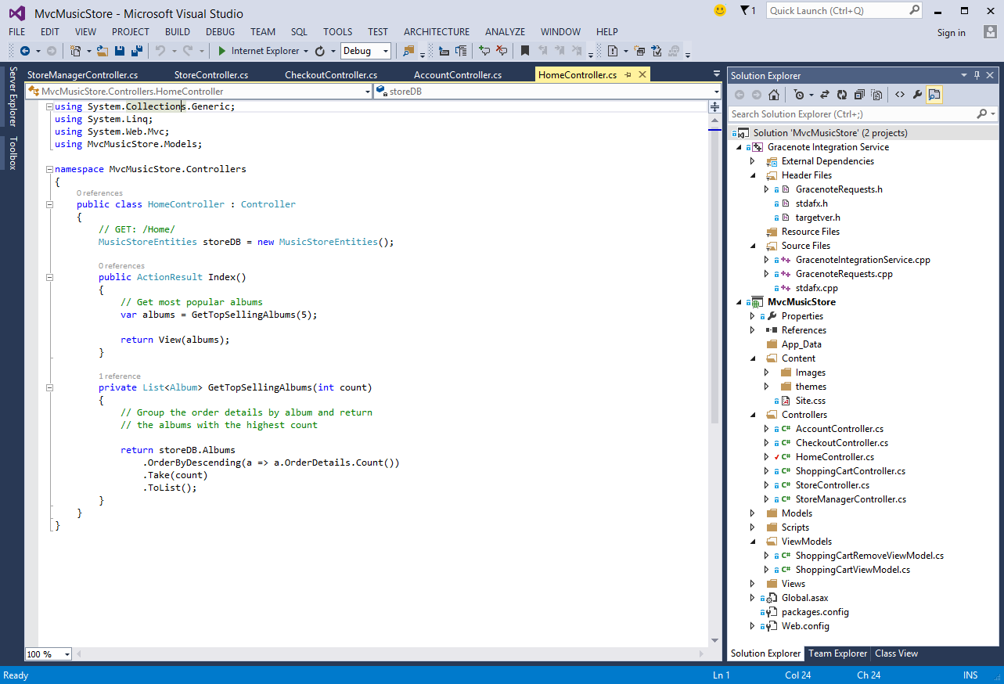
IDE
Multiple themes
Blue theme is back ☺

Slide 15
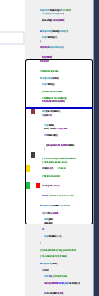
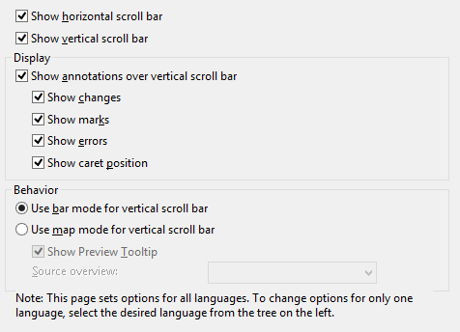

IDE
Improved scrollbar
Shows
Break points
Current line
Bookmark
Unsaved change
Saved change
Error
Right click scrollbar > “Scroll Bar Options…”

Slide 16
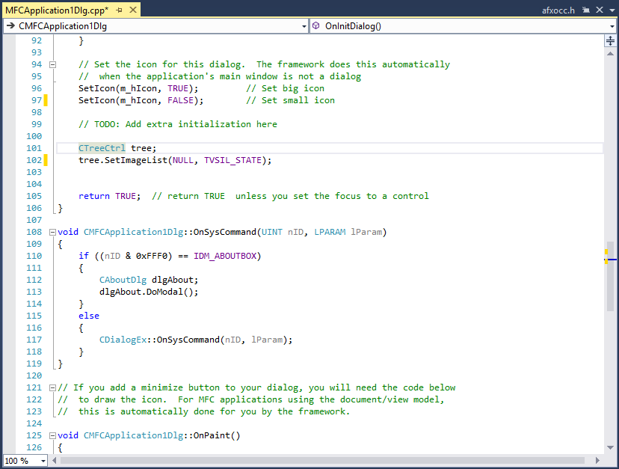
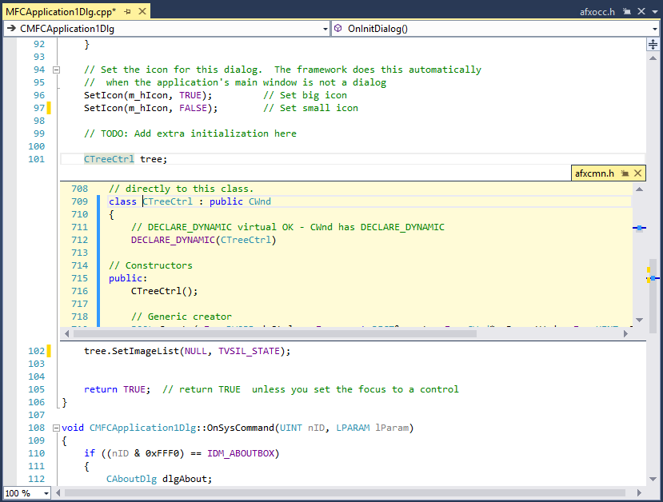
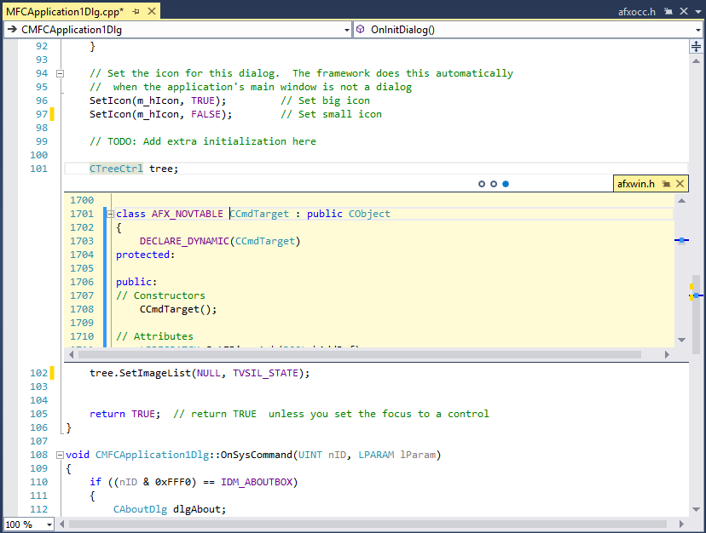
IDE
Code Peek Alt+F12

Slide 17
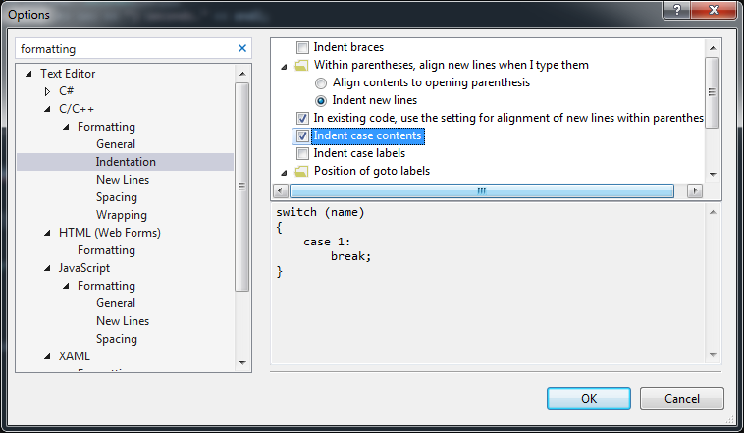
IDE (C++ Specific)
Auto formatting ☺

Slide 18
IDE (C++ Specific)
Configuration switching
325% Improvement

Slide 19
New C++ Features in VC++2013 RTM
Explicit Conversion Operators (C++11)
Raw String Literals (C++11)
Function Template Default Arguments (C++11)
Delegating Constructors (C++11)
Uniform Initialization / initializer_list (C++11)
Variadic Templates (C++11)
Non-Static Data Member Initializers (C++11)
= default (C++11)
= delete (C++11)
Type aliases (C++11)
cbegin() / cend() (C++14)
make_unique (C++14)

Slide 20
Explicit Conversion Operators (C++11)
class IntWrapper
{
public:
IntWrapper(int i) : m_int(i) { }
operator int() { return m_int; }
private:
int m_int;
};
...
IntWrapper wrap(123);
int i = wrap; // <- Implicit conversion due to
// operator int()

Slide 21
Explicit Conversion Operators (C++11)
class IntWrapper
{
public:
IntWrapper(int i) : m_int(i) { }
explicit operator int() { return m_int; }
private:
int m_int;
};
...
IntWrapper wrap(123);
int i1 = wrap; // Compilation error
int i2 = static_cast<int>(wrap); // OK

Slide 22
Raw String Literals (C++11)
Useful for SQL statements, regular expressions, …
Regular expression searching for spaces, newlines, form feeds, and back slashes: string s = "( |\\n|\\r|\\\\)";
Using raw string literal: string s = R"(( |\n|\r|\\))";

Slide 23
Function Template Default Arguments (C++11)
template<typename TARGET = int, typename SOURCE>
TARGET Convert(const SOURCE& src)
{
return static_cast<TARGET>(src);
}
...
auto res1 = Convert<double>(123);
cout << typeid(res1).name() << endl; // double
auto res2 = Convert(123.1);
cout << typeid(res2).name() << endl; // int

Slide 24
Delegating Constructors (C++11)
class C
{
public:
C(int data) : m_data(data) { }
C() : C(123) { }
private:
int m_data;
};
Note: The call to the delegating constructor should be the only thing in the constructor initializer

Slide 25
Uniform Initialization / initializer_list (C++11)
int i{ 1 };
class C
{
public:
C() { }
C(int i) { }
};
C c1{}; // Compare to “C c1()” which declares a function
C c2{ 123 };
C c3 = { 123 };
C c4 = C{ 123 };
vector<int> v1 = { 1, 2, 3 };
vector<int> v2{ 1, 2, 3 };
Note: never write:
auto i{1}
Because then i will be of type initializer_list!

Slide 26
Variadic Templates (C++11)
Type-safe, variable-number-of-arguments functions
Example, type-safe printf(): works based on recursion, so we need an end-condition first:
void printf(const char* s)
{
while (s && *s)
{
// make sure that there wasn't meant to be more arguments
// %% represents plain % in a format string
if (*s=='%' && *++s!='%')
{
throw runtime_error("invalid format: missing arguments");
}
std::cout << *s++;
}
}

Slide 27
Variadic Templates (C++11)
And the recursive step:
template<typename T, typename... Args> // note the "..."
void printf(const char* s, T value, Args... args) // note the "..."
{
while (s && *s)
{
if (*s=='%' && *++s!='%') // a format specifier (ignore which one it is)
{
std::cout << value; // use first non-format argument
return printf(++s, args...); // "peel off" first argument
}
std::cout << *s++;
}
throw std::runtime error("extra arguments provided to printf");
}
Usage:
const string pi = "pi";
const char* m = "The %s of %s is about %g.";
printf(m, "value", pi, 3.14159);

Slide 28
Non-Static Data Member Initializers (C++11)
Class definitions can now have non-static data member initializers
class B
{
public:
B(int i) : m_int(i) {};
private:
int m_int;
};
class C
{
private:
std::string m_str1 = "Default1";
std::string m_str2{ "Default2" };
B m_b{ 123 };
};
Note: non-const static data members should still be defined outside the class definition.

Slide 29
= default (C++11)
Ask the compiler to forcefully generate the default implementation
Example:
class C
{
public:
C(int i) {}
C() = default;
};

Slide 30
= delete (C++11)
Forcefully delete an implementation
Error message states intent, which is a better error message than making it private without implementation
Example:
class C
{
public:
C() = delete;
C(const C& src) = delete;
C& operator=(const C& src) = delete;
};
C c; // error C2280: 'C::C(void)' :
// attempting to reference a deleted function

Slide 31
= delete (C++11)
Can be used to disallow calling a function with certain types
Example:
void foo(int i) { }
...
foo(123);
foo(1.23); // Compiles, but with warning
You can disallow calling foo() with doubles by deleting a double overload of foo():
void foo(int i) { }
void foo(double d) = delete;
...
foo(123);
foo(1.23); // error C2280: 'void foo(double)' :
// attempting to reference a deleted function

Slide 32
Type aliases (C++11)
Replacement for typedef
Easier to read
int Foo(int i) { return 1; }
typedef int(*FooPtr1)(int);
FooPtr1 f1 = Foo;
f1(123);
using FooPtr2 = int(*)(int);
FooPtr2 f2 = Foo;
f2(123);

Slide 33
cbegin() / cend() (C++14)
C++11 already had begin() and end() helper functions
C++14 adds cbegin(), cend(), rbegin(), rend(), crbegin(), and crend()
Example:
vector<int> v1{ 1, 2, 3 };
for_each(cbegin(v1), cend(v1), ...);

Slide 34
make_unique (C++14)
C++11 already had std::make_shared
C++14 adds std::make_unique
class C
{
public:
C() {}
C(int i) {}
};
...
// Simple pointer
auto ptr1 = make_unique<C>(123);
// Array of 5 instances (can’t use make_shared for this!)
auto ptr2 = make_unique<C[]>(5);

Slide 35
Visual C++ 2013 Nov CTP

Slide 36
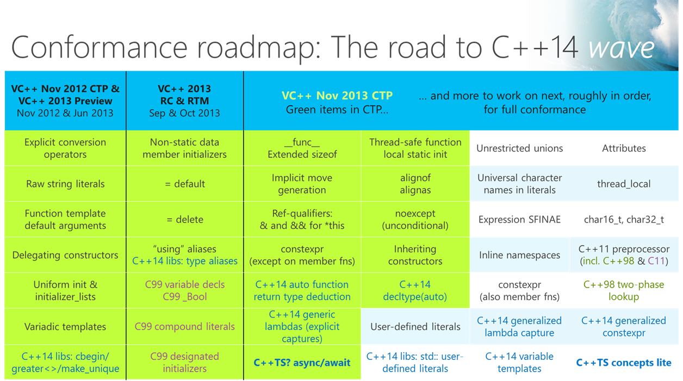
Visual C++ November 2013 CTP

Slide 37
New C++ Features in VC++2013 Nov CTP
__func__ (C++11)
noexcept (C++11)
constexpr (C++11)
Inheriting Constructors (C++11)
Function Return Type Deduction (C++14)
decltype(auto) (C++14)
Generic Lambdas (C++14)
__resumable / __await (C++TS?)
Note: This CTP does not come with a Go-Live license!

Slide 38
__func__ (C++11)
Standard way to get the name of a function
int _tmain(int argc, _TCHAR* argv[])
{
cout << __func__ << endl;
return 0;
}
Output:
wmain

Slide 39
noexcept (C++11)
void Foo() noexcept
{
throw 1;
}
...
warning C4297: 'Foo' : function assumed not to throw an exception but does

Slide 40
constexpr (C++11)
Constant expressions
Simple example
static constexpr size_t FACTOR = 2;
constexpr size_t CalculateArraySize(size_t base)
{
return base * FACTOR;
}
...
double arr[CalculateArraySize(123)];

Slide 41
Inheriting Constructors (C++11)
class Base
{
public:
Base(int data) : m_data(data) {}
private:
int m_data;
};
class Derived : Base
{
public:
Derived(const std::string& msg) : Base(1), m_msg(msg) {}
private:
std::string m_msg;
};
...
Base b1(123); // OK
Derived d1("Message"); // OK
Derived d2(456); // NOT OK

Slide 42
Inheriting Constructors (C++11)
class Base
{
public:
Base(int data) : m_data(data) {}
private:
int m_data;
};
class Derived : Base
{
public:
using Base::Base;
Derived(const std::string& msg) : Base(1), m_msg(msg) {}
private:
std::string m_msg;
};
...
Derived d2(456); // OK

Slide 43
Function Return Type Deduction (C++14)
Specifying the return type is optional
Example: return type will be int
auto Foo(int i)
{
return i + 1;
}
Example: return type will be double
template<typename T>
auto Bar(const T& t)
{
return t * 2;
}
...
auto result = Bar(1.2);

Slide 44
Function Return Type Deduction (C++14)
Multiple return statements are allowed but all need to be of exactly the same type
Following won’t compile: returns int and unsigned int
auto Foo(int i)
{
if (i > 1)
return 1;
else
return 2u;
}

Slide 45
Function Return Type Deduction (C++14)
Recursion allowed but there must be a non-recursive return before the recursive call
Correct:
auto Foo(int i)
{
if (i == 0)
return 0;
else
return i + Foo(i - 1);
}
Wrong:
auto Foo(int i)
{
if (i > 0)
return i + Foo(i - 1);
else
return 0;
}

Slide 46
decltype(auto) (C++14)
Example:
static const string message = "Test";
const string& Foo()
{
return message;
}
...
auto f1 = Foo();
decltype(Foo()) f2 = Foo();
decltype(auto) f3 = Foo();
← Type: string
← Type: const string&
← Type: const string&

Slide 47
decltype(auto) (C++14)
Both auto and decltype can be used to let the compiler deduce the type
auto will strip ref-qualifiers (lvalue and rvalue references) and will strip cv-qualifiers (const and volatile)
decltype will not strip those

Slide 48
Generic Lambdas (C++14)
Lambda parameters can be declared as auto ☺
auto doubler = [](const auto& value){ return value * 2; };
...
vector<int> v1{ 1, 2, 3 };
transform(begin(v1), end(v1), begin(v1), doubler);
...
vector<double> v2{ 1.1, 2.2, 3.3 };
transform(begin(v2), end(v2), begin(v2), doubler);

Slide 49
__resumable / __await (C++TS?)
Makes using asynchronous methods much much much easier
Currently Microsoft specific
Possibly included in a C++TS
If you don’t use managed code, specify the /clrcompat- compiler switch to increase performance

Slide 50
__resumable / __await (C++TS?)
task<void> sleep(int sec)
{
return create_task([sec] {
this_thread::sleep_for(chrono::seconds(sec));
cout << "After sleep_for(" << sec << ") seconds." << endl;
});
}
void FooNonResumable()
{
sleep(3).then(
[]{ cout << "After sleep with .then" << endl; });
}
task<void> FooResumable() __resumable
{
__await sleep(3);
cout << "After sleep with __await" << endl;
}

Slide 51
__resumable / __await (C++TS?)
Second example:
Windows Store App
Create a file
Open the file
Write a string to the file
Flush the file

Slide 52

__resumable / __await (C++TS?)
void WriteFileTest()
{
auto item = KnownFolders::PicturesLibrary;
auto createStorageFileOp = item->CreateFileAsync("myfile.txt");
task<StorageFile^> createFileTask(createStorageFileOp);
createFileTask.then([](StorageFile^ storageFile) {
return storageFile->OpenAsync(FileAccessMode::ReadWrite);
}).then([](IRandomAccessStream^ rastream) -> task<bool> {
IOutputStream^ ostream = rastream->GetOutputStreamAt(0);
DataWriter^ bbrw = ref new DataWriter(ostream);
bbrw->WriteString("Hello async!");
task<unsigned int> writtenTask(bbrw->StoreAsync());
return writtenTask.then([ostream](unsigned int bytesWritten) {
return ostream->FlushAsync();
});
}).then([](bool flushed) {
});
}

Slide 53

__resumable / __await (C++TS?)
task<void> WriteFileTest() __resumable
{
auto item = KnownFolders::PicturesLibrary;
auto storageFile = __await item->CreateFileAsync("myfile.txt");
auto rastream = __await storageFile->OpenAsync(FileAccessMode::ReadWrite);
auto ostream = rastream->GetOutputStreamAt(0);
auto bbrw = ref new DataWriter(ostream);
bbrw->WriteString("Hello async!");
auto bytesWritten = __await bbrw->StoreAsync();
auto flushed = __await ostream->FlushAsync();
}

Slide 54
Visual C++ Update 2 CTP2

Slide 55
AVX2
VC++ compiler now supports AVX2
256 bits wide SIMD instructions
Supported starting with Intel Haswell
Also FMA (Fused Multiply Add) and BMI (Bit Manipulation Instructions)
Surface Pro 2 has a Haswell CPU
Specify: /arch:AVX2
App will crash if it uses AVX2 instructions and your CPU doesn’t support them
Check for AVX2 support using the CPUID instruction

Slide 56
Rename Refactoring in VC++ 2013

Slide 57
Rename Refactoring in VC++2013
First step to refactoring in VC++
No yet included in the box
Free download from http://visualstudiogallery.msdn.microsoft.com/164904b2-3b47-417f-9b6b-fdd35757d194?SRC=Home

Slide 58
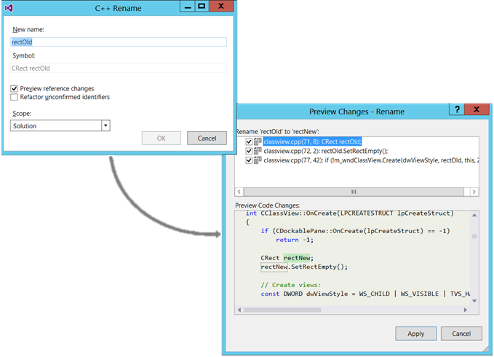

Slide 59
Debugging in VC++ 2013

Slide 60
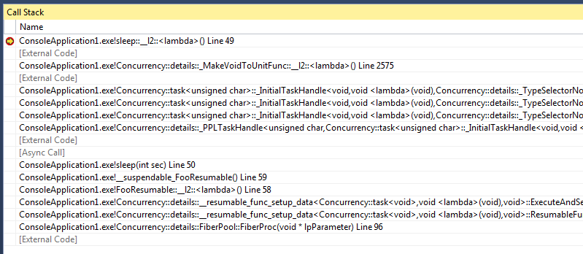
Debugging – Async
Much better Async debugging
Shows the callstack on how you arrived in an async task

Slide 61
Debugging – Just-My-Code
Filters call stacks to only display my code

Slide 62
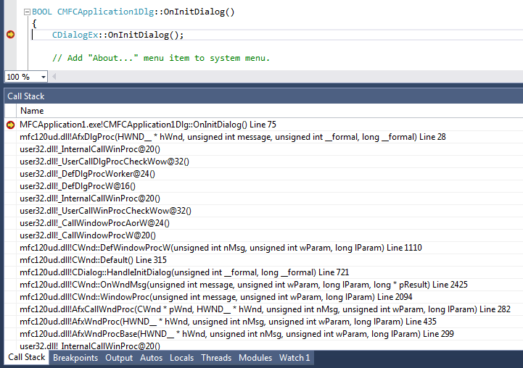
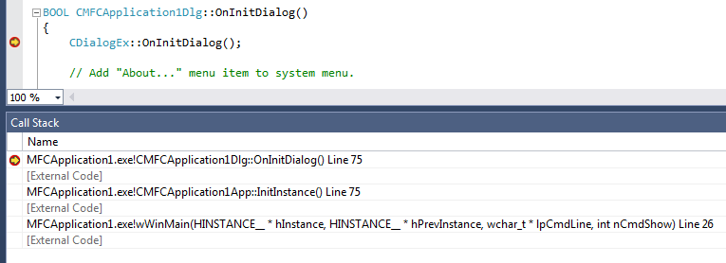
Debugging – Just-My-Code

Slide 63
Debugging – Dump Files
Dump files of 32-bit processes created with a 64-bit dumper (ex: Task Manager) can be opened in VS2013
No need to explicitly use the 32-bit dumper anymore on 64-bit platforms

Slide 64
Debugging – /d2Zi+ for Locals
Cryptic and undocumented feature, but powerful
Records optimization information into the PDB
Strictly PDB changes, EXE stays the same!
Might increase size of PDB files
Makes debugging release code easier
Shows local variables in the debugger that might be optimized away in optimized release builds
Available since 2012, but nobody knew
Unfortunately it’s broken in VC++2013 ☹ Bug report filed.

Slide 65
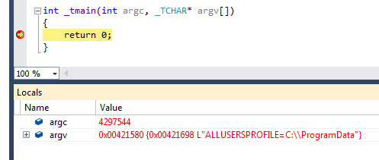
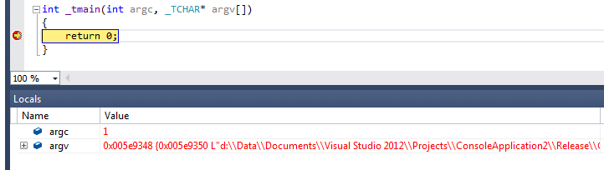
Debugging – /d2Zi+ for Locals

Slide 66
Debugging – C++ AMP
C++ AMP is deeply integrated into >= VC++2012
Debugging
CPU/GPU breakpoints (even simultaneously)
GPU threads
Parallel Stacks
Parallel Watch
Concurrency Visualizer

Slide 67
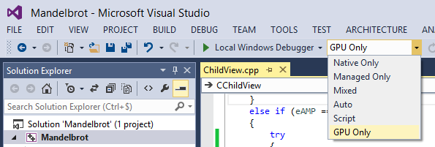
Debugging – C++ AMP
GPU breakpoints are supported
On Windows 8 and 7, no CPU/GPU simultaneous debugging possible
You need to enable the GPU Only debugging option

Slide 68
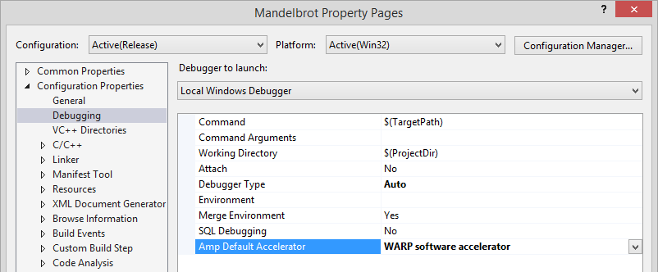
Debugging – C++ AMP
Simultaneous CPU/GPU debugging:
Requires Windows 8.1 and VC++2013
Requires the WARP accelerator
Notes:
WARP: Windows Advanced Rasterization Platform

Slide 69
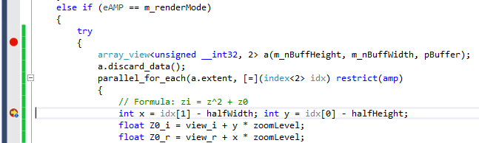
Debugging – C++ AMP
Example of a simultaneous CPU and GPU breakpoint

Slide 70
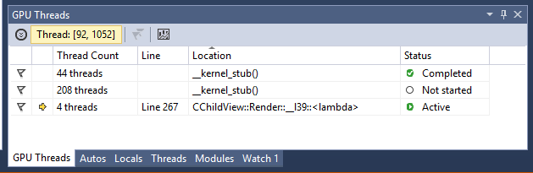
Debugging – C++ AMP
GPU Threads

Slide 71
Debugging – Concurrency Visualizer
Concurrency Visualizer is not included with VC++2013 anymore
Download and install it from: http://visualstudiogallery.msdn.microsoft.com/24b56e51-fcc2-423f-b811-f16f3fa3af7a

Slide 72
Debugging – Concurrency Visualizer
Concurrency Visualizer
Shows activity on CPU and GPU
Locate performance bottlenecks
Copy times to/from the accelerator
CPU underutilization
Thread contention
Cross-core thread migration
Synchronization delays
DirectX activity

Slide 73
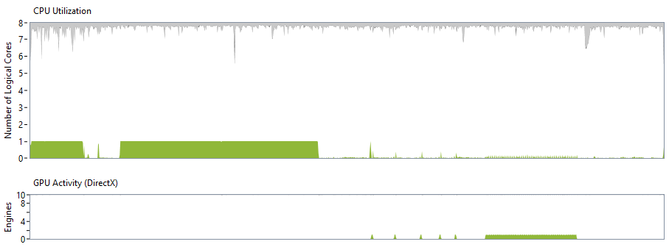
Debugging – Concurrency Visualizer

Slide 74
SAL Annotations
Source-code annotation language (SAL)
You can annotate your code to express intent
Example:
void Func1(_In_ int *p1) {
}
_Success_(return != 0, _Acquires_lock_(*lpCriticalSection))
BOOL WINAPI TryEnterCriticalSection(
_Inout_ LPCRITICAL_SECTION lpCriticalSection
);
Notes:
Not new to VC++2013, but I don’t think a lot of people know about it.

Slide 75
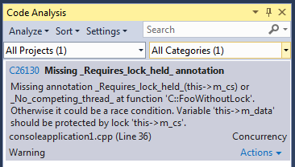
SAL Annotations
Locking annotations
class C
{
public:
void FooWithLocking() {
EnterCriticalSection(&m_cs);
m_data++;
LeaveCriticalSection(&m_cs);
}
void FooWithoutLock() {
m_data++;
}
private:
CRITICAL_SECTION m_cs;
_Guarded_by_(m_cs) int m_data;
};

Slide 76
SAL Annotations
Find more at: http://msdn.microsoft.com/en-us/library/ms182032.aspx

Slide 77
C++ Future

Slide 78
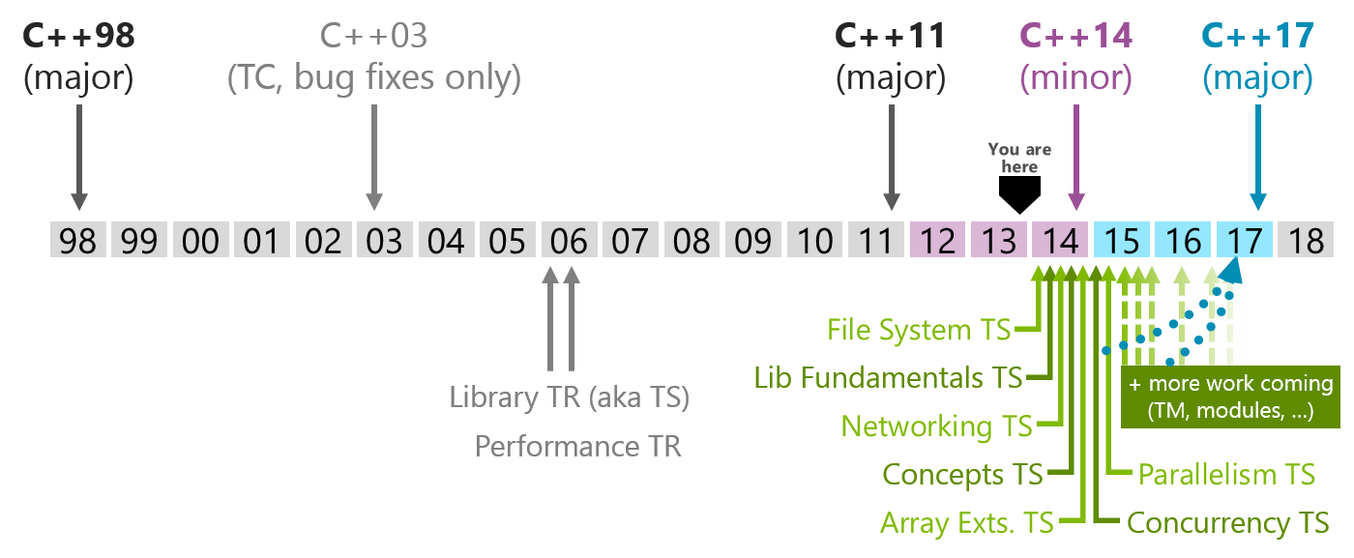
C++ Future

Slide 79
C++ Future
Lots of new features are planned for a future standard, most of it will come first in technical specifications
File System TS (based on boost filesystem v3)
Library fundamentals TS
std::optional<T>
Networking TS
Concepts Lite TS
Checking template uses only
Checking template definitions comes later

Slide 80
C++ Future
Array extensions TS
ARB: Array of Runtime Bounds
std::dynarray
Concurrency TS
.wait_any(), .wait_all(), …
__resumable / __await
Parallelism TS
Execution policies:
std::seq (sequential)
std::par (parallel)
std::vec (vector)
Example: sort(std::par, begin(v), end(v));
Extensible, example: sort(compute_this_in_the_cloud, begin(v), end(v));

Slide 81
Questions
?

Slide 82
Widescreen Test Pattern (16:9)
Aspect Ratio Test
(Should appear circular)
4x3
16x9

