Slide 1
Vulnerability Analysis
Raul Gonzalez
Jenna Kallaher
Costas Akrivoulis

Slide 2
Agenda
Dynamic Analysis
Dynamic Taint Analysis
Testing
Static Analysis
Formal Models
Meta-level Compilation

Slide 3
Analysis Considerations
Code Size
Language
Scalability
False Positive/Negative Rate

Slide 4
Dynamic Analysis
Notes:
What is at least one disadvantage of dynamically testing code for rule violations? Answers:
Growth of execution paths
Requires execution of the code, which is oftentimes unreasonable (e.g. acquiring thousands of devices to test device drivers)
Development of tests that fully exercise all paths
Inability to scale to large or complex code bases (time to create and execute tests, etc.)
Difficulty in finding the cause of a test failure

Slide 5
Dynamic Analysis
The class of program analysis that relies on active execution of code in order to analyze code properties
Examples
Valgrind
GDB
Notes:
The primary advantage of dynamic analysis: It reveals subtle defects or vulnerabilities whose cause is too complex to be discovered by static analysis. Dynamic analysis can play a role in security assurance, but its primary goal is finding and debugging errors.
Valgrind runs programs on a virtual processor and can detect memory errors (e.g., misuse of malloc/free) and race conditions in multithreaded programs.

Slide 6
Dynamic Analysis
Advantages
Lack of false positives
Avoids analysis of unreachable code
Disadvantages
Prone to false negatives
Single execution path per run
Incomplete code coverage
Time to execute
Hardware-based testing

Slide 7
Dynamic Analysis: Techniques
Testing
Fuzzing
Dynamic Taint Analysis

Slide 8
Testing

Slide 9
Testing
Code execution to verify correctness
Unit tests, regression tests, system tests....

Slide 10
Testing
Advantages
Simple
Runs directly on code (no abstractions)
Source not needed

Slide 11
Testing
Disadvantages
Many test cases
Time + effort increases with code size
Finding cause of failure is hard
Nondeterministic errors are hard
Heisenbugs
Must run the code
Testing device drivers requires devices

Slide 12
Testing: Limitations
Environment can mask bugs
int flags = 7;
size_t size = 16;
// C's weak typing allows swapped args
kmalloc(flags, size)
If kernel uses power-of-2, min 32B allocator,
bug is masked... for now.

Slide 13
Testing: Limitations
Bugs can mask other bugs
int * foo(int *x)
{
cli();
if(something_something_error_condition)
return NULL;
restore_flags(flags) //sti() implicit
return x;
}
...
int *y = foo(x);
int z = *y;

Slide 14
Testing: Fuzzing
Passing unintended input to a target,
seeking unintended behavior
Notes:
Genetic algorithms: have a set of "genes", evolve based on feedback. in this case, program crashes/defects

Slide 15
Testing: Fuzzing
Approaches to input generation
Random
Biased
Genetic algorithms
Fuzzing Targets
Applications
File formats
Protocols
Notes:
Genetic algorithms: have a set of "genes", evolve based on feedback. in this case, program crashes/defects

Slide 16
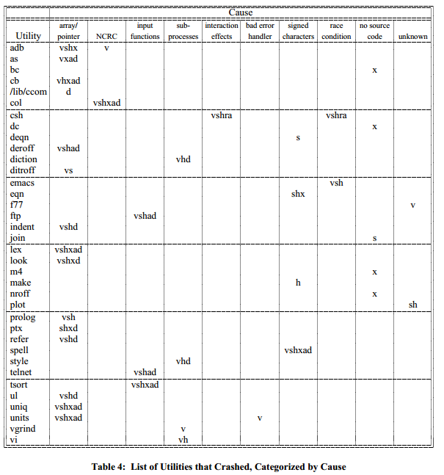
Testing: Fuzzing
Notes:
Mention the Unix utility paper.
Highlights:
- most assume OS and utilities are more thoroughly tested
- able to crash 25-33% of the utility programs on any version of UNIX that was
tested
- large spectrum of vulnerability types disclosed

Slide 17
Fuzzing: Genetic Algorithms
Genetic Algorithms (GA) use evolution to solve search or optimization problems
Creates a population of abstract representations (genome) of candidate solutions (individuals)
Each generation is evaluated with a fitness function

Slide 18
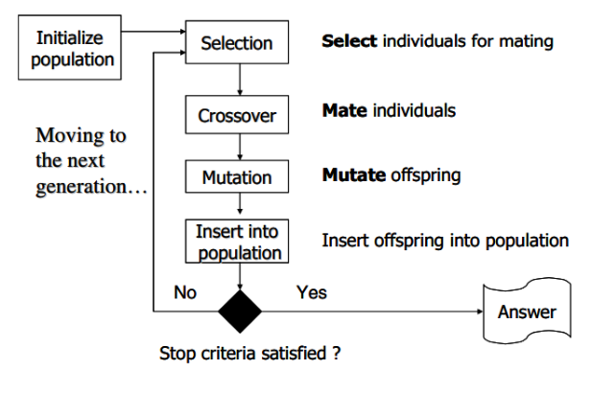
Fuzzing: Genetic Algorithms

Slide 19
Fuzzing: Genetic Algorithms
The Control Flow Graph is a fuzzy search space CFG: Obtained by disassembly Solution candidates: Individual program inputs Determining Fitness: Markov probabilities associated with state transitions on a control flow graph.
Notes:
4. Besides MC, there were 3 general methods of finding bugs. One of them is Testing (Fuzzing, test cases ..) What are the other two general techniques? (optional: what is one advantage or disadvantage of these two techniques over testing?) Answer: Model Checking and Manual Inspection.

Slide 20
(Dynamic) Taint Analysis

Slide 21
Taint Analysis
Track propagation of tainted data during execution in order to identify dangerous use
Notes:
- mention there is static taint analysis
In dynamic taint analysis, we label data originating from or arithmetically derived from untrusted sources such as the network as tainted. We keep track of the propagation of tainted data as the program executes (i.e., what data in memory is tainted), and detect when tainted data is used in dangerous ways that could indicate an attack. This approach allows us to detect overwrite attacks, attacks that cause a sensitive value (such as return addresses, function pointers, format strings, etc.) to be overwritten with the attacker’s data. Most commonly occurring exploits fall into this class of attacks.

Slide 22
Taint Analysis
Taint
Protected data
Untrusted data
Danger
Information leakage
Overwrites of sensitive values
Return addresses
Function pointers
Format strings
Notes:
- mention there is static taint analysis
In dynamic taint analysis, we label data originating from or arithmetically derived from untrusted sources such as the network as tainted. We keep track of the propagation of tainted data as the program executes (i.e., what data in memory is tainted), and detect when tainted data is used in dangerous ways that could indicate an attack. This approach allows us to detect overwrite attacks, attacks that cause a sensitive value (such as return addresses, function pointers, format strings, etc.) to be overwritten with the attacker’s data. Most commonly occurring exploits fall into this class of attacks.

Slide 23
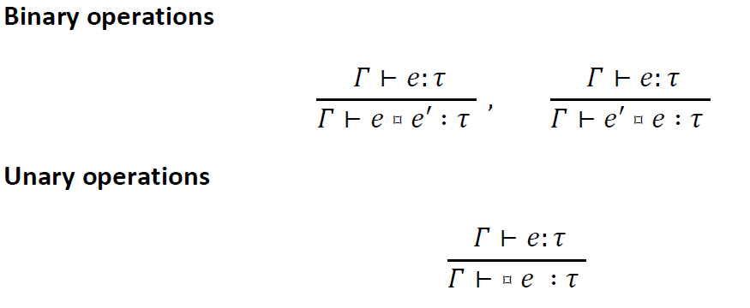
Taint Analysis: Information Flow
Operational Semantics
Notes:
e = epsilon
t = tau
T = gamma

Slide 24
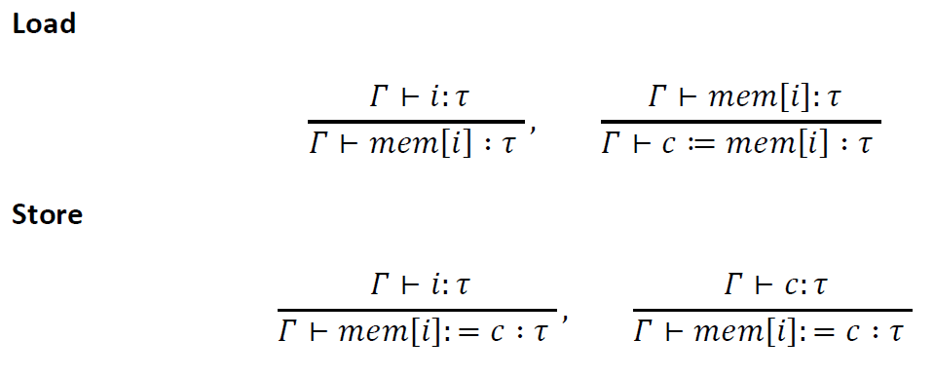
Taint Analysis: Information Flow
Operational Semantics
Notes:
e = epsilon
t = tau
T = gamma

Slide 25
Demo

Slide 26
Static Analysis

Slide 27
Static Analysis
Analysis performs all operations without executing the program
Examples
Clang
SPIN

Slide 28
Static Analysis
Advantages
Examines all execution paths
Lower false negative rate
No runtime overhead
Disadvantages
Performance penalty
Analyzes unreachable paths
Undecidability => Intractability

Slide 29
Static Analysis: Techniques
Manual Inspection
Formal Models
Meta-Level Compilation

Slide 30
Manual Inspection
Advantages
Considers all semantic levels
Applies expert knowledge
Flexible to adhoc conventions/system rules
Disadvantages
Not scalable
Human error
Tedious
“Non-deterministic"

Slide 31
Formal Models

Slide 32
Formal Models
A: Formalize the design requirements
B: Formalize the code that implements
the design requirements
Logically verify that B Satisfies/Violates A
Notes:
2. Why do formal verification techniques generally find fewer bugs than meta-level compilation? Answer: Formal verification usually only verifies small amounts of the code base due to the difficulty in writing specifications. In contrast, most code goes through meta-level compilation, making the technique applicable to millions of lines of code or only a few lines of code.

Slide 33
Formal Models
Advantages
Verification > Testing (Strong guarantees)
Exposes hard to find errors

Slide 34
Formal Models
Disadvantages
Implementation exists, requirements don't
Difficult, Costly to reconstruct
Can't verify during D&D phases of lifecycle
Results apply to old versions of code
Abstracted
Oversimplified, Subset of functionality
Formal Model itself can be flawed
Notes:
subset of functionality: Undecidability, Missing Features

Slide 35
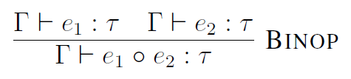

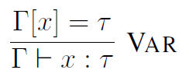

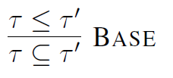
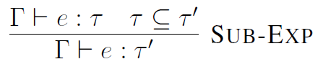

Formal Models
Notes:
Sub-exp: (SUBSUMPTION) We use sub-typing to implement our intuition that we can always up-classify a value

Slide 36
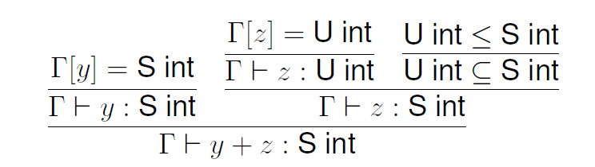




Formal Models
TS int x;
S int y;
U int z, u;
x = y + z;

Slide 37
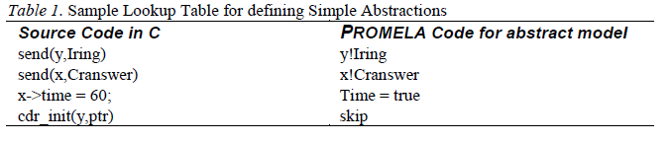
Formal Models: Automation
Source Code
Extract control flow skeleton
Extract abstract model
Extract abstract data objects

Slide 38
Meta-Level Compilation

Slide 39
Compilers
Check for semantic rule violations
Insufficient info to enforce "meta"-semantics

Slide 40
Cross-Cutting Concerns
Examples
Synchronization
Data integrity validation
Memory management
Caching
Logging

Slide 41
Cross-Cutting Concerns: Caching
def fib(n):
if (n < 2):
return n
else:
return fib(n-2) + fib(n-1)

Slide 42
Cross-Cutting Concerns: Caching
def fib(n):
if (n < 2):
return n
else:
if (n-2) not in memo:
memo[n-2] = fib(n-2)
if (n-1) not in memo:
memo[n-1] = fib(n-1)
ans = memo[n-1] + memo[n-2]
memo[n] = ans
return ans

Slide 43
Unfortunate Dichotomy
"Implementors understand the semantics of the system operations ... but do not have the mechanisms to check or exploit these semantics automatically.
Compilers have the machinery to do so, but their domain ignorance prevents them from exploiting it."

Slide 44
Bridging the Gap
Can we leverage a compiler's semantic knowledge to enforce meta-semantics?

Slide 45
Bridging the Gap
Yes. The answer is Meta-level Compilation. (MC)

Slide 46
Meta-Compilation: Techniques
Higher-level Compilation
Source Annotation
Extensible Compilation
Making the compiler aware

Slide 47
Higher Level Compilation
Hard-wired with higher-level abstractions
I/O management
Race condition detection
System call errors
Security errors in privileged programs
Notes:
-Wall in gcc

Slide 48
Source Annotation
Source code annotated with directives
Conveys meta-semantics to compiler
Examples
PREfix, LCLint, Microsoft's SAL
scales unfavorably with code

Slide 49
Source Annotation: MS SAL
void FillString(
TCHAR* buf,
size_t cchBuf,
char ch)
{
for (size_t i = 0; i < cchBuf; i++)
buf[i] = ch;
}

Slide 50
Source Annotation: MS SAL
TCHAR *b =
(TCHAR *)malloc(200*sizeof(TCHAR));
FillString(b, 210, 'x');
// ERROR! Allocation not large enough!

Slide 51
Source Annotation: MS SAL
void FillString(
TCHAR* buf,
size_t cchBuf,
char ch)
{
for (size_t i = 0; i < cchBuf; i++)
buf[i] = ch;
}

Slide 52
Source Annotation: MS SAL
void FillString(
__out_ecount(cchBuf) TCHAR* buf,
size_t cchBuf,
char ch)
{
for (size_t i = 0; i < cchBuf; i++)
buf[i] = ch;
}

Slide 53
Source Annotation: MS SAL
TCHAR *b = (TCHAR *)malloc(200*sizeof(TCHAR));
FillString(b, 210, 'x');
warning C6203: Buffer overrun for non-stack buffer 'b' in call to 'FillString': length '420' exceeds buffer size '400'
warning C6386: Buffer overrun: accessing 'argument 1', the writable size is '200*2' bytes, but '420' bytes might be written
warning C6387: 'argument 1' might be '0': this does not adhere to the specification for the function 'FillString'

Slide 54
Extensible Compilation
Adds extra semantic checks to compiler
Lord's ctool (AST walker in Scheme)
Crew's Prolog-based AST-LOG
xg++ and metal
Notes:
5. How is a rule/template that needs to be enforced converted from an english language proverb (“Always do X before Y”) to an extension that is enforced by the compiler? Answer: The extension is written in a high level language (metal) which pattern matches code into states and captures a checker within a state machine (SM). Then, this extension is dynamically linked through the extensible compiler, xg++. Compiler applies the extension after it translates functions into its internal representations.

Slide 55
Extensible Compilation
Meta language (metal)
State Machine (SM) encodes meta-semantics
C++ pattern recognition determines transitions
Extensible compiler infrastructure (xg++)
Links SM with target at compile time
Performs analysis, leveraging the compiler
Notes:
6. The Metal SM can be applied linearly through code (flow-insensitive), as well as down all paths (flow-sensitive). Even though flow-sensitive execution may have an exploding number of execution paths, how do the authors mitigate this issue? Answer: The authors of MC use aggressive caching to prune redundant code paths where SM follows paths that join and reach the join point in the same state. This works because a deterministic SM applied to the same input and same state must compute the same result.

Slide 56
Temporal Orderings
Order of events matter for correctness
Allow, Disallow, Require
Example
disable_interrupts() sync across functions which may expect different synchronization semantics

Slide 57
Extensible Compilation
Verify interrupt usage
struct buffer_head *
get_free_buffer(struct stripe_head *sh, int b_size)
…
save_flags(flags);
cli();
if ((bh = sh->buffer_pool) == NULL)
/* INTERRUPTS STILL DISABLED */
return NULL;
…
restore_flags(flags); // sti() implicit
return bh;

Slide 58
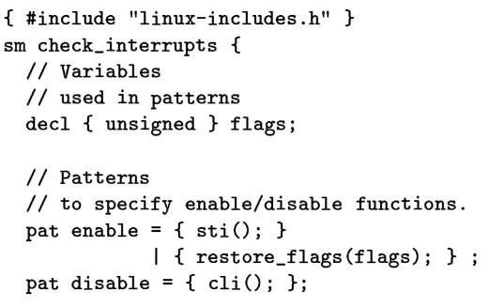
Extensible Compilation
sti();
restore_flags();
cli();
enable
disable

Slide 59
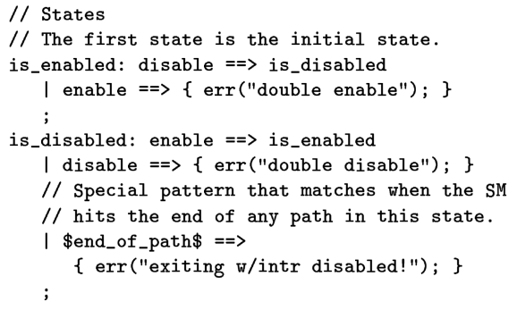
Extensible Compilation

Slide 60
Extensible Compilation
disable
exiting w/ intr disabled
(exit)
double enable
is_enabled
is_disabled
enable
double
disable
enable
disable
Notes:
8. Is MC used for local analysis, global analysis, or both? Answer: Both. MC was originally written to support local analysis (analysis within a single function), but extensions to the compiler, xg++, were made such that limited global analysis was possible through the same local techniques, used at a larger scale.
How is MC’s limited global analysis facilitated? Answer: A two-pass style is used, first a local pass applied at the function level, then after CFGs are stored for each function (using xg++ support routines) they are stitched together for all functions followed by a global analysis pass.

Slide 61
Extensible Compilation: Global
Local analysis => IR
Sum(IR) = Super CFG
Similar analysis, now on global scale
Can be difficult in some cases
Functions may not be immediately apparent

Slide 62
Extensible Compilation
Advantages
Unmodified source code
No abstractions/annotations
Considers data flow information (metal, xg++)
Examines all execution paths
Switches for flow (in)sensitivity
Written in native language (metal, xg++)
Scalable
Notes:
Scalable: no testcases

Slide 63
Extensible Compilation
Disadvantages
Exponential runtime in the worst case
Flow-sensitive analysis on larger SMs/programs
Aggressive caching may not help
Checkers, not verifiers
Reasonable compilers required
Limits languages

Slide 64
Real World Static Analysis
Researchers have different goals from users
No check == no bug
Checking code requires parsing it
User knowledge of security is limited
More analysis != better
Notes:
Incorporates "A few billion lines of code later: using static analysis to find bugs in the real world"
researcher vs user:
- nightly builds/testing (user wants it done before morning), requires > 1,400 lines of code per minute
- meaningful messages/output
- user wants an autorun button, no need for training or modification
- a few researchers working on a few code bases, in contrast with thousands of users working on thousands of code bases
no check means no bug (if you can't see the code, you can't check it)
- this seems simple at first, but it's not always easy to find the code that you need to check in large code bases. solution seems to be to grab at build time, but this is complicated by home-grown build processes, etc
- companies universally say "don't touch that" or "don't look at that"
parsing:
- a language standard is not a compiler, and the differences can be surprising
- compilers have bugs and extensions
user insists something is not really a bug and it may run correctly 99 times out of 100, but the bug still exists

Slide 65
Learning from Analysis
Why did a certain class of errors occur?
How can we prevent this class in the future?
From errors to idioms
Multiple exit points may lead to memory leaks

Slide 66
“Goto” Idiom
int *a = (int *)malloc(4);
if (a == NULL) return NULL;
int *b = (int *)malloc(5);
if (b == NULL) return NULL;
int *c = (int *)malloc(6);
if (c == NULL) return NULL;
return SUCCESS;

Slide 67
“Goto” Idiom
int *a = (int *)malloc(4);
if (a == NULL) return NULL;
int *b = (int *)malloc(5);
if (b == NULL) return NULL;
int *c = (int *)malloc(6);
if (c == NULL) return NULL;
return SUCCESS;
Success
Success
Failure!
a and b leaked!

Slide 68
“Goto” Idiom
int *a = (int *)malloc(4);
if (a == NULL) return NULL;
int *b = (int *)malloc(5);
if (b == NULL) { free(a); return NULL; }
int *c = (int *)malloc(6);
if (c == NULL) { free(a); free(b); return NULL; }
return SUCCESS;

Slide 69
“Goto” Idiom
int *a = (int *)malloc(4);
if (a == NULL) goto err_a;
int *b = (int *)malloc(5);
if (b == NULL) goto err_b;
int *c = (int *)malloc(6);
if (c == NULL) goto err_c;
return SUCCESS;
err_c:
free(b);
err_b:
free(a);
err_a:
return NULL;

Slide 70
Conclusion
Where does VA fit into the dev cycle?
Compiler (type-check, syntax)
Static Analysis
Dynamic Analysis
Formal Verification
Testing (fuzz, unit)

Slide 71

Questions?

Slide 72
END

Slide 73
References
https://www.owasp.org/index.php/Fuzzing
Software Model Checking Extracting Verification Models from Source Code
The Concept of Dynamic Analysis (Thomas Ball)
http://blogs.msdn.com/b/michael_howard/archive/2006/01/26/517975.aspx
http://blogs.msdn.com/b/michael_howard/archive/2006/05/19/602077.aspx
Dynamic Taint Analysis for Automatic Detection, Analysis, and Signature Generation of Exploits on Commodity Software

