Slide 1
Computer Forensics
NTFS File System

Slide 2
MBR and GPT Disks
MBR disks for 32b 86x-compatibles
GPT disks for 64b Itanium processors
  Start with a MBR in order to maintain compatibility
  MBR has a single partition with a partition table entry of 0xEE

Slide 3
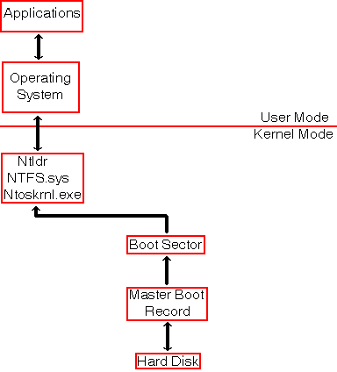
NTFS
Architecture

Slide 4

NTFS Partition Layout
Boot Record
  Basic parameters of NTFS partition
Master File Table (5%-10% of partition)
  Table of entries
    Collection of attributes.
      Attributes can be resident or in the File System Data
File System Data
Master File Table Copy

Slide 5
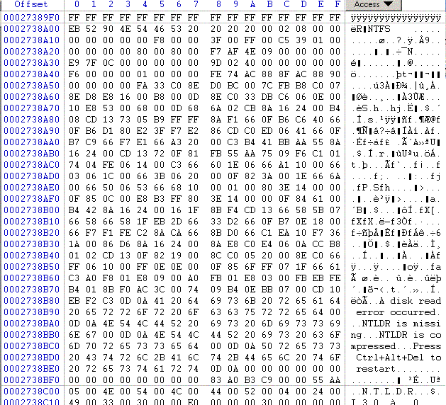
NTFS Boot Sector
Notice that the end of sector marker is 55 AA.
You can look for this to find boot sectors for NTFS and DOS.

Slide 6
NTFS Boot Sector
0x00 3B Jump Instruction
0x03 8B OEM ID
0x0B 25B BPB
0x24 48B Extended BPB
0x54 426B Bootstrap Code.
0x1FE 2B End of Sector Marker

Slide 7
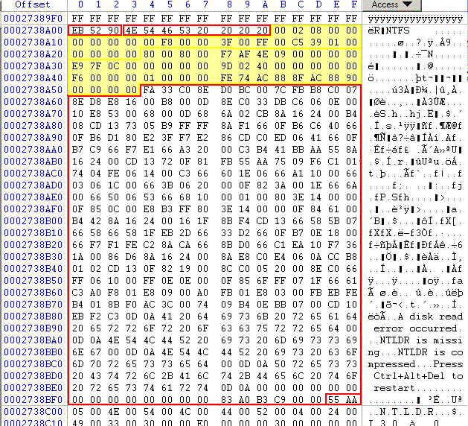
NTSF Boot Sector

Slide 8
NTSF Boot Sector
Many fields are not important, but:
  0x0B, Bytes per sector.
  0x0D Sectors per Cluster
  0x15 Media descriptor. F8: HD; F0: HD Floppy
  0x28 Total sectors.
  0x30 Logical cluster number for the MFT
  0x38 Logical cluster number copy of the MFT
  0x40 Clusters per MFT Record.
  0x48 Volume serial

Slide 9
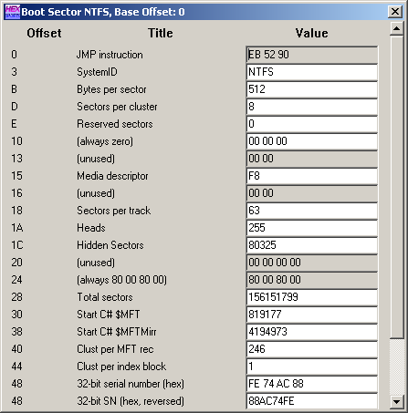
NTFS Boot Sector
WinHex allows access to an interpreted NTFS Boot Sector.
  Use the Access Tab.

Slide 10
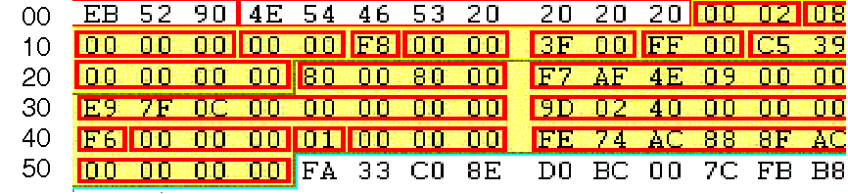
NTFS BPB
0x0B Bytes per sector: 00 02 → 0200 = 512 decimal
0x0D Sectors per cluster: 0x 08
0x0E Reserved sectors 0x 00 00

Slide 11
NTFS BPB
0x15: Media Descriptor: F8 is hard drive, F0 is floppy.
0x28 Total number of sectors: F7AF4E0900000000 → 000000094EAFF7 → 156,151,799 sectors, i.e. ~80GB

Slide 12
NTFS BPB
0x30: Logical cluster number for MFT copy 1: cluster C07FE9 (File $MFT)
0x38: Logical cluster number for MFT copy 2: cluster 40029D

Slide 13
NTFS BPB
0x40: Clusters per MFT record: F6
0x48: Volume Serial Number

Slide 14
NTFS Master File Table
First four entries are replicated, so that MFT can be repaired
First 16 records are reserved for metadata files, their name begins with a dollar sign ($)

Slide 15
NTFS Master File Table
Master file table $MFT.
Master file table mirror $MftMirr.
Log file $LogFile.
Volume $Volume Attribute definitions $AttrDef.
The root folder “.”
Cluster bitmap $Bitmap
Boot sector $Boot (located at the beginning of partition)
Bad cluster file $BadClus
Security file $Secure
Upcase table $Upcase
NTFS extension file $Extend, that is used for future use.

Slide 16
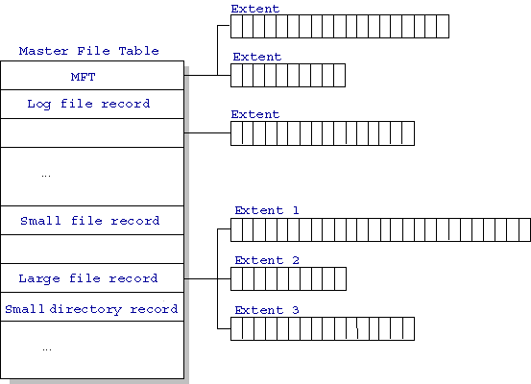
NTFS Master File Table

Slide 17
MFT Record Structure
Entries are 1KB each
Entries contain
  File Attributes
  Location Data

Slide 18
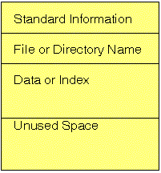
MFT Records
Small Files (<900B) are contained completely in the MFT entry.

Slide 19
MFT Records
Folders contain index data.
Small folders reside within the MFT record
Larger folders have an index structure to other data blocks. They use a B-tree structure.

Slide 20
MFT Record
Each MFT record is addressed by a 48 bit MFT entry value.
  First entry has address 0.
Each MFT entry has a 16 bit sequence number that is incremented when the entry is allocated.
MFT entry value and sequence number combined yield 64b file reference address.

Slide 21
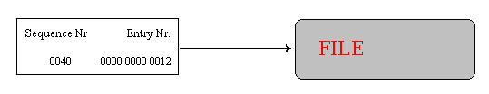
MFT Record
NTFS uses the file reference address to refer to MTF entries.
  When the system crashes during allocation, then the sequence number describes whether the MTF entry belonged to the previous file or to the current one.

Slide 22
MFT Record
MFT entry attributes are loosely defined.
Each attribute is preceded by the attribute header.
The attribute header identifies
  Type of attribute.
  Size.
  Name.

Slide 23
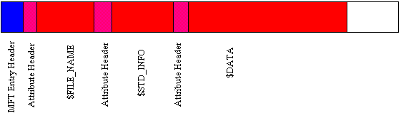
MFT Record Structure
The attribute header gives basic information about the attribute.
A resident attribute is stored in the MFT entry.
A non-resident entry is stored in a cluster outside the MFT.

Slide 24
MFT Record Structure
Resident attributes are stored in MFT record.
Non-resident attributes are stored in cluster runs.
  Cluster run consists of consecutive clusters and are identified by starting cluster and run length.
  NTFS distinguishes between Virtual Cluster Numbers and Logical Cluster Numbers.
    LCN * (#sectors in cluster) = sector number
    LCN 0 is first cluster in the volume (boot sector).
    VCN 0 refers to the first cluster in a cluster run.

Slide 25
MFT Record Structure
MFT entry header has a fixed structure

Slide 26
MFT Record Structure
0x00 - 0x03: Magic Number: "FILE"
0x04-0x05: Offset to the update sequence.
0x06-0x07: Number of entries in fixup array
0x08-0x0f: $LogFile Sequence Number (LSN)
0x10-0x11: Sequence number
0x12 - 0x13: Hard link count
0x14-0x15: Offset to first attribute

Slide 27
MFT Record Structure
0x16 - 0x17: Flags: 0x01: record in use, 0x02 directory.
0x18-0x1b: Used size of MFT entry
0x1c-0x1f: Allocated size of MFT entry.
0x20-0x27: File reference to the base FILE record
0x28-0x29: Next attribute ID
0x2a-0x2b: (XP) Align to 4B boundary
0x2c-ox2f: (XP) Number of this MFT record
0x30-0x100: Attributes and fixup value

Slide 28
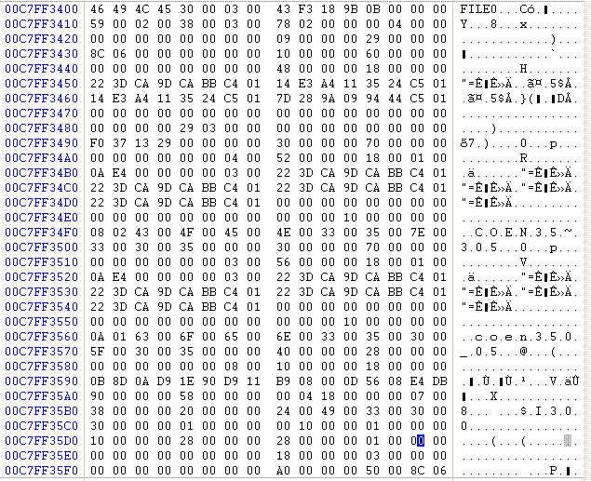
MFT Record Structure
EXAMPLE 1:
  A directory entry

Slide 29
MFT Record
MFT records start with “FILE”. A bad cluster would start with “BAAD”

Slide 30
MFT Record
Bytes 4-5: Offset to update sequence.
Bytes 6-7: Number of entries in fixup array
Bytes 8-f: Log file sequence number
Bytes 0x10-0x11: Sequence number: 59 00

Slide 31
MFT Record
Bytes 0x12-0x13: 2 – hard link count
Bytes 0x14-0x15: Offset to first attribute: 0x 38
Bytes 0x16-0x17: Flags: In use and contains a directory 0x 0001 | 0x 0002

Slide 32
MFT Record
Bytes 0x14 – 0x15: First attribute starts at 0x 38 00 → 0x 00 38

Slide 33
MFT List of possible attributes
Defined in $AttrDef entry of MFT, but default is:
        0x10 STANDARD_INFORMATION
        0x20$ATTRIBUTE_LIST
        0x30$FILE_NAME0
        X40 (NT) $VOLUME_VERSION (2K) $OBJECT_ID
        0x50 $SECURITY_DESCRIPTOR
        0x60$VOLUME_NAME
        0x70 $VOLUME_INFORMATION
        0x80$DATA
        0x90$INDEX_ROOT
        0xA0$INDEX_ALLOCATION
        0xB0$BITMAP
        0xC0 (NT) $SYMBOLIC_LINK, (2K) $REPARSE_POINT
        0xD0$EA_INFORMATION
        0xE0$EA0xF0NT$PROPERTY_SET
        0x100 (2K) $LOGGED_UTILITY_STREAM

Slide 34
MFT Attribute Layout
Attributes can be resident or non-resident.
Beginning is always the same:
  0x00 Attribute Type Identifier
  0x04 Length of Attribute
  0x08 non-resident flag
  0x09 length of name
  0x0a offset to name
  0x0c flags

Slide 35
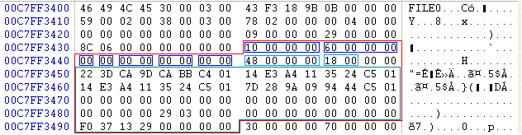
MFT Attribute Example
Attribute is of type 00 00 00 01.
  Standard Information
Attribute is 0x 00 00 00 60 bytes long.
Attribute is resident (0x00)
Contents are 0x 00 00 00 48 bytes long and start at offset 0x 00 18.

Slide 36
MFT Attribute Example
Standard Info Attribute Layout
0x00 | 8 |  | File Creation Time
0x08 | 8 |  | File Alteration Time
0x10 | 8 |  | MFT Change
0x18 | 8 |  | File Read Time
0x20 | 4 |  | DOS File Permissions
0x24 | 4 |  | Maximum number of versions
0x28 | 4 |  | Version number
0x2C | 4 |  | Class ID
0x30 | 4 | 2K | Owner ID

Slide 37
MFT Attribute Example
This allows us to extract the file access times just as for DOS.
Time values are in 100 nanoseconds since January 1, 1601 UTC.

Slide 38
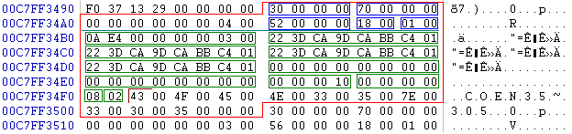
MFT Attribute Example
Second entry has attribute number 00 00 00 03 → 300000.
  $FILE_NAME attribute
Total attribute length is 70 B.
Contents start at offset 18B

Slide 39
MFT Attribute Example
The content layout for the $FILE_NAME attribute is:
      0x00 File reference to parent directory
      0x08 File creation time
      0x10 File modification time
      0x20 File access time
      0x28 Allocated size of file
      0x30 Real size of file
      0x38 Flags
      0x40 File name length in unicode characters
      0x42 File name in unicode

Slide 40
MFT Attribute Example
Obviously, this is a short file name.

Slide 41
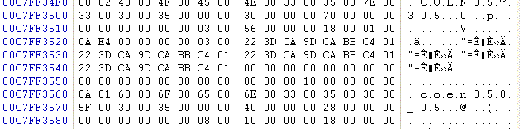
MFT Attribute Example
Third attribute is also a file name, but this time the complete entry

Slide 42
NTFS Versions
File system improves.
Disk Layout changes.

