Slide 1
CSN08101
Digital Forensics
Lecture 8: File Systems
Module Leader: Dr Gordon Russell
Lecturers: Robert Ludwiniak

Slide 2
Objectives
Investigative Process
  Analysis Framework
File Systems
  FAT
  NTFS
  EXT2/EXT3
last week

Slide 3
NTFS

Slide 4
File System: NTFS
Master File table grows, never shrinks
B-tree algorithm used for file tree
  re-“balances” file system tree when tree changes
  creating or deleting a file can cause entire tree to change and can overwrite nodes that were marked as free but still had information in them
Lots of attributes on files, can be confusing (e.g., which access time is the “official” one to use)
  most useful attributes are MAC times
Master File Table (MFT)
  Contains information about all files and directories
  Each has at least one entry in the table

Slide 5
NTFS Features
Logging
Transaction-based
File and folder permissions
Disk quotas
Reparse points (used to link files)
Sparse file support
Compression
Encryption
Alternate data streams

Slide 6
Sparse Files
Clusters that contain all zeros aren’t written to disk
Analysis considerations
  A deleted sparse file is hard to recover
  If file system metadata is deleted or corrupted, a sparse file might not be recoverable

Slide 7
File Compression
Data is broken into equal-sized compression units (e.g. 16 clusters)
An attempt is made to compress each unit
Parts of a file may be compressed while other parts aren’t

Slide 8
File Compression Analysis Considerations
A single file can use different compression methods (e.g. none, sparse, or variant of LZ77)
Recovery tools need to support decompression
A deleted compressed file is hard to recover
If file system metadata is deleted or corrupted, a compressed file might not be recoverable

Slide 9
Encrypting File System (EFS)
Uses both symmetric key encryption (DESX) and asymmetric key encryption (RSA)
Generates a single file encryption key (FEK) and encrypts file with FEK using DESX
Stores FEK with file

Slide 10
File Encryption Key Encryption
FEK is encrypted with user’s public key
FEK is decrypted with user’s private key
If policy allows it, FEK is also encrypted with public key of recovery agent (and decrypted with private key of recovery agent)

Slide 11
EFS Analysis Considerations
By default a user’s private key is stored in the Windows registry, encrypted with login password as key
  Login password is susceptible to brute force attack and private key might be compromised
EFS creates a temporary file (EFS0.TMP) with plaintext data
  Marks it as deleted when finished but doesn’t actually erase contents

Slide 12
Alternate Data Streams
Data added to a file
Introduced to support Macintosh files that have a data and resource fork
Almost impossible to detect with normal file browsing techniques
A favourite of hackers and criminals

Slide 13
File System Metadata Files
Files that store file system administrative data
Do not confuse with file metadata
First 16 MFT entries reserved for files that describe the file system listed in the root directory
Each file begins with ‘$’

Slide 14
File System Metadata Files
Entry | File Name | Description
0 | $MFT | MFT entry
1 | $MFTMirr | Backup of the MFT
2 | $LogFile | Contains journal information for metadata transactions
3 | $Volume | Volume Information: label, identifier, version
4 | $AttrDef | Attribute information: identifier values, name, sizes
5 | . | Root directory of the files system
6 | $Bitmap | Contains allocation status for each cluster
7 | $Boot | Contains the boot code
8 | $BadClus | Contains clusters that have bad sectors

Slide 15
Master File Table
Contains information about all files and directories
Every file and directory has at least one entry in the table
Each entry is simple
  – 1 KB in size
  – Entry header is first 42 bytes
  – Remaining bytes store attributes

Slide 16
Resident and Non-Resident Attributes
A resident attribute stores its content in the MFT entry
A non-resident attribute stores its content in external clusters
Non resident attributes are stored in cluster runs
The attribute header gives the starting cluster address and its run length

Slide 17
Data Structure Categories
 | File System | Content | Metadata | File Name | Application
NTFS | $Boot, $Volume, $AttrDef | Clusters, $Bitmap | $MFT, $MFTMirr, $STANDARD_ INFORMATION, $DATA, $ATTRIBUTE_ LIST, $SECURITY_ DESCRIPTOR | $FILE_NAME$IDX_ROOT, $IDX_ ALLOCATION, $BITMAP | Disk Quota, Journal, Change Journal

Slide 18
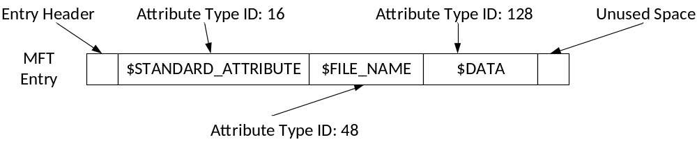
NTFS Record Layout

Slide 19
NTFS Record
Each MFT record is addressed by a 48 bit MFT entry value.
First entry has address 0.
Each MFT entry has a 16 bit sequence number that is incremented when the entry is allocated.
MFT entry value and sequence number combined yield 64b file reference address.

Slide 20
NTFS Record
MFT entry attributes are loosely defined
Each attribute is preceded by the attribute header
The attribute header identifies
  Type of attribute
  Size
  Name

Slide 21
MFT Record Structure
0x00-0x03: Magic Number: "FILE"
0x04-0x05: Offset to the update sequence.
0x06-0x07: Number of entries in fixup array
0x08-0x0f: $LogFile Sequence Number (LSN)
0x10-0x11: Sequence number
0x12-0x13: Hard link count
0x14-0x15: Offset to first attribute

Slide 22
MFT Record Structure
0x16-0x17: Flags: 0x01 record in use, 0x02 directory.
0x18-0x1B: Used size of MFT entry
0x1C-0x1F: Allocated size of MFT entry.
0x20-0x27: File reference to the base FILE record
0x28-0x29: Next attribute ID
0x2A-0x2B: (XP) Align to 4B boundary
0x2C-0x2F: (XP) Number of this MFT record
0x30-0x100: Attributes and fixup value

Slide 23
MFT Attribute Layout
MFT Header is always the same:
  0x00 Attribute Type Identifier
  0x04 Length of Attribute
  0x08 non-resident flag
  0x09 length of name
  0x0a offset to name
  0x0c flags

Slide 24
MFT List of Possible Attributes
Defined in $AttrDef entry of MFT, but default is:
  0x10 $STANDARD_INFORMATION
  0x20 $ATTRIBUTE_LIST
  0x30 $FILE_NAME0
  X40 (NT) $VOLUME_VERSION (2K) $OBJECT_ID
  0x50 $SECURITY_DESCRIPTOR
  0x60 $VOLUME_NAME
  0x70 $VOLUME_INFORMATION
  0x80 $DATA
  0x90 $INDEX_ROOT
  0xA0 $INDEX_ALLOCATION
  0xB0 $BITMAP
  0xC0 (NT) $SYMBOLIC_LINK, (2K) $REPARSE_POINT
  0xD0 $EA_INFORMATION
  0xE0 $EA0xF0NT$PROPERTY_SET
  0x100(2K) $LOGGED_UTILITY_STREAM

Slide 25
MFT Attribute Example
Standard Info Attribute Layout
0x00 | 8 |  | File Creation Time
0x08 | 8 |  | File Alteration Time
0x10 | 8 |  | MFT Change
0x18 | 8 |  | File Read Time
0x20 | 4 |  | DOS File Permissions
0x24 | 4 |  | Maximum number of versions
0x28 | 4 |  | Version number
0x2C | 4 |  | Class ID
0x30 | 4 | 2K | Owner ID

Slide 26
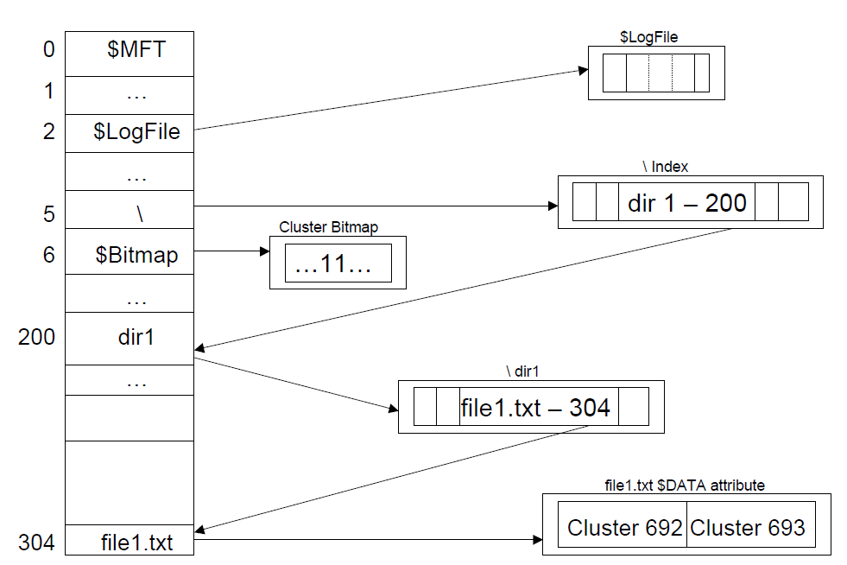

Slide 27
Creating File
Read volume boot sector to locate MFT.
Read first entry in MFT to determine layout of MFT.
Allocate an MFT entry for the new file.
Initialize MFT entry with $STANDARD_INFORMATION, etc.
Check MFT $Bitmap to find free clusters, using best-fit algorithm.
Set corresponding $Bitmap bits to 1.
Write file content to clusters and update $DATA attribute with starting address of cluster run and run length.
Read root directory (MFT entry 5), traverse index, and find dir1.
Read $INDEX_ROOT attribute for dir1 and determine where file1.txt should go.
Create new index entry; resort index tree.
Enter steps in $LogFile (as each step is take

Slide 28
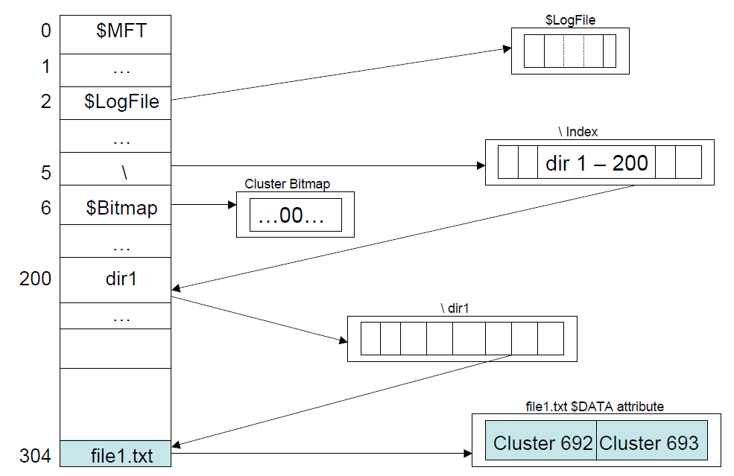

Slide 29
Deleting File
Read volume boot sector to locate MFT.
Read first entry in MFT to determine layout of MFT.
Read root directory (MFT entry 5), traverse index, and find dir1.
Read $INDEX_ROOT for dir1 entry and find file1.txt entry.
Remove filename entry from index; move other entries over.
Set MFT $Bitmap entries to 0.
Enter steps in $LogFile (as each step is taken).

Slide 30
fsstat - display general details of a file system
FILE SYSTEM INFORMATION
--------------------------------------------
File System Type: NTFS
Volume Serial Number: 2A040574040543F3
OEM Name: NTFS
Version: Windows XP
METADATA INFORMATION
--------------------------------------------
First Cluster of MFT: 324570
First Cluster of MFT Mirror: 486856
Size of MFT Entries: 1024 bytes
Size of Index Records: 4096 bytes
Range: 0 - 14519
Root Directory: 5
CONTENT INFORMATION
--------------------------------------------
Sector Size: 512
Cluster Size: 2048
Total Cluster Range: 0 - 973711
Total Sector Range: 0 - 3894847

Slide 31
fsstat (continue)
$AttrDef Attribute Values:
$STANDARD_INFORMATION (16) Size: 48-72 Flags: Resident
$ATTRIBUTE_LIST (32) Size: No Limit Flags: Non-resident
$FILE_NAME (48) Size: 68-578 Flags: Resident,Index
$OBJECT_ID (64) Size: 0-256 Flags: Resident
$SECURITY_DESCRIPTOR (80) Size: No Limit Flags: Non-resident
$VOLUME_NAME (96) Size: 2-256 Flags: Resident
$VOLUME_INFORMATION (112) Size: 12-12 Flags: Resident
$DATA (128) Size: No Limit Flags:
$INDEX_ROOT (144) Size: No Limit Flags: Resident
$INDEX_ALLOCATION (160) Size: No Limit Flags: Non-resident
$BITMAP (176) Size: No Limit Flags: Non-resident
$REPARSE_POINT (192) Size: 0-16384 Flags: Non-resident
$EA_INFORMATION (208) Size: 8-8 Flags: Resident
$EA (224) Size: 0-65536 Flags:
$LOGGED_UTILITY_STREAM (256) Size: 0-65536 Flags: Non-resident

Slide 32
fls - list file and directory names
r/r 4-128-4: $AttrDef
r/r 8-128-2: $BadClus
r/r 8-128-1: $BadClus:$Bad
r/r 6-128-1: $Bitmap
r/r 7-128-1: $Boot
d/d 11-144-4: $Extend
r/r 2-128-1: $LogFile
r/r 0-128-1: $MFT
r/r 1-128-1: $MFTMirr
r/r 9-128-8: $Secure:$SDS
r/r 9-144-11: $Secure:$SDH
r/r 9-144-14: $Secure:$SII
r/r 10-128-1: $UpCase
r/r 3-128-3: $Volume
r/r 6679-128-1: AUTOEXEC.BAT
r/r 3052-128-3: boot.ini
r/r 5505-128-1: CONFIG.SYS
d/d 3058-144-6: Documents and Settings
r/r 3039-128-1: hiberfil.sys
r/r 13377-128-3: hpfr5550.log
r/r 6680-128-1: IO.SYS
r/r 6681-128-1: MSDOS.SYS
r/r 3020-128-3: NTDETECT.COM
r/r 3016-128-3: ntldr
r/r 27-128-1: pagefile.sys
d/d 3457-144-6: Program Files
d/d 12728-144-1: RECYCLER
d/d 7611-144-1: System Volume Information
d/d 28-144-6: WINDOWS
d/d 14519: $OrphanFiles

Slide 33
istat - Display details of a meta-data structure
MFT Entry Header Values:
Entry: 5505 Sequence: 11
$LogFile Sequence Number: 15634044
Allocated File
Links: 1
$STANDARD_INFORMATION Attribute Values:
Flags: Archive
Owner ID: 0
Security ID: 258 ()
Created: Mon Oct 21 16:56:44 2002
File Modified: Mon Oct 21 16:56:44 2002
MFT Modified: Mon Oct 21 16:56:44 2002
Accessed: Mon Oct 21 16:56:44 2002

Slide 34
istat - Display details of a meta-data structure
$FILE_NAME Attribute Values:
Flags: Archive
Name: CONFIG.SYS
Parent MFT Entry: 5 Sequence: 5
Allocated Size: 0 Actual Size: 0
Created: Mon Oct 21 16:56:44 2002
File Modified: Mon Oct 21 16:56:44 2002
MFT Modified: Mon Oct 21 16:56:44 2002
Accessed: Mon Oct 21 16:56:44 2002
Attributes:
Type: $STANDARD_INFORMATION (16-0) Name: N/A Resident size: 72
Type: $FILE_NAME (48-2) Name: N/A Resident size: 86
Type: $DATA (128-1) Name: N/A Resident size: 0

Slide 35
icat - Output the contents of a file based on its inode number
0000000: 4649 4c45 3000 0300 2497 2b02 0000 0000 FILE0...$.+.....
0000010: 0100 0100 3800 0100 9801 0000 0004 0000 ....8...........
0000020: 0000 0000 0000 0000 0600 0000 0000 0000 ................
0000030: f000 0000 0000 0000 1000 0000 6000 0000 ............`...
0000040: 0000 1800 0000 0000 4800 0000 1800 0000 ........H.......
0000050: c08e 3200 e478 c201 c08e 3200 e478 c201 ..2..x....2..x..
0000060: c08e 3200 e478 c201 c08e 3200 e478 c201 ..2..x....2..x..
0000070: 0600 0000 0000 0000 0000 0000 0000 0000 ................
0000080: 0000 0000 0001 0000 0000 0000 0000 0000 ................
0000090: 0000 0000 0000 0000 3000 0000 6800 0000 ........0...h...
00000a0: 0000 1800 0000 0300 4a00 0000 1800 0100 ........J.......
00000b0: 0500 0000 0000 0500 c08e 3200 e478 c201 ..........2..x..
00000c0: c08e 3200 e478 c201 c08e 3200 e478 c201 ..2..x....2..x..
00000d0: c08e 3200 e478 c201 0040 0000 0000 0000 ..2..x...@......
00000e0: 0040 0000 0000 0000 0600 0000 0000 0000 .@..............
00000f0: 0403 2400 4d00 4600 5400 0000 0000 0000 ..$.M.F.T.......
0000100: 8000 0000 4800 0000 0100 4000 0000 0100 ....H.....@.....
0000110: 0000 0000 0000 0000 5f1c 0000 0000 0000 ........_.......
0000120: 4000 0000 0000 0000 0000 e300 0000 0000 @...............
0000130: 00dc e200 0000 0000 00dc e200 0000 0000 ................
0000140: 3260 1cda f304 0080 b000 0000 4800 0000 2`..........H...
0000150: 0100 4000 0000 0500 0000 0000 0000 0000 ..@.............
0000160: 0000 0000 0000 0000 4000 0000 0000 0000 ........@.......
0000170: 0008 0000 0000 0000 1807 0000 0000 0000 ................
0000180: 1807 0000 0000 0000 3101 d9f3 0400 0000 ........1.......
0000190: ffff ffff 0000 0000 006c 0000 0000 0000 .........l......
00001a0: 006c 0000 0000 0000 3110 daf3 0400 0000 .l......1.......
00001b0: b000 0000 4800 0000 0100 4000 0000 0500 ....H.....@.....
00001c0: 0000 0000 0000 0000 0000 0000 0000 0000 ................
00001d0: 4000 0000 0000 0000 0008 0000 0000 0000 @...............
00001e0: 0800 0000 0000 0000 0800 0000 0000 0000 ................
00001f0: 3101 d9f3 0400 0000 ffff ffff 0000 f000 1...............

Slide 36
EXT2/EXT3

Slide 37
Introduction
Ext2 and Ext3 are the default Linux file system.
Ext3 is the new version of Ext2 and adds journaling mechanism, but the basic structures are the same.
The metadata is stored throughout the file system, and the metadata which is associated with a file are stored “near” it.

Slide 38
File System Layout
The whole area is divided into several block groups, and block groups contains several blocks.
A block group is used to store file metadata and file content
Block Group 0
Block Group 1
Super Block | Group Descr Table | Block Bitmap | Inode Bitmap | Inode Table | File Data | ... | File Data | Block Bitmap | Inode Bitmap

Slide 39
Metadata Concepts
Superblock:
  The Ext2 superblock is located 1024 bytes from the start of the file system and is 1024 bytes in size. ( The first two sectors are used to store boot code if necessary)
  Back up copies are typically stored in the first file data block of each block group
  It contains basic information of the file system, such as the block size, the total number of blocks, etc.

Slide 40
Metadata Concepts
Block Group Descriptor Table:
  It contains a group descriptor data structure for every block group.
  The group descriptor stores the address of block bitmap and inode bitmap for the block group.
Bitmaps:
  The block bitmap manages the allocation status of the blocks in the group.
  The inode bitmap manages the allocation status of the inodes in the group.

Slide 41
Metadata Concepts
Block Bitmap
Inode Bitmap
Inode Table
Group 0
Super Block
Block Desc Table
Block Bitmap
Inode Bitmap
Inode Table
Group 1
…
Block Bitmap
Inode Bitmap
Inode Table
Group n

Slide 42
Metadata Concepts
Inode Tables:
  Inode table contains the inodes that describes the files in the group
Inodes:
  Each inode corresponds to one file, and it stores file’s primary metadata, such as file’s size, ownership, and temporal information.
  Inode is typically 128 bytes in size and is allocated to each file and directory

Slide 43
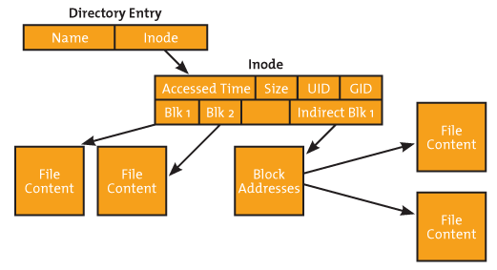
Inode Structure

Slide 44
Metadata Concepts
Inode Allocation:
  If a new inode is for a non-directory file, Ext2 allocates an inode in the same block group as the parent directory.
  If that group has no free inode or block, Ext2 uses a quadratic search (add powers of 2 to the current group)
  If quadratic search fails, Ext2 uses linear search.

Slide 45
Metadata Concepts
Inode Allocation:
  If a new inode is for a directory, Ext2 tries to place it in a group that has not been used much.
  Using total number of free inodes and blocks in the superblock, Ext2 calculates the average free inodes and blocks per group.
  Ext2 searches each of the group and uses the first one whose free inodes and blocks are less than the average.
  If the pervious search fails, the group with the smallest number of directories is used.

Slide 46
Indexing and Directories
An Ext2 is just like a regular file except it has a special type value.
The content of directories is a list of directory entry data structure, which describes file name and inode address.
The length of directory entry varies from 1 to 255 bytes.
There are two fields in the directory entry:
  Name length: the length of the file name
  Record length: the length of this directory entry

Slide 47
Indexing and Directories
Directory entry allocation:
  Ext2 starts at the beginning of the directory and examines each directory entry.
  Calculate the actual record length and compare with the record length field.
  If they are different, Ext2 can insert the new directory entry at the end of the current entry.
  Else, Ext2 appends the new entry to the end of the entry list.

Slide 48
Journaling
A file system journaling records updates to the file system can be recovered after a crash.
There are two modes of journaling:
  Only metadata updates are recorded
  All updates are recorded
Journaling in Ext3 is done at block level
The first block in the journal is journal superblock, and it contains the first logging data address and its sequence number.

Slide 49
Journaling
Updates are done in transactions, and each transaction has a sequence number.
Each transaction starts with a descriptor block that contains the transaction sequence number and a list of what blocks are being updated.
Following the descriptor block are the updated blocks.
When the updates have been written to disk, a commit block is written with the same sequence number.

Slide 50
ANY QUESTIONS ...

