Slide 1








Demo Architecture
networks: Private VPC
networks: PUBLIC AWS
AWS Voice Skill +
AWS Lambda +
CA Rapid App Security
Voice Assistant
“ALEXA”
Policy Server
CA Single Sign-On
CA Mobile
API Gateway
AWS skill
“APIM demo”
CA Advanced Authentication
CA Developer Console
Developers
Auth and Risk Services
Risk Engine
Rules & Policies
Strong Authentication
OAuth HUB

Slide 2
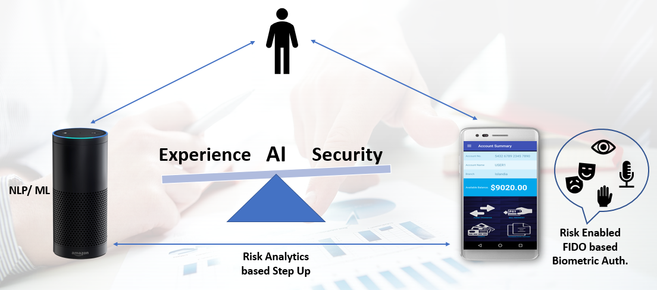

Balancing Experience with Trust…
Business Scenarios
Voice Banking: - Login via echo - check balance via echo. - request transfer fund via echo between accounts in 2 separate banks. - Risk eval on Amt, Device DNA: - If Amt < stepup amt no step up - If Amt > stepup amt voice based FIDO step up via mobile app on mobile device
Voice Ecommerce ( Digital purchase/ Digital Payment): - Look up an item via echo - check price via echo - Request Buy Item(s) via echo - Provide credit card via echo Validate Credit card Risk eval on Amt, Device DNA: - If Amt < stepup amt no step up - If Amt > stepup amt voice based FIDO step up via mobile app on mobile device

Slide 3
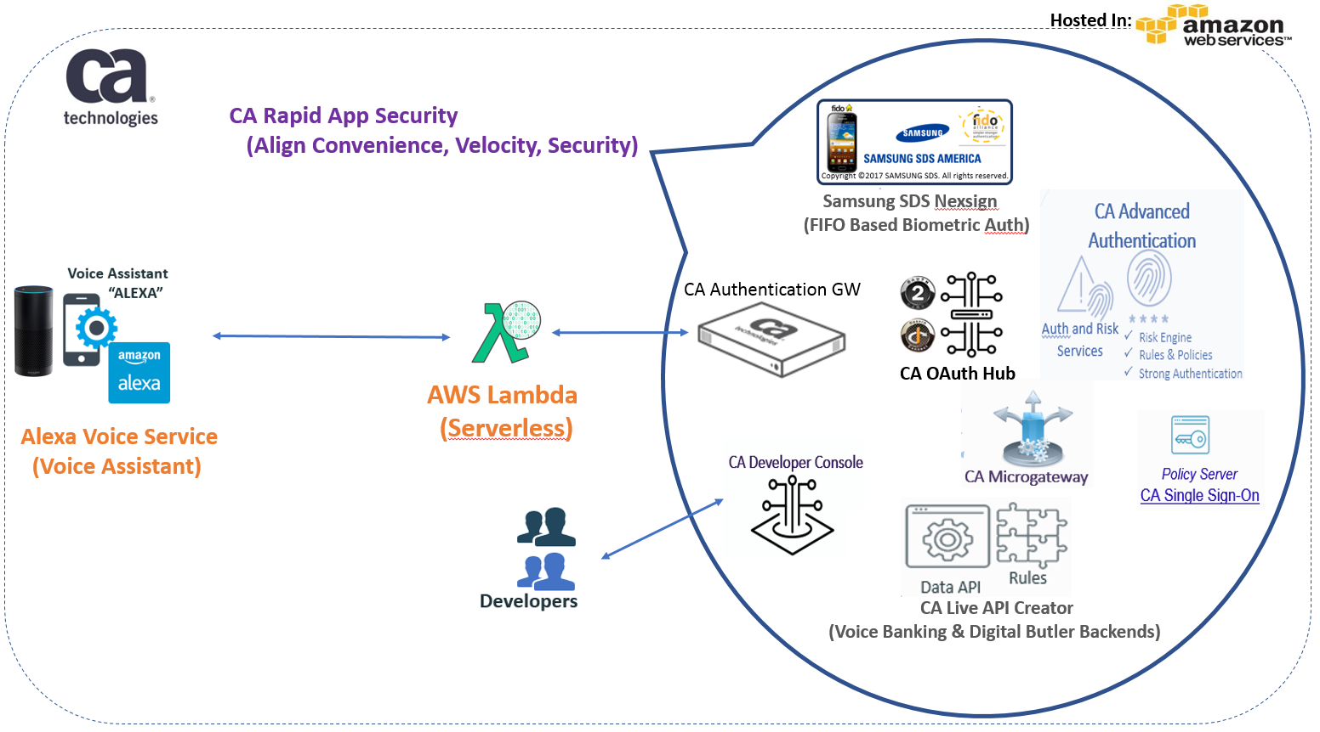
Balancing Experience with Trust…
## Speaking Flow ##
(user) Load voice demo
(avs) Welcome to the CA Alexa demo
---
(user) hello gateway
(avs) Hello from the gateway
Connection is valid
---
(user) request with token
(avs) OAuth token valid (if present)
---
(user) OTP service
(avs) Pin sent
< OR >
Here is the secret resource
---
(user) enter pin {PIN}
(avs) Accepted. Resource ulocked
CA Components

Slide 4
Use Case | Alexa Phrase | Purpose
Connect Alexa to Lambda | Alexa, load voice demo | Initialize
Connect Alexa to APIM | Hello gateway | Connect API through GW
Secure API w/ OAuth (AuthZ) | Request with token | Validate OAuth and user
Issue Twilio OTP | OTP service | MFA requirement service
Submit OTP received | Enter pin {} | Validate Twilio SMS
Close session | Log out | Clear OTP session

