Slide 1

Sentimental Analysis of Mme Bovary blog comments
Ariana ayaviri

Slide 2
Madame Bovary" is a novel written by the French author Gustave Flaubert. The novel was first published in 1857 and is considered one of the greatest works of literature. The full title of the novel is "Madame Bovary: Mœurs de province" (Madame Bovary: Provincial Customs). The story is set in provincial France in the 19th century and follows the life of Emma Bovary, a young woman who marries a country doctor named Charles Bovary.
We will analyse reviews from the website:
https://www.babelio.com/livres/Flaubert-Madame-Bovary/894329/critiques

Slide 3
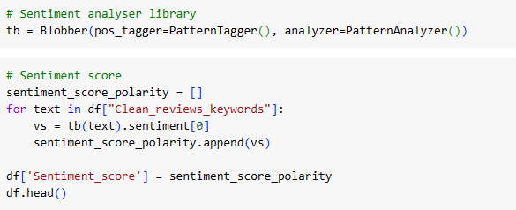
Blobber sentiment Classification analysis

Slide 4
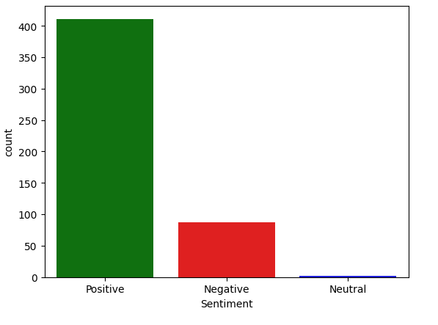
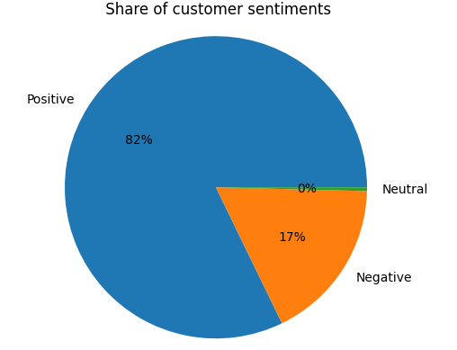
Negative, positive and neutral reviews from Mme Bovary

Slide 5
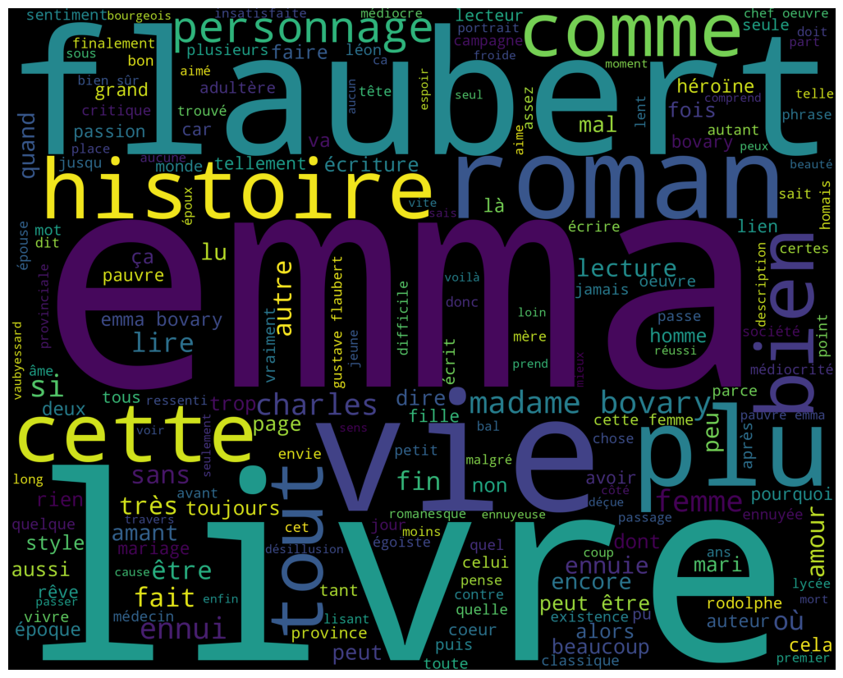
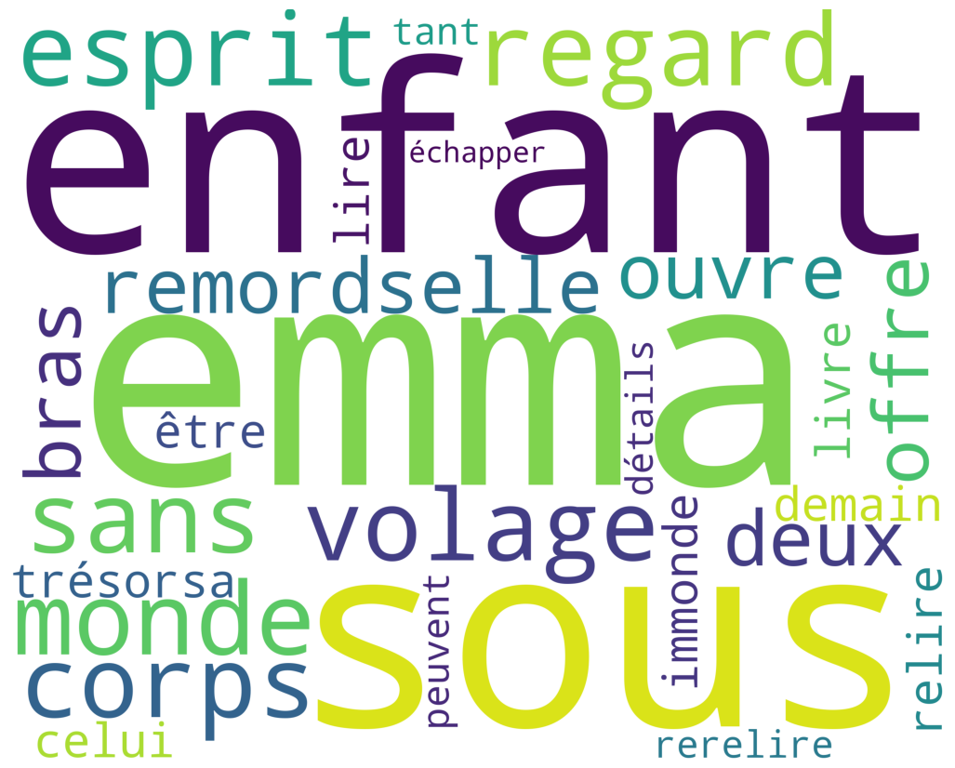
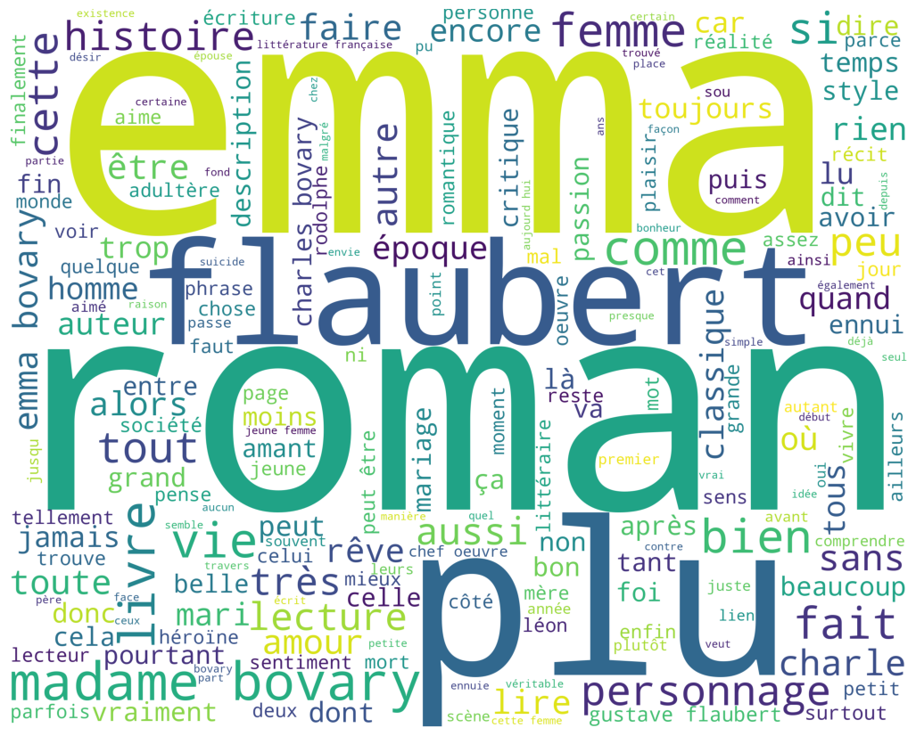
Positive words
Neutral words
Negative words

Slide 6
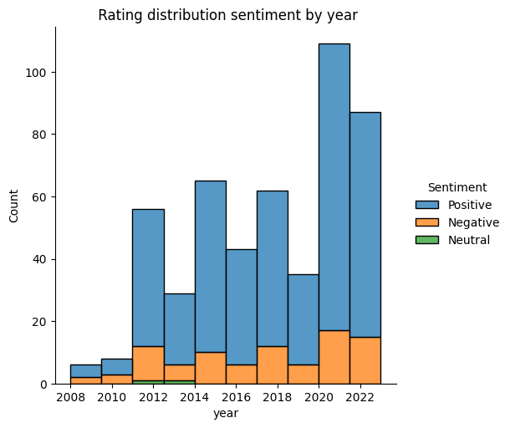
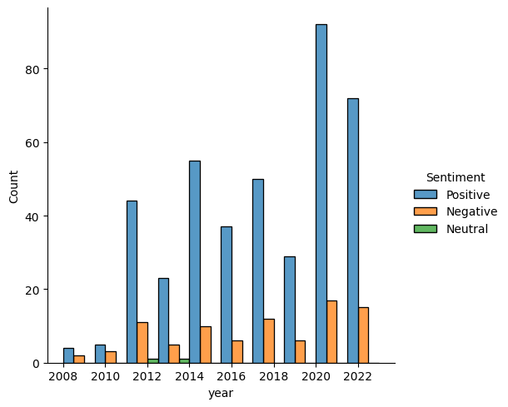

Slide 7
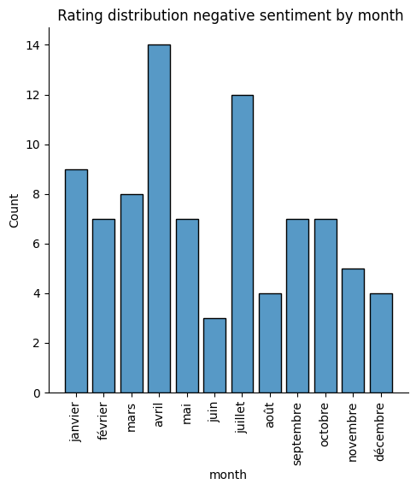
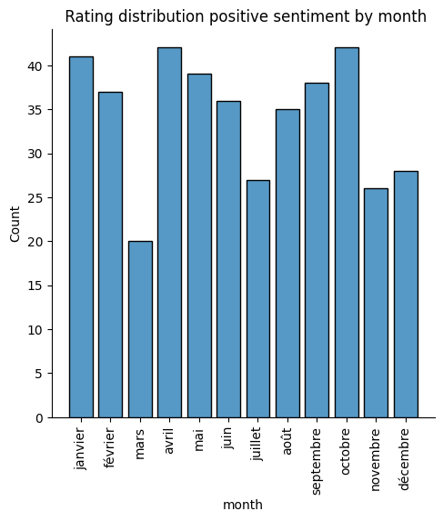

Slide 8
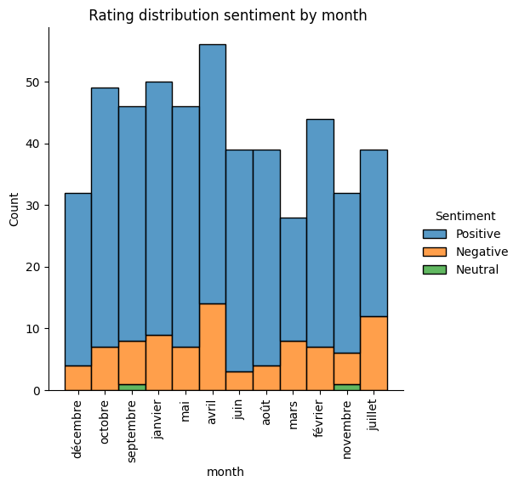
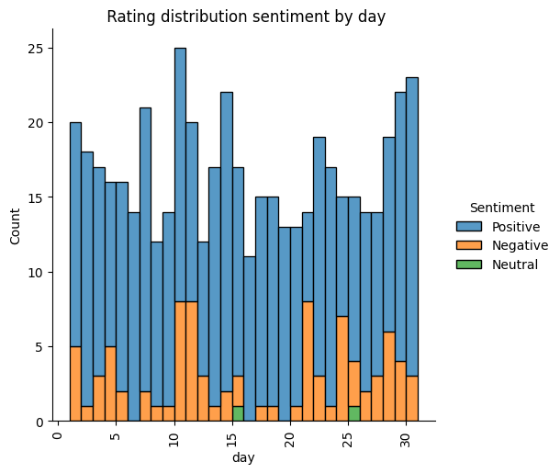

Slide 9
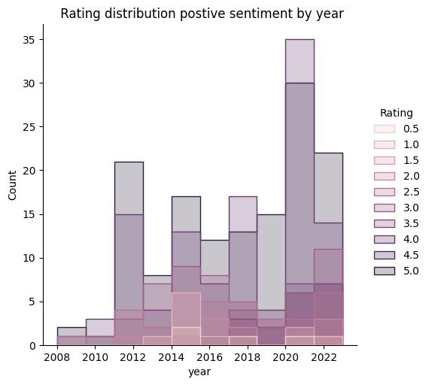

Slide 10
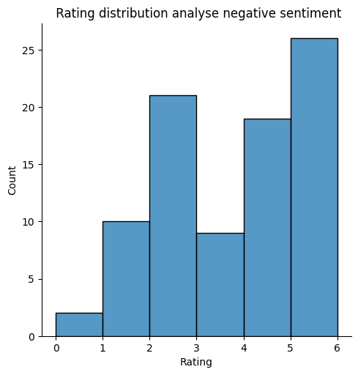
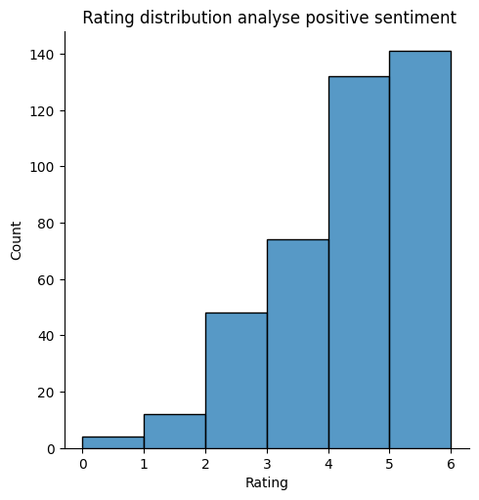

Slide 11
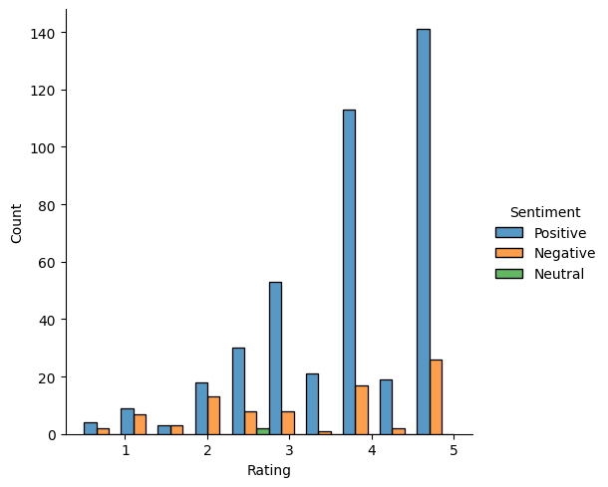
Rating by sentiment

Slide 12
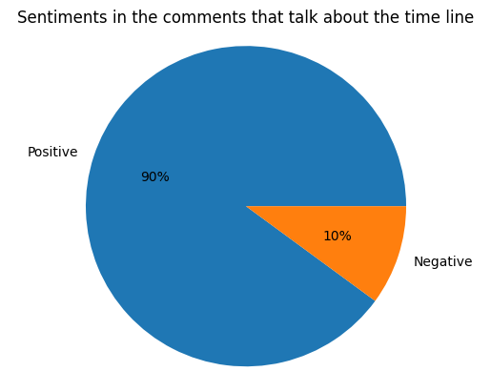
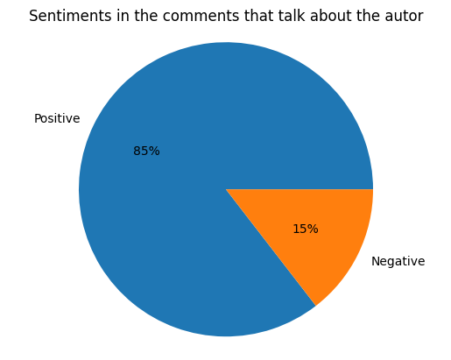
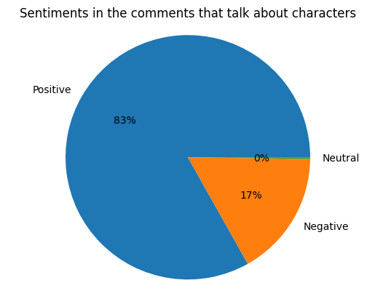
Cathegorize with key words the comments

Slide 13
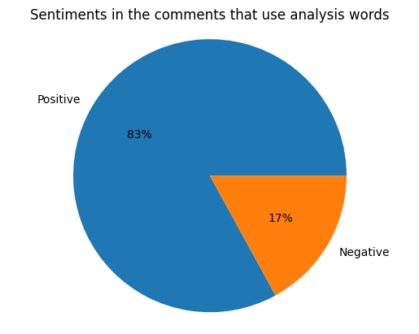
We create a cathegory that makes more Depth análisis with some commun adejctives

Slide 14
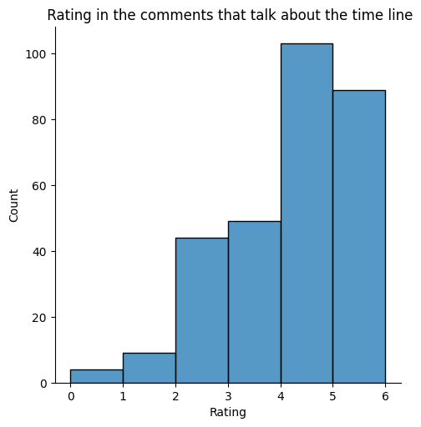
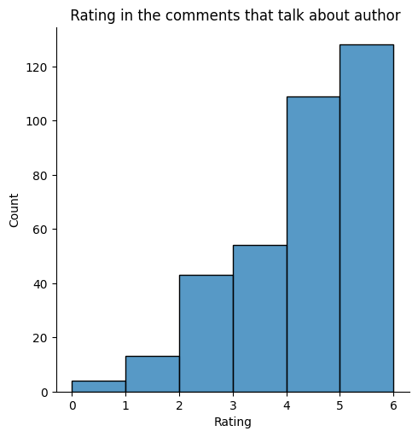

Slide 15
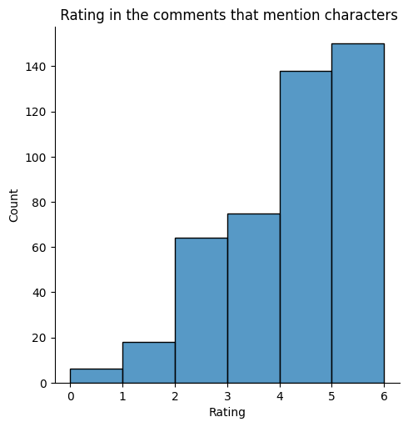
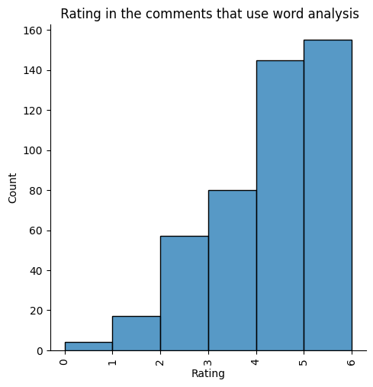

Slide 16
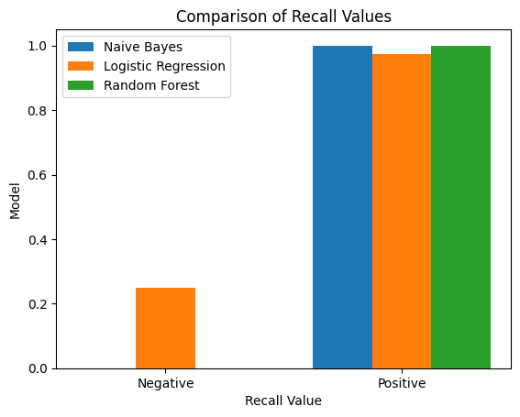
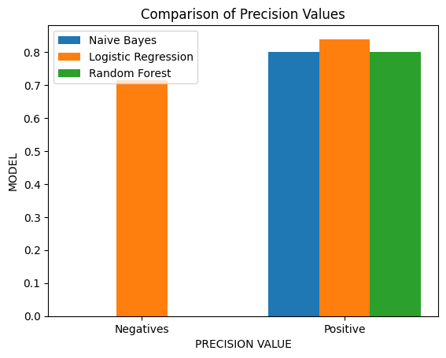
We use Machine Learning to predict sentiment

Slide 17
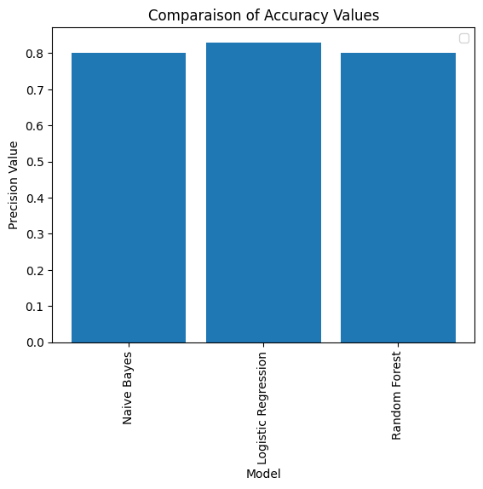

Slide 18
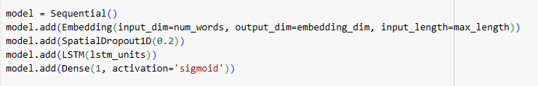
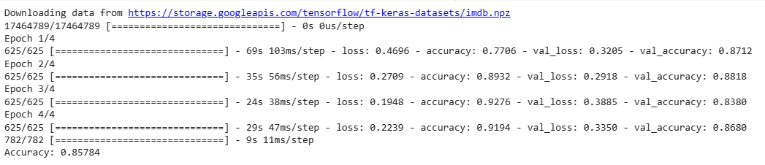
Performing accuracy with LSTM model

