Slide 1

Analysis of Google Play Store Applications
Chad Schaschwary, Aridania Gerardo, Phu Hoang

Slide 2
Stage 1: Analyzing Our Dataset
Our dataset was published on Kaggle
Contains data about 1.1 million applications from the Google Play Store
Strong representation of available apps (around 3.5 million apps altogether)
23 columns of descriptive application data
App name, category, rating, rating count, # of installs, price, developer, last update, etc.

Slide 3
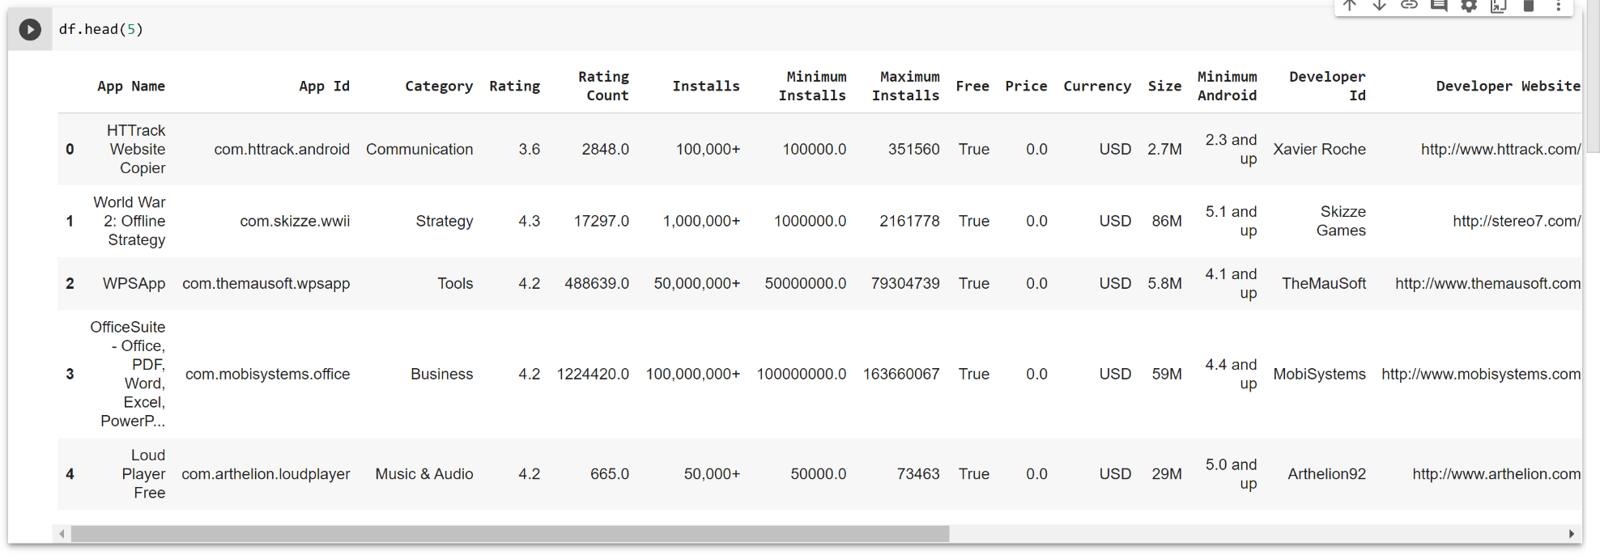
Preview

Slide 4
What we want to know
Goal: We want to understand common characteristics of apps with higher ratings
What strongly influences the rating of an application?
Machine learning: Can we create a model that predicts the rating of an app based on specific features?
Regression analysis
Correlations between two variables
Do free or paid apps receive higher ratings?
Are there specific categories of apps that receive better ratings, on average?
Do applications with more installations get rated more based on whether it being free, ad supported, or an editor’s choice?

Slide 5
Benefits of our research
Understanding consumer preferences can help businesses cater their offerings that meet the needs of end consumers
Helps application developers determine what features are most important prior to release
Predict performance of an application in the marketplace (based on customer perception)

Slide 6

STAGE 2: Cleaning and Data Preparation

Slide 7
Cleaning and Data Preparation
How you get your data?
We acquired our data from a pre - existing dataset from kaggle.com
Google Play Store Apps | Kaggle
How you clean your data?
We used pandas data manipulation package to clean up the data. First by removing duplicates. Second by deleting unnecessary categories of data. Lastly by dropping series with values of NaN. From that data, we used a finite range of data to accommodate to unexpected outliers.

Slide 8
Outside Resources to Support Data
No outside datasets were needed or used to support our dataset and our research questions.

Slide 9

STAGE 3: Exploring the Data

Slide 10
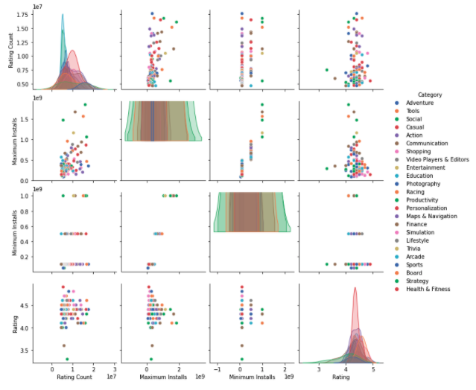
Descriptive analysis:What strongly influences the rating of an application?
Figure 1. Correlation Matrix of Top 100 Rating Count - Rating Count,Maximum Installs,Minimum Installs, and Rating

Slide 11
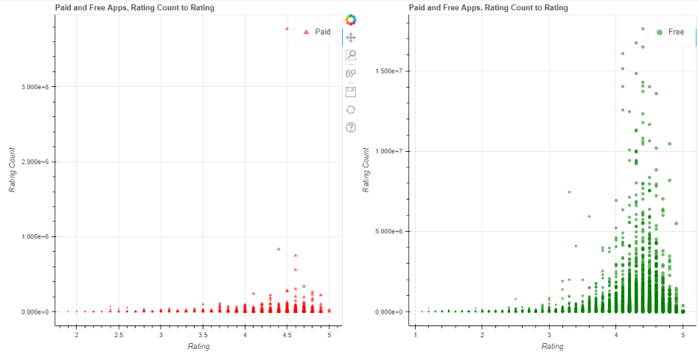
Do free or paid apps receive higher ratings?
Figure 2. Bokeh Scatter Plot of Paid vs Free Apps, Rating Count to Rating

Slide 12
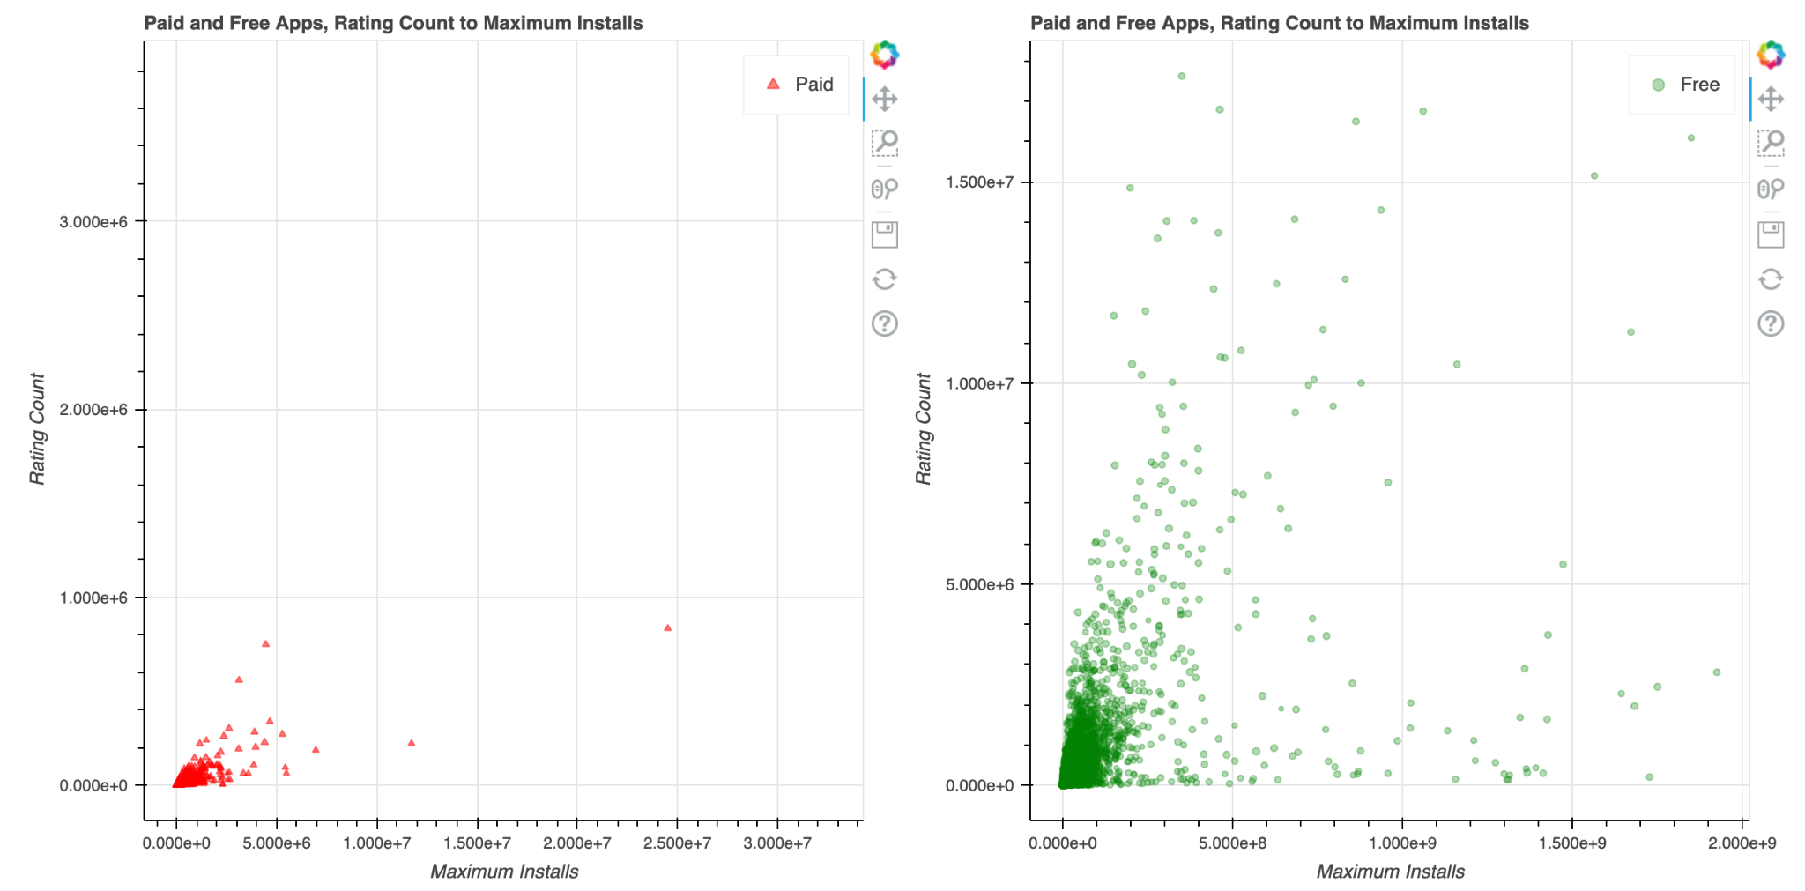
Do applications with more installations get rated more based on whether it being free, ad supported, or an editor’s choice?: Free
Figure 3. Bokeh Scatter Plots of Paid Apps and Free Apps Rating Count to Maximum Installs

Slide 13
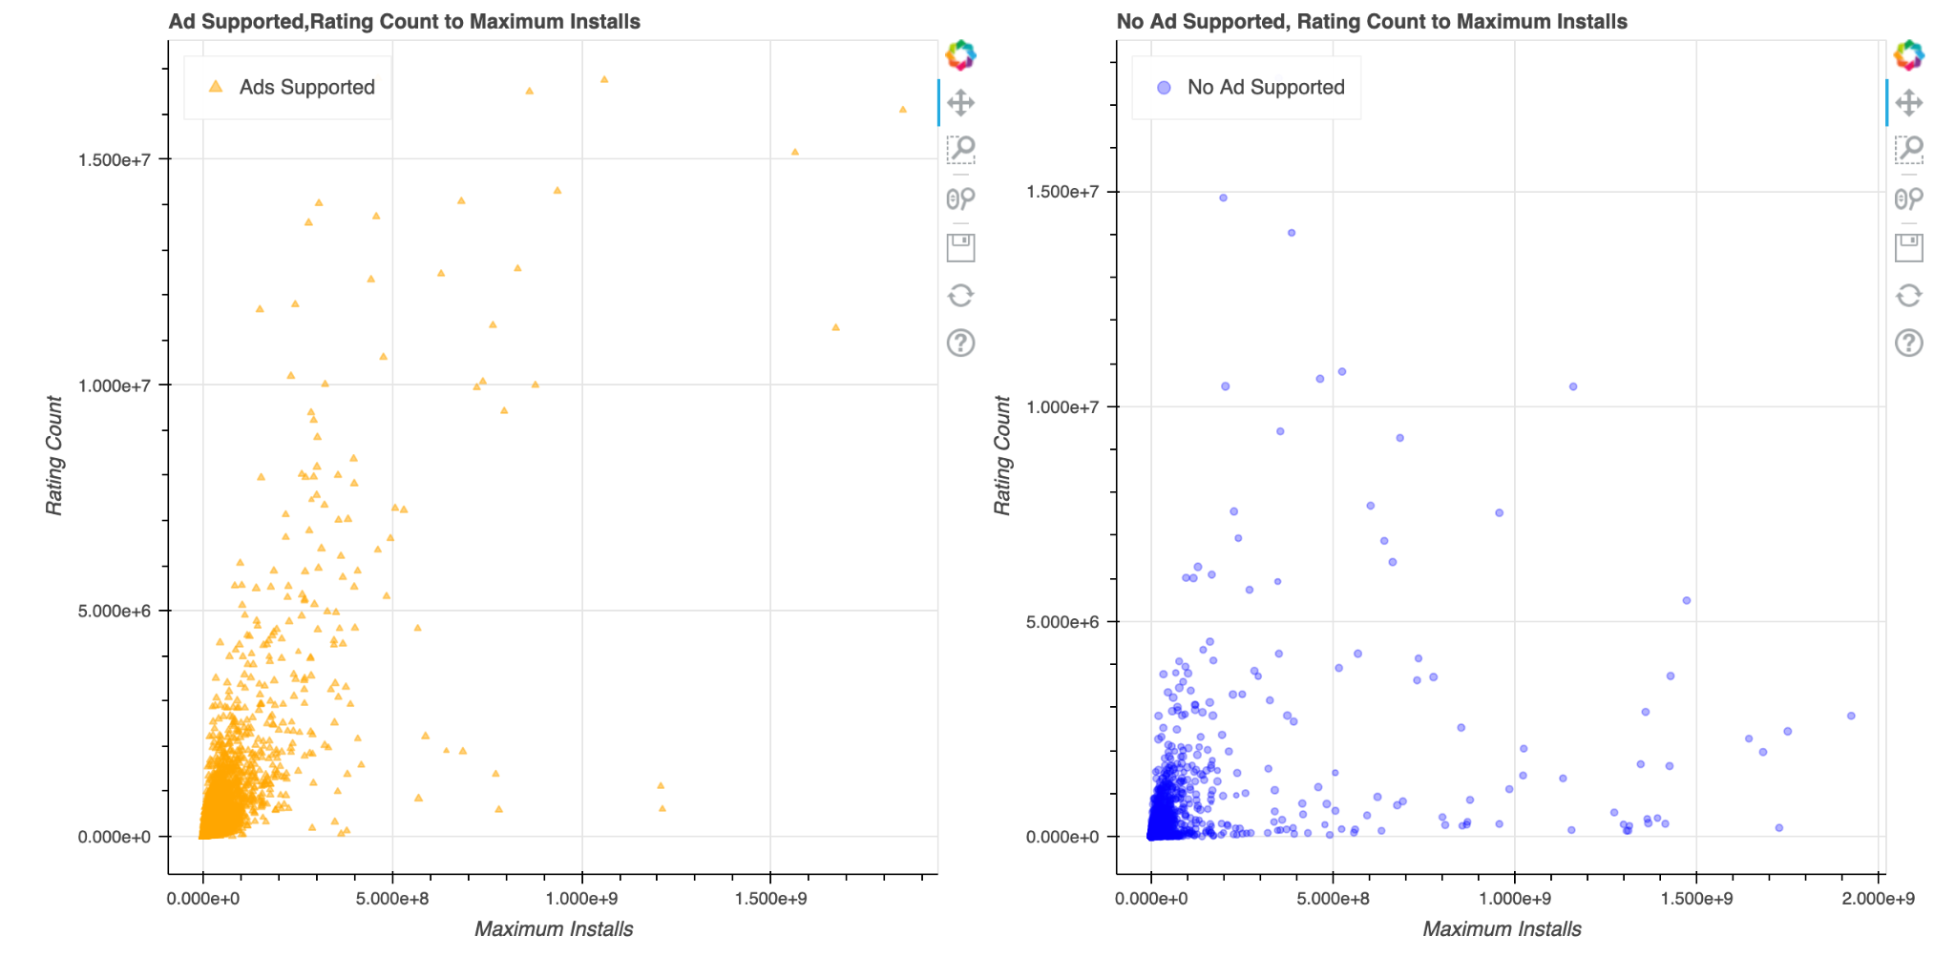
Do applications with more installations get rated more based on whether it being free, ad supported, or an editor’s choice?: Ad Supported
Figure 4. Bokeh Plot of Ads supported Apps Rating Count to Maximum Installs

Slide 14
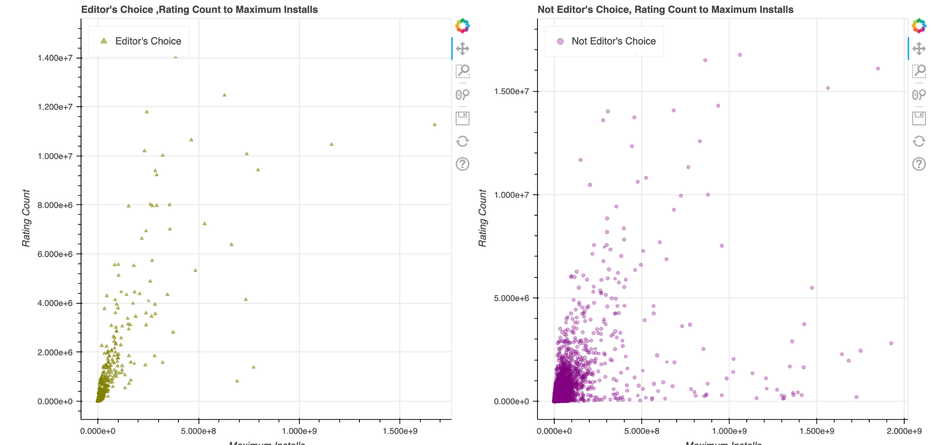
Do applications with more installations get rated more based on whether it being free, ad supported, or an editor’s choice?: Editor’s Choice
Figure 5. Bokeh Plot of Editor's Choice Apps Rating Count to Maximum Installs

Slide 15
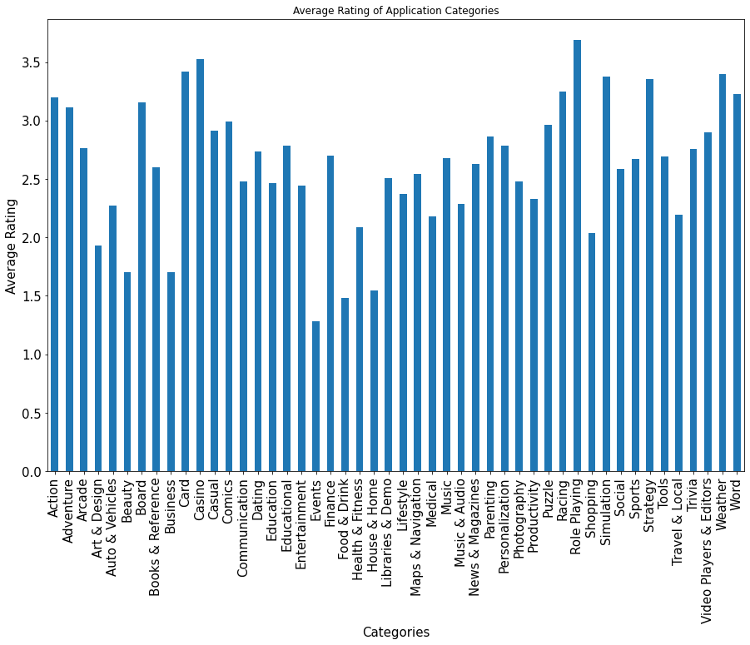
Are there specific categories of apps that receive better ratings, on average?
Figure 6. Average Rating of Application Categories

Slide 16
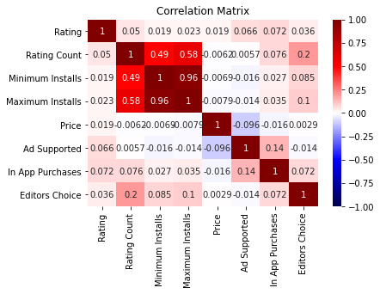
Figure 7. Correlation Matrix

Slide 17
Machine Learning Model
Used K Nearest Neighbor Machine learning to predict if certain data features could identify the type of category it belongs to.
Chose this ML method because the data appears to be non-linear which KNN supports.
We split the training/testing size to a ratio of 80/20 and 70/30.
We also used logistic regression to see if there was a trend of any kind. The LR returned an accuracy score of about 7.5 %

Slide 18
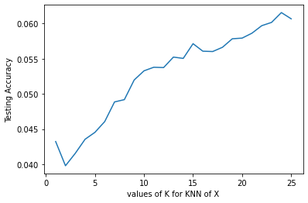

Figure 8: KNN 80/20
Figure 9: KNN 70/30

Slide 19
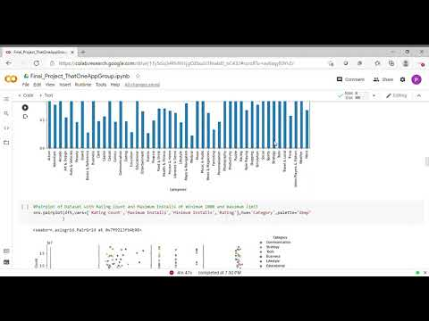
How we used Google Collaboratory

Slide 20
Summary of Current Observations
What strongly influences the rating of an application?
With the current data, nothing suggests a strong influence over the rating of an application
Do applications with more installations get rated more based on whether it being free, ad supported, or an editor’s choice?
It’s difficult to conclude since there is an unequal balance of data for free, ad supported, or editor’s choice
Do free or paid apps receive higher ratings?
Free apps have receive higher ratings in majority than paid apps
Are there specific categories of apps that receive better ratings, on average?
On average, role playing, casino, and card receive better ratings
Can the data predict the type of category?
After some machine learning, we find that the prediction accuracy of the prediction is really low, which indicates random data.

Slide 21
Issues with Dataset
Problems with Data
Large database until it was reduced and more manageable to code
Too many outliers that distort graphs
How to improve dataset for future use
By grouping genre of categories to have a more straightforward graph instead of the subdivided categories
Are there patterns or anomalies?
Patterns and Anomalies:
No patterns
On the Bokeh Scatter Plot of Paid vs Free Apps, it has an anomaly around the 4.5 range on the paid apps chart

Slide 22
Prescriptive analysis
With such a large data that has weak correlations, what can be done is very limited.
This project could be used as reference for future App development.
The project shows some correlation between rating and whether it has In app purchases, Ad Supported, or Editor’s choice. This information may help developers decide whether or not to include these features.
The probable inclusions of features may benefit a developers or an organizations by improving the chances the app would be downloaded and given high ratings.

