Slide 1
MKT 552: Market Basket Analysis Assignment
Aridania Gerardo
7/30/2022

Slide 2
Questions
What products are likely to be bought together?
Consumers buy two products together, which one is the leader and which one is the add-on?

Slide 3
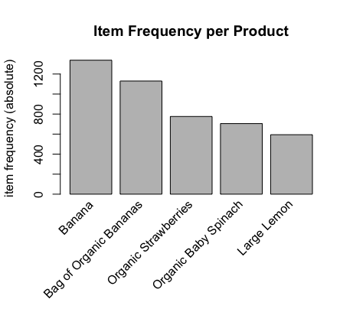
Specific product data
The five most frequent products bought on instacart are Bananas, Bag of Organic Bananas, Organic Strawberries, Organic Baby Spinach, and Large Lemon's.

Slide 4
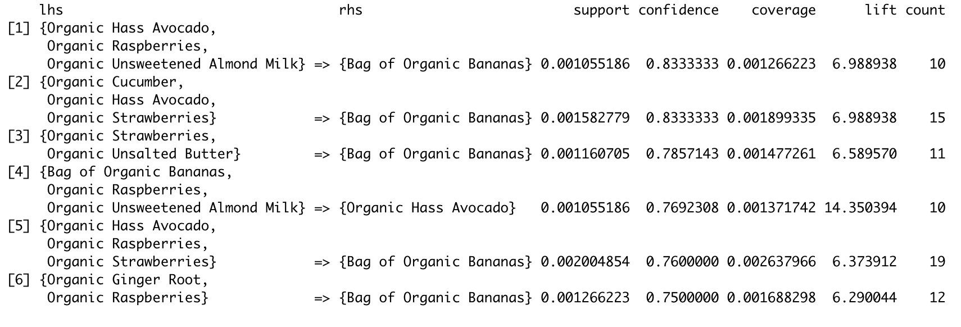
Confidence
Organic Hass Avocado, Organic Raspberries, and Organic Unsweetened Almond Milk are most likely to be purchased with a Bag of Organic Bananas with a confidence level of 0.83.

Slide 5
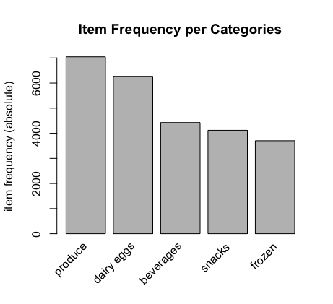
Department data
The top five most popular categories that are bought from are produce, dairy eggs, beverages, snacks, and frozen items.

Slide 6
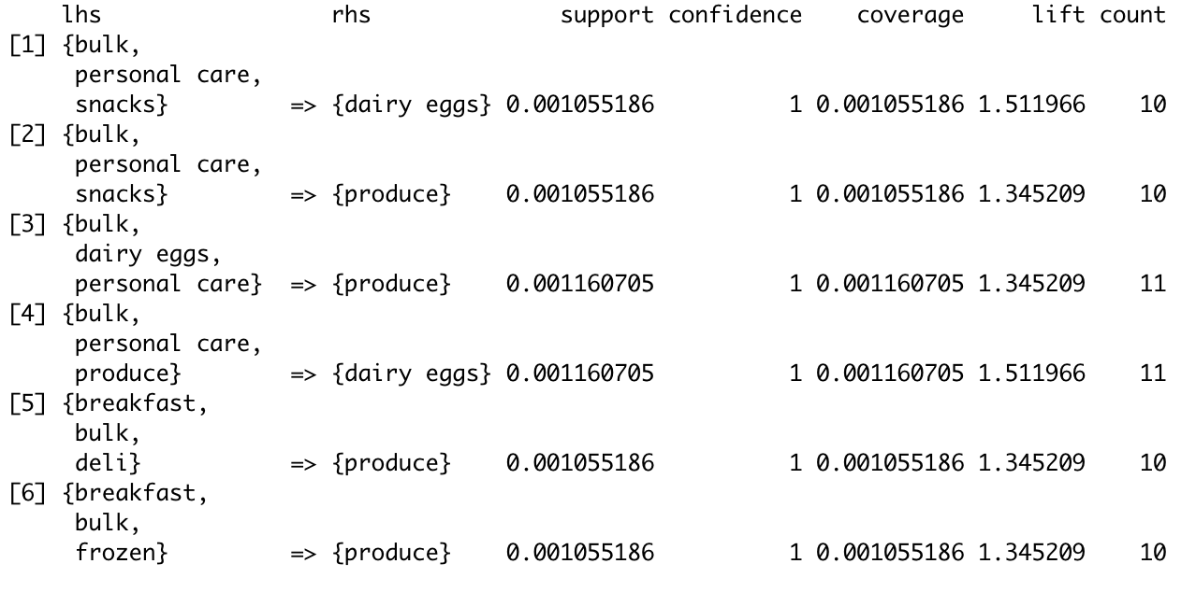
Confidence
Purchase of dairy eggs is associated with bulk, personal care, and snacks. Purchase of produce is associated with bulk, dairy eggs, personal care.

Slide 7
Summary
Items that are likely to be bought together are from the produce department such as dairy eggs and produce with snacks and personal care.
Customers buying items such as snacks and produce should be recommended personal care items.
If consumers buy two products together, the leader of the basket is most likely to be an item from the produce department sand the add-on is most likely to be items that would accompany such as beverages and snacks.
Customers buying products such as produce (eggs, milk, avocados) should be recommended best selling snacks.

