Slide 1
Genome-Wide Association Studies (GWAS) Demo
July 2020
Notes:
In this video, I will first introduce you to Genome-Wide Association (GWAS) and then walk you through an example GWAS study in the Aridhia's workspace.

Slide 2
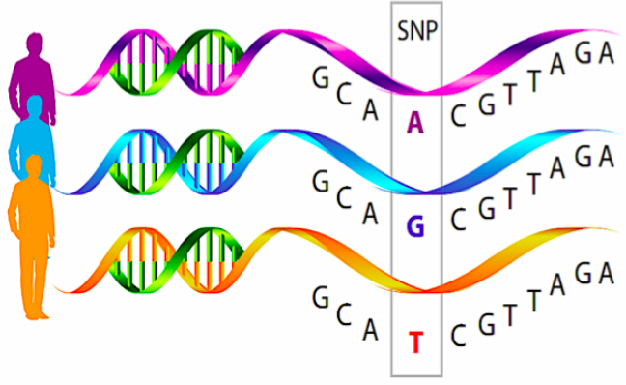
Concepts Underlying GWAS
GWAS is a hypotheses free method for identifying associations between genetic regions and traits or diseases.
Notes:
GWAS is a hypotheses free method for identifying associations between genetic regions and traits or diseases (e.g. height, diabetes, hair color).
GWAS typically searches for small variations in the genome, known as single-nucleotide polymorphisms (SNPs), that occur more frequently in people with a particular disease than in people without the disease. GWAS already has seen success at identifying SNPs related to conditions such as diabetes, Parkinson and Crohn.

Slide 3
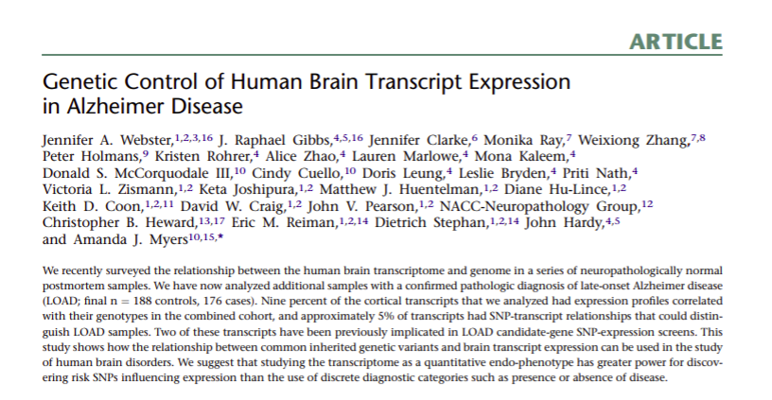
Case Study: Late-Onset Alzheimer's Disease (Webster et al., 2009)
Notes:
For our case study, we will be looking at Late-Onset Alzheimer's disease.
We will use publicly available data from Webster et al. study, which investigated the genetic control of human brain transcript expression in Late-Onset Alzheimer's disease.

Slide 4
Case Study: Late-Onset Alzheimer's Disease (Webster et al., 2009)
Case and control GWAS to identify genetic variants associated with Late-Onset Alzheimer's disease.
Notes:
The paper did multiple types of analysis, but we will only implement a simple case/control GWAS using the data from this study to identify genetic variants associated with Late-Onset Alzheimer's Disease.

Slide 5
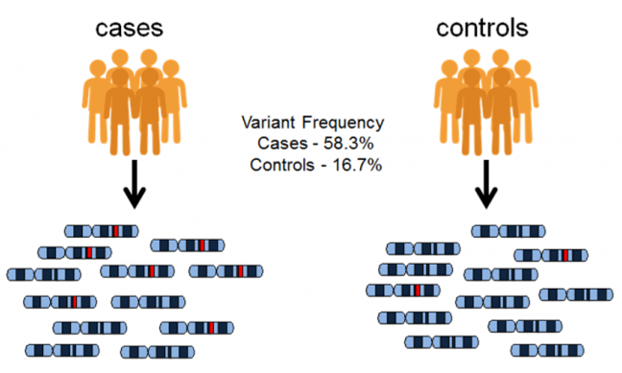
Case and Control Study Design
Notes:
In case/control GWAS study, we typically have two groups of participants: people with the disease being studied, say Alzheimer's, which is our case group, and similar people without the disease, which is our control group.
We simply look at the genomes from both groups, and ask where do they differ? If certain variants are found to be significantly more frequent in people with the disease compared to people without the disease, the variations are said to be associated with the disease.

Slide 6
Case and Control Study Design
Late-Onset Alzheimer's Disease GWAS:
176 cases
188 controls
Notes:
In our Late Onset Alzheimer's Disease study we have 364 people of European descent, of which 176 are cases and 188 are controls.

Slide 7
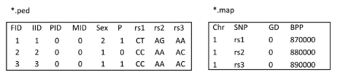
Data
SNP information file
Pedigree and genotype calls
The data is in PLINK text format (*.map, *.ped)
Notes:
The data is in bioinformatics software PLINK text format. The data is composed of two files: *.map file, which contains SNP information such as: chromosome, variant ID, and so on; and *.ped file, which contains sample pedigree information and genotype calls.
The data is already slightly pre-processed: ethnic outliers and samples with gender mismatch removed. As getting a hold of human genome data is extremely difficult if you are not a researcher, we will go with this.

Slide 8
GWAS Workflow in Aridhia Workspace
Quality Control in PLINK+R (VM)
Notes:
The GWAS analysis is composed of three steps:
Data quality control, which will be done on the Linux Virtual Machine

Slide 9
GWAS Workflow in Aridhia Workspace
Quality Control in PLINK+R (VM)
Association testing in PLINK (VM)
Notes:
The GWAS analysis is composed of three steps:
Data quality control, which will be done in PLINK and R on the Linux Virtual Machine
Association testing in PLINK, also done on the VM

Slide 10
GWAS Workflow in Aridhia Workspace
Quality Control in PLINK+R (VM)
Association testing in PLINK (VM)
Visualisation of results in a Shiny app
Notes:
The GWAS analysis is composed of three steps:
Data quality control, which will be done on the Linux Virtual Machine
Association testing, also done on the VM
GWAS Results visualisation in a Shiny app

Slide 11
Conclusions
We have introduced a standard approach to case-control genome-wide association studies.
Finding publicly available human genome data is very difficult if you are not a researcher.
We have also successfully implemented a Late-Onset Alzheimer’s disease case study in the Aridhia's DRE workspace.

Slide 12

info@aridhia.com | @aridhia | www.aridhia.com

