Slide 1
CSH3J3 SISTEM PARALEL DAN TERDISTRIBUSI
MATERI 10: Desain Paralel Programming

Slide 2
Outline Today
Parallel Programming Model
Design parallel program

Slide 3
Design Parallel Program
Understand the problem and program
Partitioning
Communication
Synchronization
Data Dependencies
Load Balancing
Granularity
I/O

Slide 4
Understand the Problem and the Program
Undoubtedly, the first step in developing parallel software is to first understand the problem that you wish to solve in parallel. If you are starting with a serial program, this necessitates understanding the existing code also.
Before spending time in an attempt to develop a parallel solution for a problem, determine whether or not the problem is one that can actually be parallelized.

Slide 5
Easy to parallelize problem
Calculate the potential energy for each of several thousand independent conformations of a molecule. When done, find the minimum energy conformation.
This problem is able to be solved in parallel. Each of the molecular conformations is independently determinable. The calculation of the minimum energy conformation is also a parallelizable problem.

Slide 6
Problem with little-to-no parallelism
Calculation of the Fibonacci series (0,1,1,2,3,5,8,13,21,...) by use of the formula:F(n) = F(n-1) + F(n-2)
The calculation of the F(n) value uses those of both F(n-1) and F(n-2), which must be computed first.

Slide 7
Identify the program's hotspots
Know where most of the real work is being done. The majority of scientific and technical programs usually accomplish most of their work in a few places.
Profilers and performance analysis tools can help here
Focus on parallelizing the hotspots and ignore those sections of the program that account for little CPU usage.

Slide 8
Identify bottlenecks in the program:
Are there areas that are disproportionately slow, or cause parallelizable work to halt or be deferred? For example, I/O is usually something that slows a program down.
May be possible to restructure the program or use a different algorithm to reduce or eliminate unnecessary slow areas

Slide 9
Cont.
Identify inhibitors to parallelism. One common class of inhibitor is data dependence, as demonstrated by the Fibonacci sequence above.
Investigate other algorithms if possible. This may be the single most important consideration when designing a parallel application.
Take advantage of optimized third party parallel software and highly optimized math libraries available from leading vendors (IBM's ESSL, Intel's MKL, AMD's AMCL, etc.)

Slide 10
Partitioning
One of the first steps in designing a parallel program is to break the problem into discrete "chunks" of work that can be distributed to multiple tasks. This is known as decomposition or partitioning.
There are two basic ways to partition computational work among parallel tasks: domain decomposition and functional decomposition.

Slide 11
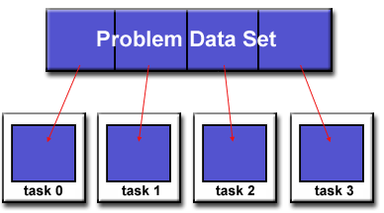
Domain Decomposition
In this type of partitioning, the data associated with a problem is decomposed. Each parallel task then works on a portion of the data.

Slide 12
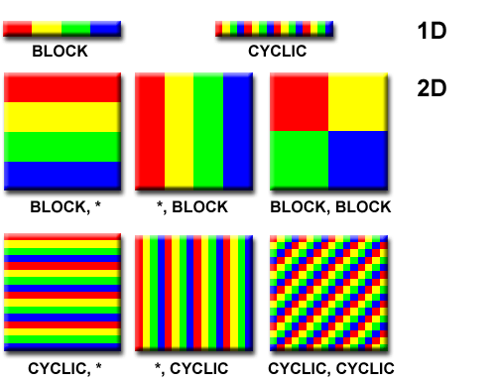
There are different ways to partition data

Slide 13
Functional Decomposition
In this approach, the focus is on the computation that is to be performed rather than on the data manipulated by the computation. The problem is decomposed according to the work that must be done. Each task then performs a portion of the overall work

Slide 14
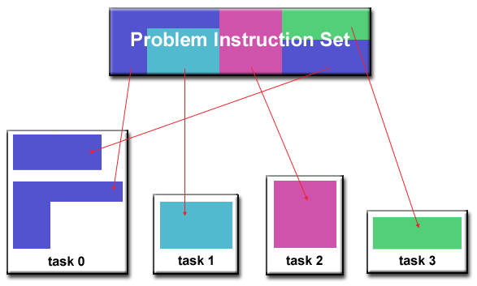

Slide 15
Ecosystem Modeling
Each program calculates the population of a given group, where each group's growth depends on that of its neighbors. As time progresses, each process calculates its current state, then exchanges information with the neighbor populations. All tasks then progress to calculate the state at the next time step.

Slide 16
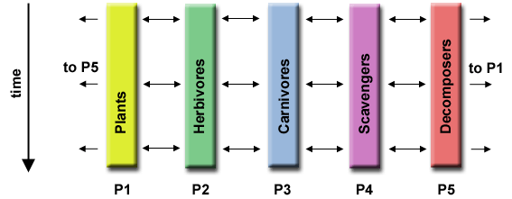

Slide 17
Signal Processing
An audio signal data set is passed through four distinct computational filters. Each filter is a separate process. The first segment of data must pass through the first filter before progressing to the second. When it does, the second segment of data passes through the first filter. By the time the fourth segment of data is in the first filter, all four tasks are busy.

Slide 18
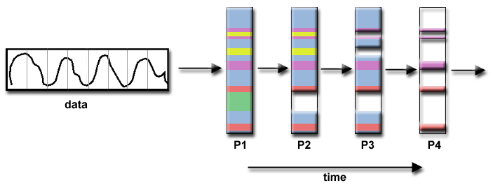

Slide 19
Climate Modeling
Each model component can be thought of as a separate task. Arrows represent exchanges of data between components during computation: the atmosphere model generates wind velocity data that are used by the ocean model, the ocean model generates sea surface temperature data that are used by the atmosphere model, and so on.

Slide 20
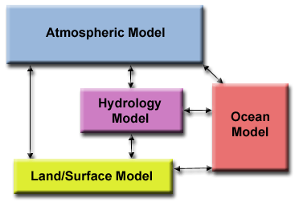

Slide 21
Who Needs Communications?
The need for communications between tasks depends upon your problem:
You DON'T need communications
Some types of problems can be decomposed and executed in parallel with virtually no need for tasks to share data. For example, imagine an image processing operation where every pixel in a black and white image needs to have its color reversed. The image data can easily be distributed to multiple tasks that then act independently of each other to do their portion of the work.
These types of problems are often called embarrassingly parallel because they are so straight-forward. Very little inter-task communication is required.

Slide 22
Cont.
You DO need communicationsMost parallel applications are not quite so simple, and do require tasks to share data with each other. For example, a 3-D heat diffusion problem requires a task to know the temperatures calculated by the tasks that have neighboring data. Changes to neighboring data has a direct effect on that task's data.

Slide 23
Factors to consider when designing program's inter-task communications:
Cost of communications
Latency vs. Bandwidth
Visibility of communications
Synchronous vs. asynchronous communications
Scope of communications
Efficiency of communications
Overhead and Complexity

Slide 24
Cost of communications
Inter-task communication virtually always implies overhead.
Machine cycles and resources that could be used for computation are instead used to package and transmit data.
Communications frequently require some type of synchronization between tasks, which can result in tasks spending time "waiting" instead of doing work.
Competing communication traffic can saturate the available network bandwidth, further aggravating performance problems

Slide 25
Latency vs. Bandwidth
latency is the time it takes to send a minimal (0 byte) message from point A to point B. Commonly expressed as microseconds.
bandwidth is the amount of data that can be communicated per unit of time. Commonly expressed as megabytes/sec or gigabytes/sec.
Sending many small messages can cause latency to dominate communication overheads. Often it is more efficient to package small messages into a larger message, thus increasing the effective communications bandwidth.

Slide 26
Visibility of communications
With the Message Passing Model, communications are explicit and generally quite visible and under the control of the programmer.
With the Data Parallel Model, communications often occur transparently to the programmer, particularly on distributed memory architectures. The programmer may not even be able to know exactly how inter-task communications are being accomplished.

Slide 27
Synchronous vs. asynchronous communications
Synchronous communications require some type of "handshaking" between tasks that are sharing data. This can be explicitly structured in code by the programmer, or it may happen at a lower level unknown to the programmer.
Synchronous communications are often referred to as blocking communications since other work must wait until the communications have completed.
Asynchronous communications allow tasks to transfer data independently from one another. For example, task 1 can prepare and send a message to task 2, and then immediately begin doing other work. When task 2 actually receives the data doesn't matter.
Asynchronous communications are often referred to as non-blocking communications since other work can be done while the communications are taking place.
Interleaving computation with communication is the single greatest benefit for using asynchronous communications.

Slide 28
Scope of communications
Knowing which tasks must communicate with each other is critical during the design stage of a parallel code. Both of the two scopings described below can be implemented synchronously or asynchronously.
Point-to-point - involves two tasks with one task acting as the sender/producer of data, and the other acting as the receiver/consumer.
Collective - involves data sharing between more than two tasks, which are often specified as being members in a common group, or collective. Some common variations (there are more):

Slide 29
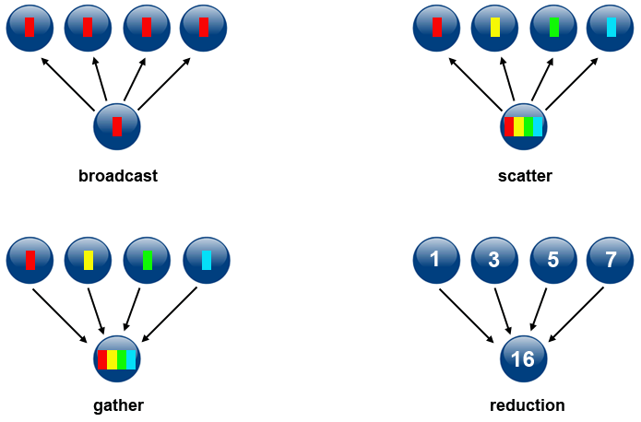

Slide 30
Efficiency of communications
Very often, the programmer will have a choice with regard to factors that can affect communications performance. Only a few are mentioned here.
Which implementation for a given model should be used? Using the Message Passing Model as an example, one MPI implementation may be faster on a given hardware platform than another.
What type of communication operations should be used? As mentioned previously, asynchronous communication operations can improve overall program performance.
Network media - some platforms may offer more than one network for communications. Which one is best?

Slide 31
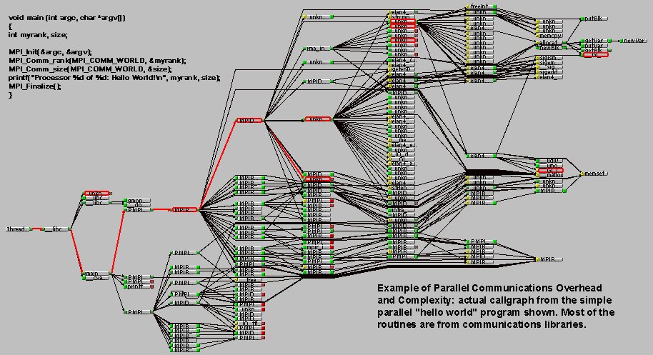
Overhead and Complexity

Slide 32
Synchronization
Managing the sequence of work and the tasks performing it is a critical design consideration for most parallel programs.
Can be a significant factor in program performance (or lack of it)
Often requires "serialization" of segments of the program.

Slide 33
Types of Synchronization
Barrier
Lock / semaphore
Synchronous communication operations

Slide 34
Barrier
Usually implies that all tasks are involved
Each task performs its work until it reaches the barrier. It then stops, or "blocks".
When the last task reaches the barrier, all tasks are synchronized.
What happens from here varies. Often, a serial section of work must be done. In other cases, the tasks are automatically released to continue their work.

Slide 35
Lock / semaphore
Can involve any number of tasks
Typically used to serialize (protect) access to global data or a section of code. Only one task at a time may use (own) the lock / semaphore / flag.
The first task to acquire the lock "sets" it. This task can then safely (serially) access the protected data or code.
Other tasks can attempt to acquire the lock but must wait until the task that owns the lock releases it.
Can be blocking or non-blocking

Slide 36
Synchronous communication operations
Involves only those tasks executing a communication operation
When a task performs a communication operation, some form of coordination is required with the other task(s) participating in the communication. For example, before a task can perform a send operation, it must first receive an acknowledgment from the receiving task that it is OK to send.

Slide 37
Data Dependencies
A dependence exists between program statements when the order of statement execution affects the results of the program.
A data dependence results from multiple use of the same location(s) in storage by different tasks.
Dependencies are important to parallel programming because they are one of the primary inhibitors to parallelism.

Slide 38
Loop carried data dependence
DO 500 J = MYSTART,MYEND
A(J) = A(J-1) * 2.0
500 CONTINUE
The value of A(J-1) must be computed before the value of A(J), therefore A(J) exhibits a data dependency on A(J-1). Parallelism is inhibited.
If Task 2 has A(J) and task 1 has A(J-1), computing the correct value of A(J) necessitates:
Distributed memory architecture - task 2 must obtain the value of A(J-1) from task 1 after task 1 finishes its computation
Shared memory architecture - task 2 must read A(J-1) after task 1 updates it

Slide 39
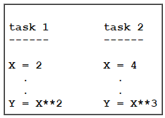
Loop independent data dependence
As with the previous example, parallelism is inhibited. The value of Y is dependent on:
Distributed memory architecture - if or when the value of X is communicated between the tasks.
Shared memory architecture - which task last stores the value of X.
Although all data dependencies are important to identify when designing parallel programs, loop carried dependencies are particularly important since loops are possibly the most common target of parallelization efforts.

Slide 40
How to Handle Data Dependencies
Distributed memory architectures - communicate required data at synchronization points.
Shared memory architectures -synchronize read/write operations between tasks.

Slide 41
Load Balancing
Load balancing refers to the practice of distributing approximately equal amounts of work among tasks so that all tasks are kept busy all of the time. It can be considered a minimization of task idle time.
Load balancing is important to parallel programs for performance reasons. For example, if all tasks are subject to a barrier synchronization point, the slowest task will determine the overall performance.

Slide 42
How to Achieve Load Balance
Equally partition the work each task receives
Use dynamic work assignment

Slide 43
Equally partition the work each task receives
For array/matrix operations where each task performs similar work, evenly distribute the data set among the tasks.
For loop iterations where the work done in each iteration is similar, evenly distribute the iterations across the tasks.
If a heterogeneous mix of machines with varying performance characteristics are being used, be sure to use some type of performance analysis tool to detect any load imbalances. Adjust work accordingly.

Slide 44
Use dynamic work assignment
Certain classes of problems result in load imbalances even if data is evenly distributed among tasks:
Sparse arrays - some tasks will have actual data to work on while others have mostly "zeros".
Adaptive grid methods - some tasks may need to refine their mesh while others don't.
N-body simulations - where some particles may migrate to/from their original task domain to another task's; where the particles owned by some tasks require more work than those owned by other tasks.
When the amount of work each task will perform is intentionally variable, or is unable to be predicted, it may be helpful to use a scheduler - task pool approach. As each task finishes its work, it queues to get a new piece of work.
It may become necessary to design an algorithm which detects and handles load imbalances as they occur dynamically within the code.

Slide 45
Granularity
Computation / Communication Ratio:
In parallel computing, granularity is a qualitative measure of the ratio of computation to communication.
Periods of computation are typically separated from periods of communication by synchronization events.

Slide 46
Fine-grain Parallelism
Relatively small amounts of computational work are done between communication events
Low computation to communication ratio
Facilitates load balancing
Implies high communication overhead and less opportunity for performance enhancement
If granularity is too fine it is possible that the overhead required for communications and synchronization between tasks takes longer than the computation

Slide 47
Coarse-grain Parallelism
Relatively large amounts of computational work are done between communication/synchronization events
High computation to communication ratio
Implies more opportunity for performance increase
Harder to load balance efficiently

Slide 48
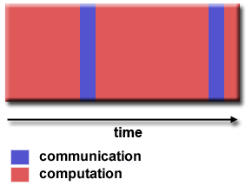
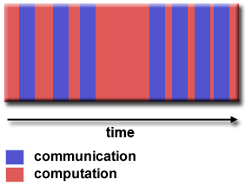

Slide 49
Which is Best?
The most efficient granularity is dependent on the algorithm and the hardware environment in which it runs.
In most cases the overhead associated with communications and synchronization is high relative to execution speed so it is advantageous to have coarse granularity.
Fine-grain parallelism can help reduce overheads due to load imbalance.

Slide 50
I/O The Bad News
I/O operations are generally regarded as inhibitors to parallelism.
I/O operations require orders of magnitude more time than memory operations.
Parallel I/O systems may be immature or not available for all platforms.
In an environment where all tasks see the same file space, write operations can result in file overwriting.
Read operations can be affected by the file server's ability to handle multiple read requests at the same time.
I/O that must be conducted over the network (NFS, non-local) can cause severe bottlenecks and even crash file servers.

Slide 51
I/O The Good News
Parallel file systems are available. For example:GPFS: General Parallel File System (IBM)
Lustre: for Linux clusters (Intel)
OrangeFS: Open source parallel file system follow on to Parallel Virtual File System (PVFS)
PanFS: Panasas ActiveScale File System for Linux clusters (Panasas, Inc.)
And more - see http://en.wikipedia.org/wiki/List_of_file_systems#Distributed_parallel_file_systems

Slide 52
Cont.
Rule #1: Reduce overall I/O as much as possible
If you have access to a parallel file system, use it.
Writing large chunks of data rather than small chunks is usually significantly more efficient.
Fewer, larger files performs better than many small files.
Confine I/O to specific serial portions of the job, and then use parallel communications to distribute data to parallel tasks. For example, Task 1 could read an input file and then communicate required data to other tasks. Likewise, Task 1 could perform write operation after receiving required data from all other tasks.
Aggregate I/O operations across tasks - rather than having many tasks perform I/O, have a subset of tasks perform it.

Slide 53
Parallel Examples: PI Calculation
The value of PI can be calculated in a number of ways. Consider the following method of approximating PI Inscribe a circle in a square:
Randomly generate points in the square
Determine the number of points in the square that are also in the circle
Let r be the number of points in the circle divided by the number of points in the square
PI ~ 4 r
Note that the more points generated, the better the approximation

Slide 54
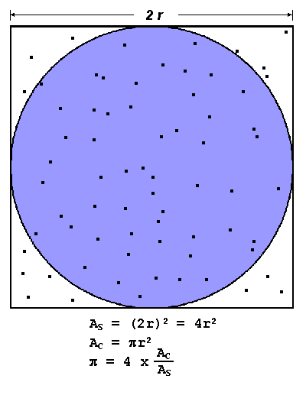

Slide 55
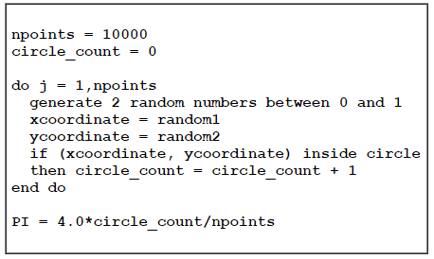
Pseudo code

Slide 56
Design
Is this problem able to be parallelized?
How would the problem be partitioned?
Are communications needed?
Are there any data dependencies?
Are there synchronization needs?
Will load balancing be a concern?

Slide 57
Parallel Solution
Another problem that's easy to parallelize:All point calculations are independent; no data dependencies
Work can be evenly divided; no load balance concerns
No need for communication or synchronization between tasks

Slide 58
Strategy
Divide the loop into equal portions that can be executed by the pool of tasks
Each task independently performs its work
A SPMD model is used
One task acts as the master to collect results and compute the value of PI

Slide 59
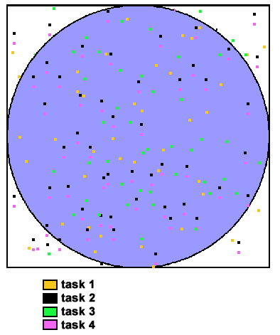

Slide 60
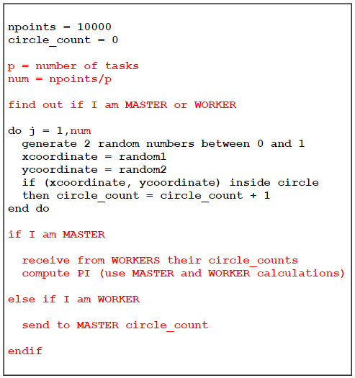

Slide 61
References
Blaise Barney, Lawrence Livermore National Laboratory
https://computing.llnl.gov/tutorials/parallel_comp/

