Slide 1






Introduction to Computer Science for Biologists
Lesson 1 · Why compute, what is computation, how fast, how far — and where AI fits
Dr. Arie Fouren · Faculty of Life Sciences, Bar-Ilan University · 2026–27, Semester A
Notes:
Welcome. This course is for biologists with no CS background. Today is not yet about Python syntax: it frames six questions that the whole course will answer. The six circles on the right are those questions; the same colours tag them throughout the deck.

Slide 2
Six questions this course will answer
Q1
Q2
Q3
Why does computation matter for the life sciences?
What is computation?
What is efficient computation?
Today, and in every lesson
Lessons 1–4: Python, readable code
Lessons 5–7: time, memory, hashing
Q4
Q5
Q6
What are the limits of computation?
How do we use AI tools correctly in computational biology?
Does AI change the limits of computation?
Lesson 13: unsolvable vs. intractable
Lessons 10–12, HW 5: code review
Lesson 13: computation today
Notes:
Write the six questions on the board and leave them there. Ask the class to guess an answer to each now; we will return to them in the last slide and again in lesson 13. The bottom line on each card says where in the course the full answer lives.

Slide 3
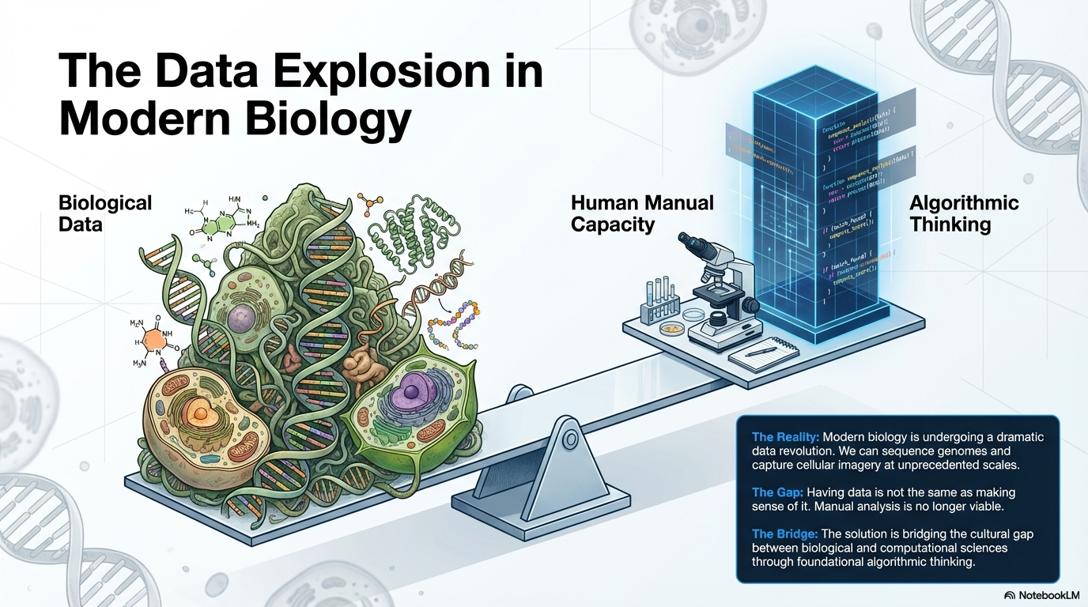
Notes:
Data explosion: the amount of biological data now exceeds what manual analysis can handle. The bridge is algorithmic thinking, not just more tools.

Slide 4
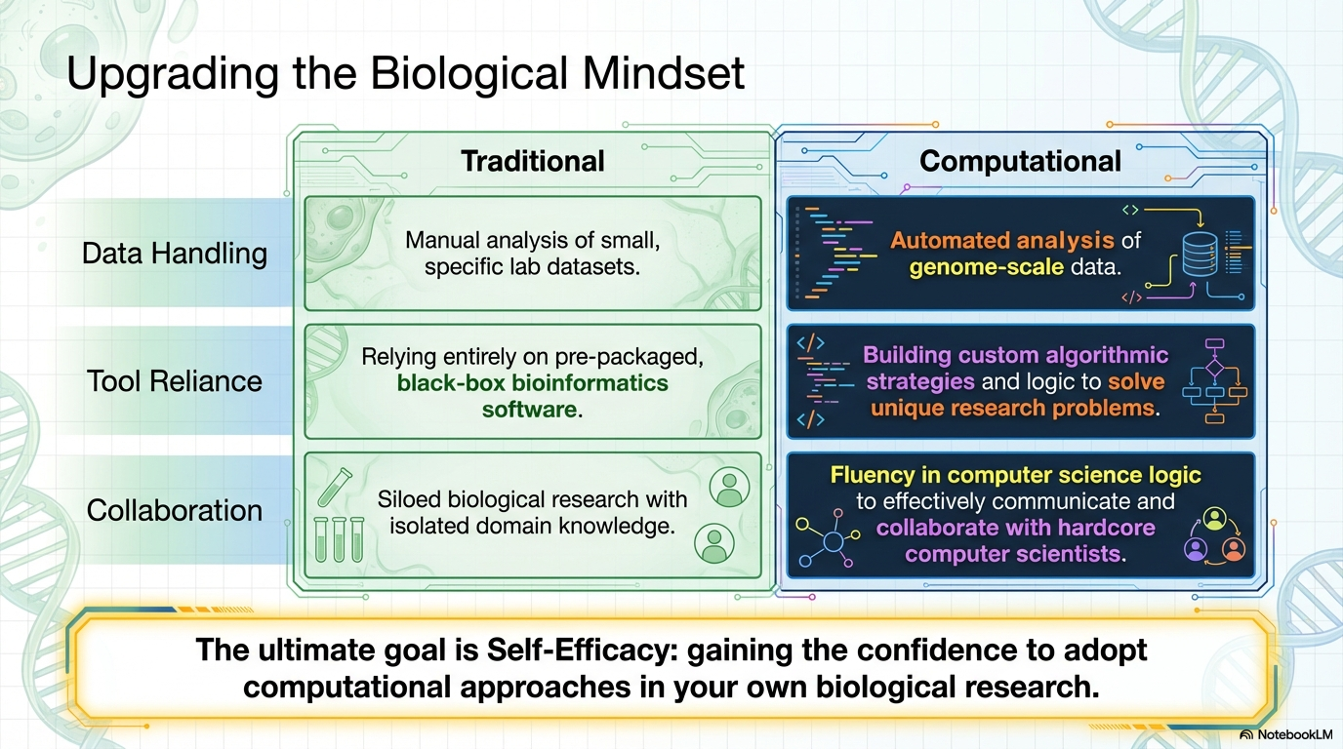
Notes:
From the traditional to the computational mindset: data handling, tool reliance, collaboration. Goal: self-efficacy — the confidence to use computation in your own research.

Slide 5
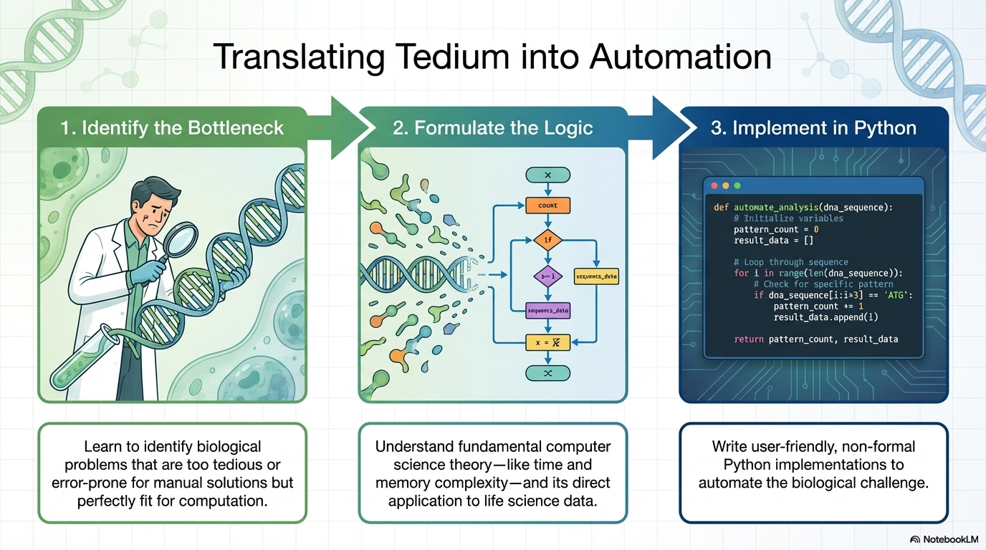
Notes:
The workflow we will practise all semester: identify the bottleneck, formulate the logic (including its time and memory cost), implement in Python.

Slide 6
Biology now produces more data than people can read
Q1 · Why does computation matter?
3.1 billion
> 100,000×
200 million+
letters (A, C, G, T) in one human genome
cheaper to sequence a human genome than in 2001: $100M then, a few hundred dollars now
predicted protein structures in the AlphaFold database
Reading one genome aloud, one letter per second, day and night, would take about 100 years. A short Python loop does it in seconds. The question is no longer whether to compute, but how to think about the computation.
Sources: NHGRI, “The Cost of Sequencing a Human Genome”; EMBL-EBI AlphaFold Protein Structure Database.
Notes:
3.1×10^9 seconds ≈ 98 years — let students do the arithmetic. The cost drop (faster than Moore's law) is why data, not sequencing, is now the bottleneck. AlphaFold DB: >200M predicted structures, released by DeepMind and EMBL-EBI in 2022.

Slide 7
What is computation? Problem → algorithm → program
Q2 · What is computation?
Problem
WHAT we want
def gc_content(dna):
"""%GC in dna (uppercase ACGT)"""
gc = 0
for nuc in dna:
if nuc == "G" or nuc == "C":
gc += 1
return 100 * gc / len(dna)
seq = "TTAGACCAGTAGAAGTAC"
print(gc_content(seq)) # 33.33...
Input: a DNA sequence.
Output: its GC content, in %.
Algorithm
HOW, step by step
Go over the letters, count G and C, divide by the length.
Program
The algorithm, in a language a computer runs
Python code (right).
Notes:
The distinction matters all semester: a problem is a specification (input → desired output); an algorithm is a precise method; a program is one implementation. The example sequence is from M. tuberculosis (as in the textbook): 6 of 18 letters are G/C → 33.33%. Run it live in the intro notebook.

Slide 8

When is a recipe an algorithm?
Q2 · What is computation?
1
2
3
4
Precise
Finite
General
Correct
Every step is unambiguous. “Count the G’s” — not “look for G-rich regions”.
It always stops, after a finite number of steps.
It works for every valid input — not just for today’s sequence.
The output matches the specification — and we check it with tests.
assert gc_content("GGCC") == 100
assert gc_content("ATAT") == 0
gc_content("") # ZeroDivisionError!
An edge case the recipe forgot. Is GC content even defined for an empty sequence? Deciding that is part of specifying the problem — and it is exactly where hidden assumptions (yours or an AI’s) live.
Notes:
Tests make 'correct' concrete: assert states what the code is supposed to do (lesson 2). The empty-string case foreshadows lesson 3 (empty or malformed biological files) and lesson 12 (silent failures in AI-generated code). Ask: what should the function return? None? Raise a clear error?

Slide 9
Efficient computation: same answer, very different cost
Q3 · What is efficient computation?
Task: does any 20-letter stretch appear twice in the human genome? (n ≈ 3 × 10⁹ letters, computer ≈ 10⁹ simple steps per second)
Naive
Hash table
Compare every position with every other position
One pass: put each 20-letter stretch in a table, look up repeats
≈ n² ≈ 9 × 10¹⁸ steps
≈ n ≈ 3 × 10⁹ steps (× a small constant)
≈ 285 years
≈ seconds
Both are correct. Only one is usable. Efficiency is about how the cost grows with the input — this is what “complexity” measures.
Notes:
(3×10^9)^2 = 9×10^18 comparisons; at 10^9 per second that is 9×10^9 s ≈ 285 years. The hash-based method (lesson 6) needs roughly one table operation per position. It pays in memory: the table stores billions of entries — the time/memory trade-off of the next slide.

Slide 10
Efficiency means time and memory, as the input grows
Q3 · What is efficient computation?
Memory is a resource too
One microscope frame: 2048 × 2048 pixels, 16 bits = 8 MB
× 3 channels × 1,000 time points
≈ 25 GB
— more than most laptops’ RAM (lesson 11)
Trade-offs: a hash table spends memory to save time. Choosing an algorithm means weighing both (lessons 5–6).
Notes:
Polynomial curves stay manageable; the exponential 2^n reaches 10^18 by n = 60. Memory example: 2048·2048·2 bytes = 8 MiB per frame; ×3×1000 ≈ 25 GB. Lesson 5 formalises worst-case time and memory complexity and asymptotic bounds; HW 2 measures both in practice.

Slide 11
The limits of computation: two different walls
Q4 · What are the limits of computation?
Unsolvable
Intractable
No algorithm can exist — on any computer, ever.
An algorithm exists, but (as far as we know) every one is far too slow on large inputs.
Example: the halting problem. Decide, for every program and input, whether the program will eventually stop.
Example: the most parsimonious evolutionary tree (NP-hard). The number of possible trees explodes:
We do not even know how to check this for a 10-line program — see the next slide.
Species | Possible unrooted trees
10 | ≈ 2 million
20 | ≈ 2 × 10²⁰
50 | ≈ 3 × 10⁷⁴
Notes:
Unrooted binary trees on n leaves: (2n−5)!! — 2,027,025 for 10 species; 2.2×10^20 for 20; 2.8×10^74 for 50. Checking them one by one is hopeless even at 10^9 per second. Maximum parsimony is NP-hard; in practice we use heuristics that give good, not guaranteed-best, trees. Full treatment: lesson 13 (chapters 10–11).

Slide 12
Will this program stop?
Q4 · What are the limits of computation?
def steps(n):
count = 0
while n != 1:
if n % 2 == 0:
n = n // 2
else:
n = 3 * n + 1
count += 1
return count
n = 6
6 → 3 → 10 → 5 → 16 → 8 → 4 → 2 → 1. Stops after 8 steps.
n = 27
Climbs as high as 9,232 and stops only after 111 steps.
Every n?
Checked by computer far beyond 10²⁰. No one has proved it always stops.
Turing, 1936: no program can decide, for every program and input, whether it halts. The proof is in lesson 13.
Notes:
The Collatz (3n+1) conjecture: nine lines of Python whose termination nobody can prove. Let students run steps(27) in the notebook. Careful: Collatz is an open problem, not an undecidable one — it is an intuition pump. The undecidability of the general halting problem is a theorem (Turing, 1936).

Slide 13
Using AI tools correctly: you stay the author
Q5 · How to use AI tools correctly?
1
2
3
4
5
Specify
Generate
Read
Test
Own
State input, output and edge cases precisely.
Let the tool draft the code.
Understand every line. Code you cannot read, you cannot check.
assert on known answers, edge cases, bad input; check time and memory.
Fix, document, take responsibility. The tool is not the author.
Typical failures in AI-written biology code — what to look for (lesson 12)
Indexing
Hidden assumptions
Wasted resources
Silent failure
off-by-one; 0-based vs. 1-based genome coordinates
uppercase only, no ‘N’, one sequence per file
n² where n would do; loading everything into memory
empty or malformed FASTA gives a wrong answer, not an error
Notes:
This five-step loop is what HW 5 asks you to document: the prompt (Specify), the initial output (Generate), your fixes (Read/Own), and the tests that prove them (Test). The four failure types are the checklist for the code-review assignment — note that wasting time or memory counts as a defect, not only wrong answers.

Slide 14

Why we first learn without AI
Q5 · How to use AI tools correctly?
1
2
3
4
5
6
7
8
9
10
11
12
13
Lessons 1–9 · HW 1–4: without AI tools
Lessons 10–13 · HW 5: AI allowed — and expected
You cannot critique code you cannot read.
Every AI-phase submission includes
The prompt you gave the tool
The tool’s first output
The fixes you made
The tests that verify the result
First we build independent reading and writing of code; only then do we use the tools. Understanding the limits of computation is what lets you judge what a tool can and cannot give you.
Responsibility for the code’s correctness is yours alone.
Notes:
This is the course AI policy from the syllabus. The order is deliberate, not a ban for its own sake: lessons 1–9 build the reading skill that lessons 10–13 depend on. The midterm (lesson 9) is written and AI-free — practise accordingly.

Slide 15


Does AI change the limits of computation?
Q6 · Does AI change the limits?
What AI does not change
What AI does change
Unsolvable stays unsolvable. No tool decides halting for every program.
Who writes the code, and how fast a first draft appears.
Hard stays hard. AI may find good answers to NP-hard problems — not guaranteed-best ones, fast.
What is required of you: precise specification, reading, testing, judging cost.
n² stays n². Code written in seconds still runs at its own complexity.
What is practical: learned approximations (e.g., AlphaFold) give useful answers in many real cases — with confidence scores you must check.
AI moves the line of what is practical — not the line of what is possible.
Notes:
This is the thesis of lesson 13. AlphaFold is a good discussion example: it made structure prediction practical for a huge number of proteins, through learning from data, not by making a hard computational problem easy in the worst case. Its per-residue confidence (pLDDT) is exactly the kind of output a scientist must read critically. Ask: what would convince you an AI-written analysis is right?

Slide 16





Course roadmap: 13 lessons
AI tools in use
1
2
3
4
5
6
7
8
9
10
11
12
13
HW 1
HW 2
HW 3
Midterm
HW 4
HW 5
Lessons 1–4
Lesson 5
Lessons 6–7
Lessons 8–10
Lessons 11–12
Lesson 13
Python & readable code
Efficiency
Sequences
Graphs & networks
Images
Limits
variables, control, collections, files, comprehensions
time & memory complexity
hashing, regular expressions, DNA motifs
BFS, shortest paths, network simulation
memory of images, cell counting, code review
unsolvable, NP-hard, computation today
Notes:
The small coloured icons on each module show which of the six questions it mainly answers. Readings: Chor & Rubenstein, chapters 1–11, as listed in the syllabus. The shaded band marks lessons 10–13, where AI tools are part of the work.

Slide 17
Assessment
25%
10%
65–75%
Homework
Midterm
Final exam
5 assignments
HW 1–4 without AI
HW 2: time & memory
HW 5: code review — find errors and wasted resources
Written, lesson 9 (material of lessons 1–8)
Protective: counts only if it helps your grade
No make-up (מועד ב׳) for the midterm
Written, multiple-choice and open questions
75% if it beats your midterm, 65% otherwise
Pass the exam with ≥ 60 and the course with ≥ 60
Notes:
Weights as in the syllabus. The midterm is protective (מגן): if the final exam grade is higher, the exam counts 75% and the midterm drops out.

Slide 18



Course team and resources
Team
When & where
Reading
Lecturer: Dr. Arie Fouren · fourena@biu.ac.il
Office hours: Sunday 19:30–20:30, by appointment
Teaching assistant: Oren Polak (tutorial time to be announced)
Lecture: Sunday 17:00–19:30, Building 902, Room 201
Tutorial: 2 hours weekly
Course site: Lemida (lemida.biu.ac.il)
Main text: Chor & Rubenstein, Computational Thinking for Life Scientists (Cambridge UP) — free with your BIU login
Background: D. Harel, Algorithmics (Open University, Hebrew)
Prerequisites: none
Notes:
Check the TA's name spelling and tutorial slot before class.

Slide 19
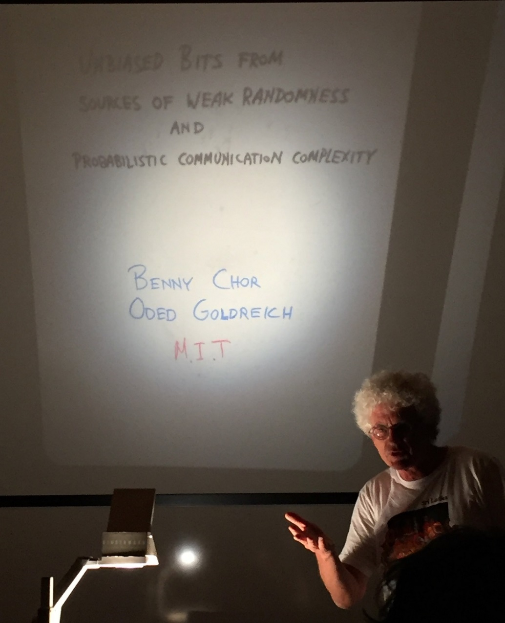
In memory of the textbook’s first author
Ben-Zion “Benny” Chor (1956–2021)
Prof. Chor did seminal work in cryptography, was one of the pioneers of bioinformatics, and a gifted and loved teacher. He served as Head of the School of Computer Science in TAU in the years 2018–2020, previously being a professor at the Technion.
Beyond cryptography, he also made important contributions in distributed shared-memory consensus and in the discovery of patterns in gene expression data.
Notes:
Text kept from the original slide. The course follows his and Amir Rubenstein's book; its approach — algorithmic thinking for biologists, not tool usage — is the spirit of this course.

Slide 20
Up next: your first Python program
Biology needs computation: the data outgrew us.
Computation = precise, finite, general, correct recipes.
Efficiency = how time and memory grow with the input.
Variables, data types, arithmetic and logic, input and output, lists and strings
Some problems are unsolvable; some are hopelessly slow.
AI is a tool you must be able to read and test.
AI changes what is practical, not what is possible.
Notes:
One-line answers to the six questions — the short versions we will earn properly over the semester. Then switch to the notebook and start lesson 1.

