Slide 1
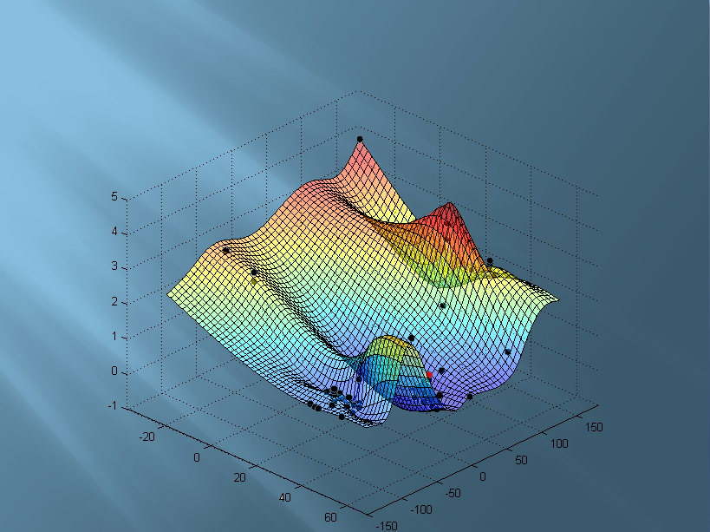
Visualization
of Network Distances
The Computer Communication Lab
Tel-Aviv University
Project Outline – The idea, importance and uses
The basic idea was to implement a tool that would give a visual enhancement to stored data from researches done with DIMES and emphasis the distortion between the real distances and the measured time , the main approach was to show a visual graph for the ratio between network distances and real distances.
Better understanding of network area distances may help in spotting a ‘slow’ area that needs to be fixed or decongested, and spotting a better area, that is preferred to be used for routing through it.
User Interface
At the beginning of the application, the user is asked to choose how to connect and where to connect to the DIMES DB
The user is also given extra information regarding how to manipulate the information coming back from the DB, and how it will be presented.
After all these configurations were set, a confirmation screen will pop and user can review his choices.
The GUI was done using SWT (a Java library)
Project Flowchart
The project will start form a script to run the application (i.e. run the java files)
JAVA module with the GUI offering the user with multiple choice form, and containing all the user configurations to be used by the DB module
DB module ….
Prepare input file for Matlab…
Another script is called, to run the Matlab module with the input file.
Matlab module is divided into 2 parts:
Computational module to compute the real distances and the virtual distances and the derived ratio.
in addition computing a 3D plot based on a few sample points
Visual module to render the 3d plot to the screen based on user preferences.
Visualization
The main issue was to find the best way to show the distortion of network distances.
The visualization is based on showing the ratio between the virtual distance and the real distance, instead of solely showing the virtual distance which gets higher in large distances, and also instead of showing the mathematical difference between them which will show greater difference with greater distances as well.
Computing the graph based on samples to a whole plot is done using the Tpaps formula in Mathlab.
DB and Queries
The code querying the DIMES DB was implemented in Java using MySQL API given as a .jar file distributed in the internet
The Application works with two connection objects, since the schemas containing the tables with data on the experiments reside on a different server then the schema containing the mapping between IP and it’s geo-location (longitude-latitude)
Using smart queries Application code helps the Application to allow the user to have many choices over the queries we run
Specific date
Limit the number of results (or no limit)
Choose between using best, average or worst time
Include specific IPs or use a list of only specific IPs
Exclude specific IPs from the results
Finally the Application writes the data collected to a file, that would be read by the Matlab module. The file is written in a certain way that the Matlab module expects
Reaserch Advisor: Noa Zilberman
Technical assistance: Ido Blutman
Creators: Amir Lazevnik
and Ariel Groenteman

