Slide 1
Ch.3 Communicating, Cooperating Teams
溝通,合作的團隊
Projects need people to notice important event and 注意到重要事情
to be both willing and 願意及能夠溝通此事
able to COMMUNICATE
to others what they notice.

Slide 2
Topics
1. Convection Currents of Information
Compare movement of information
to heat or gas.
2. Jumping Communication Gap
warmer/cooler communication channel;
stickiness of information
3. Teams as Communities
4. Teams as Ecosystems
Each project produces its own unique
ecosystem making methodology design difficult.

Slide 3
1. Convection Currents of Information
資訊的對流
A project’s rate of progress is linked to
專案的進度與溝通
HOW LONG 多長 and
HOW DIFFICULT 多困難
有關
it takes information to get from one person’s mind to another’s.

Slide 4
Delay Cost 耽擱溝通的成本
A programmer costs about
$2.1 per minute.
Suppose 100 questions are asked and answered per week (each just delays 1 minute). Then, it costs $2.1 *100 *1
$210 per person per week.
For a 12-person, 20-week team,
it costs $50,400. ($210 *12 *20)

Slide 5
Lost-Opportunity Cost
不溝通而造成喪失機會的成本
If Pat has to walk upstairs to ask Kim a question, Pat might not do it, and just makes an assumption.
Some percentage of his assumptions will be wrong, and each wrong assumption results in Pat introducing an error into the program. Finding and fixing that error may cost several days.
Pat’s not asking thus represents a
lost-opportunity cost.

Slide 6
Delay cost rises in six cases
耽擱成本增加的六個狀況
1. Kim and Pat pair programs. (least time)
2. They sit at separate workstations, but side-by-side. (Not much time)
3. They work on opposite sides of a room, facing away from each other.
4. They sit in adjacent offices, separated by a wall.
5. They sit on different floors or in adjacent buildings.
6. They sit in different cities, possibly with several time zones between them.

Slide 7
Why Pair Programming?
何以要雙人組開發?
As shown in the six cases above, pair programming is the least cost method of communication.
Thus, to realize one of the XP philosophy:
“communication”, the pair programming practice is developed.

Slide 8
Meme 迷因 vs. Gene 基因
Gene 基因: 遺傳資訊傳承時的單位
Meme 迷因: 文化資訊傳承時的單位
A meme is an idea, behavior, or style that spreads from person to person within a culture. … that can be transmitted from one mind to another through writing, speech, gestures, rituals, … [wiki]

Slide 9
Erg-Seconds 爾格-秒
Memes – the quantity of IDEAS
如：你有多重? 70 Kg. 你有多少ideas? 5 memes
Erg – a unit of work
such as walking up the stairs, making phone call
Second – a unit of time
such as time spent on stairs, or on the phone
Thus, Erg-Second means the cost of asking a question and getting it answered
(cost of movement of memes).

Slide 10
Osmotic Communication
滲透式溝通
While writing, reading, typing, or talking, we pick up traces of the ongoing conversation around us, using some background listening mode even though we are not consciously paying attention.
We register enough about the conversation to ask about it.
This lowers the cost of idea transfer.

Slide 11
Drafts 雜訊
Two programmers enjoyed their shared room but were bothered by their neighbors, who argued loudly with each other. Their room is drafty, in an information sense.
Drafts mean unwanted information in osmotic communication. (story p.83a,b)

Slide 12
Drafty Cubicles
3-1 吵雜的小隔間
有天我在講解資訊流動時，一位聽眾說：你要注意雜訊。
他說：他和同事在矮牆隔開的小隔間工作，彼此可聽到，因而受益。
他們辦公室的另一邊，是客服中心的小隔間，整天在回客戶電話，也因彼此可聽到而受益。但，客服中心的對話，流過隔間到程式師區域，就形成了雜訊。

Slide 13
E-Presence and E-Awareness
3-2 電子輔助現場感
如果人們無法坐在一起，下面的例子就運用科技來模擬現場感。
人們坐在同一大樓的不同部分，人們的電腦上裝有麥克風及網路攝影機，電腦的監視器上開個小視窗，視窗上則顯示其他人的電腦上的網路攝影機的影像。

Slide 14
Information Radiator
資訊放射器 (白板)
An information radiator
displays information in a place
where passersby can see it.
With that, the passersby do not need to ask questions; the information simply hit them as they pass by.資訊會射至路過者
Story p.84,85,86,87,88

Slide 15
Automated Build Report
3-3 自動 Build 報告
有一程式每十五分鐘自動 build 系統，build後，送email給test case 沒過的人，且將 build statistics 貼在某網頁。
越來越多人把此網頁，隨時留在螢幕上，隔一小段時間就按 refresh 鍵，看最新的build 狀況。

Slide 16
Progress Radiator
3-4 進度顯示器
Martin 描述說，測試小組擔心系統的狀況。
為緩和測試師們的顧慮，程式師們在走道上張貼海報來顯示進度(圖3-6)。
圖上顯示各 user stories 在本回合的工作狀況，每個story用一張便利貼。程式師移動便利貼，來顯示story的「完成度」及「品質」。向右移表示完成度增加，向上移表示品質增加。某便利貼可能有段時間不向右移，而一直上移。

Slide 17
Displaying Work Breakdown
3-5 顯示工作細分
團隊為每個user story掛上一張掛圖，在掛圖上貼上便利貼，每個便利貼代表這story需要做的工作。
團隊可能把某些便利貼移到下方，這表示這些工作已移出本次工作回合，以因應交貨期限。

Slide 18
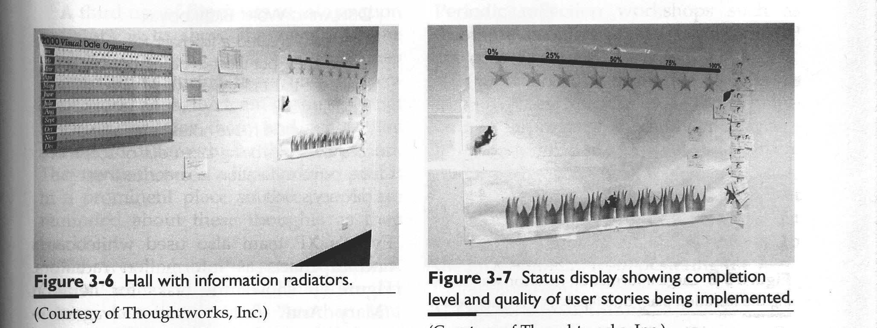
Fig.3-6 3-7

Slide 19
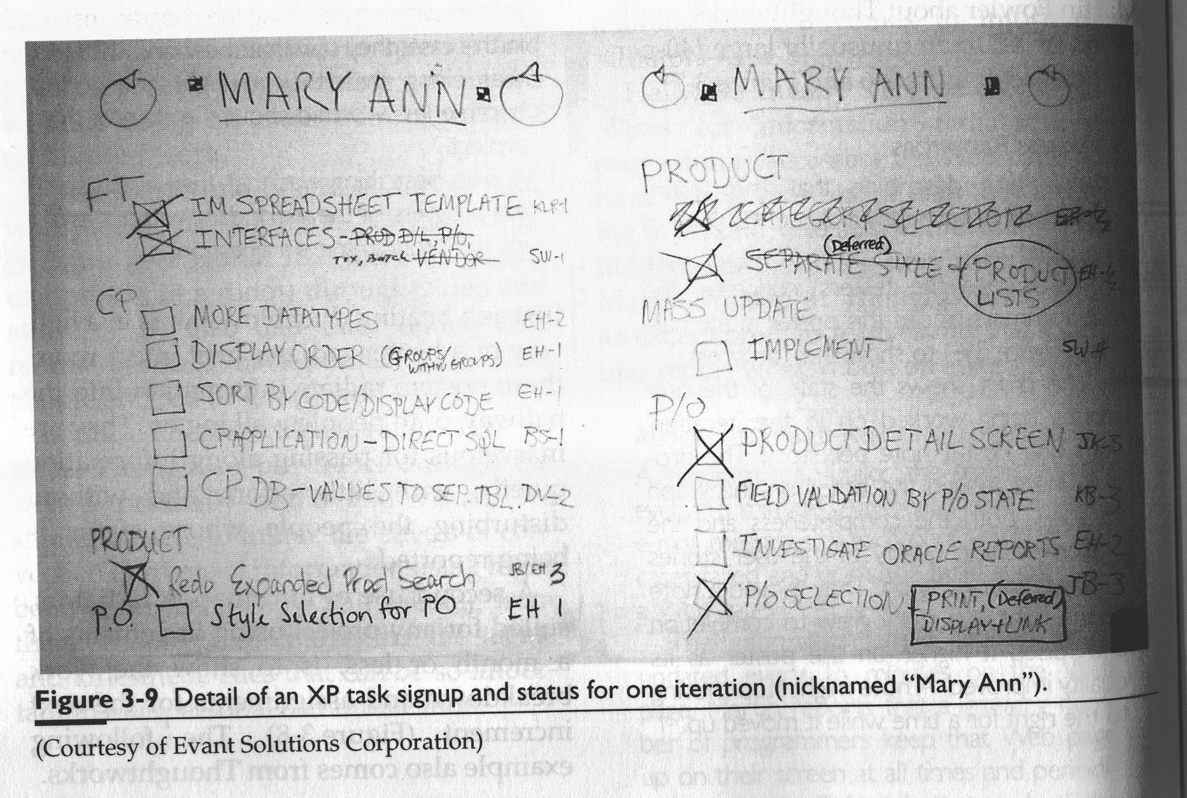
Fig. 3-9

Slide 20
Displaying System Status
3-6 顯示系統狀況
程式師一直在問：「系統A可以嗎？系統B可以嗎？後端連結可以嗎？｣
於是，維修團隊就把各系統及連結的狀況，寫在他們區域外面的白板上，並且每天更新狀況。這看起來很像滑雪場公佈纜車的狀況；這樣子，遊客就不必一直問滑雪場工作人員。

Slide 21
Displaying Work Progress
3-7 顯示工作進度
程式師每隔一兩個小時就會被問工作進度，這造成他們無盡的挫折感。
所以，他們在房間外面的白板上，寫下本週要做的工作。工作經過仔細安排為半天至兩天的份量，當工作完成時，他們在白板標示為完成。
程式師試用白板成功後，其他幾個部門也開始使用白板，來發佈優先序及進度。

Slide 22
Applying the theory of Hot Air
“Hot air theory of software development” refers to 軟體開發的熱空氣理論
the significance of actually being
within sight and earshot of each other.
彼此能看到能聽到 是很重要的
Story p. 88,89 next

Slide 23
Repairing Design Discussions
3-8 修復設計對話
Winifred 專案中，組長定期宣稱：不需設計，程式自然會從指尖流出。結果，跟他同辦公室的年輕人也覺得不需設計，他們的程式也看來就是那樣。
後來組長離職，由我接任。為扭轉局勢，我安排：設計時要在白板前對話。這樣做一段時間後，我開始聽到像這樣的問題：「你可否看一下這物件的責任(或溝通形式)？｣

Slide 24
Crystal Un-clear
3-9 水晶「不｣透明
Pat要我去參訪他的 Crystal Clear 專案。我到時，他剛好不在他辦公桌。祕書說：他跟隊友在一起，我說：那我走過去找他好了。但秘書說：「你不能去，因為去那一區的走道上，裝有對號鎖。｣
我愣住了…。
註: 作者是外人，所以沒有對號鎖的號碼，這也沒錯呀。

Slide 25
Common and Caves
公共區與洞穴區
A room arrangement for XP teams.
Two zones in the room:
1) Common area is to maximize osmotic communication and information transfer
2) Cave area is to give people a private place to do e-mails, make phone calls, and take their needs for separation.

Slide 26
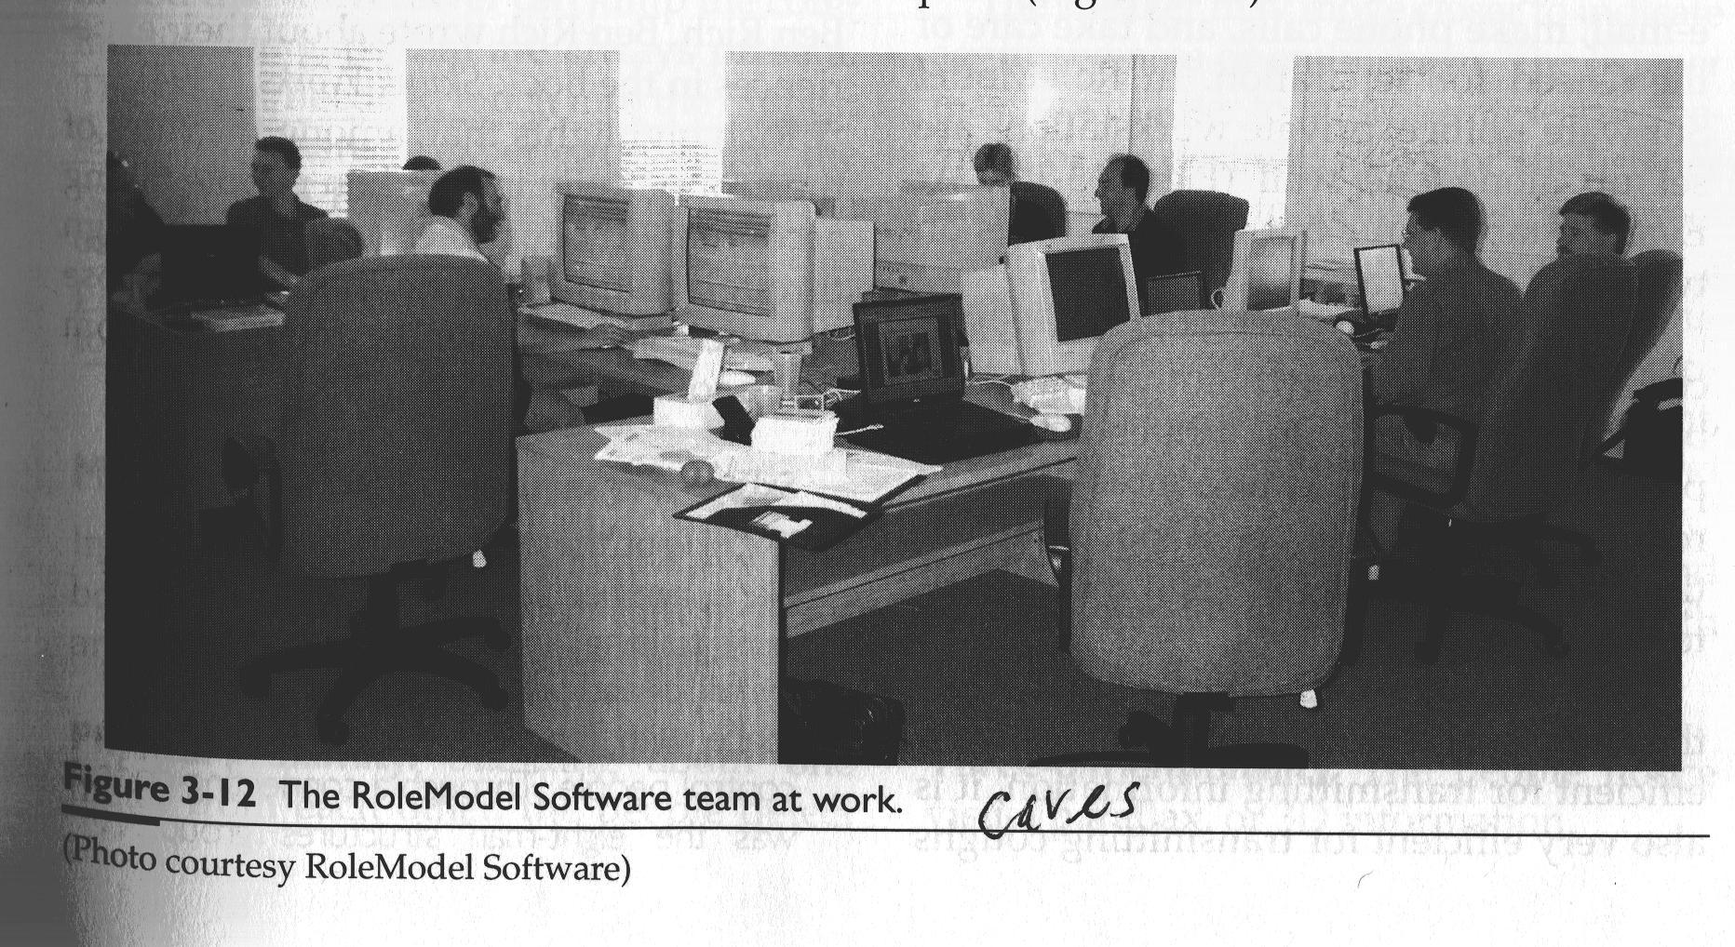
Fig. 3-12

Slide 27
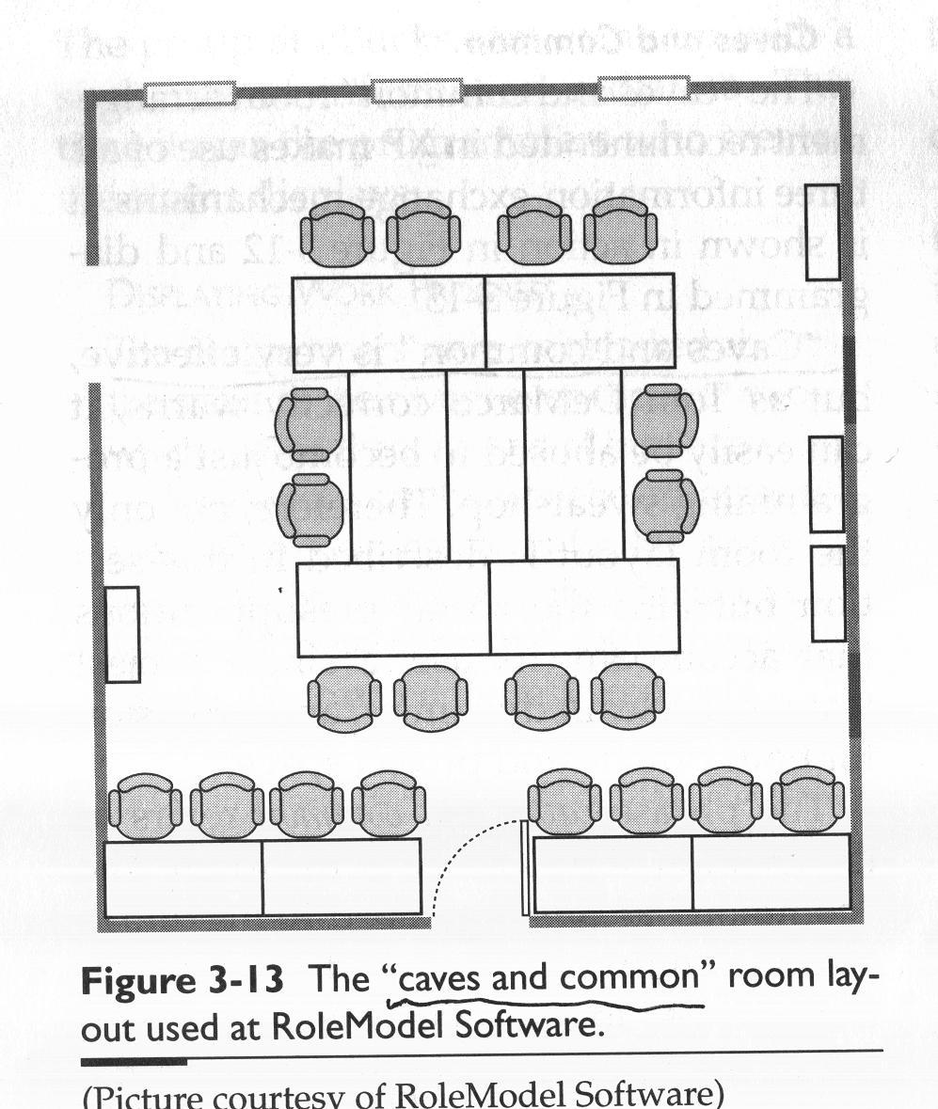

Slide 28
Caves and Common (Cont.)
Besides the “caves and common” room, the team needs:
1) Ample wall space for whiteboards and
posted flipcharts,
2) A food-preparation room, and
3) Areas for small discussions
Story Next

Slide 29
Skunk Works Room
3-10 鼠輩之室
洛克希德公司的鼠輩團隊，由Jim Kelly 及 Ben Rich 領軍，以快速開發嶄新飛機而聞名於世。
Kelly 把整個設計團隊擠在大樓的一個角落，三人熱力組與穩定控制組在一起，隔一扇門，就是八人結構組，我們可隔走道握手，… 有天我突發奇想，拆下門，架在幾張桌上，舖上長長的白紙，全部人馬參與最終設計，只花一天半就完成…

Slide 30
Jumping Communication Gaps
跨越溝通鴻溝
The sender needs to touch into the HIGHEST level of shared experience with the receiver.
The two people should provide constant feedback to each other in this process so that they can detect the extent to which they miss their intension.

Slide 31
HIGHEST level of shared experience
例子: 甲向乙問路:
甲: 請問行政大樓怎麼去?
乙:
1.在校門對面 (校門 is a high level shared experience)
2.從這兒向前走三百公尺，再左轉二百公尺，再右轉走四百公尺 (公尺 左轉 右轉 are low level shared experiences)

Slide 32
Modalities in Communication
溝通的多元向度
Imagine a simple discussion at the whiteboard.
How many communication modalities are at play?
Consider the 11 modalities below:

Slide 33
Modalities in Communication (Cont.)
1. Physical proximity 實質接近感
The speaker may move closer to indicate aggressiveness or enthusiasm.
The listener may move away to indicate fear, disagree, or the need to think privately for a moment.

Slide 34
Modalities in Communication (Cont.)
2. Three-dimensionality 三度空間感
The people notice visual parallax, or 3D
information. The parallax shift of the visual image is lost when the same people talk over a video link, even if they are similarly close to the camera and screen.

Slide 35
Modalities in Communication (Cont.)
3. Smell 嗅覺
It certainly is available at the whiteboard and is lost in remote communication.

Slide 36
Modalities in Communication (Cont.)
4. Kinesthetics 運動知覺
Many people use kinesthetics (sensation of movement) to help them think and remember.
The speaker might use it to help construct a new explanation or to help improve the building of a question.

Slide 37
Modalities in Communication (Cont.)
5. Touch 觸覺
One person touches another on the shoulder to mean “ Don’t feel threatened by this discussion.”

Slide 38
Modalities in Communication (Cont.)
6. Sound 音感
The speaker uses pitch, volume, and pacing to differentiate and emphasize ideas in a sentence.

Slide 39
Sound of Mandarin
漢語 (Mandarin) 四聲聲調似音樂
先交右腦處理音樂 (前注意階段)
只有需要注意語義時
才交左腦處理語義 (注意階段)
這比講英語者具優勢
[中國科學院網站]

Slide 40
Modalities in Communication (Cont.)
7. Visuals 視覺訊號
People communicate through gesture as well as words, often making a point by:
gesturing,
raising an eyebrow, or
pointing while speaking.

Slide 41
Modalities in Communication (Cont.)
8. Cross-modality timing. 跨向度時間感
The speaker
1) moves facial muscles and gestures while talking,
2) draws while talking and moving,
3) pauses in speech for effect while drawing, and
4) carefully announces key phrases in time, while drawing lines between shapes.

Slide 42
Modalities in Communication (Cont.)
9. Low latency 低延遲感
Because two people are standing next to each other, the round-trip time for a signal and a response is very small. This allows:
real-time question and answer, and
interruptions.

Slide 43
Modalities in Communication (Cont.)
10. Trust and learning 信任感與學習
Two people build small emotional normalization rituals of movement and expression to indicate things like
“I am starting to feel attacked here.”
Story next page.

Slide 44
Flying places to be there
3-11 就是要飛過去
一家視訊通訊公司的資深經理，剛從倫敦飛回聖荷西。這是她十天內的第二次旅行，而每次都只是去開一個會。
令我們驚訝的是，顯然她可用現代視訊會議，但她覺得無法這樣做生意，她的會議要求低延遲、豐富多元向度的「親身與會｣。
用視訊會議容易開場，但不易圓滿收場。

Slide 45
Modalities in Communication (Cont.)
11. Use of a shared, persistent
information radiation 白板保存資訊
The whiteboard holds the drawn information in place, while words dissolve in the air.

Slide 46
The impact of removing modalities
Remove only physical proximity
Remove the visuals (use a telephone)
Remove voice (use e-mail)
Remove the ability to ask questions
Remove almost everything then you get paper
Thus, documentation is the least effective communication form.
Face to face communication is the most effective.

Slide 47
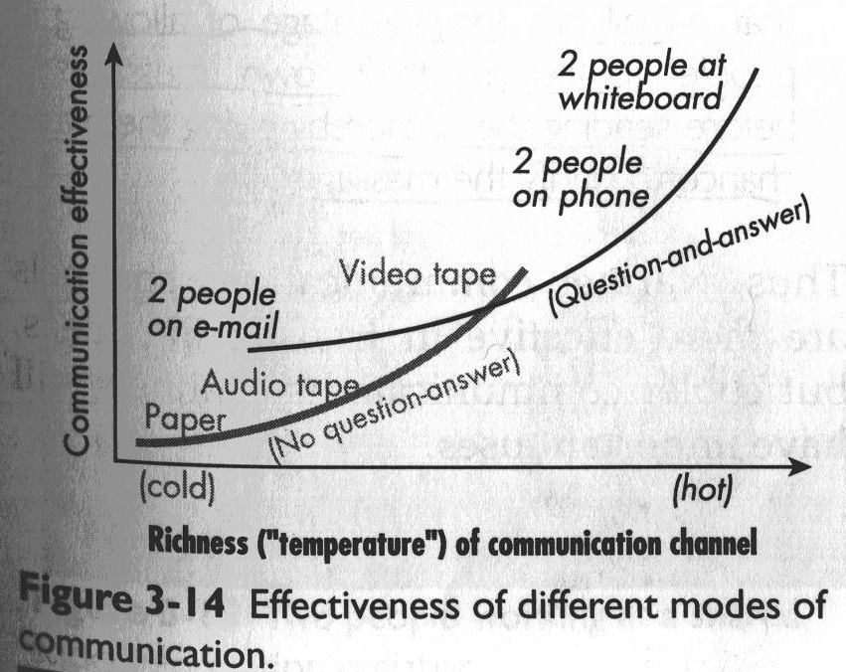
Making use of Modalities
Fig. 3-14

Slide 48
Videotaped Archival Documentation
3-12 錄影帶歸檔文件
請設計師以五至十五分鐘，向一兩位不熟此設計的同仁，簡短講解此設計。這位同仁以後將擔任看錄影帶的人的服務專員。當設計師講解時，這同仁如需要，可打斷並提問。然後，把講解錄影。
最後，印出講解中用到的例子及草圖，當作以後講解的說明文件。

Slide 49
Cooler Communication Needed
3-13 有時需要冷些的溝通
(1)有位專案經理說：她團隊跟他用電話溝通比面對面溝通效果好，因為她當面會激動、太強勢了。
(2)某資深設計師在某次會議中，佔領白板全部時間，把會議搞扎了。
(3) McCarthy 說：email的好處是，在發信前讓我們可重讀自己寫的信，因而有機會釐清訊息。

Slide 50
Stickiness 黏著性
面對面溝通是最棒的!
那麼，何以需要文件?
答案是:要賦予資訊一些黏著性。
當資訊被記錄在文件時，就有黏著性。
而談話溝通中的資訊，沒有黏著性。
.

Slide 51
手機簡訊 vs. 手機通話
手機簡訊 類似 Email
數字(金錢時間) 文字(地點)
描述清楚 可重覆閱讀 可儲存(stickiness)
不需real-time 故便宜
手機通話 則無上述優點
軟體開發上，手機簡訊似比手機通話好

Slide 52
Jumping Gaps Across Time
跨越時間的鴻溝
我們會自然的認為:長期專案要靠文件，錄音帶，錄影帶來留住資訊。
然而，我們發現: 關鍵人員，如主架構師 (chief architect) 會擔任檔案儲存器，他鮮明的記得專案的關鍵觀念 (archival medium to keep memories of key ideas alive)。

Slide 53
Sticking Thoughts onto the Wall
3-14 把想法黏在牆上
某專案的企業分析師很挫折，因大家工作越來越相關，需協同工作，但卻無方法讓大家各自的想法能夠清晰的呈現。
我們討論了「合作活動」「文件」「黏著性」。他們想到設立大型、持久、可修改的「想法展示區」有助解決此事。有人馬上在走廊牆上張貼一張領域圖，他們實驗了數週，實驗各自想法的不同表達方式，而這些方式會讓他們看到彼此的相關性。

Slide 54
Teams as Communities
團隊形成生命共同體
In last chap., we studied what it costs to notice something of value on a project and to communicate it to someone in the team.
Now, let us consider whether a person cares to notice and communicate anything – this is a community if he cares.

Slide 55
Better aligned team
團隊目標一致
The project priority chart is used.
At the start of the project, the sponsor and the developers discuss and select one single desirable aspect, such as time to market, defect reduction, response time, ease of learning to use, speed of expert usage, memory used, or ease of maintenance. Then, select the second one.
And then, select 3 or 4 desirable aspects that team will sacrifice in order to achieve the main two. Team members thus see the priority.

Slide 56
Amicability 容人雅量 and Conflict 意見衝突
Amicability is the willingness of people to hear the thoughts of another person with good will and to speak without malice.
Removing all conflict from a team is NO GOOD. People need to be able to disagree, in order to identify design problems!

Slide 57
Amicability and Conflict (Cont.)
Japanese seem to fail this!
Japanese society is noted for its non-conflict polite culture. People do not express, or fight for, different opinions. This is really bad for the software industry.
日本人注重和睦客氣，這樣對軟體業不良。
Isralis are frank. They demand of you to
have your own opinion and to stand behind it.
以色列人注重坦率，為自己意見辯護，這樣才對!

Slide 58
Not Enough Conflict
3-15 衝突不夠
我去過一個教會，職員想待多久就待多久。他們鍾愛謙遜、和平、和睦等美德，累積的負面效應是；欠缺不同意見及主動性。
每人在批評別人想法前，總會再三考慮，怕被視為散播不合。每人在主動做事前，總會再三考慮，怕被視為求名爭權。
結果是：專案進行非常緩慢。只有當教會找到方式來處理衝突，但不傷害謙遜和睦的價值觀時，專案才可能改善。

Slide 59
Deliberate Conflict
3-16 刻意的衝突
波音777設計團隊刻意在其設計中，引入與其他系統衝突之事。雖然波音官方說，這衝突是自然演生；但工程師說，是有意造成的。
為什麼？工程師利用此事，得以與其他相關部門的工程師討論，解決未來設計議題。衝突促成互動，之後的對話、談判，在更嚴重問題浮現之前，解決了設計衝突。

Slide 60
Citizenship 好公民資格
1. Getting to meeting on time
2. Answering questions from other people
3. Bothering to mention things they notice
4. Following group coding conventions
5. Using code libraries
Note that the citizenship does not
include working overtime!

Slide 61
Hostile XP
敵意的XP
駐點客戶不太確定他們要什麼，程式師堅持：「
告訴我要做什麼。｣ 所以，駐點客戶就說些東西，程式師完全照做，然後說：「告訴我，再來要做什麼。｣
程式師做任何駐點客戶說的事，縱使程式師很確定那是愚蠢的主意。
這專案失去了一項創意的互動：尖銳的程式師提出具洞察力的意見，來改進 (refine) 駐點客戶的請求。
.

Slide 62
Building Teams by Winning
靠打勝仗 建團隊士氣
有專案在開工時，辦聚餐或郊遊，來建立士氣，這有幫助，但不是頂重要。
Hohmann 觀察到:
建團隊士氣的最佳方式是: 成功產出結果 不管結果是大是小。所以，獲得小勝 (small wins) 是很重要的。

Slide 63
Team Culture and sub-cultures
團隊文化及次文化
The project team itself creates a mini-culture which sits within the culture within the larger organization and also within the dominant national culture around it.

Slide 64
4 Culture Types 四種文化
Some sociologists name 4 culture types:
Hierarchical culture 階級文化 has the traditional top-down chain of command.
Older, larger corporations have this culture. Many people internalize this as the natural or default corporate culture as they grow up, and they have to be trained away from it.

Slide 65
2. Random culture 隨機文化 is the opposite of hierarchical. There is little, or no, central control in a group.
Many start-up companies 新創公司 work this way. Some consider it a fun way to work, others find it stressful as there are no clear points of control.

Slide 66
3. Collaborative culture 合議文化
works in consensus (依共識工作).
A decision has to be agreed by all the members of the group.
See story next.

Slide 67
Consensus Culture at Work
3-17 共識文化的運作
有團隊要我去教使用情節。我碰到組長，他職稱叫教練；當然，在合議文化中，只教導、不領導。一個月後，我去第二次，這次人更多。再幾個月後，我去最後一次，整個部門全參加。雖然教練早已決定使用情節很好，但他要每個人都有機會了解、同意後，團隊才要使用。
這教練在第三次上課的行為很有趣。我講課時，他用筆電在寫程式，他只是人在教室。我一點都不介意，他完全符合他的兩種角色：身為資深程式師，他直接在貢獻專案；身為教練，他人在教室，表示對教材的支持(他聽三遍了)。
因此，他的行為是他兩種角色的自然表示：
程式師及教練。

Slide 68
4. Synchronous culture 同步文化 is the opposite of collaborative culture 合議文化.
They coordinate action without verbal communication, with people performing their roles without attempting to affect the other role’s work styles.
An example is an accident scene (救災現場).

Slide 69
Overtime Lights at Norges Bank
3-18 挪威央行的加班燈
挪威央行的上班時間是到下午三點半。
有一天下午三點半，我突然從雜事中「醒｣過來，想完成一些事。結果，三點四十五分，我在走道晃蕩；我不能發傳真，找不到人在公文簽字或問問題。職員真的三點半都回家了。到下午五點，燈光自動熄掉。我開了加班燈。再次嚇死我的是：下午七點加班燈又自動熄掉。(你真的真的該回家了)

Slide 70
Programmer sub-culture
程式師的次文化
Why programmers hate meeting?
何以程式師痛恨開會?
They spend a great deal of time lifting and holding together a set of ideas. Say, 30 minutes to build the idea structure and an hour to make progress.
Any phone call, discussion, or meeting that distract him/her for longer than a few minutes cause him/her to lose one and half hour and an immense amount of energy.

Slide 71
Teams as Ecosystems
A software project sets up a small ecosystem 生態系統 made up of personalities from diverse cultures.
Some elements of the ecosystems are:
1) Walls acting as barriers 阻隔 and open space acting as conduits 導管
2) Individuals with strong personalities changing the way in which the ecosystem works
個性強的成員會改變生態系統 的運作方式

Slide 72
Teams as Ecosystems (Cont.)
Each team’s ecosystem is UNIQUE.
每個團隊的生態系統 都是獨一無二的
Only the people on the team can deduce and decide what will work in that particular environment and tune that environment to support them.
The team will naturally reexamine and adjust their conventions over time.
The set of conventions and policies is referred to as methodology which is a “social construction.”
方法論 是一套團隊規範及政策
就是一種「社會建構｣

Slide 73
Lizards and Penguins
3-19 蜥蜴與企鵝
在某公司，從舊大樓搬到新大樓，吵翻天了。在舊大樓，每人有自己的辦公室，每間辦公室有空調控溫器。而新大樓，每人也有自己的辦公室，但每兩間辦公室共用一個空調控溫器。突然間，員工兩極化，分為溫暖組
(蜥蜴)及寒冷組(企鵝)。員工使盡手段，找「溫度喜好」相似的人來共用空調控溫器。

