Slide 1
Ch. 4 Methodologies 方法論
1. Methodology Concepts 方法論的觀念
Vocabulary used to design methodologies 詞彙
How to publish methodology 如何發佈方法論
2. 7 Methodology Design Principles方法論設計七原則
3. XP Under Glass 透視XP
Apply the principles to analyze and adjust XP
應用七原則來分析及調整XP
4. Why Methodology at All? 為何需方法論?

Slide 2
An Ecosystem that Ships Software
能產出軟體的生態系統
All organizations have a methodology. It is
simply how they do business. 任何組織都有
方法論，那就是他們做事的方式。
A methodology is the convention that your
group agrees to. This convention is a social
construction 方法論是一種社會建構.

Slide 3
1. Methodology Concepts
A methodology (方法論) is the conventions that your group agrees to,
which is a social construction (社會建構).
A method (方法) is a systematic procedure,
similar to a technique.
A methodology (方法論) is the conventions or team coordination rules.

Slide 4
方法論設計 的13個元素
任何團隊努力 (team endeavor)，不管是軟體開發、攀岩、或吟詩雅會，都可運用下頁圖中的13個元素，來設計其方法論。
各方法論的每個元素內容會不同，但元素名稱皆同。
隨後將逐一解釋各元素，使學生了解如何設計方法論。

Slide 5
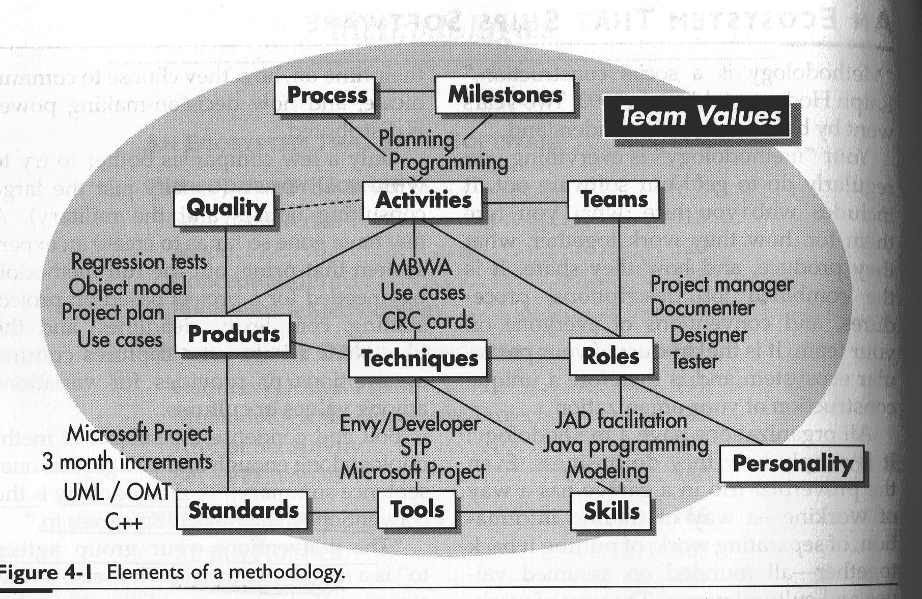
Fig. 4-1 13 Elements of a methodology

Slide 6
1. Roles 職位
Who is hired to do what.
聘何人來做何事
Who you employ, what you employ them for, what skills they are supposed to have, and what personality expected of them.
聘何人來做何事 他應有何技能 有何個性

Slide 7
2. Personality 人格特質
The personal traits of a person.
適合某職位的某些人格特質
EX:
An O-O designer should have good abstraction faculties 抽象化能力, and
a mentor 導師 should be good at explaining things.

Slide 8
3. Skills 技能
The “personal prowess” 傑出才能 of a person, which is a product of his training and talent. 技能是後天訓練加先天才能
EX:
Programmers learn unit-testing.
User interface designers learn how to conduct usability examination.
Managers learn interviewing, motivating.

Slide 9
4. Teams 團隊
The roles that work together under various
circumstances.
因應不同環境之下 各職位合力工作
Small project has only one team.
Large project has multiple, overlapping teams.

Slide 10
5. Techniques 技術
The specific procedure 特定步驟 people use to accomplish tasks performed by:
single person
(e.g., designing a class or test case) OR
multiple persons
(e.g., group planning sessions).

Slide 11
6. Tools 工具
Hardware or software tools used.

Slide 12
7. Activities 動作 工序
How the people spend their days. 上班時做的工作
Sample activities are: 例如:
planning, 規劃
programming, 程式開發
testing, 測試
searching for an API on the Web, 網上找API
reading an API on workstation, and 讀API
meeting 開會

Slide 13
8. Process 流程
How activities fit together over time,
often with pre- and post-conditions
for the activity. 工序加條件依時間結合成流程
e.g., activity: Design review 工序:設計審查
前條件 pre-condition: The material is sent out to participants two days before the review.
後條件 post-condition: A list of recommendation for improvement.

Slide 14
9. Work products 文件
What someone constructs. 人們構建之物
A work product may be disposable, as with
CRC design cards, 可拋文件 OR
it may be relatively permanent, 永存文件
as the usage manual or source code.

Slide 15
10. Milestones 里程碑
Milestones are events marking progress or completion. 記錄進度或完工的事件
An event occurs in an instant of time, and it is either fully met
OR not met
(it is not partially met).

Slide 16
11. Standards 標準
The conventions the team adopts for particular tools, work products, and decision policies.
團隊對工具,產品,決策所採用的規範
A coding standard 程式標準 might declare this: “Every function has the following header comment 標頭…”

Slide 17
12. Quality 品質
Quality may refer to: 品質可指
work products 產品
(e.g., all checked-in code must pass unit tests at 100 percent at all times) OR 或
activities 工序
(e.g., how available are the customers for questions?).
Quality is sometimes given a numerical
value. Sometimes qualitative description.

Slide 18
13. Team values 團隊價值觀
The rest of the methodology elements are governed by the team’s value system.
Quick-to-market value 快速上市 OR
Family-first value 家庭優先
will govern how a team works.

Slide 19
Types of Methodologies
1. Normative 規範式 methodologies
are based on solutions or sequences of steps known to work for the discipline.
Electrical and other building codes in house wiring 房屋配線規範 are examples.

Slide 20
2. Rational 合理式 methodologies
are based on method and technique.
They would be used for system analysis and engineering disciplines.

Slide 21
3. Participative 參與式 methodologies
are stake-holder based and capture aspects of customer involvement.
4. Heuristic 經驗式 methodologies
are based on lessons learned.
Most of software development is still in the stage where heuristic methodologies are appropriate.

Slide 22
三種里程碑 3 Milestones
Review 審查
several people examine a work product.
Publication 發佈 a work product is distributed or posted for open viewing.
Declaration 宣告 verbal notice from one
person to another, or to multiple persons, that
a milestone was reached.
It is an announcement or a promise which constructs a web of promises inside the team’s social structure.

Slide 23
Discovering Declarations
4-1 發現「宣告｣
我第一次發現「宣告｣是在一個一百人的專案中，與technical writer的經理談話。
她說一位小組長告訴她：某部分程式 ready for her. Ready 的意思是：screen design 已經 relatively stable。
小組長的承諾(promise)是；「我們估計往後的 screen 程式變動對technical writer要做的事的影響相對很小，所以現在是開始 technical writing 的時間點。｣

Slide 24
Conceptual Terms 觀念詞彙
Methodology Size 方法論大小
The number of control elements in the methodology. Each deliverable, standard, activity, quality measure, and technique description is an element of control.

Slide 25
Conceptual Terms (Cont.)
Ceremony 儀式性
The amount of precision and the tightness of tolerance in the methodology.
Greater ceremony corresponds to tighter controls. One team may write use cases on napkins (餐巾紙), while the other in a three-page template (三頁的模板).
Methodology weight 方法論重量
The product of size and ceremony.

Slide 26
Conceptual Terms (Cont.)
Problem size 問題大小
The number of elements in the problem and their inherent cross-complexity.
Project Size 專案大小
The number of people whose efforts need to be coordinated: staff size.
System criticality 關鍵性
The damage from undetected defects.

Slide 27
Conceptual Terms (Cont.)
Precision 精準性
How much you care to say about something. “Pi is 3.1416” is more precise than “Pi is 3.1”. Source code is more precise than a class diagram. Assembler code is more precise then its high-level source code.
Accuracy 正確性
How correct you are when you say something. “Pi is 3.4” is not accurate.

Slide 28
Conceptual Terms (Cont.)
Relevance 相關性
Whether or not to speak about a topic.
EX: User interface prototype do not discuss
the domain model. UI雛型與領域模型無關
Tolerance 寬容性
How much variation is permitted. 容許的差異
EX: A working release must be available
every 3 months, plus or minus one month.

Slide 29
Conceptual Terms (Cont.)
Visibility 可視性
How easily an outsider can tell if the methodology is being followed.
外界是否易於檢視 有否遵循方法論
通常以檢視文件達到可視性
Scale 規模性
How many items are rolled together to be presented as a single item.
EX: The UML “package” allows for scaled view of use cases. classes, or hardware boxes.

Slide 30
Conceptual Terms (Cont.)
Stability 穩定性
How likely it is to change:
wildly fluctuating;
varying;
relatively stable

Slide 31
16 Smalltalkers, 2 Database Designers
4-2 16 Smalltalk 程式師及2資料庫設計師
某專案有16 位Smalltalk程式師，但只有2位資料庫設計師。此情況下，只要需求開始成形，我們就讓Smalltalk程式師盡快開始工作。同時，要等物件模型通過設計審查，才讓資料庫設計師開始工作。
物件模型要通過”stable enough for review”；要實際審查過；且要資料庫設計師當審查委員；資料庫設計師才開始工作。

Slide 32
How to Publish Methodology
如何發佈方法論
The Pictorial View
In “Role-WorkProduct-Milestone” view (Fig. on next page), time runs from left to right; Roles as broad bands on left; Work Products as single lines in a band; Milestones shown on the lines.
2. The Methodology Text
The pictorial view misses practices, standards, and other forms of collaboration.
Those must be listed textually.

Slide 33
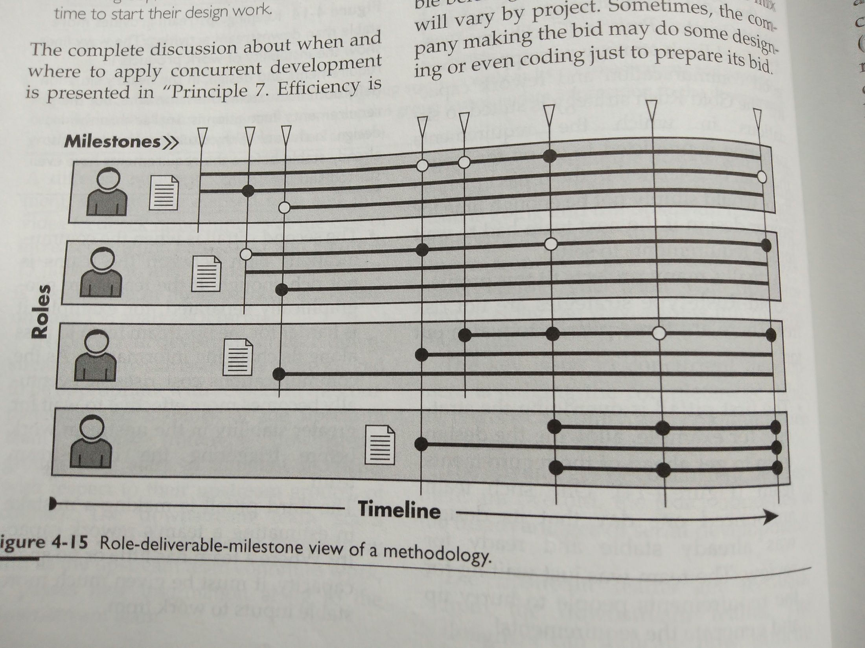

Slide 34
Methodology Chart as Sleeping Aid
4-3 看方法論圖 易入睡
我有次在牆上掛上大型專案的方法論圖，用“Role-WorkProduct-Milestone” view 方式表達方法論中數百個相互影響的零件。
有趣的是：每當我介紹其他Role時，如專案經理或技術文件職員，他們眼光四處飄移；只在講到他們Role時，才會專心。
結果發現：大部分人只關心方法論與他們相關的部分，而不是組織裡每個人在做何事。

Slide 35
Methodology texts are large. How to reduce it? (方法論文字描述龐雜，如何簡化之)
1.做出文件範例 Provide examples of work products
2.不寫作業描述，改為向專家請教或動手做的課程 Remove the technique guides, let people learn from experts or from a hand-on course.

Slide 36
3. Organize the text by role 依職位描述之
Ex:
1. Customer 訂專案範圍優先序，提供資金
2. Team lead 一個team的direction, progress
3. Cross-team Lead 協調多個 teams
4. Developer 開發UI, business class, infrastructure, or data
5. Rollout 協調developer及customer出貨

Slide 37
For each Work Product 文件,
record:
WHO writes it,
WHO reads it, and
WHAT it contains.

Slide 38
EX Product: Project Plan
Writer: Cross-Team Lead
Readers: Customer,Team Leads,Newcomer
Contains:
What is planned in next several releases
Cross team dependencies
Planned timing of development

Slide 39
For each review milestone,
record:
WHAT is being reviewed,
WHO is to review it, and
WHAT the outcome is.

Slide 40
EX: Design Review
Reviewers: Team lead, customer
Purpose: check quality, correctness,
conformance
Reviewing: Use cases, class diagram, screen flow, screen designs, sequence diagrams
Outcome: factual corrections to details.
suggestions for improving UI or design based on quality or conformance

Slide 41
方法論長什麼樣子
With all the above, a methodology can be published by roles. Ex:
Developer
Writes source code, test code
Reads UI style guide
Reviews design review
Publishes source code, test code
Declares UI stable

Slide 42
方法論長什麼樣子(Cont.)
The methodology is a checklist
for each person
that can fit onto one sheet of paper
各人一頁 職掌清單
and pinned up in
the person’s work place
張貼在該人工作區

Slide 43
另類發佈方法論: 流程縮小版
前述發佈方法論的方式，無內心的了解， 也無團隊的生活小花絮，所以沒什麼體驗。而人們需看到或親身去執行方法論。
流程縮小版 (process miniature) 中，參加者要在很短時間內，演出流程的一或二個交貨 (release) 。
某公司要新人在第一週，從需求到交貨，開發一個小軟體。目的是讓新人熟悉公司的人員，職位，標準，東西放那裡等等。

Slide 44
極限小時 (Extreme Hour)
Peter Merel 發明一小時長的極限開發 (XP) 的流程縮小版，叫極限小時 (Extreme Hour)。
有些人被指定為客戶。前十分鐘，客戶向開發者提出請求，執行 XP planning session。
接下來二十分鐘，開發者在投影機上，畫出並測試其設計，第一回合共花三十分鐘。再重複做第二回合也花三十分鐘。兩回合共花一小時。
主持人通常會找好玩題目(fun assignment)，並縮小其範圍。

Slide 45
A Process Miniature Experience
4-4 流程縮小版的體驗
我們要在九十分鐘，展示兩個完整的工作回合 (iterations)。
我們要顯示，人們談判需求，然後創造及測試程式。我們使用正式的五層架構，執行資料庫，版本管理系統，正式 Web style sheet，及全自動廻歸測試套件。
因此，我們要選個小型應用-簡單的計數器(up-down counter)，會停在0及20，可歸零到0，這計數器使用 Web browser界面，儲存其值於公司正式資料庫。

Slide 46
流程縮小版的體驗 (Cont.)
受限於每回合僅四十五分鐘，我們稍微編排展示內容。我們故意要市場分析師，提出不可能三十分鐘寫好的程式: 計數器要幅射狀圖形，要三種顏色。這樣，可讓觀眾體驗他們真實「生活｣中，會碰到的範圍談判。
我們也排演程式師對完成第一回合，會如何「出價｣ (討價還價)，及程式師在回合當中，如何縮小範圍，讓觀眾看到此事的運作。

Slide 47
流程縮小版的體驗 (Cont.)
編入這些的目的，是要給全公司，建立一個觀點，就是在專案進行中，正常的範圍談判，是一種「社會建構｣ 。
我們讓實際寫程式為現場實況方式，雖然成員早已知道題目，他們仍需輸入程式碼，當作經驗的一部分。
而觀眾看著輸入繁瑣的程式碼，會感受到這工作的繁重，縱使這只是個微小的系統。

Slide 48
方法論設計的常見錯誤
One Size for All Projects 一套用於所有專案
Intolerant 無寬鬆度
Heavy 太重
Embellished 美化
Untried 沒用過
Used once 只用一次

Slide 49
Embellishing A Methodology
4-5 美化方法論
我設計我的第一個方法論時，就發現這種傾向。
我問一位程式師同事(他剛做完某專案)，來檢查，編輯，修剪我的設計。他真的找到我擔心的美化點。可是，他又增加一章，談他剛讀到的產出contract-based design and deliverables。
我打電話給他:「你確定你上個專案有用這個?｣
他回答:「喔! 那專案沒用這個，可是，這想法很棒，我們應該用的。｣

Slide 50
Discovering “Should”
4-6 發現「應該｣
測試師:然後，開發者與測試師開會討論基本設計。
我:真的? 他們那樣做?
測試師:你什麼意思，當然他們那樣做。
我:喔!是的，他們真的那樣做，是吧?
測試師:他們必須那樣做，否則測試師做不下去。
我:對! 唔，那應該有開這個會。那我能訪談與會者嗎，看會中發生什麼事，你能告訴我開會日期? 誰去開會?
測試師:嗯，我們會取得這些資料。我意思是，真的需要開那個會，那是很有價值的。

Slide 51
Uncovering Process Shortcuts
4-7 發現流程捷徑
我:這些是產品樣本……這是狀態圖。
組長:嗯!不完全是，這較像流程圖，我必須教他們做正確的狀態圖。
我:可是，這是實際產出的產品的樣本呀!你有用反覆增量流程嗎?
開發者: 點頭。
組長:我們用 Boehm 的螺旋模型的修正版。
我:好的，在第二回合，需求或設計有無改變?
開發者: 當然。
我:好的……在第二回合，你如何設法去更新這些圖?
開發者:喔! 我們沒有，我們只更改程式……。

Slide 52
Don’t Touch My Private Variable
4-8 別碰我的私用變數
某組長想簡化某複雜設計，那是用非私用(private)程式寫入local變數。有人建議把所有程式改為公用(public)，這將大幅簡化設計。
組長考慮一下，他擔心有人不守規定，而使軟體陷危險；於是，他規定只在造成麻煩處，才可用公用程式 (這規定寫在白板上)。他怕期限壓力造成不守規定，產生維修問題。我說你寫個 script 就可知道大家守不守規定了。
組長同意了，他去度假兩週。回來後，他跑了script，發現大家都不守規定，都使用公用程式！

Slide 53
Seven Methodology Design Principles
方法論設計七原則
Interactive, face-to-face communication is the cheapest and fastest channel
for exchanging information.

Slide 54
2. Excess 多餘 methodology weight is costly.
First, imagine six people working in a room using osmotic communication and printing whiteboard. The bureaucratic load is low.
Next, ask the team to maintain written plans, GANTT charts, requirements documents, analysis documents, design documents, and test plans. These take time away from development.

Slide 55
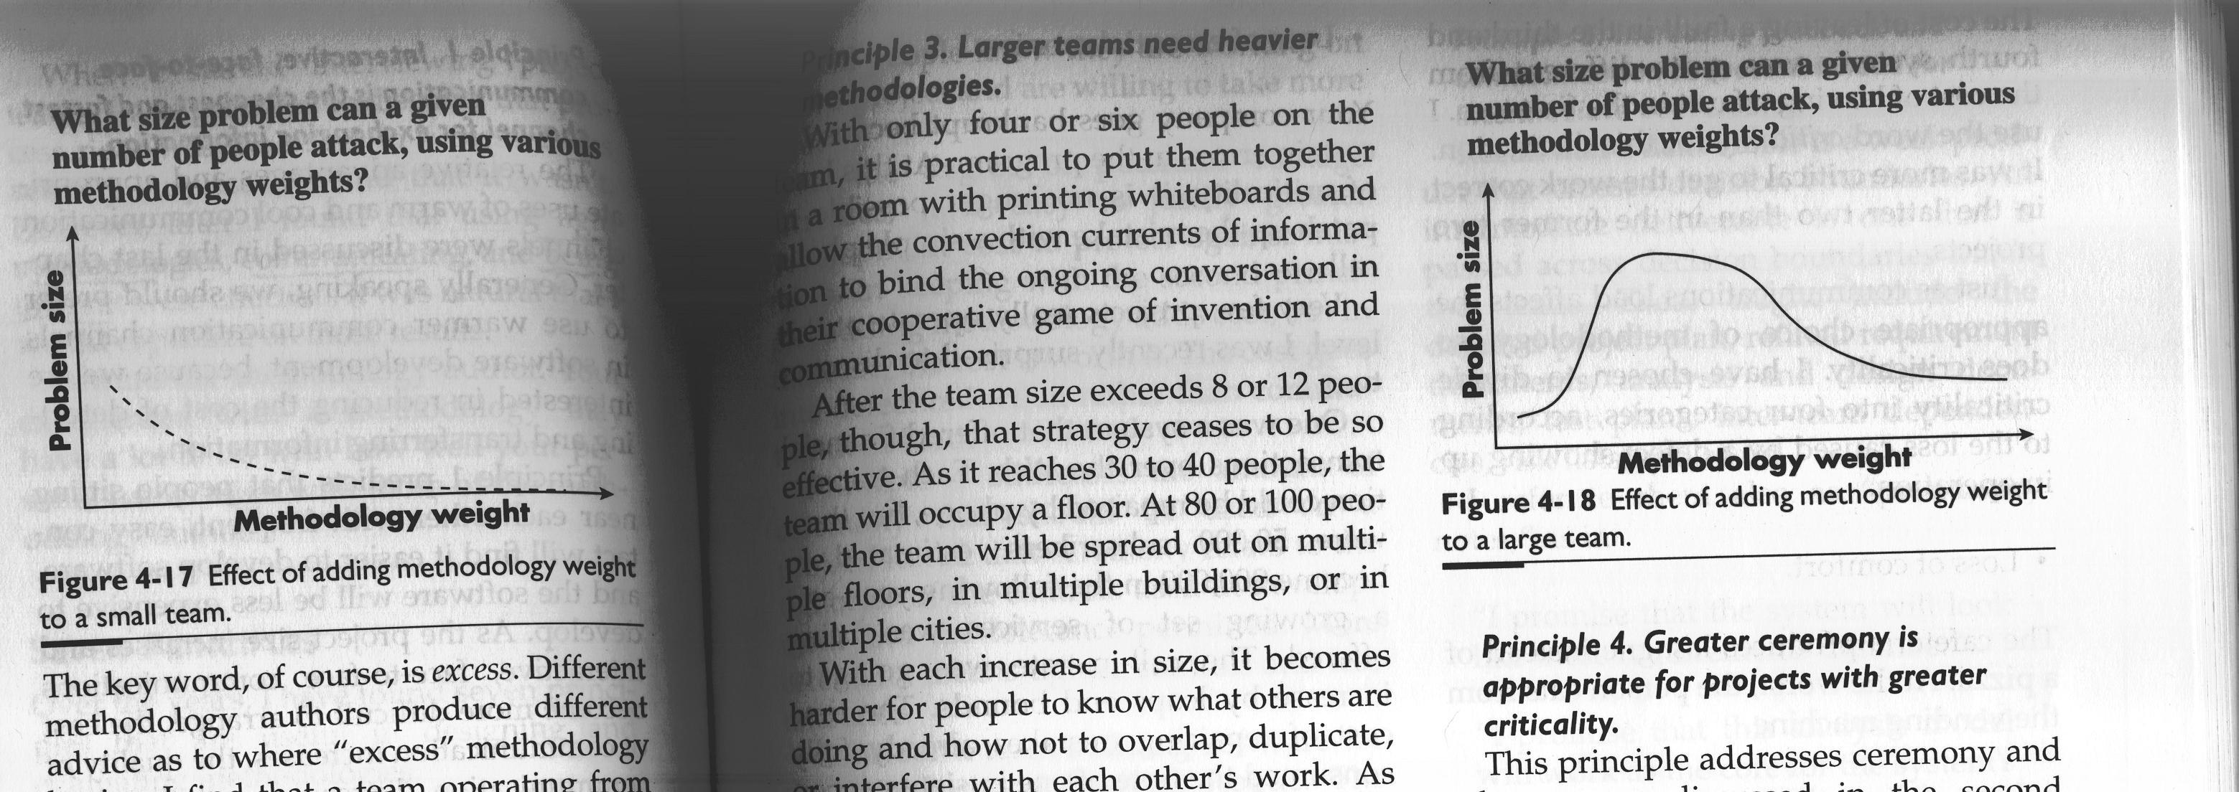
Fig. 4-17 Effect of adding methodology to a small team

Slide 56
3. Larger teams need
heavier methodologies.
When a team reaches 30 to 40 people,
the team will occupy a floor.
It becomes harder for people
to know what others are doing.
This requires some form of coordination.

Slide 57
Fig. 4-18 Effect of adding methodology to a large team

Slide 58
4. Greater ceremony is appropriate for projects with greater criticality
Just as communication load affects the appropriate choice of methodology, so do criticality.
Four categories of criticality:
1) loss of comfort,
2) loss of discretionary money,
3) loss of essential money,
4) loss of life.

Slide 59
A Portfolio of Projects
4-9 專案有不同特性
在挪威央行的資訊部門，我們做多種專案：
一個是加班時可跟餐廳訂晚餐，
一個是支援SQL程式給做財務投資的同事，
一個是追蹤全國銀行之間的交易，
一個是維修全央行的系統，使之2000年安全。
當系統出錯時，上述第三、第四的錯顯然比第一、第二嚴重，我用「關鍵性｣此詞(criticality) 予以區別之。

Slide 60
5. Increasing feedback reduces the need for documents
Increasing feedback and communication
reduces the need for
intermediate deliverables (documents),
which are “promissory notes” 承諾文件 for internal team communication.
With feedback, they can be greatly reduced.

Slide 61
6. Understanding vs. Documentation
Discipline vs. Process;
Skills vs. Formality;
Jim Highsmith No.1: Don’t confuse documentation with understanding.
文件不等同了解。寫入文件的知識，只是人腦中的知識的一小部分。

Slide 62
Highsmith No.2: Process is not discipline.
流程不等同紀律
Discipline involves a person choosing to work in a way that requires consistency.
Process involves a person following instructions.
Of the two, discipline is the more powerful.

Slide 63
Highsmith No.3:
Don’t confuse formality with skill.
正式不等同技能
Design skill (such as OO design) needs to examine a lot of material (use cases), then come up with a design (a class diagram). Next, the design should be reworked many times.
This is SKILL!
It cannot be replaced by formal form filling.

Slide 64
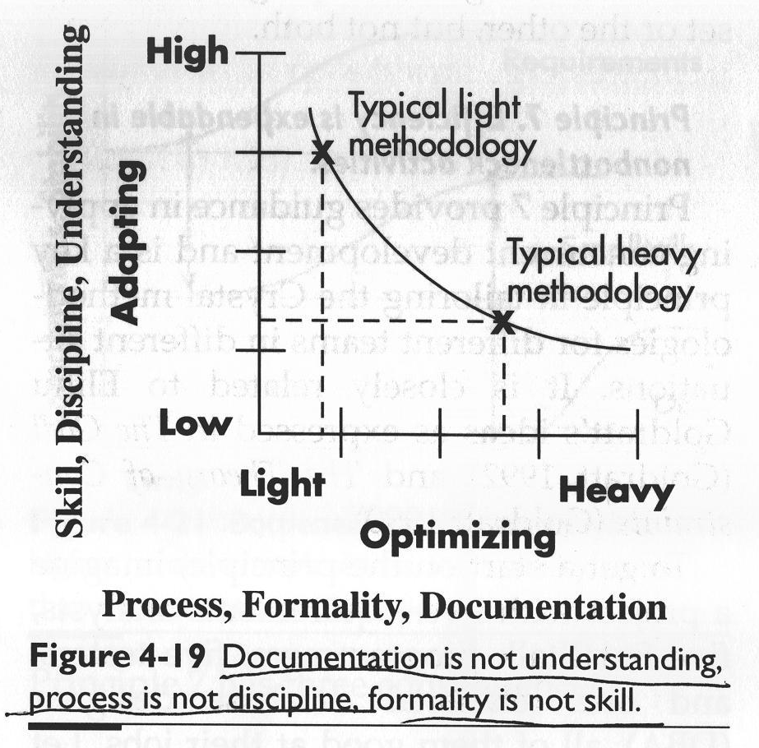
Fig. 4-19

Slide 65
Fig. 4-19
Adapting activities 需廣泛調整的動作
EX: searching for new oil wells.
One cannot predict what is going to happen
Light methodology suits this.
Optimizing activities 需深入優化的動作
EX: reducing cost of an oil well.
One can do things in a predictable situation.
Heavy methodology suits this.

Slide 66
7. Efficiency is expendable 不必要的
in non-bottleneck 非瓶頸 activities.
The speed of the “bottleneck” activity determines the speed of the project.
Non “bottleneck” activity with excess capacity can be used in other places.

Slide 67
Consequence 1: 後果之一
Do whatever you can
to speed up the work
at the bottleneck activity.

Slide 68
Consequence 2: 後果之二
People at the non-bottleneck activities can work inefficiently without affecting the overall speed of the project.
They can do more rework, do it earlier, or help the person at the bottleneck activity.

Slide 69
Consequence 3: 後果之三
Applying the principles of expendable efficiency yields different methodologies in different situations, even keeping the other principles in place.
下面三個小故事 分別用不同方法論 處理 expendable efficiency

Slide 70
4-10 Winifred and Principle 7
Winifred 專案有12個 Smalltalk程式師、4個 COBOL 程式師、及 2個資料庫管理師 (DBAs)。Smalltalk 程式師工作很快；DBA 則是瓶頸。
我們安排Smalltalk 程式師與 requirement writer 用滲透式及面對面溝通工作，而不藉文件溝通，只要程式師從 requirement writer 聽到新資訊，就反覆修改程式。非瓶頸工作反覆做，可提升品質。
而 DBAs 及 COBOL 程式師則等到 Smalltalk code 通過 design review ，得到 relatively stable 後，才開始工作。

Slide 71
4-11 eBucks.com and Principle 7
eBucks.com 有15位程式師及12位業務師(business specialist)，待開發軟體(backlog)壓積達七十多件。
程式師每天要被叫去做其他事好幾次，所以清理待開發軟體進度緩慢。重賞策略不可行，因程式師已無多餘能量，他們正是瓶頸。
我們先設法降低程式師每天的干擾，但不夠。因而我們決定：業務師寫 use cases, business rules, data descriptions 再交給程式師。

Slide 72
4-12 Udall and Principle 7
Udall專案卡住了，它有12位程式師及大量不能用的設計。
四位資深程式師決定：不管其他人，重做！他們慢慢擴充他們的小團體，只找最棒的加入。他們判斷兩個瓶頸是: (1)對設計爭取政治認同 及 (2) 說服其他人。
他們決定讓其他人做任何事都可以，就是不要去寫程式，因要他們花寶貴資源去說服、去訓練其他人，這太沒效率了。

Slide 73
The above 7 principles work together to help you:
1) choose appropriate team size
given a problem
2) choose appropriate methodology size
given the team
Combined consequences follows.

Slide 74
Combined Consequence 1
綜合後果之一
Adding people to a project is costly.
Imagine 40 or 50 people working together.
You create teams.
You add meetings, managers, secretaries to
orchestrate their work. These costs a lot.
Also, adding these people adds communication needs, which calls for additional methodology elements and overall lowered the productivity for the group.

Slide 75
Combined Consequence 1 (Cont.)
製造業是: 人多好辦事
相反地
軟體業是:人多壞了大事

Slide 76
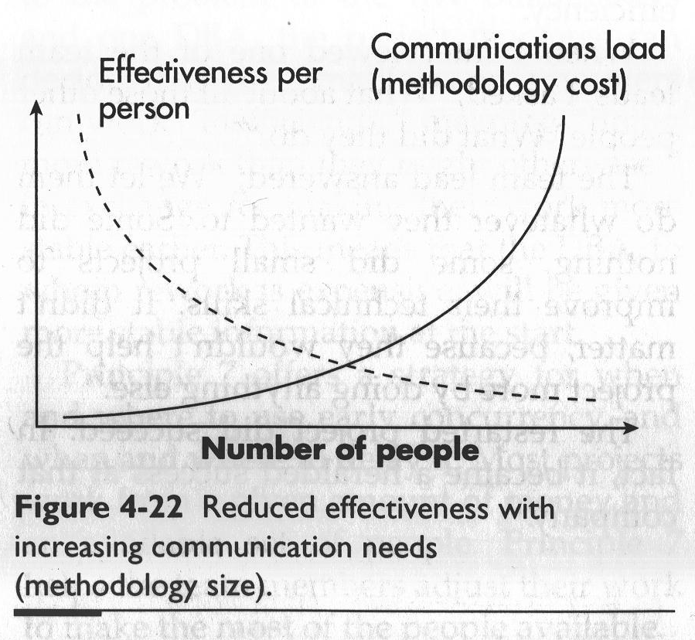
Fig. 4-22

Slide 77
Combined Consequence 2
綜合後果之二
Team size increases in large jumps.
The effects of adding people and then adding methodology load COMPOUNDS.
You want to double the output,
you may need four times people.

Slide 78
Mythical Man-Month Revisited
4-13 再談神秘人月
Fred Brooks 在「神秘人月｣書中說，某專案縱有十位全球最佳程式師，也無法及時完成。結果是，後來用了200或300人。
他解釋人員爆增的原因有二。一是需更多人處理專案溝通重擔。二是無法聘到200人，像前述十位水準的，這使得溝通重擔更為加重。

Slide 79
Six to 24 Programmers
4-14 六位程式師變成二十四位
某個固定價錢的專案中，我們估計需六位 Smalltalk 高手。可是這不可行，因為找不到六位；更慘的是，我們只有十位新手及二位高手，而這兩位既要訓練新手，又要寫程式。
隨著專案的進行，我們最後有了四位高手及二十位程度不一的程式師。
所以，正確的人數跳增就是從六位高手到二十四位程度不一者。

Slide 80
Combined Consequence 3
綜合後果之三
Teams should be improved, not enlarged.
How to improve?
1) Send them to courses
2) Seat them closer
3) Improve their amicability 和睦
4) Replace some with more talented and
more highly paid people

Slide 81
Fewer and Better
4-15 人越少 就越好
Kent Arett 在兩家公司，都成功了。
Fingerhut公司本來士氣低落，人員流失有如「旋轉門｣。資訊部約八十人，全忙於維修，無暇開發新軟體。
他做兩件事：裁掉四分之一較差的；留下的加薪。結果產出增加，只需十五人做維修，其他人可開發新軟體了。此時，他把做維修的加更高薪。
他最驕傲的是：多位日後的資訊部主管就來自這群人。

Slide 82
Fewer and Better (Cont.)
人越少 就越好
Kent Arett 在兩家公司，都成功了。
他在 Sears 公司當副總裁時，五年內把年虧八億轉為年賺一億，他說秘訣是；同時裁掉較差的及提升留下的。原有三百位程式師，他只留下八十人，同時加薪。
他說；還有一事，要塑造願景(paint the vision)，當你塑造了願景，找來了有動機的人，事就成了 (it’s “Game Over.”)

Slide 83
Combined Consequence 4
綜合後果之四
Different methodologies are needed
for different projects.
The grid next shows methodology by:
1) The number of people being coordinated
2) The system criticality
3) The project priority

Slide 84
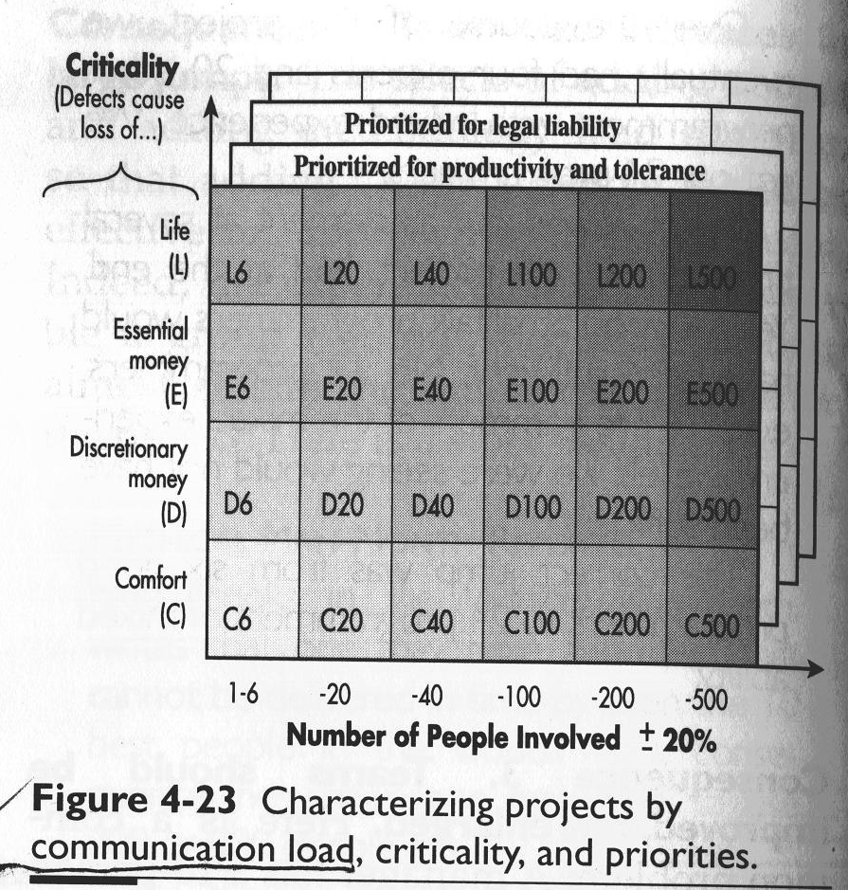
Fig. 4-23

Slide 85
Changing Grid Cells Mid-Project
4-16 專案進行中 更換方法論
挪威央行有個三人專案，以原來三人去做，我歸類為D6專案，我想這三人應做的很好。
一個月後，我發現這專案涉及大量金錢，需更小心，於是改列為E6專案，用一兩週對fault tolerance, recovery, race condition 做設計變更。
接著，架構師及小組長請陪產假，請了兩位新程式師及兩位測試師。此刻專案有七人：兩人在Lillehammer城，五人在Oslo城(其中二人在一樓，二、三、四樓各一人)。我們發現這系統事實上由兩家公司開發，而我們要跟Oslo城另一地點的35人用瀑布模式的團隊協調。此時，方格(Grid)就好用了，我改列它為E20專案。
我在此考慮了方法論原則，所以專案未增文件，只加用電話及視訊，提升溝通即可。

Slide 86
Combined Consequence 5
綜合後果之五
Lighter methodologies are better,
until they run out of steam (馬力不足).
As long as a problem can be solved
with 10 people in a room,
that will be more effective
than adding people.

Slide 87
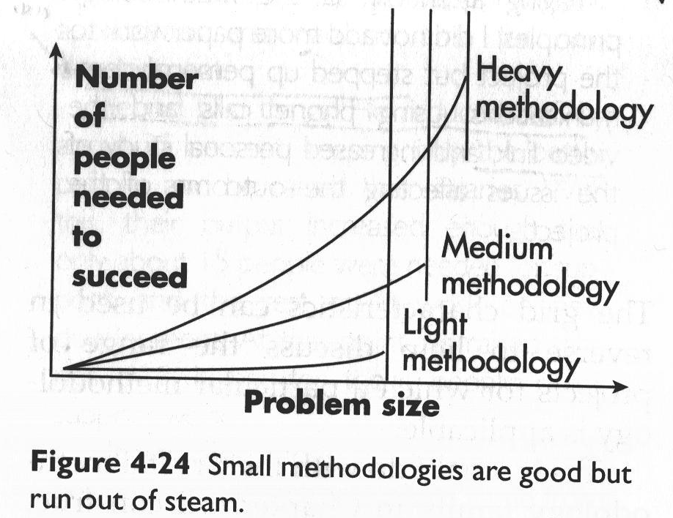
Fig. 4-24

Slide 88
Combined Consequence 6
綜合後果之六
Methodologies should be stretched to fit.
Look for the lightest, most “face-to-face” – centric methodology that will work for the project.
Then, stretch the methodology.
High Smith: A little less than enough is better than a little more than enough.

Slide 89
XP under glass (檢視 XP)
Extreme programming (XP) is a wonderful
example of agile method.
It is effective 使用有效,
well documented 說明完整, and
controversial 具爭議性.

Slide 90
XP in a Nutshell (簡介)
3 to 10 programmers and
one or more on-site customers
in one room or adjacent rooms.
Do development in 3-week periods,
called iterations,
each producing tested code.
2 to 5 iterations form one release.

Slide 91
Pair programming (雙人組開發)
Programmers work in pairs (雙人組)
They follow strict coding standards,
create unit tests for all they write,
make sure tests run 100%
every time they check in code
develop tiny code (15 min - a few hours)
integrate code several times a day,
each time ensure
entire code base passes all unit tests

Slide 92
User Story 使用者故事
The unit of requirements gathering is the “user story,” user-visible functionality that can be developed within one iteration. The customer wrote the stories for the iteration onto simple index cards. The customer(s) and programmers negotiate the iteration as below:
1. The programmers estimate the time to complete each card.
2. The customers prioritize, alter, and de-scope as needed so that the most valuable stories are most likely to get done.

Slide 93
Development on a User Story
依照使用者故事來開發
Development on a user story starts with the programmers discussing the story with the expert customer.
Because this discussion is guaranteed to take place, the text written on the story card can be very brief, just enough to remind everyone of what the conversation is going to be about.
The understanding of the requirements grow through those conversations and any picture or documents the people decide they need.

Slide 94
Programmers work in Pairs
The pairs follow strict coding standards that they set up at the beginning of the project.
They create unit tests for everything they write and make sure that those tests run at 100 percent every time they check in their code to mandatory versioning and configuration management system.
They develop in tiny increments of 15 minutes to a few hours long, integrating their code several times a day. At the end of each of these integrations, they ensure that the entire code base passes all unit tests.

Slide 95
Constant Refactoring 不斷重構
Anytime the two find a section of code
that appears hard to understand
or overly complex,
they are to revise it,
constantly simplifying and
improving it.

Slide 96
On-site Customer’s Jobs
駐點客戶的工作
While the programmers are working, the on-site customers are doing three things:
1. They visit with the programmers to clarify ideas,
2. They write system acceptance tests to be run during and at the end of iteration,
3. They select stories to be built for the next iteration.
The on-site customers may be on the project full time or not, as they decide.

Slide 97
Stand-Up Meeting
站立開會
The team holds a stand-up meeting every day, in which they describe what they are working on, what is working well for them, and what they might need help with. The meeting is held standing up to keep it short.
At the end of each iteration, they hold another meeting, in which they review what they did well and what they want to work on next time. They post this list for all to see during the next iteration.

Slide 98
Values and Coach
價值觀及教練
XP prizes four values: communication, simplicity, testing, and courage. The “courage” value is intended as courage to go ahead and make improvements to the system at any time.
One person on the team is designated the “coach” for the team, This person reviews with the team members their use of the key practices: use of pair programming and testing, pair rotation, keeping design simple, communication, and so on.

Slide 99
Dissecting (解剖) XP
XP teams use:
Osmotic communication
Face-to-face communication
Information radiator on the wall
Through pair work 雙人作業 and rapid
feedback 快速回饋, XP compensate 補救 the human tendency to make mistakes.

Slide 100
High Discipline 高度紀律
XP is high-discipline(高度紀律)methodology.
The disciplines are protected through:
Pair programming –
provides pride-in-work (工作驕傲感)
(better work in less time)
helps hold (保住) unit testing
2) Coach (教練) or enthusiastic members

Slide 101
Coach OR enthusiastic members
教練 或 熱心成員
Very enthusiastic members are more powerful than the coach.
Coach is an external force, while enthusiastic members create peer pressure – an internal, and hence more powerful, force.

Slide 102
Difficulties in Discipline
維持紀律的困難
The disciplines are exposed in three places:
Coding standards
Acceptance tests
Aggressive refactoring
3) is the most difficult, because it requires consistency, energy, and courage, and no mechanisms in the methodology reinforce it.

Slide 103
High Ceremony in XP
XP 的高儀式性
High-ceremonies in XP include:
1) The use of iteration.
Design and programming are done in tiny increments of hours or a few days, Development cycles are two to four weeks, release one to four months.
2) 100 percent unit test of all check-in code
3) The team is to be co-located.

Slide 104
XP is …..
XP is designed for small, co-located teams aiming to get quality and productivity as high as possible (push them to the extreme!).
It does this through the use of rich, short, informal communication paths with emphasis on skill, discipline, and understanding at the personal level, minimizing all intermediate work products.

Slide 105
Adjusting (調整) XP
Absence of documentation (缺乏文件)
The tacit knowledge (所有人員的知識) is communicated through:
1) osmotic communication,
2) rotation in pair programming,
3) clear and simple code,
4) extensive unit tests
如另需文件
可於 planning game 提出寫某文件之要求

Slide 106
myAgile vs. XP
myAgile 比 XP 增加 header 及 pseudo-code 兩種文件，以改善軟體易修性 (maintainability)。
而且，myAgile 要求先寫 header 及 pseudo-code，並 trace pseudo-code to debug。之後，才可寫 source code。
所以，myAgile 開發速度必較 XP 慢，但其維修速度應遠勝 XP。

Slide 107
2. Restriction to Small Team 僅適用小團隊
A larger project has to:
adjust team structure, interfaces 調整團隊介面
use of documentation 使用文件
to accommodate
greater coordination 較多協調量 and
thinner communication lines 較細溝通線

Slide 108
Why methodology at all?
畢竟 要方法論幹嘛?
It addresses “how we work around here” 它點出:我們是這樣工作的
需要方法論的原因有六：

Slide 109
1.
Introducing new people to the process
讓新進員工知道作業狀況、互動規定

Slide 110
Methodology in a Drawer
4-17 繪圖師的方法論
在我的第一個硬體設計專案中，我的小組長告訴我：「我們在這些Ｄ尺寸的紙上， 畫上gates及ICs。名字寫在左下角。我們只使用對稱clocks, triggering on the rising edge 。我們把圖存放在製圖課的第二個櫃子(由上算起)；不過，放圖前告訴我一下。還有，我們來安排設計審查的時間…｣

Slide 111
2.
Substituting people
便於人事更換

Slide 112
Methodology on the Job
4-18 公司的方法論
有位同事應聘到一家他不知道的公司，要做他不知道的提案工作，他也不知道他的客戶。
小組長跟他坐在一起兩天，講解公司的方法論：「誰產生什麼，文件如何結構，需何標準，優先順序為何，他該跟誰談。｣

Slide 113
3.
Delineating responsibilities
劃分責任
如XP規定:
user story 排優先序
是 on-site customer 責任
而工時估計 則是programmer的責任

Slide 114
4.
Impressing the sponsors
使客戶有好印象
有些軟體公司給客戶看一本本厚厚的methodology (天曉得有沒有遵行?)
這樣，通常客戶感覺較”安全”

Slide 115
5.
Demonstrating visible progress
展現可視的進度
有些客戶要求:
每天 ”看到、知道” 進度

Slide 116
6.
Curriculum for education
依 methodology 訂出教育訓練課目
如 methodology 內有個 technique
叫 “如何寫 use case”
可能就需開授這課目

