Slide 1
Data Structures
Chapter 2 Arrays and Structures

Slide 2
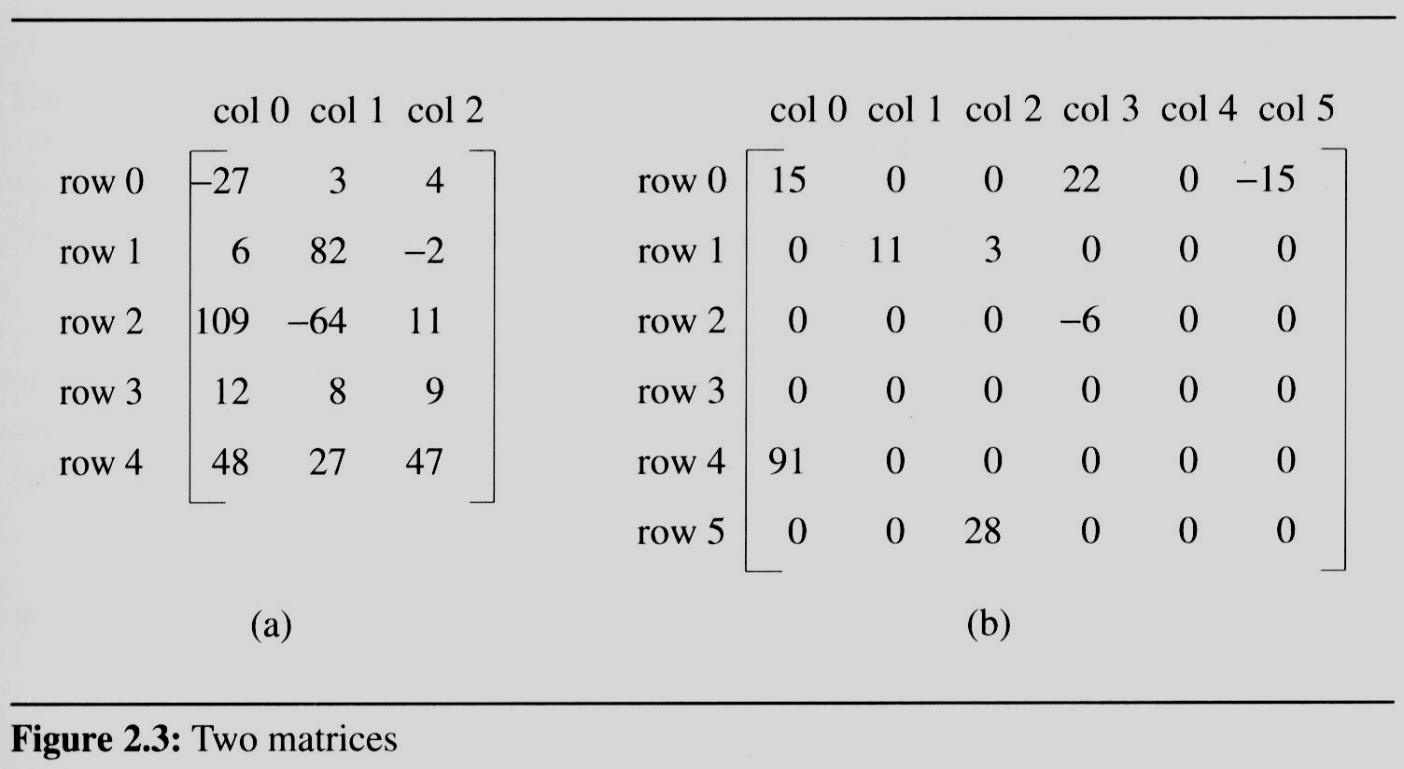
2.4 The sparse matrix ADT (1/18)
2.4.1 Introduction
  In mathematics, a matrix contains m rows and n columns of elements, we write m×n to designate a matrix with m rows and n columns.
5*3
8/36
6*6
15/15

Slide 3
2.4 The sparse matrix ADT (2/18)
The standard representation of a matrix is a two dimensional array defined as
a[MAX_ROWS][MAX_COLS]
  We can locate quickly any element by writing a[i ][ j ]
Sparse matrix wastes space
  store only nonzero elements.
  Each element is characterized by <row, col, value>.

Slide 4
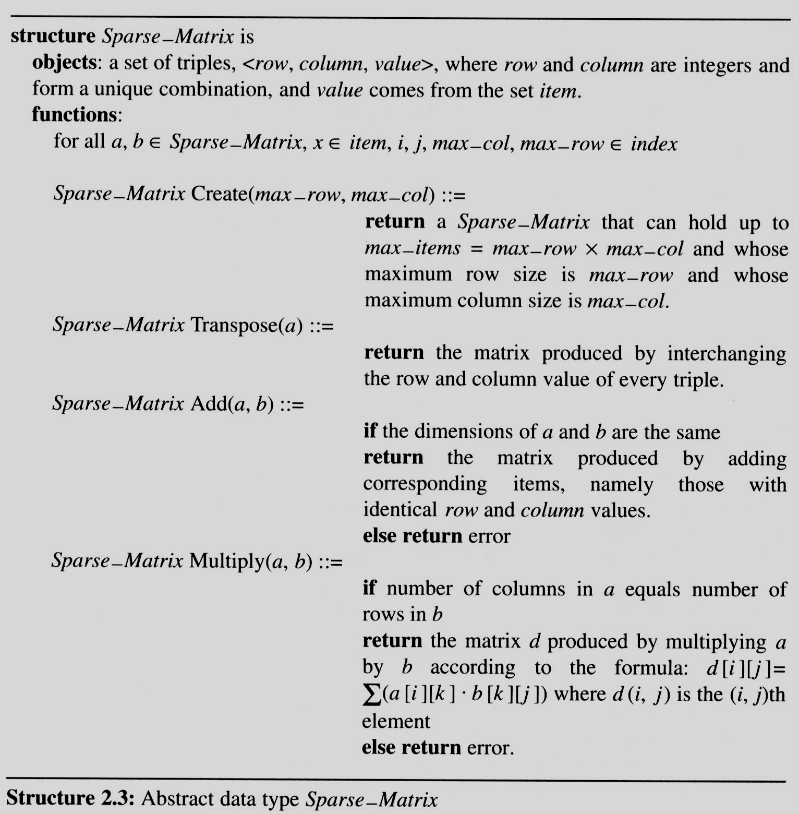
2.4 The sparse matrix ADT (3/18)
A minimal set of operations
  creation
  Addition
  Multiplication
  Transpose

Slide 5
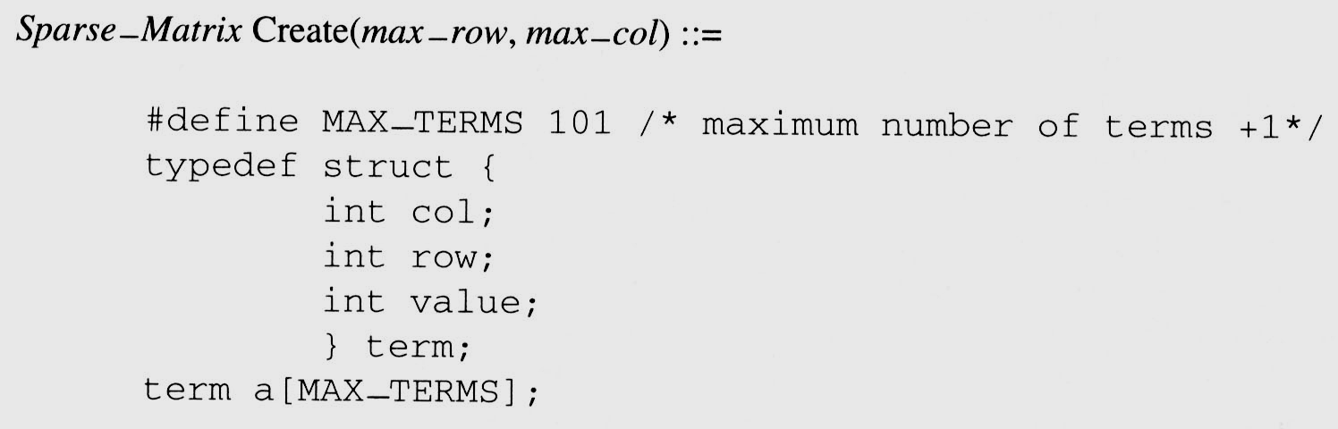
2.4 The sparse matrix ADT (4/18)
We implement the Create operation as below:

Slide 6
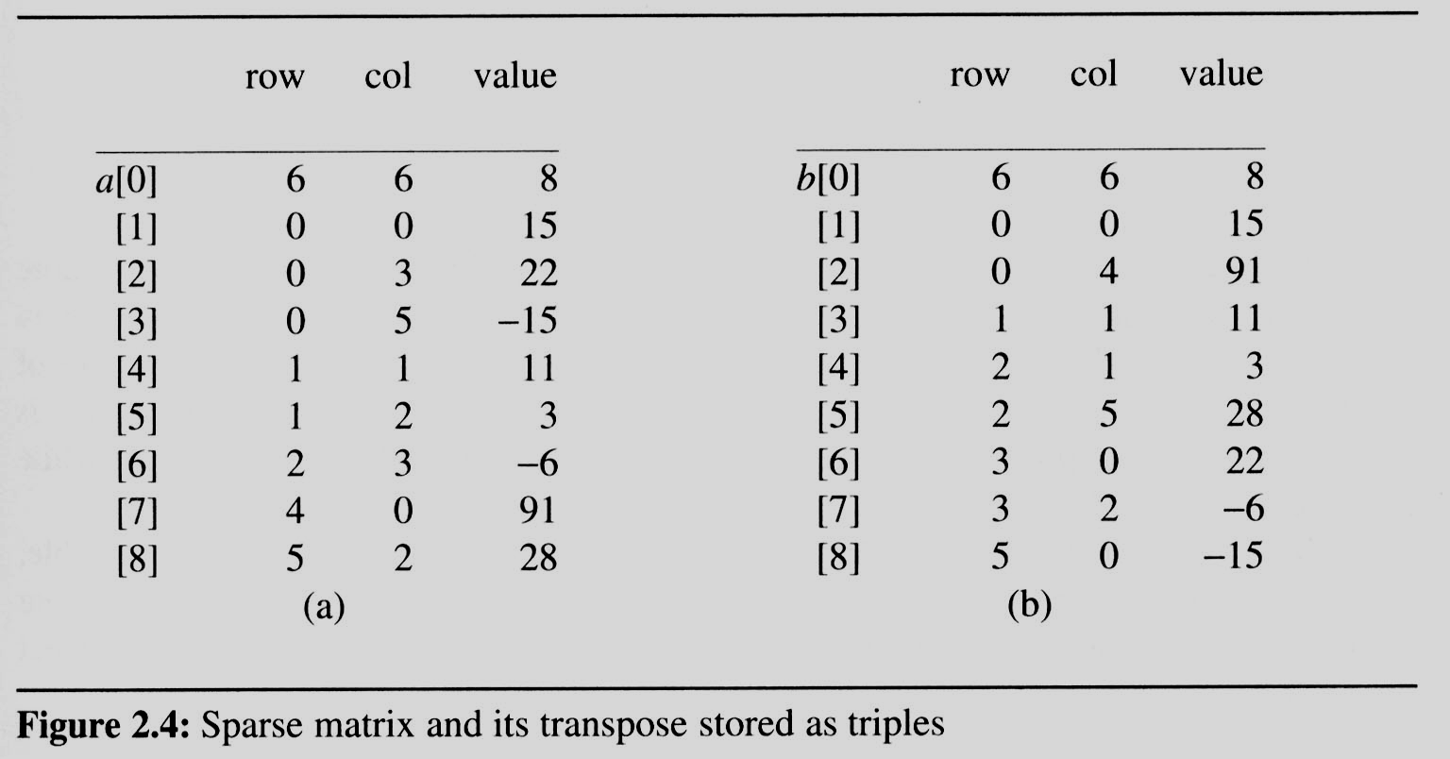
2.4 The sparse matrix ADT (5/18)
Figure 2.4(a) shows how the sparse matrix of Figure 2.3(b) is represented in one-dimensional array a.
  Each element is characterized by <row, col, value>.
# of rows (columns)
# of nonzero terms
row, column in
ascending order

Slide 7
2.4 The sparse matrix ADT (5/18)
Figure 2.4(a) shows how the sparse matrix of Figure 2.3(b) is represented in one-dimensional array a.
  Each element is characterized by <row, col, value>.
row, column in
ascending order
transpose

Slide 8
2.4 The sparse matrix ADT (6/18)
2.4.2 Transpose a Matrix
  For each row i
    take element <i, j, value> and store it in element <j, i, value> of the transpose.

Slide 9
2.4 The sparse matrix ADT (6/18)
2.4.2 Transpose a Matrix
  For each row i
    take element <i, j, value> and store it in element <j, i, value> of the transpose.
    difficulty: where to put <j, i, value>
    (0, 0, 15) ====> (0, 0, 15)
    (0, 3, 22) ====> (3, 0, 22)
    (0, 5, -15) ====> (5, 0, -15)
    (1, 1, 11) ====> (1, 1, 11)
    Move elements down very often.
  For all elements in column j,
    place element <i, j, value> in element <j, i, value>

Slide 10
2.4 The sparse matrix ADT (5/18)
Figure 2.4(a) shows how the sparse matrix of Figure 2.3(b) is represented in one-dimensional array a.
  Each element is characterized by <row, col, value>.
transpose

Slide 11
2.4 The sparse matrix ADT (5/18)
Figure 2.4(a) shows how the sparse matrix of Figure 2.3(b) is represented in one-dimensional array a.
  Each element is characterized by <row, col, value>.
transpose

Slide 12
2.4 The sparse matrix ADT (5/18)
Figure 2.4(a) shows how the sparse matrix of Figure 2.3(b) is represented in one-dimensional array a.
  Each element is characterized by <row, col, value>.
transpose

Slide 13
2.4 The sparse matrix ADT (5/18)
Figure 2.4(a) shows how the sparse matrix of Figure 2.3(b) is represented in one-dimensional array a.
  Each element is characterized by <row, col, value>.
transpose

Slide 14
2.4 The sparse matrix ADT (5/18)
Figure 2.4(a) shows how the sparse matrix of Figure 2.3(b) is represented in one-dimensional array a.
  Each element is characterized by <row, col, value>.
transpose

Slide 15
2.4 The sparse matrix ADT (5/18)
Figure 2.4(a) shows how the sparse matrix of Figure 2.3(b) is represented in one-dimensional array a.
  Each element is characterized by <row, col, value>.
transpose

Slide 16
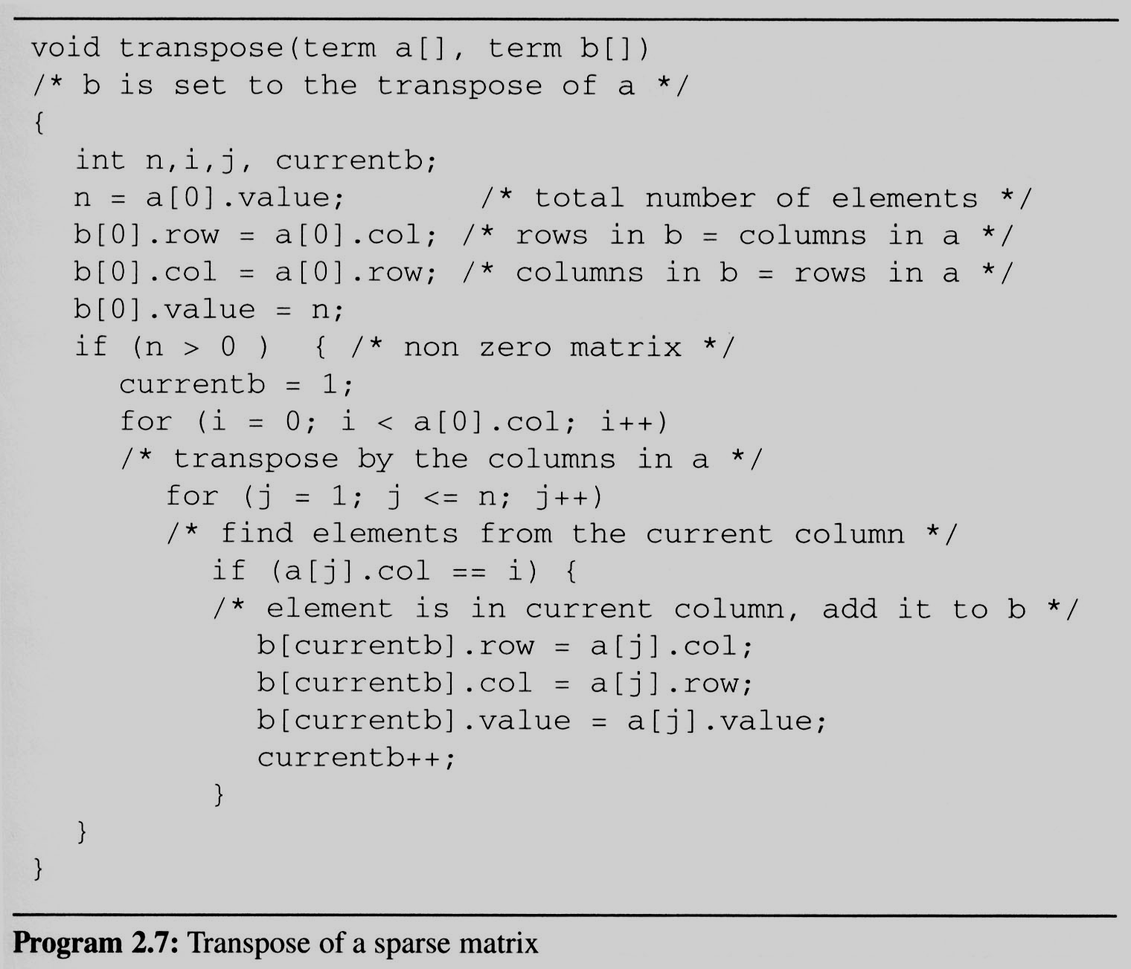
2.4 The sparse matrix ADT (7/18)
This algorithm is incorporated in transpose (Program 2.7).
==> O(columns*elements)

Slide 17
2.4 The sparse matrix ADT (7/18)
This algorithm is incorporated in transpose (Program 2.7).
Assign
A[i][j] to B[j][i]
place element <i, j, value> in element <j, i, value>
For all columns i
For all elements in column j
Scan the array
“columns” times.
The array has
“elements” elements.
==> O(columns*elements)

Slide 18
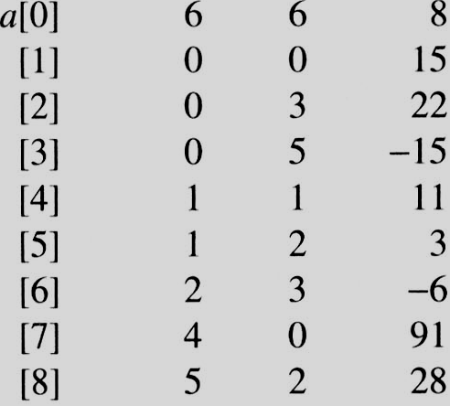
i=0 j=1
i=0 j=1
a[j]= 0 == i
i=0 j=2
i=0 j=2
a[j]=3 != i
i=0 j=3
i=0 j=3
a[j] = 5 != i
i=0 j=4
i=0 j=4
a[j].col = 1 a[j].col != i
i=0 j=5
i=0 j=5
a[j].col = 2 a[j].col != i
i=0 j=6
i=0 j=6
a[j].col = 3 != i
i=0 j=7
i=0 j=7
a[j].col = 0 == i
i=0 j=8
i=0 j=8
a[j].col = 2 != i
i=1 j=1
i=1 j=1
a[j].col = 0 != i
i=1 j=2
i=1 j=2
a[j].col = 3 != i
i=1 j=3
i=1 j=3
a[j].col = 5 != i
i=1 j=4
i=1 j=4
a[j].col = 1 == i
i=1 j=5
i=1 j=5
a[i].col = 2 != i
i=1 j=6
i=1 j=6
a[j].col = 3 != i
i=1 j=7
i=1 j=7
a[j] = 0 != i
i=1 j=8
EX: A[6][6] transpose to B[6][6]
i=1 j=8
a[i].col = 2 != i
Matrix A
Row Col Value
Set Up row & column in B[6][6]
Row Col Value
0 6 6 8
1 0 0 15
2 0 4 91
3 1 1 11
And So on…

Slide 19
2.4 The sparse matrix ADT (8/18)
Discussion: compared with 2-D array representation
  O(columns*elements) vs. O(columns*rows)
  elements --> columns * rows when non-sparse,
  O(columns²*rows)
Problem: Scan the array “columns” times.
  In fact, we can transpose a matrix represented as a sequence of triples in O(columns + elements) time.
Solution:
  First, determine the number of elements
  in each column of the original matrix.
  Second, determine the starting positions of each row
  in the transpose matrix.

Slide 20
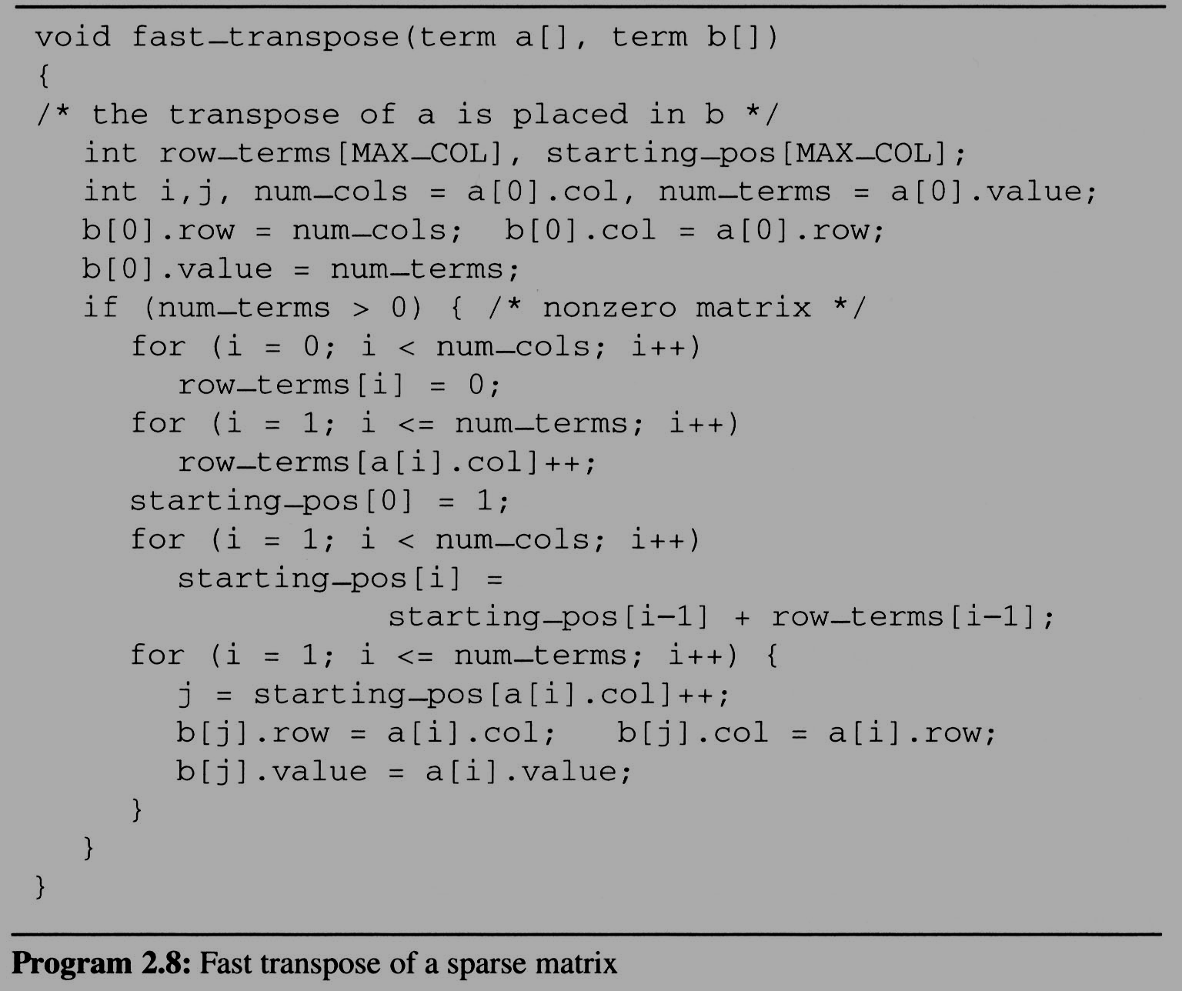
2.4 The sparse matrix ADT (9/18)
Compared with 2-D array representation:
O(columns+elements) vs. O(columns*rows)
elements --> columns * rows O(columns*rows)
Cost:
Additional row_terms and starting_pos arrays are required.
Let the two arrays row_terms and starting_pos be shared.
For columns
Buildup row_term
& starting_pos
For elements
For columns
columns
transpose
For elements

Slide 21
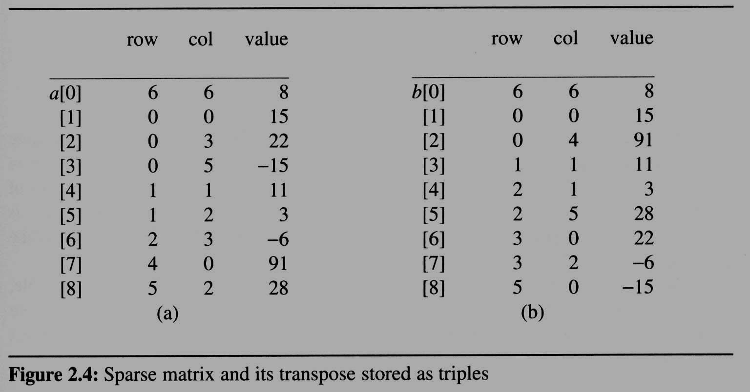
2.4 The sparse matrix ADT (10/18)
After the execution of the third for loop, the values of row_terms and starting_pos are:
[0] [1] [2] [3] [4] [5]
row_terms = 2 1 2 2 0 1
starting_pos = 1 3 4 6 8 8
transpose

Slide 22
[0] [1] [2] [3] [4] [5]
row_terms
0
1
2
0
1
0
1
2
1
2
0
0
0
1
#col = 6
#term = 6
Matrix A
Row Col Value
starting_pos
1
3
4
6
8
8

Slide 23
[0] [1] [2] [3] [4] [5]
row_terms = 2 1 2 2 0 1
starting_pos = 1 3 4 6 8 8
[0] [1] [2] [3] [4] [5]
row_terms = 2 1 2 2 0 1
starting_pos = 2 3 4 6 8 8
[0] [1] [2] [3] [4] [5]
row_terms = 2 1 2 2 0 1
starting_pos = 2 3 4 7 8 8
[0] [1] [2] [3] [4] [5]
row_terms = 2 1 2 2 0 1
starting_pos = 2 3 4 7 8 9
[0] [1] [2] [3] [4] [5]
row_terms = 2 1 2 2 0 1
starting_pos = 2 4 4 7 8 9
[0] [1] [2] [3] [4] [5]
row_terms = 2 1 2 2 0 1
starting_pos = 2 4 5 7 8 9
[0] [1] [2] [3] [4] [5]
row_terms = 2 1 2 2 0 1
starting_pos = 2 4 5 8 8 9
[0] [1] [2] [3] [4] [5]
row_terms = 2 1 2 2 0 1
starting_pos = 3 4 5 8 8 9
[0] [1] [2] [3] [4] [5]
row_terms = 2 1 2 2 0 1
starting_pos = 3 4 6 8 8 9
I = 1
I = 2
I = 3
I = 4
I = 5
I = 6
I = 7
I = 8
Matrix A
Row Col Value
Row Col Value
0 6 6 8
1 0 0 15
2 0 4 91
3 1 1 11
4 2 1 3
5 2 5 28
6 3 0 22
7 3 2 -6
8 5 0 -15

Slide 24
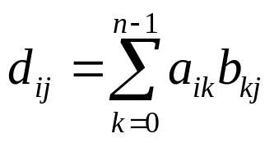
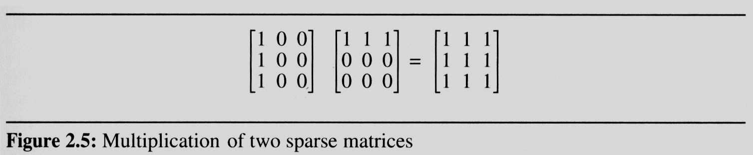
2.4 The sparse matrix ADT (11/18)
2.4.3 Matrix multiplication
  Definition:
    Given A and B where A is m×n and B is n×p, the product matrix D has dimension m×p. Its <i, j> element is
    for 0 ≤ i < m and 0 ≤ j < p.
  Example:

Slide 25
2.4 The sparse matrix ADT (12/18)
Sparse Matrix Multiplication
  Definition: [D]_{m*p}=[A]_{m*n}* [B]_{n*p}
  Procedure: Fix a row of A and find all elements
  in column j of B for j=0, 1, …, p-1.

Slide 26
2.4 The sparse matrix ADT (12/18)
Sparse Matrix Multiplication
  Definition: [D]_{m*p}=[A]_{m*n}* [B]_{n*p}
  Procedure: Fix a row of A and find all elements
  in column j of B for j=0, 1, …, p-1.
  Alternative 1.
  Scan all of B to find all elements in j.
  Alternative 2.
  Compute the transpose of B.
  (Put all column elements consecutively)
    Once we have located the elements of row i of A and column j of B we just do a merge operation similar to that used in the polynomial addition of 2.2

Slide 27
2.4 The sparse matrix ADT (13/18)
General case:
d_{ij}=a_{i0}*b_{0j}+a_{i1}*b_{1j}+…+a_{i(n-1)}*b_{(n-1)j}
  Array A is grouped by row i, and after transpose,
  array B is also grouped by column j
A’ a_{0*} B’ b_{*0}
A’’ a_{1*} B’’ b_{*1}
A’’’ a_{2*} B’’’ b_{*2}
B’’’’ b_{*3}
The multiply operation generate entries:
A’*B’, A’*B’’, A’*B’’’, A’*B’’’’, A’’*B’, A’’*B’’, A’’*B’’’ , A’’*B’’’’….

Slide 28
The sparse matrix ADT (14/18)
An Example
A = 1 0 2 B^{T} = 3 -1 0 B = 3 0 2
-1 4 6 0 0 0 -1 0 0
2 0 5 0 0 5
a[0] 2 3 5 b_{t}[0] 3 3 4 b[0] 3 3 4
[1] 0 0 1 b_{t}[1] 0 0 3 b[1] 0 0 3
[2] 0 2 2 b_{t}[2] 0 1 -1 b[2] 0 2 2
[3] 1 0 -1 b_{t}[3] 2 0 2 b[3] 1 0 -1
[4] 1 1 4 b_{t}[4] 2 2 5 b[4] 2 2 5
[5] 1 2 6
row
col
value
row
col
value
row
col
value

Slide 29
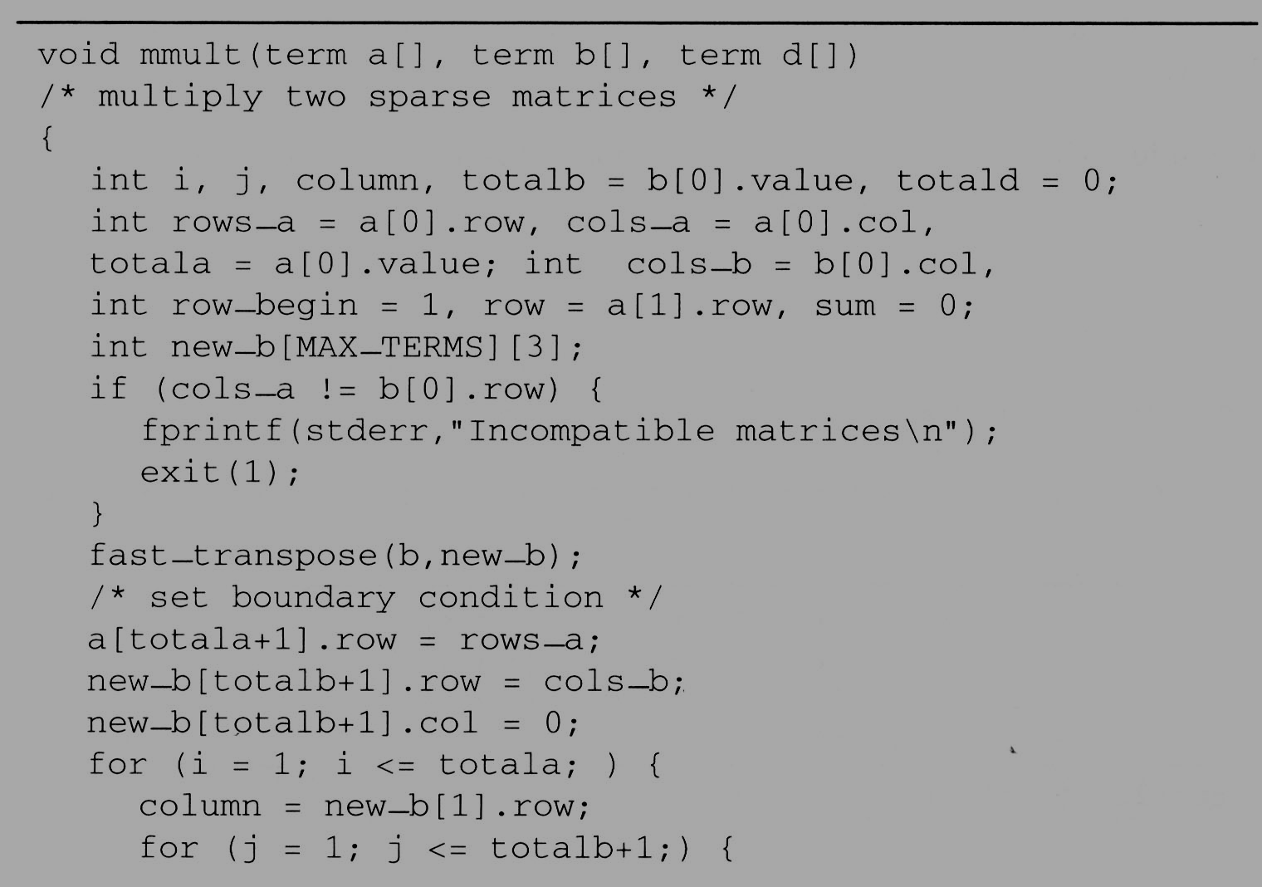
a[0] 2 3 5 b_{t}[0] 3 3 4 b[0] 3 3 4
[1] 0 0 1 b_{t}[1] 0 0 3 b[1] 0 0 3
[2] 0 2 2 b_{t}[2] 0 1 -1 b[2] 0 2 2
[3] 1 0 -1 b_{t}[3] 2 0 2 b[3] 1 0 -1
[4] 1 1 4 b_{t}[4] 2 2 5 b[4] 2 2 5
[5] 1 2 6
row
col
value
row
col
value
row
col
value
[5] 3 0
Totala = 5
Totalb = 4
Totald = 0
rows_a = 2
cols_a = 3
cols_b = 3
row_begin = 1
row = 0

Slide 30
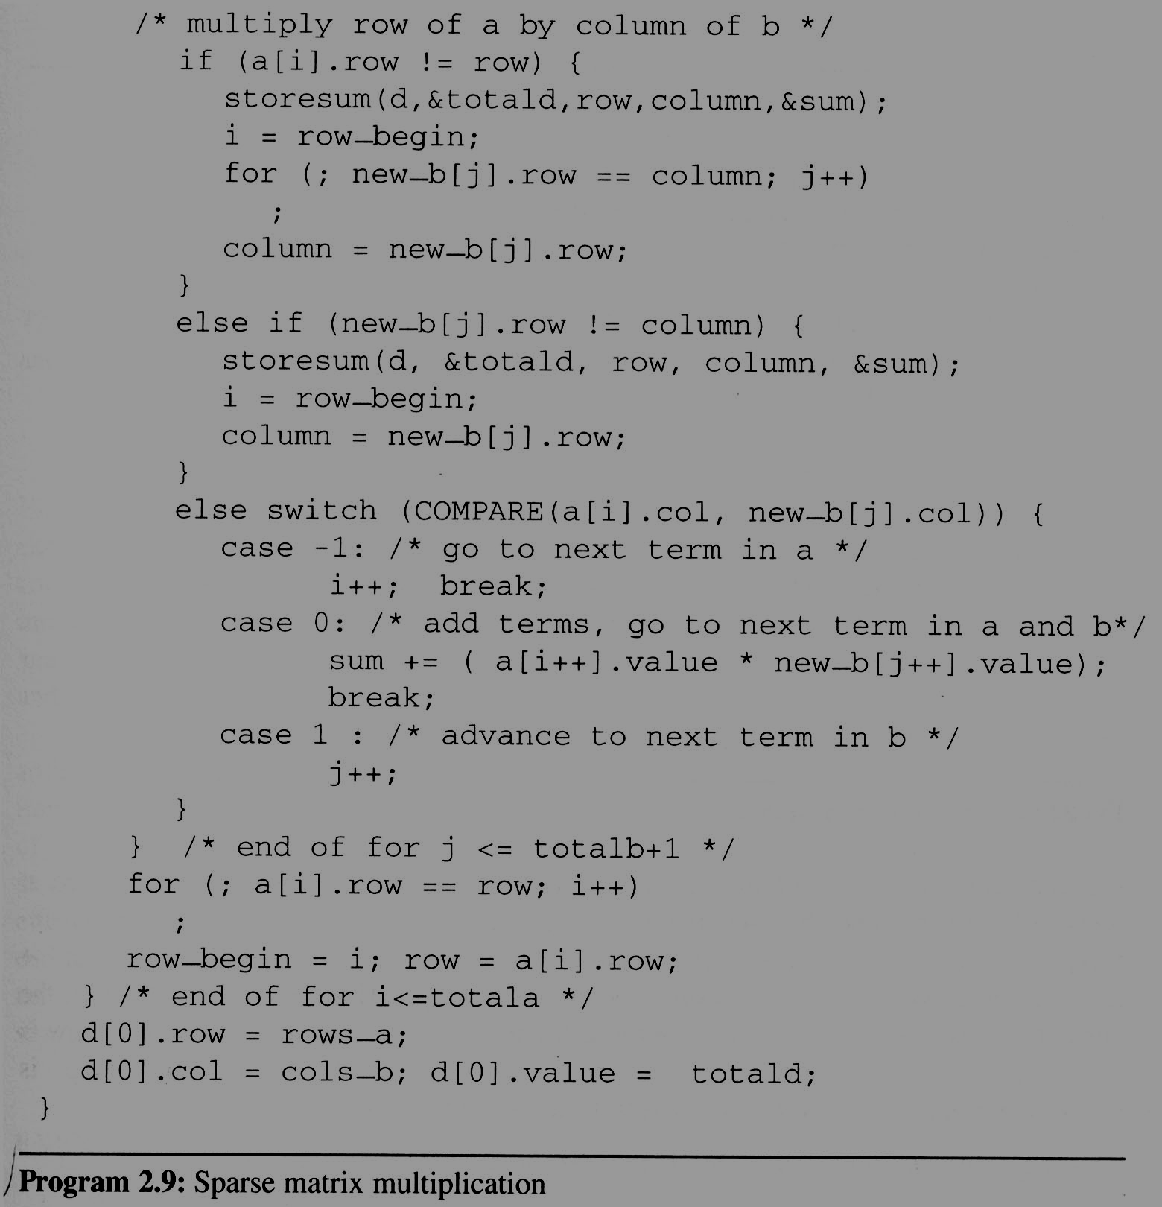
Totala = 5
rows_a = 2
row_begin = 1
Variable
Value
D
Totalb = 4
cols_a = 3
row = 0
2
3
i
1
2
1
2
3
cols_b = 3
1
Totald = 0
1
d[1] 0 0 3
j
2
3
4
5
6
7
0
d[2] 0 2 12
column
2
3
row
0
1
sum
12
3
0
2
0
row_begin
1
3
a[0] 2 3 5
[1] 0 0 1
[2] 0 2 2
[3] 1 0 -1
[4] 1 1 4
[5] 1 2 6
[6] 2
A[0][0]*B[0][0]
A[0][0]*B[0][2]
A[0][2]*B[2][2]
b_{t}[0] 3 3 4
b_{t}[1] 0 0 3
b_{t}[2] 0 1 -1
b_{t}[3] 2 0 2
b_{t}[4] 2 2 5
b_{t}[5] 3 0
And So on…

Slide 31
2.4 The sparse matrix ADT (15/18)
The programs 2.9 and 2.10 can obtain the product matrix D which multiplies matrices A and B.
a × b

Slide 32
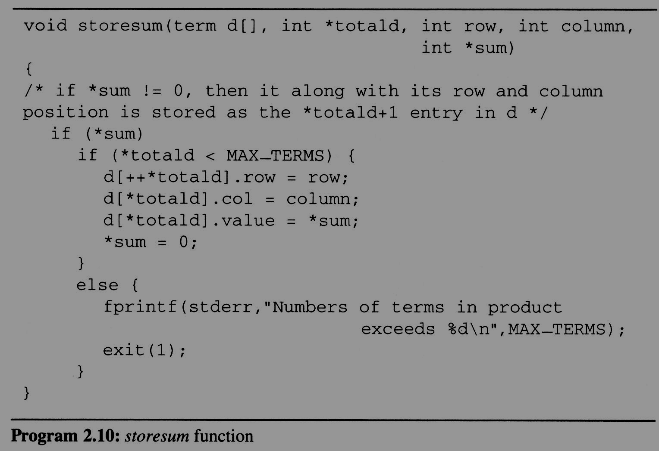
2.4 The sparse matrix ADT (16/18)

Slide 33
2.4 The sparse matrix ADT (18/18)
Compared with matrix multiplication using array
  for (i =0; i < rows_a; i++)
  for (j=0; j < cols_b; j++) {
  sum =0;
  for (k=0; k < cols_a; k++)
  sum += (a[i][k] *b[k][j]);
  d[i][j] =sum;
  }
  O(rows_a * cols_a * cols_b) vs.
  O(cols_b * total_a + rows_a * total_b)

Slide 34
2.4 The sparse matrix ADT (18/18)
Compared with matrix multiplication using array
  for (i =0; i < rows_a; i++)
  for (j=0; j < cols_b; j++) {
  sum =0;
  for (k=0; k < cols_a; k++)
  sum += (a[i][k] *b[k][j]);
  d[i][j] =sum;
  }
  O(rows_a * cols_a * cols_b) vs.
  O(cols_b * total_a + rows_a * total_b)
    optimal case:
    total_a < rows_a * cols_a
    total_b < cols_a * cols_b
    worse case:
    total_a --> rows_a * cols_a, or
    total_b --> cols_a * cols_b

