Slide 1
CS235102
Data Structures
Chapter 2 Arrays and Structures

Slide 2
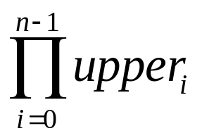
2.5 Representation of multidimensional array (1/5)
The internal representation of multidimensional arrays requires more complex addressing formula.
  If an array is declared a[upper₀][upper₁]…[upper_{n}], then it is easy to see that the number of elements in the array is:
  Where Π is the product of the upper_{i}’s.
  Example:
    If we declare a as a[10][10][10], then we require 10*10*10 = 1000 units of storage to hold the array.

Slide 3
2.5 Representation of multidimensional array (2/5)
Represent multidimensional arrays:
row major order and column major order.
  Row major order stores multidimensional arrays by rows.
    A[u₀][u₁] as
    upper₀ rows: row₀, row₁, …, row_{u0-1},
    each row containing upper1 elements.

Slide 4
2.5 Representation of multidimensional array (3/5)
Row major order: A[i][j] : α + i*u₁ + j
Column major order: A[i][j] : α + j*u₀ + i
  col₀ col₁ col_{u1-1}
  row₀ A[0][0] A[0][1] . . . A[0][u1-1]
  α α + u₀ α+(u₁-1)* u₀
  row₁ A[1][0] A[1][1] . . . A[1][u1-1]
  α + u₁
  . . .
  row_{u0-1} A[u0-1][0] A[u0-1][1] . . . A[u0-1][u1-1]
  α+(u₀-1)*u₁

Slide 5
2.5 Representation of multidimensional array (4/5)
To represent a three-dimensional array, A[upper₀][upper₁][upper₂], we interpret the array as upper₀ two-dimensional arrays of dimension upper₁×upper₂.

Slide 6
2.5 Representation of multidimensional array (4/5)
  a[i][0][0]: α + i*upper₁*upper₂ as the address of a[i][0][0] because there are i two dimensional arrays of size upper₁*upper₂ preceding this element.
  a[i][j][k]: α + i*upper₁*upper₂+j *upper₂+k
  as the address of a[i][j][k].

Slide 7
2.5 Representation of multidimensional array (5/5)
Generalizing on the preceding discussion, we can obtain the addressing formula for any element A[i₀][i₁]…[i_{n-1}] in an n-dimensional array declared as: A[upper₀][upper₁]…[upper_{n-1}]

Slide 8
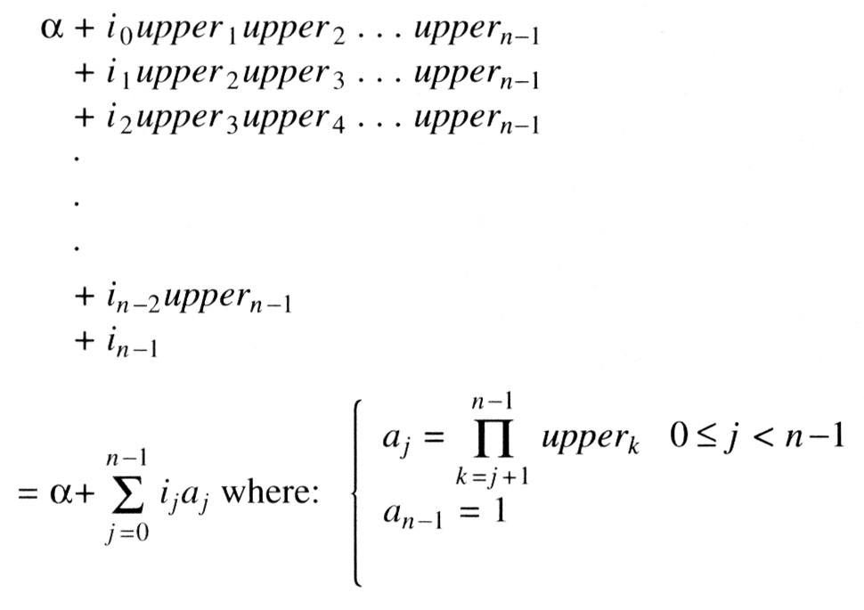
2.5 Representation of multidimensional array (5/5)
The address for A[i₀][i₁]…[i_{n-1}] is:

Slide 9
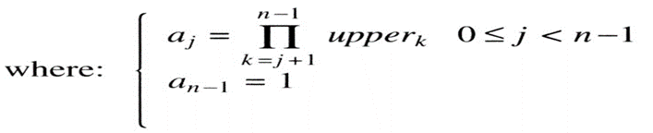
2.5 Representation of multidimensional array (5/5)
The address for A[i₀][i₁]…[i_{n-1}] is:

