Slide 1
Data Structures
Chapter 8 Hashing
(Concentrating on Static Hashing)

Slide 2
Chapter 8 Hashing: Outline
The Symbol Table Abstract Data Type
Static Hashing
  Hash Tables
  Hashing Functions
    Mid-square
    Division
    Folding
    Digit Analysis
  Overflow Handling
    Linear Open Addressing, Quadratic probing, Rehashing
    Chaining

Slide 3
The Symbol Table ADT (1/3)
In computer science, we generally use the term symbol table rather than dictionary, when referring to the ADT.
We define the symbol table as a set of name-attribute pairs.
  Example: In a symbol table for a compiler
    the name is an identifier
    the attributes might include an initial value
    a list of lines that use the identifier.

Slide 4
The Symbol Table ADT (2/3)
Operations on symbol table:
  Determine if a particular name is in the table
  Retrieve/modify the attributes of that name
  Insert/delete a name and its attributes

Slide 5
The Symbol Table ADT (2/3)
Implementations
  Binary search tree: the complexity is O(n)
  Some other binary trees (chapter 10): O(log n).
  Hashing
    A technique for search, insert, and delete operations that has very good expected performance.

Slide 6
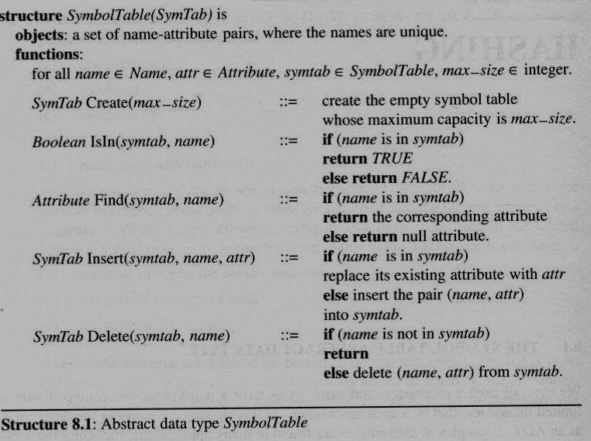
The Symbol Table ADT (3/3)

Slide 7
Search Techniques
Search tree methods
  Identifier comparisons
Hashing methods
  Relies on a formula called the hash function.
Types of hashing
  Static hashing
  Dynamic hashing

Slide 8
Hash Tables (1/6)
In static hashing, we store the identifiers in a fixed size table called a hash table
Arithmetic function, f
  To determine the address of an identifier, x, in the table
  f(x) gives the hash, or home address, of x in the table
Hash table, ht
  Stored in sequential memory locations that are partitioned into b buckets, ht[0], …, ht[b-1].
  Each bucket has s slots

Slide 9
Hash Tables (2/6)
hash table (ht) f(x): 0 … (b-1)
0
1
2
.
.
b-2
b-1
b buckets
1 2 ………. s
s slots

Slide 10
Hash Tables (3/6)
The identifier density of a hash table
is the ratio n/T
  n is the number of identifiers in the table
  T is possible identifiers
The loading density or loading factor
of a hash table is α = n/(sb)
  s is the number of slots
  b is the number of buckets

Slide 11
Hash Tables (4/6)
Two identifiers, i₁ and i₂ are synonyms with respect to f if f(i₁) = f(i₂)

Slide 12
Hash Tables (4/6)
An overflow occurs when we hash a new
identifier into a full bucket
A collision occurs when we hash two
non-identical identifiers into the same bucket.
When the bucket size is 1, collisions and overflows occur simultaneously.

Slide 13
Hash Tables (5/6)
Example 8.1: Hash table
  b = 26 buckets and s = 2 slots. Distinct identifiers n = 10
  The loading factor, α, is 10/52 = 0.19.
  Associate the letters, a-z,
  with the numbers, 0-25,
  respectively
  Define a fairly simple hash
  function, f(x), as the
  first character of x.
bucket | Slot 0 | Slot 1
0 | acos | atan
1
2 | char | ceil
3 | define
4 | exp
5 | float | floor
…
25
Synonyms
Synonyms
C library functions (f(x)):
acos(0), define(3), float(5), exp(4), char(2), atan(0), ceil(2), floor(5), clock(2), ctime(2)
Synonyms
overflow: clock, ctime

Slide 14
Hash Tables (6/6)
The time required to enter, delete, or search for identifiers does not depend on the number of identifiers n in use; it is O(1).
Hash function requirements/challenge:
  Easy to compute and produces few collisions.
  Unfortunately, since the ration b/T is usually small, we cannot avoid collisions altogether.
  => Overload handling mechanisms are needed

Slide 15
Hashing Functions (1/8)
Hashing functions should be unbiased.
  That is, if we randomly choose an identifier, x, from the identifier space, the probability that f(x) = i is 1/b for all buckets i.
  We call a hash function that satisfies unbiased property a uniform hash function.
  Mid-square, Division, Folding, Digit Analysis

Slide 16
Hashing Functions (2/8)
Mid-square f_{m}(x)=middle(x²):
  Frequently used in symbol table applications.
  We compute f_{m} by squaring the identifier and then using an appropriate number of bits from the middle of the square to obtain the bucket address.
  The number of bits used to obtain the bucket address depends on the table size. If we use r bits, the range of the value is 2^{r}.
  Since the middle bits of the square usually depend upon all the characters in an identifier, there is high probability that different identifiers will produce different hash addresses.

Slide 17
Hashing Functions (3/8)
Division f_{D}(x) = x % M :
  Using the modulus (%) operator.
  We divide the identifier x by some number M and use the remainder as the hash address for x.
    This gives bucket addresses that range from 0 to M - 1, where M = that table size.
The choice of M is critical.
  If M is divisible by 2, then odd keys to odd buckets and even keys to even buckets. (biased!!)

Slide 18
Hashing Functions (4/8)
The choice of M is critical (cont’d)
  When many identifiers are permutations of each other, a biased use of the table results.
  Example: X=x₁x₂ and Y=x₂x₁
  Internal binary representation: x₁ --> C(x₁) and x₂ --> C(x₂)
  Each character is represented by six bits
  X: C(x₁) * 2⁶ + C(x₂), Y: C(x₂) * 2⁶ + C(x₁)
  (f_{D}(X) - f_{D}(Y)) % p (where p is a prime number)
  = (C(x₁) * 2⁶ % p + C(x₂) % p - C(x₂) * 2⁶ % p - C(x₁) % p ) % p
  p = 3, 2⁶=64
  (64 % 3 * C(x₁) % 3 + C(x₂) % 3 - 64 % 3 * C(x₂) % 3 - C(x₁) % 3) % 3
  = C(x₁) % 3 + C(x₂) % 3 - C(x₂) % 3 - C(x₁) % 3 = 0 % 3
  The same behavior can be expected when p = 7
  A good choice for M would be : M a prime number (or M has no prime factor smaller than 20)

Slide 19
Hashing Functions (5/8)
Folding
  Partition identifier x =12320324111220 into several parts
  All parts except for the last one have the same length
  Add the parts together to obtain the hash address

Slide 20
Hashing Functions (5/8)
Folding
  Partition identifier x =12320324111220 into several parts
Two possibilities (divide x into several parts)
  Shift folding:
  Shift all parts except for the last one, so that the least significant bit of each part lines up with corresponding bit of the last part.
    x₁=123, x₂=203, x₃=241, x₄=112, x₅=20, address=699
  Folding at the boundaries:
  reverses every other partition before adding
    x₁=123, x₂=302, x₃=241, x₄=211, x₅=20, address=897

Slide 21
Hashing Functions (6/8)
Folding example:
123 203 241 112 20
P1
P2
P3
P4
P5
shift folding
123
203
241
112
20
699
folding at the
boundaries
123 203 241 112 20
MSD ---> LSD
LSD <--- MSD

Slide 22
Hashing Functions (7/8)
Digit Analysis
  Used with static files
    A static files is one in which all the identifiers are known in advance.
  Using this method,
    First, transform the identifiers into numbers using some radix, r.
    Second, examine the digits of each identifier, deleting those digits that have the most skewed distribution.
    We continue deleting digits until the number of remaining digits is small enough to give an address in the range of the hash table.

Slide 23
Hashing Functions (8/8)
Digital Analysis example:
  All the identifiers are known in advance, M=1~999
      X₁:d₁₁ d₁₂ … d_{1n}
      X₂:d₂₁ d₂₂ … d_{2n}
      …
      X_{m}:d_{m1} d_{m2} … d_{mn}
  Select 3 digits from n
  Criterion:
  Delete the digits having the most skewed distributions
The one most suitable for general purpose applications is the division method with a divisor, M, such that M has no prime factors less than 20.

Slide 24
Overflow Handling (1/8)
Open addressing
  Linear probing, quadratic probing, rehashing
Chaining

Slide 25
Overflow Handling (1/8)
Linear open addressing (Linear probing)
  Compute f(x) for identifier x
  Examine the buckets:
  ht[(f(x)+j)%TABLE_SIZE], 0 ≤ j ≤ TABLE_SIZE
    The bucket contains x.
    The bucket contains the empty string (insert to it)
    The bucket contains a nonempty string other than x
    (examine the next bucket) (circular rotation)
    Return to the home bucket ht[f(x)],
    if the table is full we report an error condition and exit

Slide 26
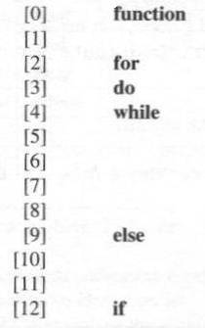
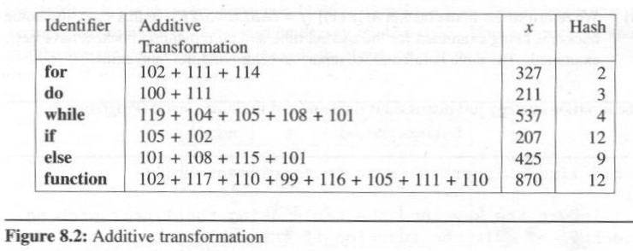
Overflow Handling (2/8)
Additive transformation and Division
Hash table with linear probing (13 buckets, 1 slot/bucket)
insertion

Slide 27
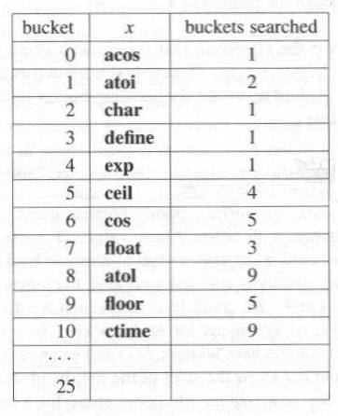
Overflow Handling (3/8)
Problem of Linear Probing
  Identifiers tend to cluster together
  Adjacent cluster tend to coalesce
    Increase the search time
    Example: suppose we enter the
    C built-in functions into a
    26-bucket hash table in order.
    The hash function uses the first
    character in each function name
ctime
float
acos
atoi
atol
ceil
define
cos
char
floor
Enter:
exp
Enter sequence:
acos, atoi, char, define, exp,
ceil, cos, float, atol, floor, ctime
# of key comparisons=41/11=3.72
Hash table with linear probing (26 buckets, 1 slot/bucket)

Slide 28
Overflow Handling (4/8)
Alternative techniques to improve open addressing approach:
  Rehashing
  Quadratic probing
Rehashing
  Try f₁, f₂, …, f_{m} in sequence if collision occurs
  disadvantage
    comparison of identifiers with different hash values

Slide 29
Overflow Handling (5/8)
Quadratic Probing
  Linear probing searches buckets (f(x)+i)%b
  Quadratic probing uses a quadratic function of i as the increment
  Examine buckets f(x), (f(x)+i²)%b, (f(x)-i²)%b, for 1<=i<=(b-1)/2
  When b is a prime number of the form
  4j+3, j is an integer, the quadratic search
  examines every bucket in the table
Prime | j | Prime | j
3 | 0 | 43 | 10
7 | 1 | 59 | 14
11 | 2 | 127 | 31
19 | 4 | 251 | 62
23 | 5 | 503 | 125
31 | 7 | 1019 | 254

Slide 30
Overflow Handling (6/8)
Chaining
  Linear probing and its variations perform poorly because inserting an identifier requires the comparison of identifiers with different hash values.
  In this approach we maintained a list of synonyms for each bucket.
  To insert a new element
    Compute the hash address f (x)
    Examine the identifiers in the list for f(x).
  Since we would not know the sizes of the lists in advance, we should maintain them as lined chains

Slide 31
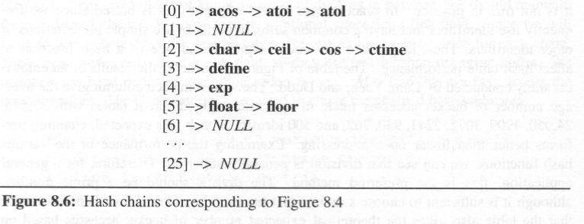
Overflow Handling (7/8)
Results of Hash Chaining
acos, atoi, char, define, exp, ceil, cos, float, atol, floor, ctime
f (x)=first character of x
# of key comparisons=21/11=1.91

Slide 32
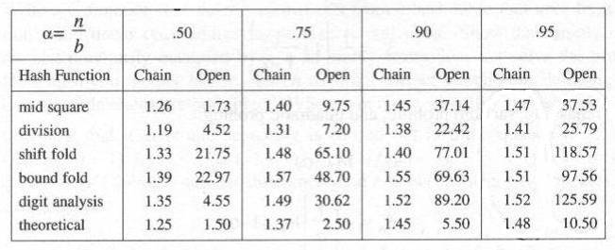
Overflow Handling (8/8)
Comparison:
  In Figure 8.7, The values in each column give the average number of bucket accesses made in searching eight different table with 33,575, 24,050, 4909, 3072, 2241, 930, 762, and 500 identifiers each.
  Chaining performs better than linear open addressing.
  We can see that division is generally superior
Average number of bucket accesses per identifier retrieved

Slide 33
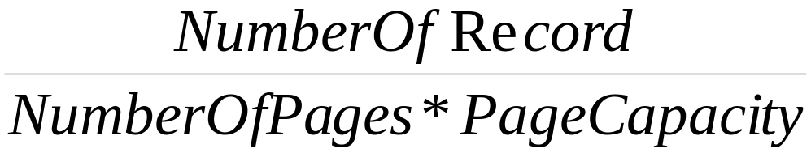
Dynamic Hashing
(extensible hashing)
dynamically increasing and decreasing file size
concepts
  file: a collection of records
  record: a key + data, stored in pages (buckets)
  space utilization
CHAPTER 8

Slide 34
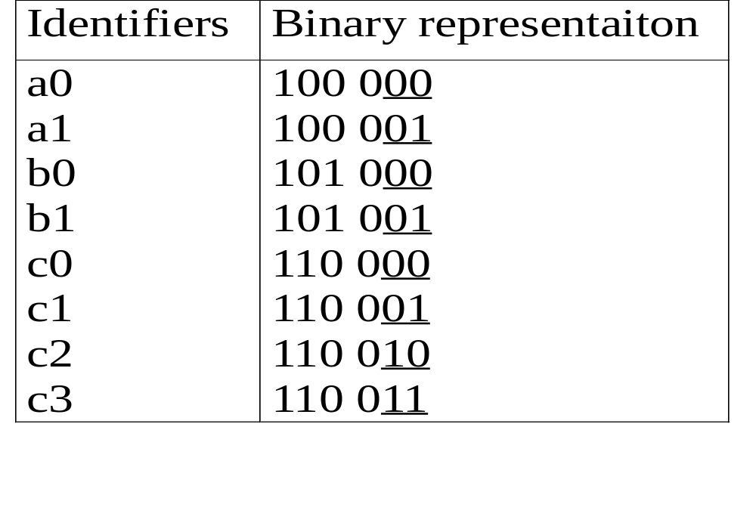
Dynamic Hashing Using Directories
CHAPTER 8

Slide 35
0
a0,b0
0
a0,b0
0
0
1
c2
1
c2
0
a1,b1
1
0
a1,b1
+c5
1
0
1
c3
1
c5
+c1
1
c3
(a) (b) inserting c5 with overflow
0
a0,b0
1
c2
0
0
a1,c1
0
0
1
b1
1
1
c5
1
c3
(c) inserting c1 with overflow
CHAPTER 8

Slide 36
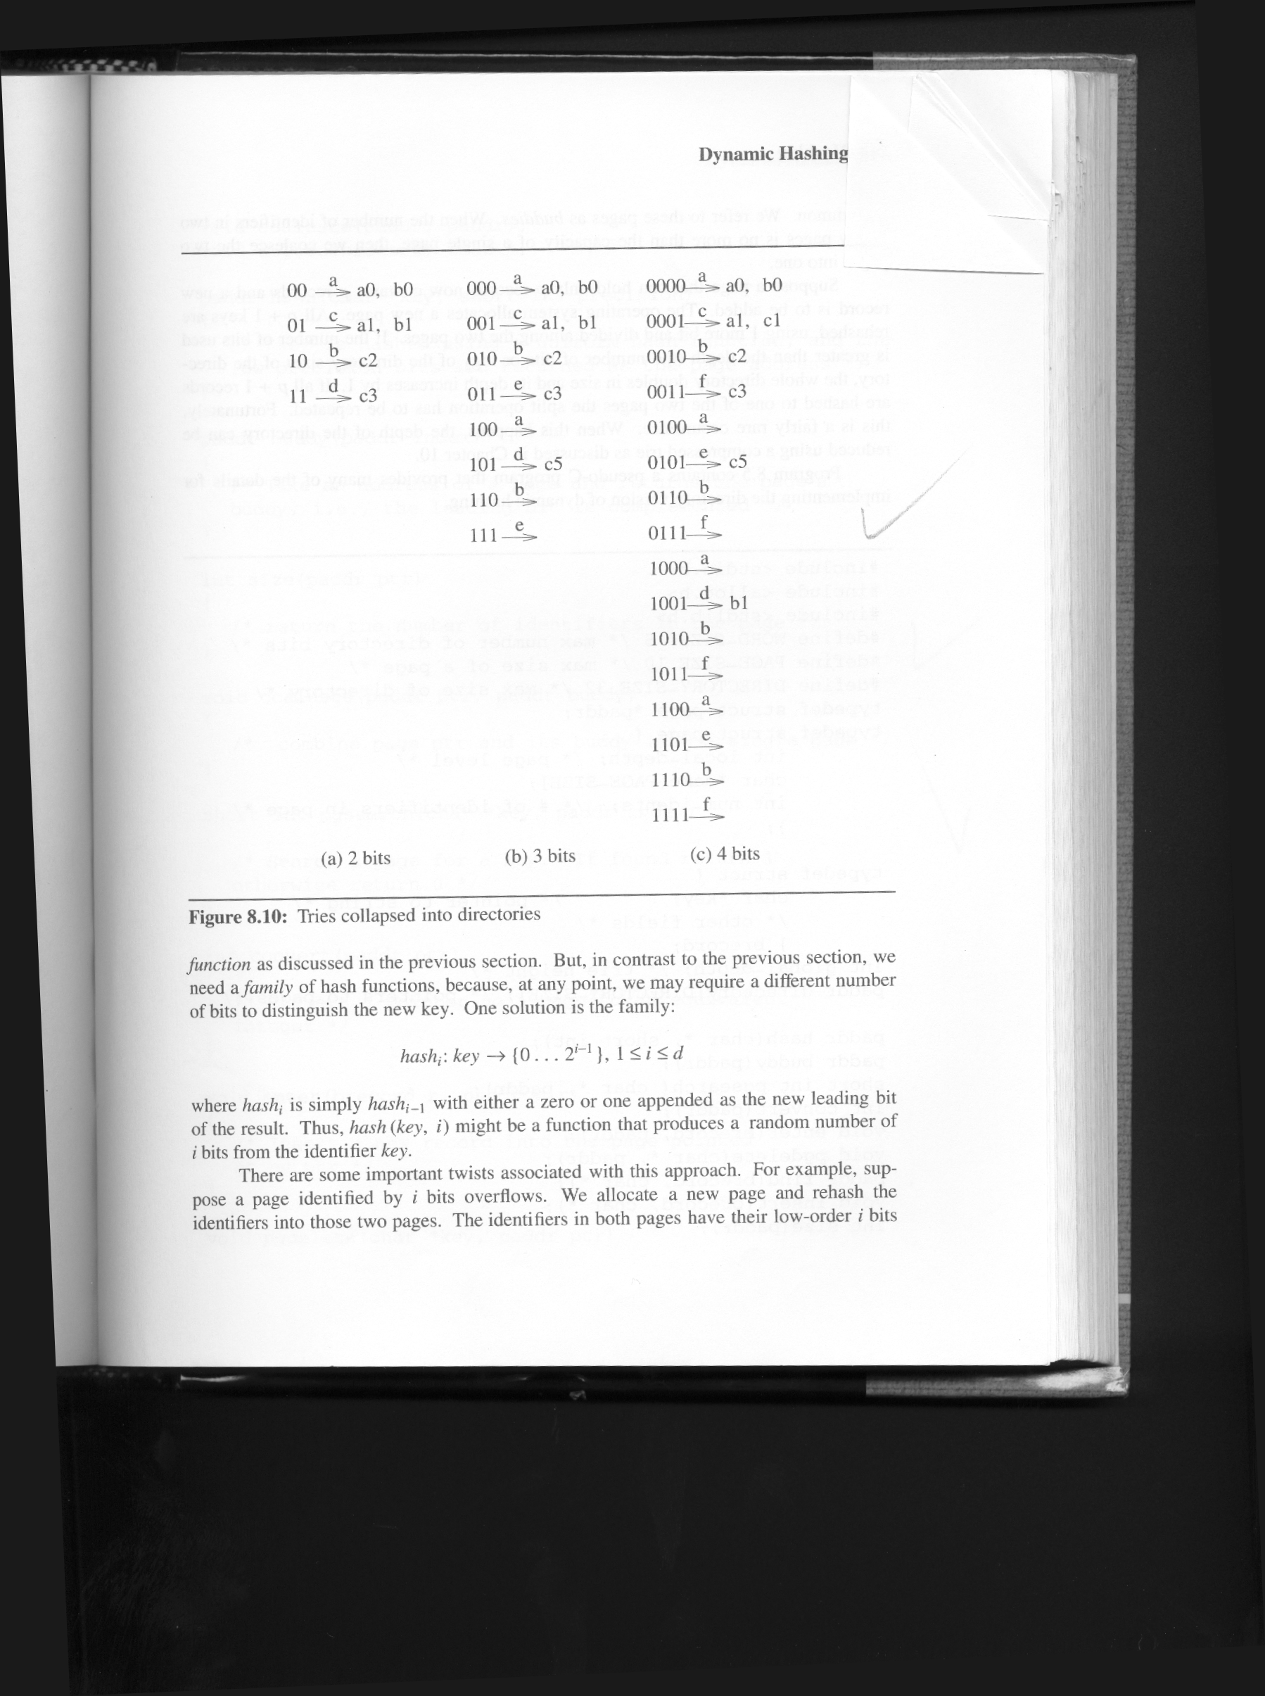

Slide 37
Directoryless Dynamic Hashing (Linear Hashing)
continuous address space
offset of base address (cf directory scheme)
0
1
0
1
a0,b0
00
01
10
11
a0
b0
c2
-
a1
b1
c3
-
0
1
c2
a1,b1
c3
*Figure 8.12: A trie mapped to a directoryless, contiguous storage (p.424)
CHAPTER 8

Slide 38
0000
0001
0010
0011
0100
0101
0110
0111
A0B0
A1C1
C2-
C3-
00
01
10
11
A0B0
A1B1
C2-
C3-
000
001
010
011
A0B0
A1B1
C2-
C3-
+c5
+c1
--
C5-
--
--
--
C5-
--
--
100
101
110
111
1000
1001
1010
1011
1100
1101
1110
1111
--
B1-
--
--
insert c5
10 overflows
00 splits
(b)
--
--
--
--
(a)

