Slide 1
Orderflow Engine
A pricing engine and an idempotent order confirmation for a multi-country B2B beverage marketplace · Jesús Ariel González Bonilla · 2026-10-17

Slide 2
The problem
Shopkeepers buy from beverage distributors on one multi-tenant B2B platform, across countries and brands
An order goes catalog → cart → checkout (quote) → confirmation → history
Tier discounts, combos, gifts, taxes and credit can all act on the same order
In three releases, an order was confirmed and its number returned, then it was missing from the history
In some cases it had not even been recorded
The task: make that impossible, and keep the quoted total equal to the confirmed total
Orderflow Engine
2
Notes:
The assignment describes a B2B marketplace where shopkeepers order beverages from distributors, in several countries and brands on one platform. Its sharpest point is an incident that repeated in three releases: the shopkeeper received an order number, and then the order was not in the history. Everything shown next is designed so that this cannot happen again.

Slide 3
What was delivered
A1: a pricing engine behind POST /api/v1/quotes, with the breakdown per line and totals
A2: an idempotent POST /api/v1/orders, the order detail and the order history
A3: one ADR of one page, in English and Spanish, as Markdown, Word and PDF
The optional front, extended to the whole flow: cart, quote, confirmation, order and My orders
The full stack with Docker Compose, and one command that runs every test of the workspace
Specification, API contract, data model, nine diagrams and these delivery documents
Orderflow Engine
3
Notes:
The three parts of the assignment live in the API repository: the engine, the confirmation and the ADR. Around them come the web client, which the product owner extended from one summary screen to the full flow, the infrastructure that runs everything together, and the documentation. Nothing in A1, A2 or A3 depends on the web client.

Slide 4
Six repositories
orderflow-engine-api: the deliverable, with the code, the tests, the README and the ADR
orderflow-engine-web: the Angular client, served by nginx
orderflow-engine-infra: the full-stack compose, test-all and the end-to-end suite
orderflow-engine-docs: specification, contract, data model, architecture, diagrams and handoff
orderflow-engine-tools: generators and checks for the documents and the repositories
orderflow-engine-app: reserved for a future mobile app, not built
Orderflow Engine
4
Notes:
Each component lives in its own repository, so the service, the client, the infrastructure and the documents evolve and are released apart. The API repository stands alone as the deliverable the assignment asks for. The infrastructure repository is the only one that references its siblings, because it orchestrates them.

Slide 5
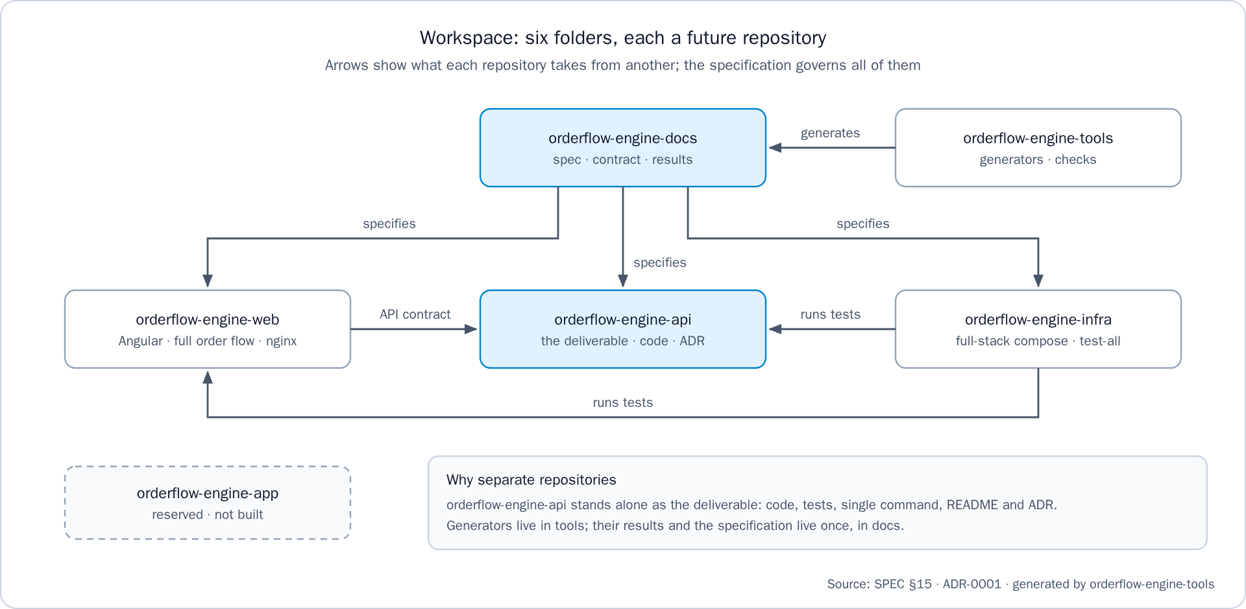
The six repositories at a glance
The six repositories of the workspace and what each one takes from another
Orderflow Engine
5
Notes:
The arrows show what each repository takes from another: the specification in orderflow-engine-docs governs all of them, the generators of orderflow-engine-tools produce what the documentation publishes, the web client follows the API contract, and orderflow-engine-infra runs the tests of both.

Slide 6
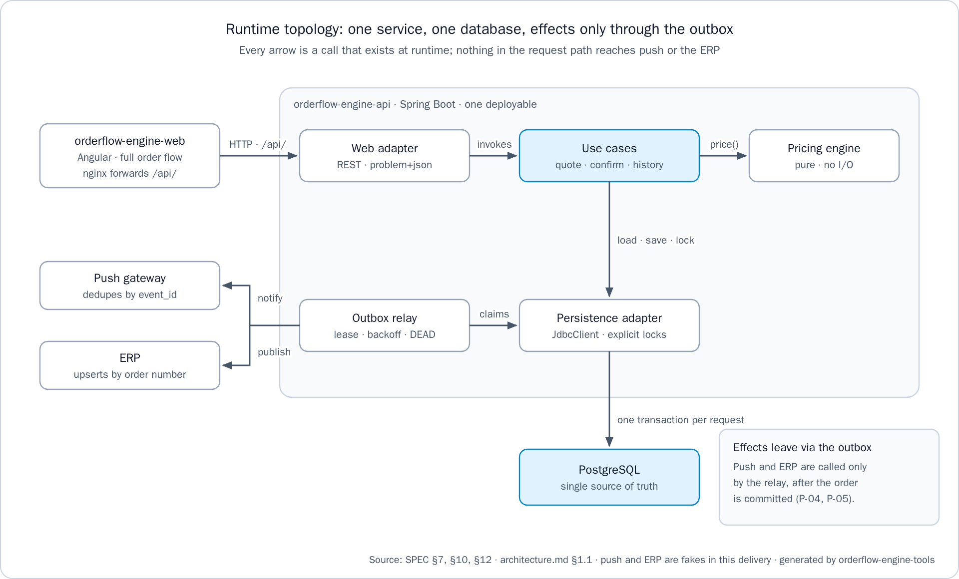
Runtime topology
One origin: nginx serves the Angular client and forwards /api/ to the API, so no CORS
One Spring Boot 4.1.1 service on Java 21: web adapter, use cases, pure engine, persistence
PostgreSQL 17 is the single source of truth: explicit SQL and row locks
Push and the ERP are called only by the outbox relay, after the order is committed
In this delivery, push and the ERP are fakes behind ports that deduplicate by event_id
Runtime topology: one service, one database, effects only through the outbox
Orderflow Engine
6
Notes:
At run time there is one service and one database. The browser only calls its own origin, and nginx forwards the API paths. Nothing in the request path calls push or the ERP: those effects leave through the outbox relay once the order is committed.

Slide 7
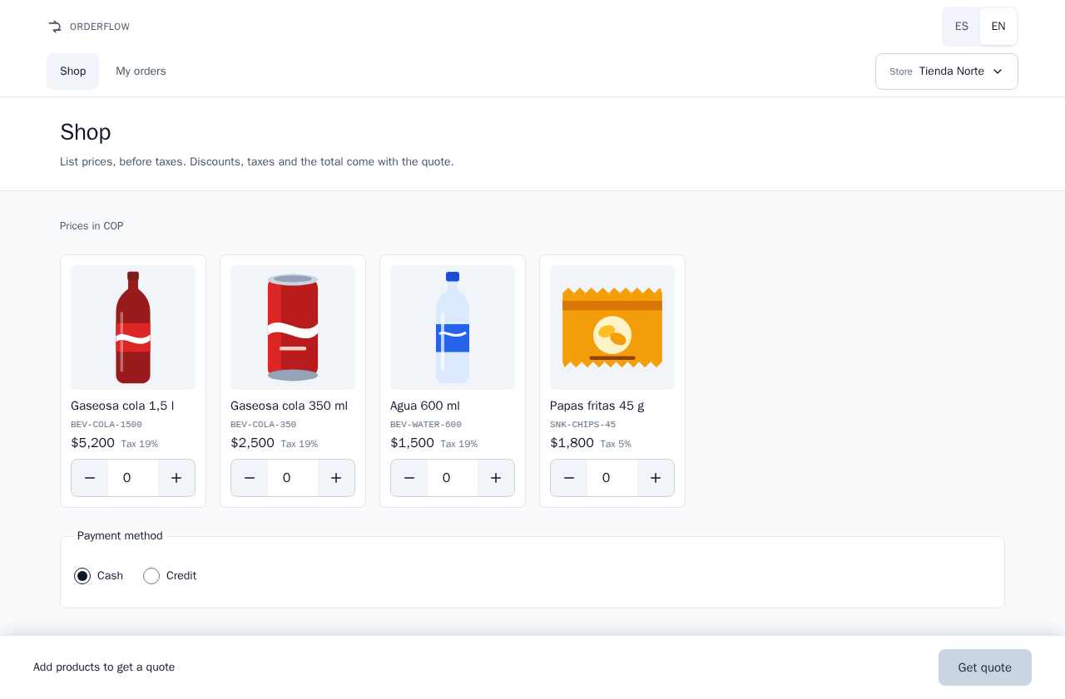
Step 1: choose a store and fill the cart
The store picker lists eight seeded stores, two per country, grouped by tenant
The cart reads the tenant's products from the API on every visit (GET /api/v1/products)
Each product shows its image, name, SKU, list price before taxes and tax rate
"Prices in COP" names the currency, because COP and USD share the $ symbol
Choose cash or credit, then tap "Get quote"
The cart shows units only: no subtotal and no total until the quote
The cart: the tenant's catalog with list prices before taxes
Orderflow Engine
7
Notes:
The store picker stands in for a login, which is out of scope: it sends a seeded tenant and customer as headers. The cart lists exactly what the API can price, and it never computes money, so the total arrives with the quote. The browser keeps one cart per store.

Slide 8
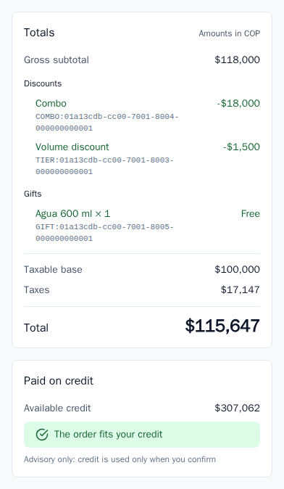
Step 2: get the quote
POST /api/v1/quotes prices the cart once and seals the quote
The summary shows each line, the order totals and the time until which the price is held
The price is held for 15 minutes, a time to live set per country
On credit, it shows the available credit and whether the order fits; nothing is reserved yet
If it does not fit, "Confirm order" is disabled and "Pay cash" quotes again in cash
The order summary: lines, totals and the time the price is held
Orderflow Engine
8
Notes:
This is the screen the assignment offered as the optional front. It reads the quote from the API on every visit and shows each amount exactly as the API sent it. The credit check here is advisory: credit is consumed only at confirmation.

Slide 9
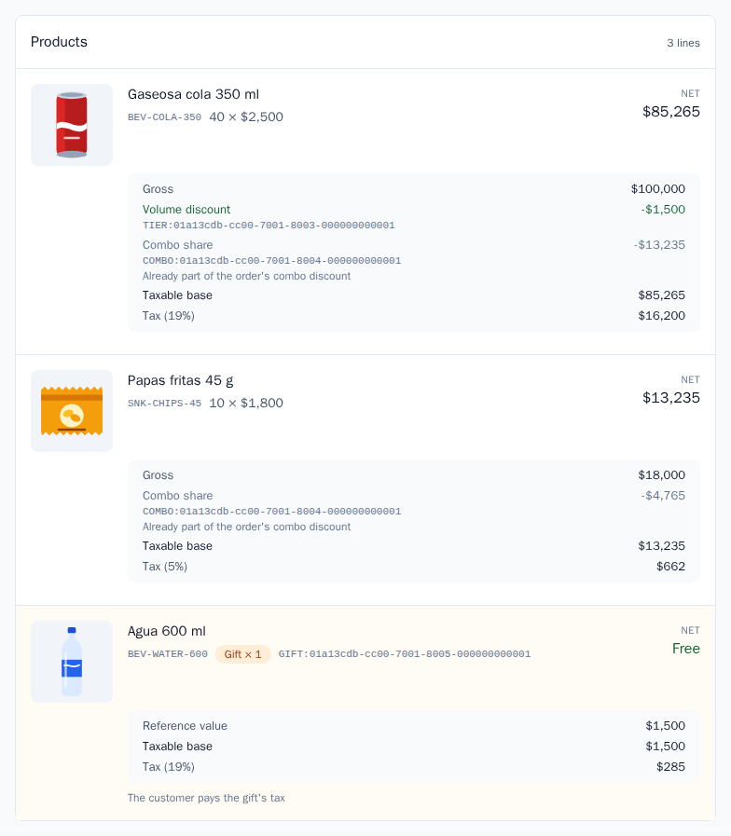
Step 3: read the levers on the quote
Each discount shows its origin: "Volume discount" for a tier, or "Combo"
A combo is one discount entry, and its products never show a loose discount
A line inside a combo shows its "Combo share", used only to derive its taxable base
A gift is a separate line with its quantity, free, with its reference value
The taxable base, the taxes and the total close the breakdown
The breakdown of the quote with the levers applied
Orderflow Engine
9
Notes:
This is the breakdown the assignment asks for: per line and in totals, the gross subtotal, discounts with their origin, gifts with their quantity, the taxable base, taxes and the total. The combo appears once, as the assignment requires, and its share on each line only explains that line's tax. Where the country taxes gifts, the screen says that the customer pays the gift's tax.

Slide 10
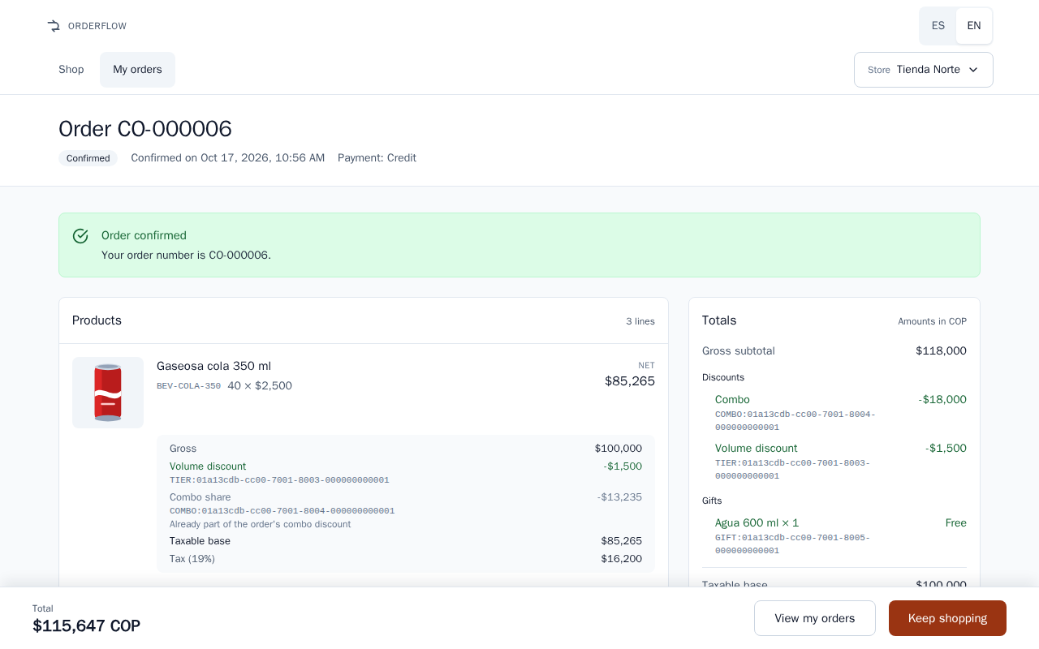
Step 4: confirm the order
"Confirm order" creates one idempotency key for the quote and keeps it in the browser
The button is disabled while the request is in flight, so a double tap sends one request
A retry after no answer, a 5xx or a reload sends the same key
A 201 opens the order with its number and the notice "Order confirmed"
A replayed 201 says "This order was already recorded": no second order, no extra credit used
The order right after its confirmation, with its number
Orderflow Engine
10
Notes:
The client side of idempotency mirrors the server side: one key per quote, created at the first tap and reused on every retry. If the network fails after the order was committed, the retry gets the same order back instead of a duplicate. The store's cart is emptied after the 201.

Slide 11
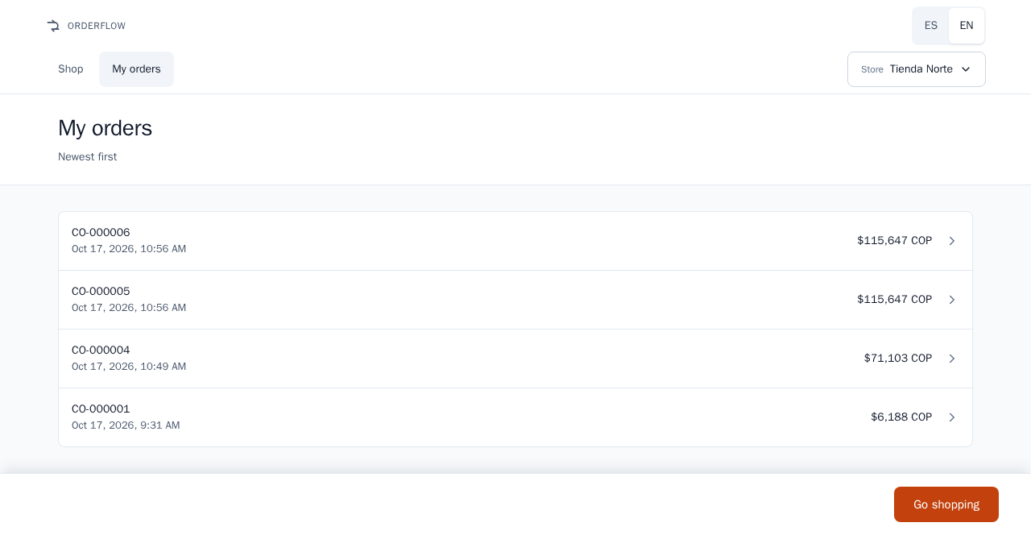
Step 5: find it in My orders
My orders reads the history from the API on every visit (GET /api/v1/orders?customerId=)
Newest first: order number, confirmation time and total with its currency code
The order just confirmed comes first, with the confirmed total
The client keeps no copy of an order, so no cache can hide a committed one
Each row opens its order, rendered from its sealed quote
My orders, newest first
Orderflow Engine
11
Notes:
This closes the loop on the reported defect: the number the shopkeeper just received is in the history right away. The history reads the same primary tables the confirmation wrote, and the end-to-end flow checks it in Spanish and in English.

Slide 12
The pricing pipeline and the lever order
Gift eligibility, on paid quantities or the gross subtotal before discounts
Combos consume their units first: one COMBO entry, never a second discount on those units
Tier discounts in marginal brackets, on the units no combo consumed
Line net = gross − discounts, then the taxable base
Tax per line at each SKU's rate, then total = Σ net + taxes
Credit check on the final total, in the application layer, outside the pure engine
Orderflow Engine
12
Notes:
The engine is a pure function: the cart is normalized first, and the same cart and snapshot always give the same breakdown. Combos go before tiers so the same units are never discounted twice, and tax is computed after the commercial discounts, as the assignment requires. Golden test 1 shows the marginal brackets: 25 colas at 2,500 give 1,250 plus 1,500, a 2,750 discount and a 71,103 total.

Slide 13
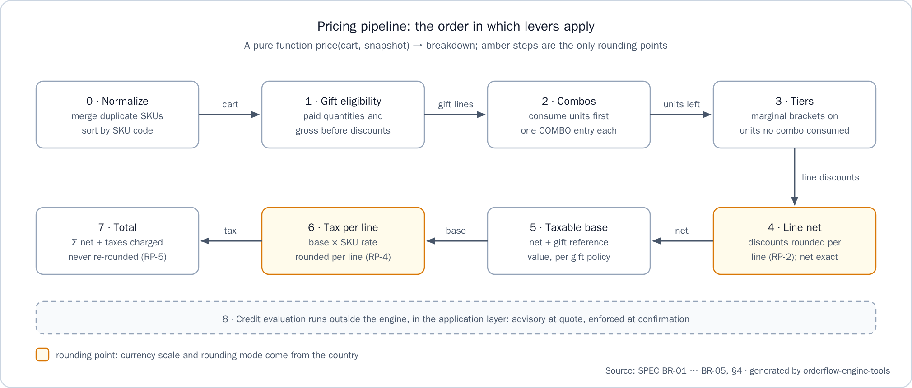
The pricing pipeline at a glance
The pricing pipeline: the order in which levers apply
Orderflow Engine
13
Notes:
The amber steps are the only rounding points: the discounts and the tax of each line, at the scale and rounding mode of the country. The total is the sum of the rounded lines and is never rounded again, and the credit evaluation runs outside the engine.

Slide 14
Money and rounding
Money wraps BigDecimal; an architecture test bans float and double from the domain
Scale and rounding mode come from the country data: COP scale 0, USD scale 2, HALF_UP
Never from java.util.Currency, which reports COP with two decimals
Rounding happens per line only: each discount component and each tax
Totals are sums of rounded lines and are never rounded again
In the API, money is a JSON string at the currency's scale, never a number
Orderflow Engine
14
Notes:
Per-line rounding matches the way an electronic invoice carries tax, so the order and its invoice always agree. Golden test 4 shows it: a 3,600 combo discount is split into 2,647 and 953 by largest remainder, the taxes are 1,397 and 132, and the total is 11,529. The web client never does arithmetic on money either: it formats the API's strings.

Slide 15
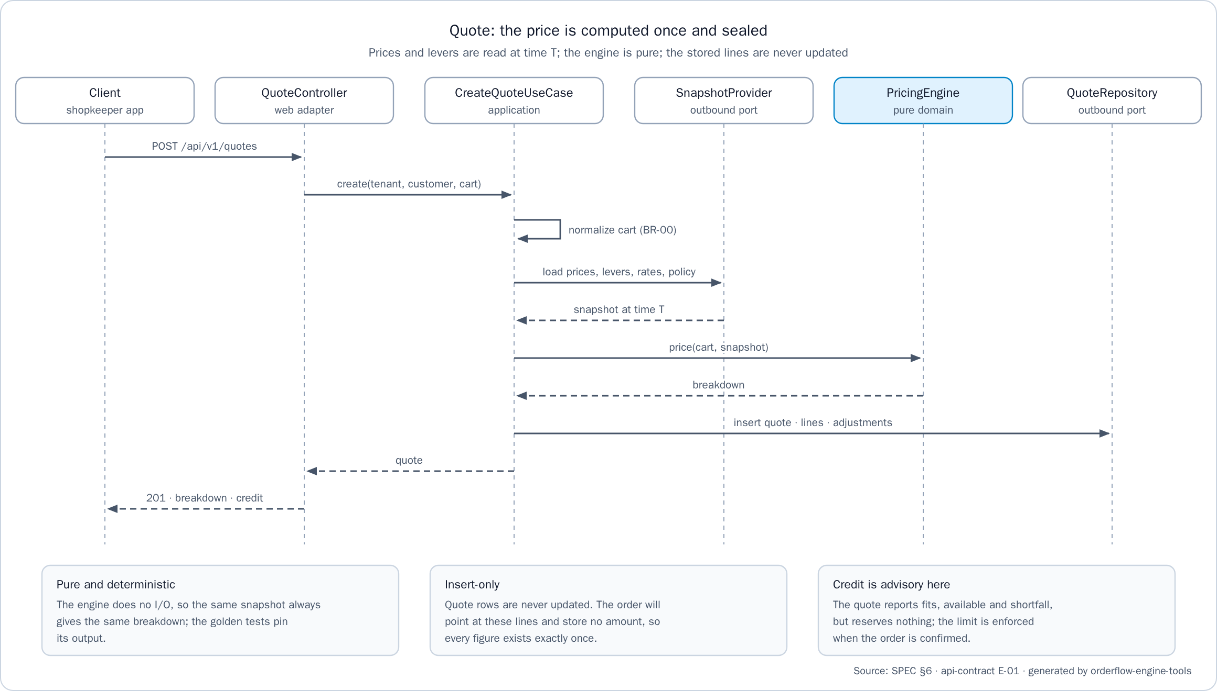
Quote equals confirmation
The quote is sealed: its lines and discount components are insert-only
Each line keeps the price and the tax rate in force when it was quoted
The order stores no amount: it references the quote, so every figure exists once
Confirmation never runs the engine again, so later price or lever changes cannot reach the order
Trade-off: an open quote keeps its price until it expires, at most 15 minutes
Golden test 6 changes a price and deactivates a lever in between: same total, and a fresh quote differs
Quote: the price is computed once and sealed
Orderflow Engine
15
Notes:
The quoted total equals the confirmed total by construction, not by comparing two computations: there is one copy of each figure, and the order points at it. The ADR records the trade-off: a wrong price is honored for at most one time to live, and quote revocation is the next step of its mitigation.

Slide 16
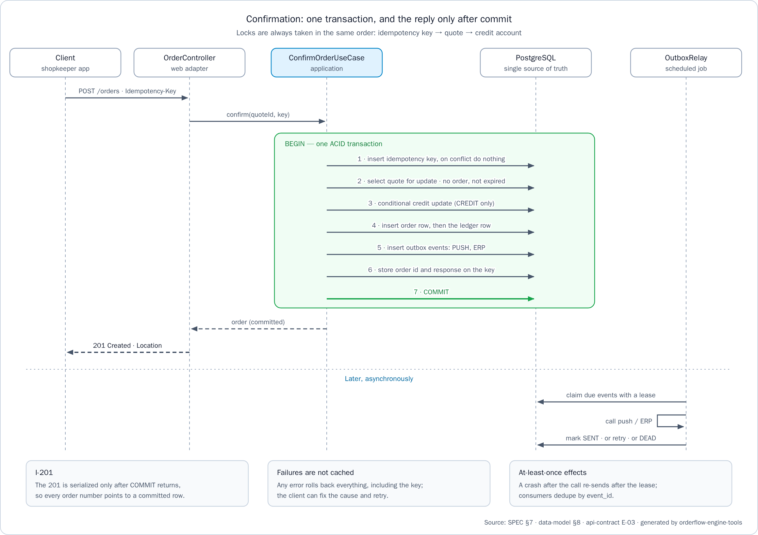
The idempotent confirmation in one transaction
Insert the idempotency key; a concurrent request with the same key waits on it
Lock the quote, then check its owner, that it has no order yet and that it has not expired
On credit, a conditional update that never exceeds the limit
Insert the order (no amounts), its ledger row on credit, and the push and ERP outbox events
Store the 201 body on the key, then commit
Only after the commit is the 201 sent
Confirmation: one transaction, and the reply only after commit
Orderflow Engine
16
Notes:
Every write of the confirmation happens in one PostgreSQL transaction, and the response is sent only after the commit, so a returned order number always points to a committed, readable row. The same key with the same body returns the stored response byte for byte, with Idempotent-Replayed: true, while a failed request is not cached, so the client can fix the cause and retry. Locks are always taken key, then quote, then credit, so concurrent confirmations cannot deadlock.

Slide 17
The outbox: effects never lost, never applied twice
The order transaction writes one outbox event for push and one for the ERP
Every second, the relay claims due events with FOR UPDATE SKIP LOCKED under a 30-second lease
It calls push or the ERP outside any transaction, passing the event_id
A failure is retried with exponential backoff and full jitter, its ceiling from 2 seconds up to 5 minutes
After 8 attempts, or a non-retryable error, the event becomes DEAD and is counted in outbox_dead
Consumers deduplicate by event_id, so sending again has no second effect
Orderflow Engine
17
Notes:
If push or the ERP is down, the order stays confirmed and the effect waits in the outbox, the outbox_pending gauge shows the backlog, and delivery resumes on recovery. If the service stops between sending and marking, the lease expires and the event is sent again, which is safe because consumers deduplicate. An operator requeues a DEAD event with one SQL update, documented in the API README.

Slide 18
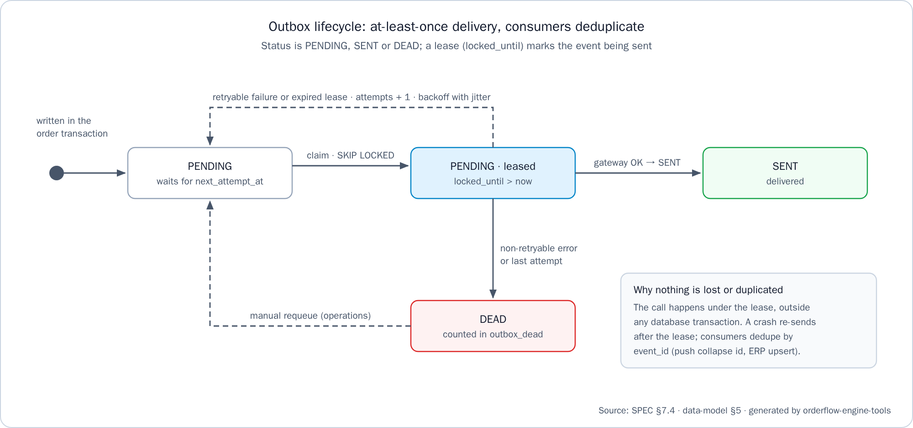
The outbox lifecycle at a glance
Outbox lifecycle: at-least-once delivery, consumers deduplicate
Orderflow Engine
18
Notes:
An event is written as PENDING in the order transaction, leased with SKIP LOCKED while it is sent, and becomes SENT when the call succeeds. A retryable failure or an expired lease returns it to PENDING with backoff; a non-retryable error or the last attempt makes it DEAD, and an operator can requeue it.

Slide 19
Four countries, two languages
co-alpha, Colombia: COP at scale 0, 19% and 5% tax, gifts taxed
ec-alpha, Ecuador: USD at scale 2, 15% tax, gifts exempt
gt-alpha, Guatemala: GTQ at scale 2, 12% tax, gifts exempt
pe-alpha, Peru: PEN at scale 2, 18% tax, gifts taxed
Guatemala and Peru arrived as one Liquibase changelog of data, with no change to the engine or the API code
Spanish by default and English complete: the API follows Accept-Language, the web client switches at run time
Orderflow Engine
19
Notes:
Currency, scale, rounding mode, tax rates, gift tax policy and quote lifetime are country data, and none of them is hard-coded; Guatemala and Peru were the proof, since they arrived as data only. Adding a language is one file per side. The ES/EN switch translates the interface, while product and store names stay in the tenant's language.

Slide 20
Quality and evidence
API: 333 unit and 308 integration tests green, the six golden tests among them
JaCoCo: 100% lines and branches on pricing.domain and pricing.domain.lever (gate 90%); 99.2% lines / 98.0% branches on the whole service
PIT: 185 of 185 mutations detected (100%, threshold 80%)
Web: 209 specs in 15 files, in headless Chromium
End to end: 2 of 2 flows pass, in Spanish and in English, against the full stack
test-all: OK on fresh clones, on 2026-10-17
Orderflow Engine
20
Notes:
These numbers come from the handoff, each with the command that produced it. The integration tests run against a real PostgreSQL 17 with Testcontainers, and ArchUnit keeps the domain pure and the transaction boundary in the use cases. Mutation testing proves that the pricing tests detect wrong code, not just execute it.

Slide 21
How to run it
Clone the six repositories side by side; Docker must be running, with JDK 21 and Node 18 or later for test-all
docker compose up --build in orderflow-engine-infra: the database, the API and the web client
Open http://localhost:8081; the API health is at http://localhost:8080/actuator/health
./mvnw verify in orderflow-engine-api: the single command for the API code and tests
bash scripts/test-all.sh in orderflow-engine-infra: API, web, end to end, documentation and integrity
Orderflow Engine
21
Notes:
Three commands cover it: one starts the stack, one runs the API tests, and one runs every check of the workspace. Compose builds the API and web images from the sibling repositories and starts PostgreSQL first, and every service restarts with Docker unless it was stopped by hand. On Windows, pwsh -File scripts/test-all.ps1 runs the same steps.

Slide 22
What was not included, and why
Authentication: out of scope; tenant and customer come from headers, and a gateway would inject them
Catalog and lever administration: Liquibase changesets seed the stores, products and levers
Payment capture, cancellation and credit release: not required
Real push and ERP clients: fakes behind ports prove the delivery guarantees
Quote revocation: the next step of the ADR's risk mitigation
CI pipeline and SonarQube: verification runs locally; CI would run the same ./mvnw verify
Orderflow Engine
22
Notes:
Each cut is deliberate and recorded, with its reason, in the API README and the ADR. SonarQube would import the JaCoCo report that the build already produces, so CI can add it without project changes. The mobile app repository is reserved and not built.

Slide 23
Four guarantees, and questions
The quoted total is the confirmed total: sealed, insert-only quotes
No floating point for money: BigDecimal, scale from country data, rounding per line
A 201 means the order exists and can be read: one transaction, reply after commit
Push and ERP effects are never lost and never applied twice: outbox and event_id
Each guarantee has its tests: golden, integration, mutation and end to end
Questions?
Orderflow Engine
23
Notes:
These are the four guarantees of the specification, each with the mechanism that holds it. The defect the assignment reported, an order number returned and then missing, cannot happen by construction, and the tests prove it. Thank you; I am glad to walk through any part of it in the code.

