Slide 1

Investigating normalization bounds for hypervolume-based infill criterion for expensive multiobjective optimization
Bing Wang, Hemant Kumar Singh, Tapabrata Ray
The University of New South Wales,
Canberra ACT 2600, Australia

Slide 2
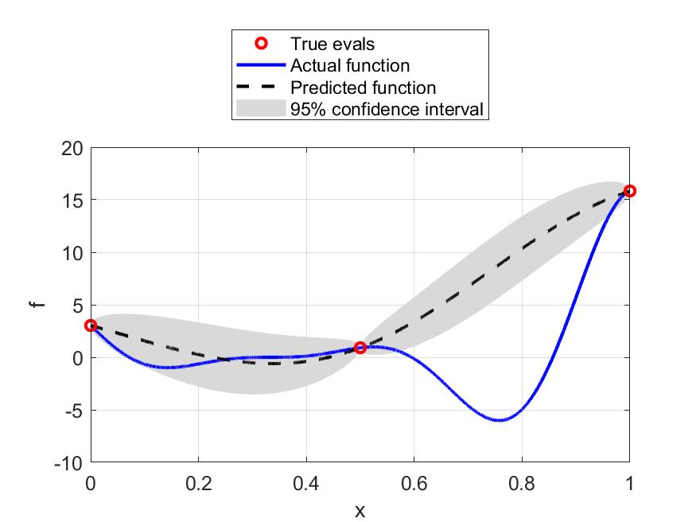
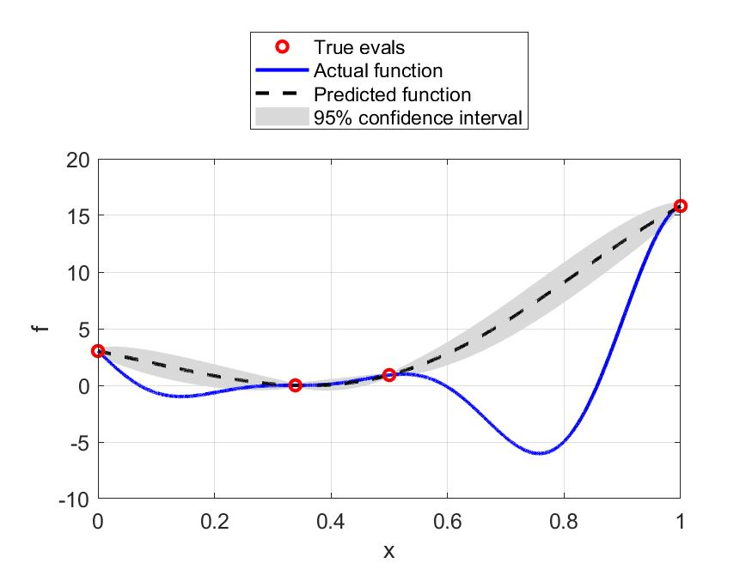
Introduction: Surrogate assisted optimization
Surrogate assisted optimization (SAO) is a typical scheme for dealing with expensive optimization problems
One Infill

Slide 3




Infill Search in multiobjective optimization
Infill search is also adapted into multiobjective optimization [1].
The infill objective is replaced by other metrics suitable for multiobjective optimization (Hypervolume, Euclidean distance to ND, Maxmin distance etc.)
In this study, we focus on Hypervolume (HV) as the basis of Infill search
$$F$$
$$HV$$
$$f_{1}$$
HV: set{ }
HV indicator measures the volume(hypervolume) dominated by a solution (set), bounded by a reference point.
HV improvement estimated from surrogate model
Max improvement is preferred
(0, 0)
$$f_{2}$$
Pareto Front(PF)
[1] Zhan. D, Cheng Y. Liu, J. Expected improvement matrix-based infill criteria for expensive multiobjective optimization. IEEE transaction on Evolutionary Computation. 21(6),956-975(2017)

Slide 4
Infill Search in multiobjective optimization
$$F$$
$$HV$$
Normalization is important
$$f_{1}$$
HV: set{ }
HV improvement
Different objectives can be in different order of magnitudes
Normalization bounds are needed
(0, 0)
$$f_{2}$$
Pareto Front

Slide 5







Existing approach and motivation
Current ND
Nadir point $Z^{N}$
Evaluated archive
$$f_{1}$$
Normalization bounds
Ideal point $Z^{I}$
Reference point
$$R$$
$$Z^{N}$$
Normalization on Archive
(all evaluated solutions)
Infill point has a large region to explore and is less focused on improving distribution on PF
$$Z^{I}$$
Pareto front
$$f_{2}$$
ND: nondominated front

Slide 6


Existing approach and motivation
$$f_{1}$$
Current ND
Evaluated archive
Normalization bounds
Reference point
$$R$$
Normalization over non-dominated solutions
ND solutions may concentrate in small region
Infill point has limited region to explore
$$Z^{I}$$
$$Z^{N}$$
Pareto front
$$f_{2}$$
What is a more balanced normalization?

Slide 7


Proposed approach
Normalization with ND + Extreme points (NDE)
Expand the ND front with extreme points of each objective estimated from surrogate
Keep the infill search have an enlarged search region and focus on improving distribution on PF
extreme point search incur only one evaluation in one objective, while potentially improving the search. Thus the proposed approach is attractive to be used in SAO
Current ND
$$f_{1}$$
Evaluated archive
Normalization bounds
Reference point
$$R$$
$Z^{N}$(updated)
Surrogate
optimization
Pareto front
$Z^{I}$(updated)
$$f_{2}$$

Slide 8
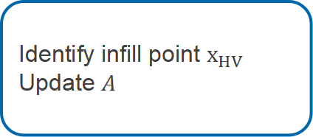
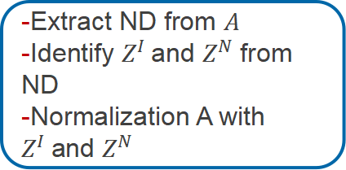


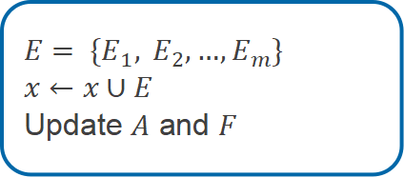
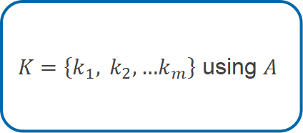
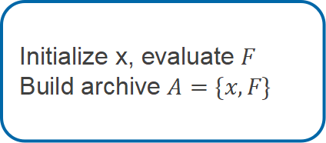
HV Infill based algorithm
Initialization
Model building
Extreme point?
$$Yes$$
Initialize x, evaluate $F$
Build archive $A=\{x,F\}$
$K=\left\{k_{1}, k_{2},…k_{m}\right\}$ using $A$
$$E= \left\{E_{1}, E_{2},…,E_{m}\right\}$$
$$x←x∪E$$
Update $A$ and $F$
Function evaluation budget exghausted: Terminate
$$No$$
Normali-zation
Yes condition
New Sample
1. First iteration
Identify infill point $x_{HV}$
Update $A$
-Extract ND from $A$
-Identify $Z^{I}$and $Z^{N}$ from ND
-Normalization A with $Z^{I}$and $Z^{N}$
2. New sample is better than current ideal on any objective

Slide 9
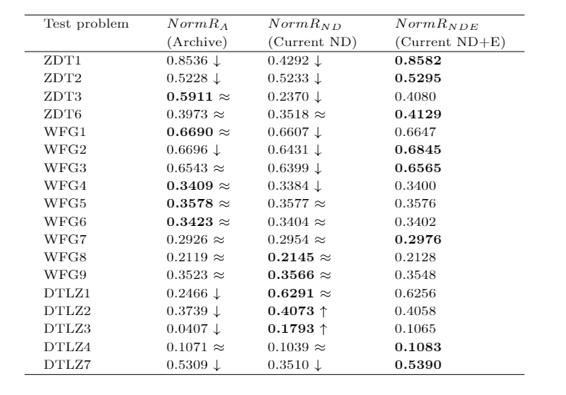
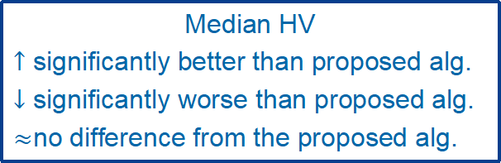
Results: Overview
- ZDT/ WFG/DTLZ series of benchmark problems are used to evaluate the performance
- 29 runs for each problem
Median HV
Proposed alg.
Median HV
$↑$ significantly better than proposed alg.
$↓$ significantly worse than proposed alg.
$≈$no difference from the proposed alg.
Overview
The proposed algorithm performs better or equivalent for the majority of problems compared to the other two algorithm

Slide 10
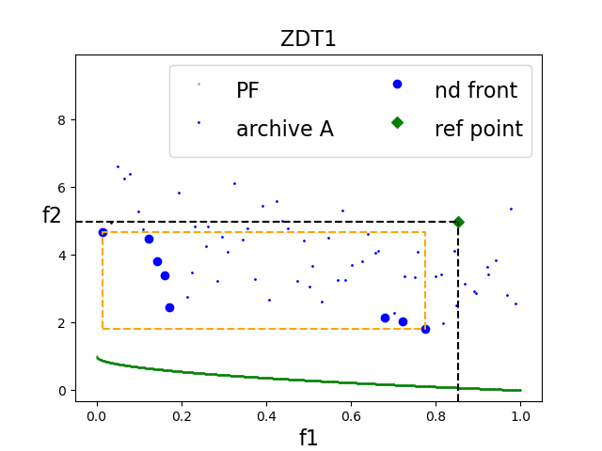
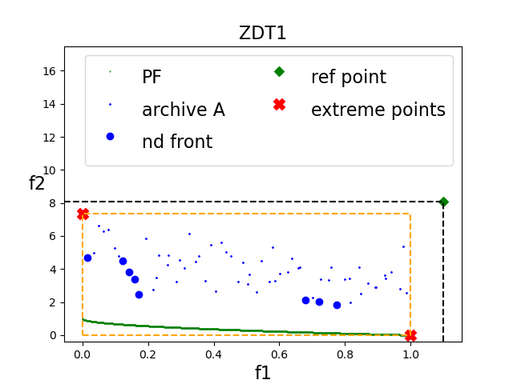
Results: ZDT typical scenario
First iteration ND
First iteration NDE
Performance Analysis
* Initialization is biased to one objective in F space
* ND normalization cause search unable to move close to PF
* NDE normalization corrects the normalization range and makes it cover PF

Slide 11
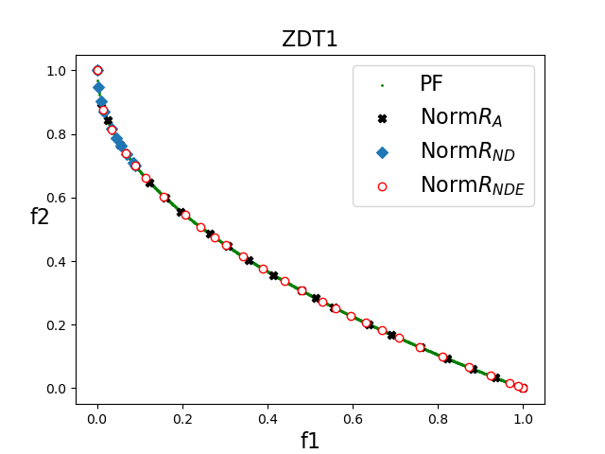
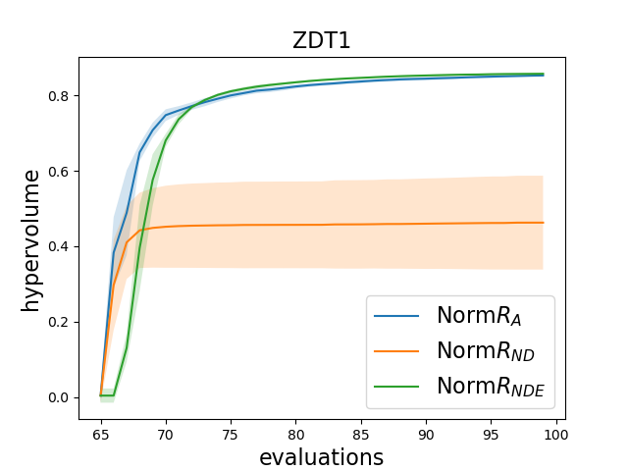
Results : ZDT typical scenario
Performance Analysis
* HV metric, ND is worse than NDE due to the reason mentioned in previous slice
* Archive method covers larger objective space, therefore, it can perform better than ND

Slide 12
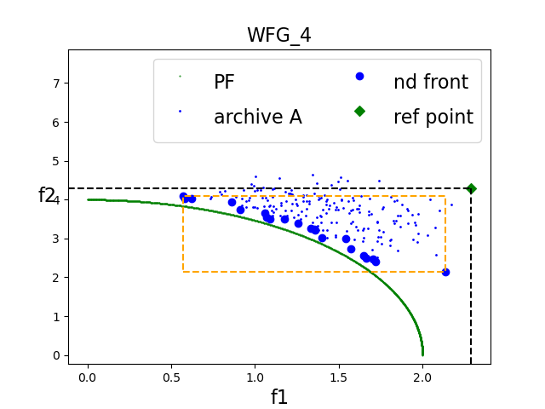
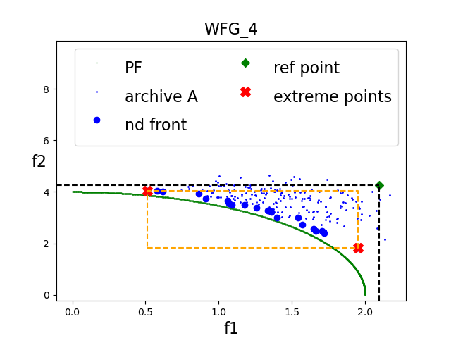
Results: WFG typical scenario
First iteration ND
First iteration NDE
Performance Analysis
* Initialization covers partial PF
* Expanding of extreme points only yield slightly better points
* All algorithms perform similar in such scenario

Slide 13
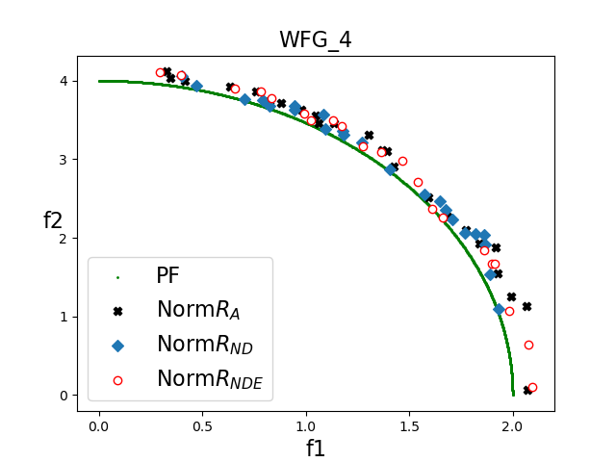
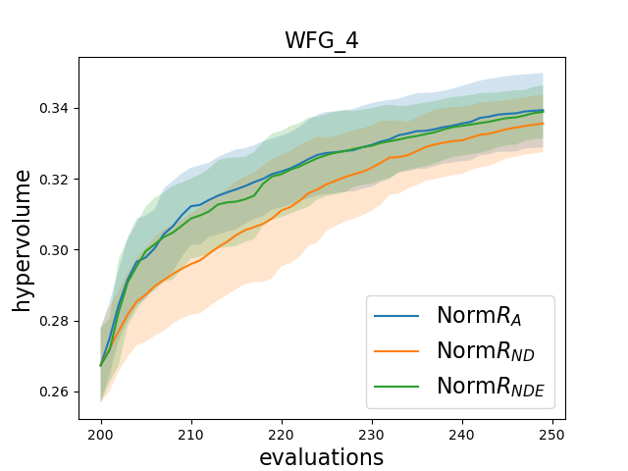
Results: WFG typical scenario
Performance Analysis
* All algorithms perform similar in such scenario

Slide 14
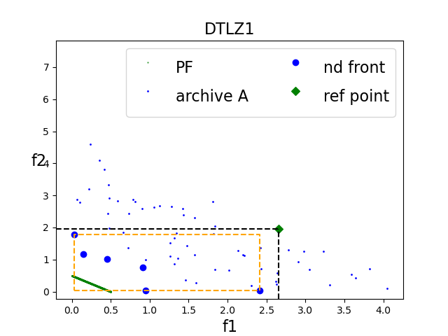
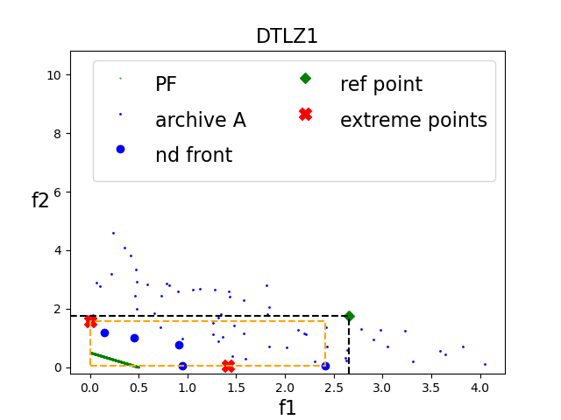
Results: DTLZ typical scenario
Performance Analysis
* Initialization span much larger space than previous examples
* Initialization yields ideal point close to true ideal point
* NDE does not provide improvement
* NDE consumes evaluation budget
* Archive method has too large space to search in this case

Slide 15
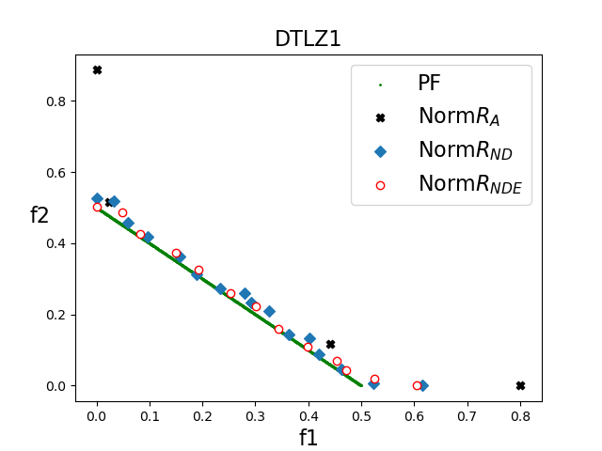
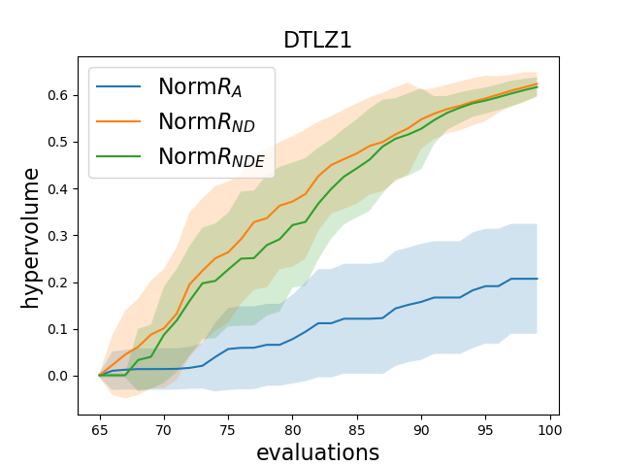
Results: DTLZ typical scenario
Performance Analysis
* NDE has no special benefit in this case
* Archive method has worse final solution distribution

Slide 16
Summary and future work
Summary
We proposed a method to improve the normalization bounds and reference point for an algorithm using HV based infill criterion for expensive multiobjective optimization problems.
The advantage gained were particularly notable for problems where the initial sampling yields solutions far from PF in F space, and extreme point search can find a better estimate of the true extremities of the PF
Future work
Improve scalability to deal with higher number of objectives
Other infill criteria can also be analysed and improved

Slide 17

Thank you for listening.
Questions?

