Slide 1
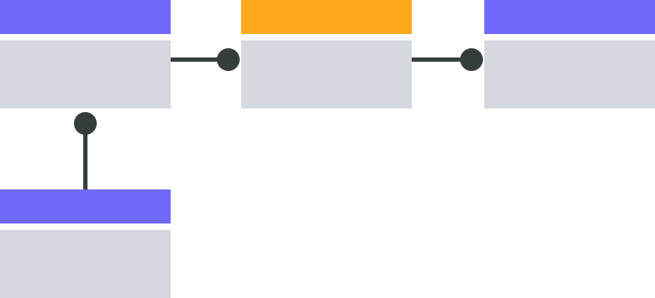






MODEL
Entity Relationship Diagram
Employee
Employee_department
Department
id- name- language_id
id- employee_id- department_id
id- name- company_code
The Entity Relationship Diagram shows the relationships between multiple entities within a system database. Jumpstart data modeling projects with this template for more efficient IT system design and troubleshooting. ​
Employee
id- name- language_id
Planning
Database overview
Identify relationships
Eleitor
Candidato
Voto
Urna
Elements 📌
Instructions
Drag and drop this into the board.
(+) nome
(-) cpf
1. Identify
Identify all the entities existing in your system, and fill in their relevant attributes. Each entity only needs to appear in the diagram once.
2. Connect
Use connectors and ERD symbols to identify and represent the relationships between entities.
3. Collab and finalize
Collaborate with your teammates, and ensure the entity relationships are well-defined.
Candidato
Candidato
Candidato

Slide 2
Tela: Dados do Eleitor
Tela: Objetos da Eleição
Tela: Confirmação de Votos
Entity Relationship Diagram
Employee
Employee_department
Department
-----------------------------------
| |
| Cadastro de Eleitor |
| |
| Nome: ________________ |
| CPF: ________________ |
| |
| [Confirmar] |
| |
-----------------------------------
-----------------------------------
| |
| Tela de Votação |
| |
| Candidatos: |
| |
| [ ] Candidato 1 |
| [ ] Candidato 2 |
| [ ] Candidato 3 |
| [ ] Candidato 4 |
| [ ] Voto nulo |
| |
| [Confirmar] |
| |
-----------------------------------
-----------------------------------
| |
| Confirmação de Voto |
| |
| Eleitor: João Silva |
| Candidato: Candidato 1 |
| |
| Deseja confirmar o voto? |
| |
| [Sim] [Não] |
| |
-----------------------------------
id- name- language_id
id- employee_id- department_id
id- name- company_code
The Entity Relationship Diagram shows the relationships between multiple entities within a system database. Jumpstart data modeling projects with this template for more efficient IT system design and troubleshooting. ​
Employee
id- name- language_id
Planning
Database overview
Identify relationships
Elements 📌
Instructions
Drag and drop this into the board.
1. Identify
Identify all the entities existing in your system, and fill in their relevant attributes. Each entity only needs to appear in the diagram once.
2. Connect
Use connectors and ERD symbols to identify and represent the relationships between entities.
3. Collab and finalize
Collaborate with your teammates, and ensure the entity relationships are well-defined.

Slide 3
ControladorEleicao
Pipeline de chamada de funções
ControlarEleitor
ControladorCandidato
ControladorVotacao
ControladorResultado
Entity Relationship Diagram
Employee
Employee_department
Department
id- name- language_id
id- employee_id- department_id
id- name- company_code
The Entity Relationship Diagram shows the relationships between multiple entities within a system database. Jumpstart data modeling projects with this template for more efficient IT system design and troubleshooting. ​
Employee
id- name- language_id
Planning
Database overview
Identify relationships
Elements 📌
Instructions
Drag and drop this into the board.
1. Identify
Identify all the entities existing in your system, and fill in their relevant attributes. Each entity only needs to appear in the diagram once.
2. Connect
Use connectors and ERD symbols to identify and represent the relationships between entities.
3. Collab and finalize
Collaborate with your teammates, and ensure the entity relationships are well-defined.

Slide 4
Entity Relationship Diagram
Employee
Employee_department
Department
id- name- language_id
id- employee_id- department_id
id- name- company_code
HASH
VOTO
The Entity Relationship Diagram shows the relationships between multiple entities within a system database. Jumpstart data modeling projects with this template for more efficient IT system design and troubleshooting. ​
Employee
id- name- language_id
N DE ELEITORES
VOTOS
VOTOS 2
VOTOS 3
Planning
Database overview
Identify relationships
ID(CPF)
NOME
HASH
Elements 📌
Instructions
Drag and drop this into the board.
1. Identify
Identify all the entities existing in your system, and fill in their relevant attributes. Each entity only needs to appear in the diagram once.
2. Connect
Use connectors and ERD symbols to identify and represent the relationships between entities.
3. Collab and finalize
Collaborate with your teammates, and ensure the entity relationships are well-defined.

