Slide 1
Welcome to Bootcamp Prep!
Fullstack Academy
BOOTCAMP PREP

Slide 2
Course Overview: Schedule
DAY | TIME | UNIT
SAT | 10:00 AM | Introduction, Tidy Code, Loops, Debugging
 | 1:00 AM | Lunch
 | 2:00 PM | Coercion and Truthiness
SUN | 10:00 AM | Scope
 | 1:00 AM | Lunch
 | 2:00 PM | Arrays I
MON | 6:40 PM | Arrays II
TUE | 6:40 PM | Objects
DAY | TIME | UNIT
WED | 6:40 PM | Object Methods
THR | 6:40 PM | PBR / PBV
SAT | 10:00 AM | Higher Order Functions I
 | 1:00 PM | Lunch
 | 2:00 PM | Higher Order Functions II
SUN | 10:00 AM | Recursion I
 | 1:00 PM | Lunch
 | 2:00 PM | Recursion II
BOOTCAMP PREP

Slide 3
Course Overview: Format
Watch the pre-recorded lecture (if time permits)
Attend the interactive lecture (required)
Work on the workshop with your partner (required)
Watch the workshop review videos and compare your answers with the provided solutions (strongly recommended)
BOOTCAMP PREP

Slide 4
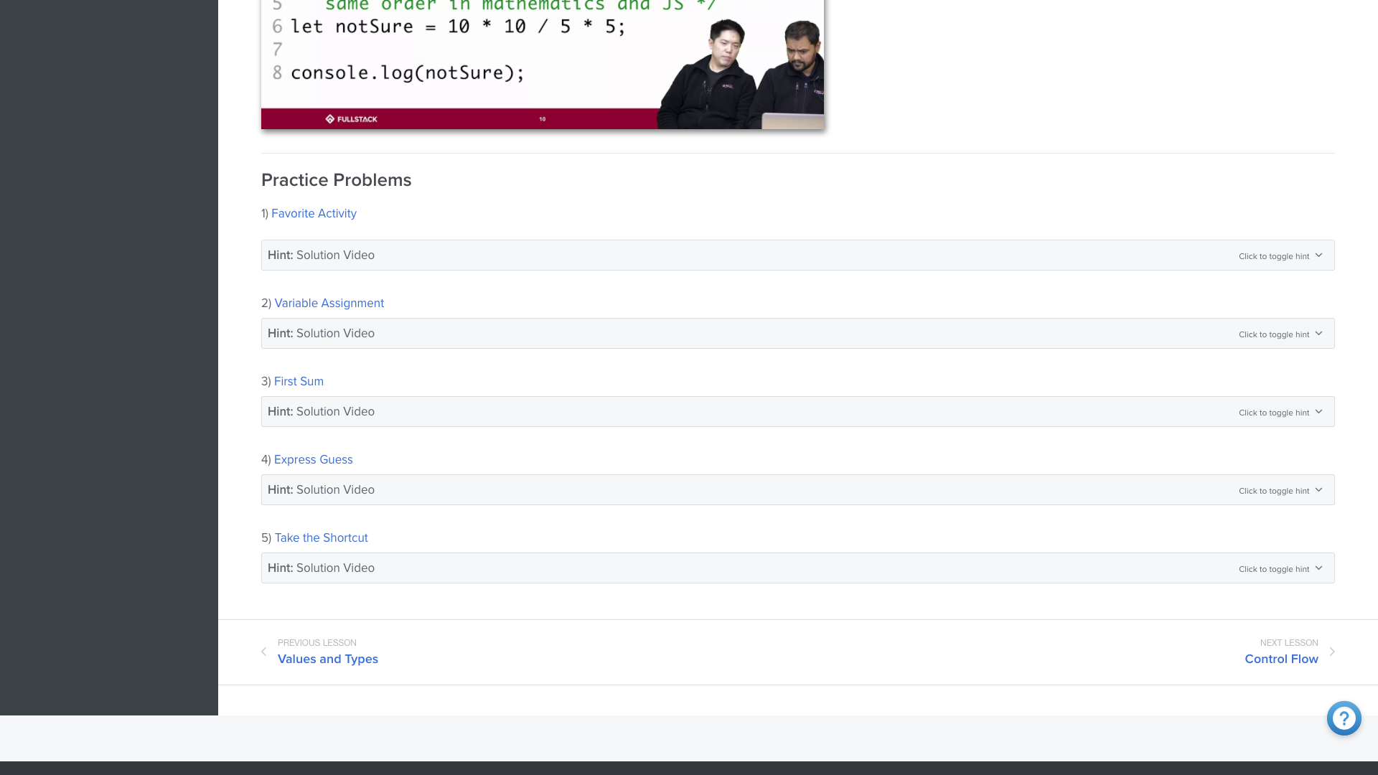

Workshops
Workshops are not intended to be finished
You will be randomly paired with a different partner or small team for each workshop
Instructors and fellows available via the Help Desk
BOOTCAMP PREP

Slide 5
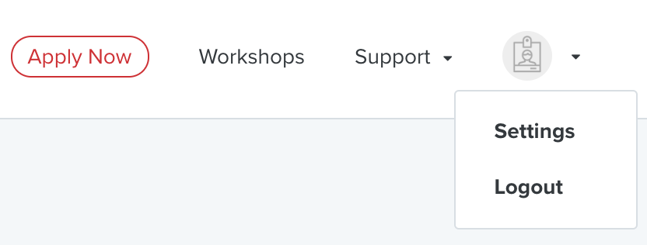


Workshops: LearnDot Picture
Add your picture to LearnDot to help instructors find you during help tickets!
BOOTCAMP PREP

Slide 6
Workshops: pair programming
Pair programming
2 programmers, sharing the same computer, work collaboratively on all aspects of software development (Williams and Kessler 2000).
"Driver" writes code
"Navigator" plans code and reviews it as it is written
Switch every 10 minutes, or every time you finish a workshop problem.
At Fullstack, you switch partners for each workshop
BOOTCAMP PREP

Slide 7
Workshops: pair programming
Why use pair programming at Bootcamp Prep? Shouldn't I practice on my own?
"Teach to learn" is a central aspect of Fullstack's instructional philosophy
Communicating about code is just as, if not more important, than actually writing it
Solving problems with a partner is the best way to prepare for an admissions interview at a top bootcamp
Most top bootcamps, and a growing number of employers, use pair programming every day
BOOTCAMP PREP

Slide 8
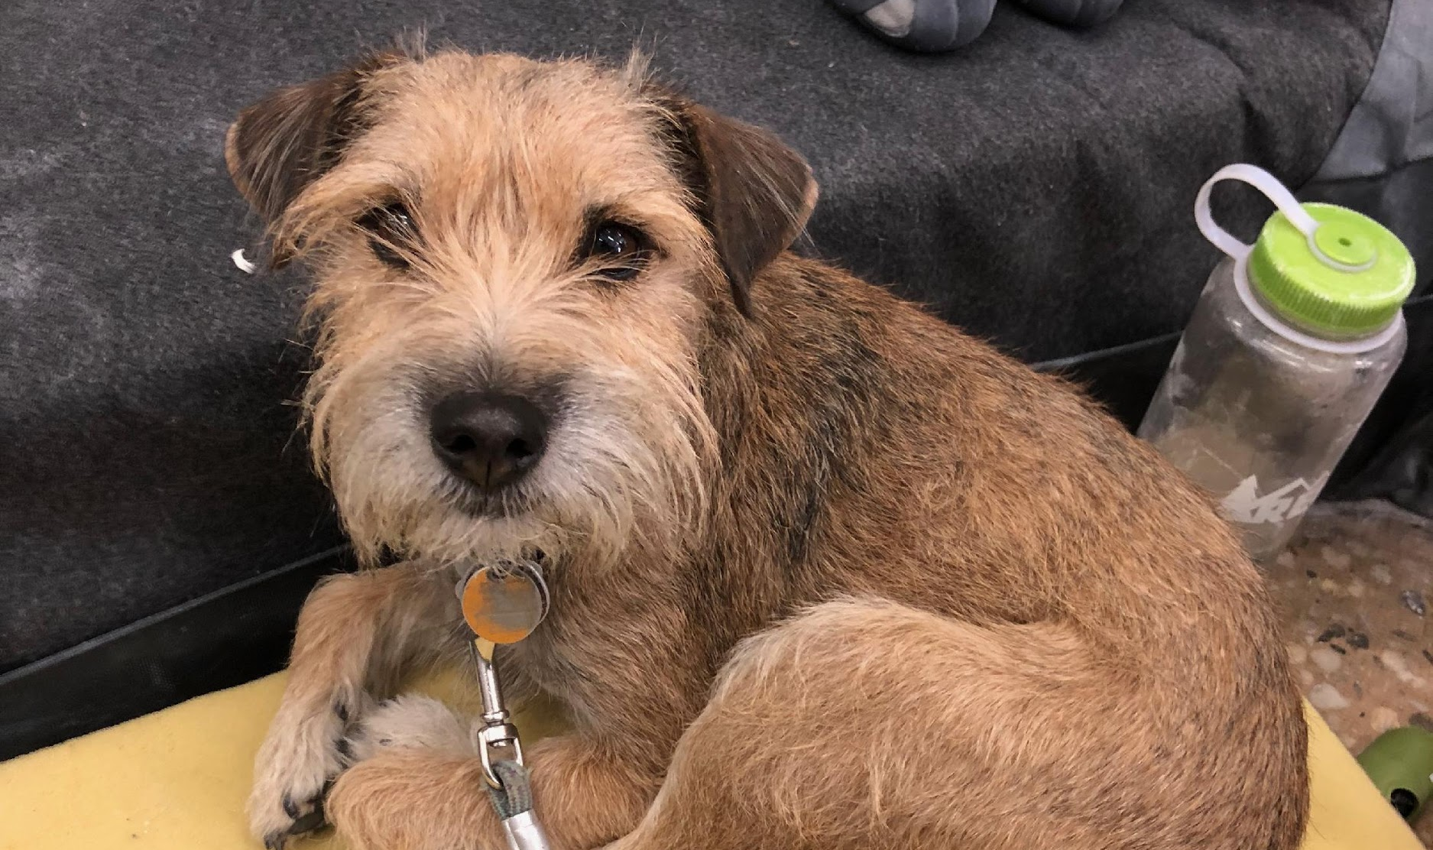
This is Bruno.
BOOTCAMP PREP

Slide 9
Ice Breaker
Say your name.
Why are you here ?
Weird / quirky thing about you OR what animal you would be if you were one
Then, you get to pick who's next - so pay attention because one person always forgets someone who has already went
BOOTCAMP PREP

Slide 10
Course Overview: Projects
Two projects will be introduced as we progress through the course
100% optional
Good opportunity to use what you're learning to build larger programs
BOOTCAMP PREP

Slide 11
Course Overview: Practice Assessments
It's meant to help you prepare for the real admissions assessment
A risk free assessment will also be available to you on LearnDot after you finish Bootcamp Prep
BOOTCAMP PREP

Slide 12
Fullstack Community Values
Be patient. With yourself and others.
Ask questions (even “dumb” ones)
Trust the process. Be on time.
Help others. Teach others.
We like to have fun, and…
BOOTCAMP PREP

Slide 13
Fullstack Community Values
Be mindful of:
Subtle “isms”
E.g. Sexism, Racism, Ageism
Be Professional - “No Asshole Policy”
You are each other’s most valuable resource
No NSFW content. When in doubt, leave it out.
BOOTCAMP PREP

Slide 14
Fullstack Remote Values
Please have your camera on.
Please keep your mic on mute when you’re not talking to me or a classmate. I love interruptions for questions.
Please wear clothes.
Try to bring some enthusiasm to this class - it’s a weird modern thing to do remote classes, and it can be hard to make them feel human.
Please don’t exit the Zoom room before breakout rooms. This makes it really hard to pair you with a paired programming partner.
BOOTCAMP PREP

Slide 15
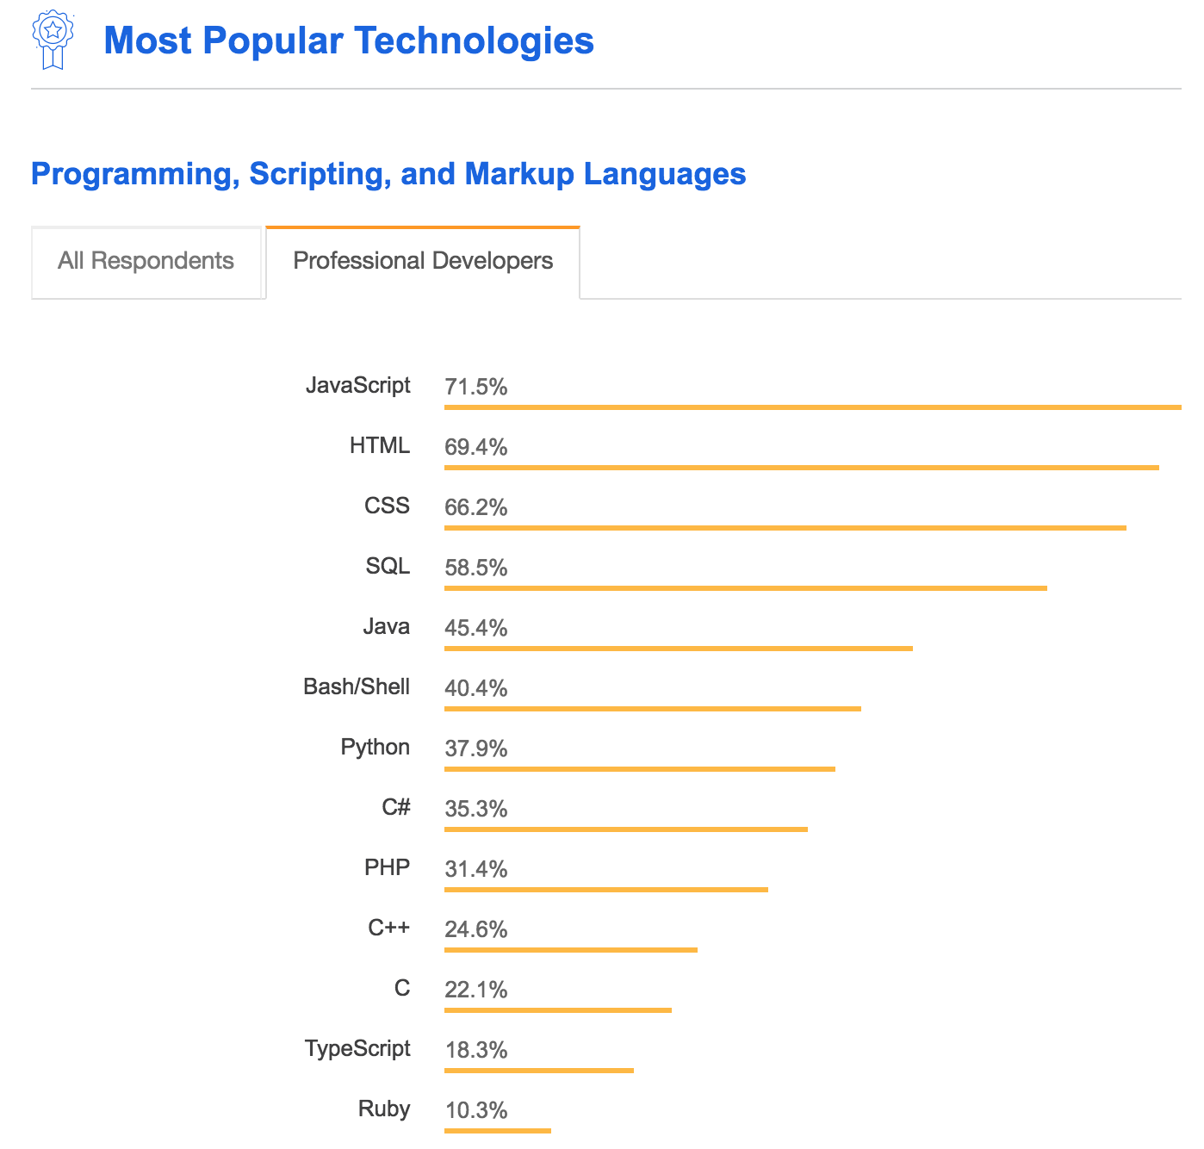
Why Javascript?
JS === most popular language in the world!
FSA/GHA curriculum
Stack Overflow 2018 Developer Survey Results
BOOTCAMP PREP
Notes:
JavaScript - netscape make internet fun - 10 days
myspace, pop ups...
JavaScript was created by Brendan Eich in 1995 during his time at Netscape Communications.
upsplash.com --> demo for what javascript is used for (front end and backend)
stack overflow
gitHub
state of the octaverse
https://octoverse.github.com/
https://octoverse.github.com/#top-languages

Slide 16
Why is JavaScript so Popular?
Have you used this thing called the internet?
Powers the majority of web applications
Atwoods Law: "Anything that can be written in JavaScript, will eventually be written in JavaScript."
Runs almost anywhere on the “full stack”: web browsers and servers
The first 7/10's of JavaScript is relatively learner friendly
BOOTCAMP PREP

Slide 17
ES5? ESNext?
ES5 and ESNext are different versions of JavaScript
function vs () => {}
JavaScript versions are backwards compatible
Older features work in newer environments
ECMA international ( https://www.ecma-international.org/ )
Newer features may not work in older environments
Can I use? ( https://caniuse.com/ )
Fullstack teaches "ESNext"
Immersive programs continuously updated to cover the latest JS features
BCP program covers some newer features too, but only those that are helpful for beginning developers — don't expect in-depth or comprehensive coverage of new JS features in this course
BOOTCAMP PREP

Slide 18
Getting the most from this course
Complete the BCP Pre-work curriculum first!
Do the pre-readings and watch the pre-recorded lectures
Enjoy the "productive struggle" - This is gonna be hard, try to enjoy the fact that you're facing a difficult task that can completely alter your life in a really big way.
Ask for help when you need it (otherwise, why are you here?)
Don’t look at solutions until you give problems an honest try
Go back to unfinished workshop problems and finish them when time permits
Watch the solution videos, even for problems you think you got right
Review the solution code
BOOTCAMP PREP

Slide 19
Tidy Code Tips
BOOTCAMP PREP

Slide 20
Why write tidy code?
Easier and faster to debug and read your code
Engineers spend a lot more time reading and debugging code than actually writing it!
Demonstrates qualities attractive to bootcamps and employers:
Professionalism: no longer a "beginner"
Attention to detail
Pride in work
BOOTCAMP PREP

Slide 21
Indentation
this function is amazing!
1
2
3
4
5
6
7
8
9
10
11
12
13
14
// indent one level inside every code block
// code blocks start with a { and end with a }
function amazingFunction() {
// inside the function block!
if (true) {
// inside the if block!
console.log('this function is amazing');
}
// outside of the if block
}
// outside of the function block
amazingFunction();
BOOTCAMP PREP

Slide 22
Variable Naming
1
2
3
1
2
3
4
5
6
7
8
9
10
11
12
13
14
// use camelCase when defining variable names
let myFavoritePlace = 'Fullstack';
// don't use ambiguous variable names!
let x = 68;
// use names that describe the value they contain
let currentTemp = 68;
// it's ok to use short variable names as counters, like i in a for loop
for (let i = 1; i <= 3; i++) {
console.log(i);
}
BOOTCAMP PREP

