Slide 1
Loops and Debugging
BOOTCAMP PREP

Slide 2
Overview
/*
- loops
- do
- while loop
- for loop
- break, continue keywords
- debugging
- interpreting a stack trace/error message
- debugging a failing test
- using debugger
*/
BOOTCAMP PREP

Slide 3
while loop
1
2
3
4
5
6
7
8
9
10
11
12
13
14
/* a while loop requires three elements:
1. the while keyword
2. a conditional expression that evaluates to a boolean value
3. a block of code
while (conditional) {
// block of code
}
the block of code will run over and over as long as the conditional expression evaluates to true */
BOOTCAMP PREP

Slide 4
while loop
count is 3
count is 2
count is 1
1
2
3
4
5
6
7
8
9
10
11
12
13
14
let count = 3;
while (count >= 1) {
console.log('count is', count);
count--;
}
BOOTCAMP PREP

Slide 5
while loop
1
2
3
4
5
6
7
8
9
10
11
12
13
14
while (false) {
console.log('this line of code will never run');
}
BOOTCAMP PREP

Slide 6
while loop
this line will run forever
this line will run forever
this line will run forever
this line will run forever
this line will run forever
this line will run forever
this line will run forever
this line will run forever
this line will run forever
this line will run forever
this line will run forever
this line will run forever
this line will run forever
this line will run forever
this line will run forever
this line will run forever
this line will run forever
this line will run forever
this line will run forever
this line will run forever
this line will run forever
this line will run forever
1
2
3
4
5
6
7
8
9
10
11
12
13
14
while (true) {
console.log('this line will run forever');
// (or until the machine running the code runs out of memory)
}
BOOTCAMP PREP

Slide 7
while loop
count is 3
count is 3
count is 3
count is 3
count is 3
count is 3
count is 3
count is 3
count is 3
count is 3
count is 3
count is 3
count is 3
count is 3
count is 3
count is 3
count is 3
count is 3
count is 3
count is 3
count is 3
count is 3
count is 3
count is 3
count is 3
1
2
3
4
5
6
7
8
9
10
11
12
13
14
let count = 3;
// have to make sure the conditional is eventually false!
while (count >= 1) {
console.log('count is', count);
}
BOOTCAMP PREP

Slide 8
for loop
1
2
3
4
5
6
7
8
9
10
11
12
13
14
15
16
/* a for loop requires three elements:
1. the for keyword
2. three optional expressions
3. a block of code
for (initialization; condition; final-expression) {
// block of code
}
the block of code will run over and over until the condition evaluates to false */
BOOTCAMP PREP

Slide 9
for loop
i is: 1
i is: 2
i is: 3
1
2
3
4
5
6
7
8
9
10
11
12
13
14
/* the initialization is run first, and only once. it's often used to define a counter variable */
/* then, before every iteration, the condition is checked to see if it's true - if it is, the for loop will run another iteration */
/* then, after each iteration, the final expression is run */
for (let i = 1; i <=3; i++) {
console.log(‘i is: , i)
}
BOOTCAMP PREP

Slide 10
for loop
i is: 5
i is: 4
i is: 3
i is: 2
i is: 1
1
2
3
4
5
6
7
8
9
10
11
12
13
14
// loop in either direction
for (let i = 5; i >= 1; i--) {
console.log('i is:', i);
}
BOOTCAMP PREP

Slide 11
for loop
i is: 100
i is: 200
i is: 300
1
2
3
4
5
6
7
8
9
10
11
12
13
14
// can increment by any number
for (let i = 100; i <= 300; i += 100) {
console.log('i is:', i);
}
BOOTCAMP PREP

Slide 12
for loop
a
b
c
d
e
f
g
1
2
3
4
5
6
7
8
9
10
11
12
13
14
// use for loops to iterate through a string
let letters = 'abcdefg';
for (let i = 0; i < letters.length; i++) {
let currentLetter = letters[i];
console.log(currentLetter);
}
BOOTCAMP PREP

Slide 13
continue keyword
i is: 1
i is: 2
i is: 4
i is: 5
1
2
3
4
5
6
7
8
9
10
11
12
13
14
// the continue keyword will cause the loop to skip to the next iteration
for (let i = 1; i <= 5; i++) {
if (i === 3) {
continue;
} console.log('i is:', i);
}
BOOTCAMP PREP

Slide 14
continue keyword
count is 5
count is 3
count is 1
1
2
3
4
5
6
7
8
9
10
11
12
13
14
// the continue keyword also works in while loops
let count = 5;
while (count >= 1) {
if (count % 2 === 0) {
count--;
continue;
}
console.log('count is ', count);
count--;
}
BOOTCAMP PREP

Slide 15
break keyword
A++
1
2
3
4
5
6
7
8
9
10
11
12
13
14
// the break keyword breaks out of the loop permanently
let myGrade = 'A';
while (true) {
myGrade += '+';
if (myGrade.length === 3) {
break;
}
}
console.log(myGrade);
BOOTCAMP PREP

Slide 16
break keyword
i is 10
i is 9
i is 8
i is 7
1
2
3
4
5
6
7
8
9
10
11
12
13
14
// the break keyword also works in for loops
for (let i = 10; i >= 1; i--) {
console.log('i is', i);
if (i === 7) {
break;
}
}
BOOTCAMP PREP

Slide 17
Debugging
1
2
3
4
5
6
7
8
9
10
11
12
13
14
/* Developers spend way more time debugging code than writing it! */
/* Let's review some good debugging techniques to help you write better code more quickly throughout the remaining workshops */
BOOTCAMP PREP

Slide 18
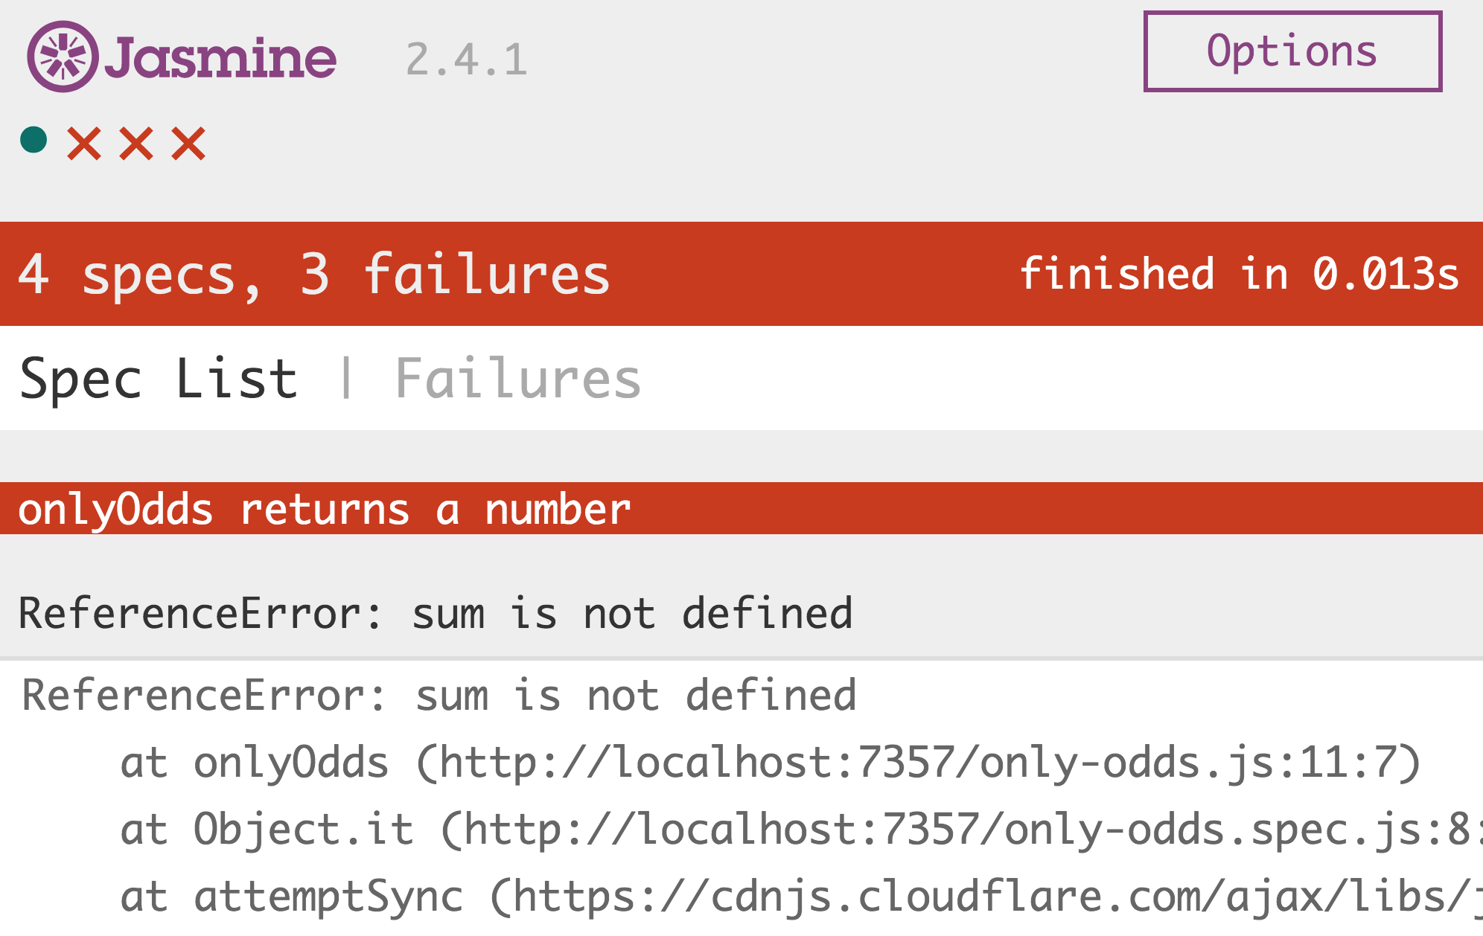
Debugging — error messages
1
2
3
4
5
6
7
8
9
10
11
12
13
14
/* Let's start by considering bugs that come from writing invalid JavaScript code. */
/* The testem page in your browser passes helpful error messages to you if it couldn't run your code as written */
/* This ReferenceError means the the code tried to reference a variable called sum that was never defined */
BOOTCAMP PREP

Slide 19
Debugging — error messages
1
2
3
4
5
6
7
8
9
10
11
12
13
14
/* Note the stack trace below the error */
/* The first at… line gives the location where the error occurred in only-odds.js: it looks like the error happened on line 11. */
/* This line number may not always be accurate, but its often a good place to start */
/* Google unfamiliar errors */
BOOTCAMP PREP

Slide 20
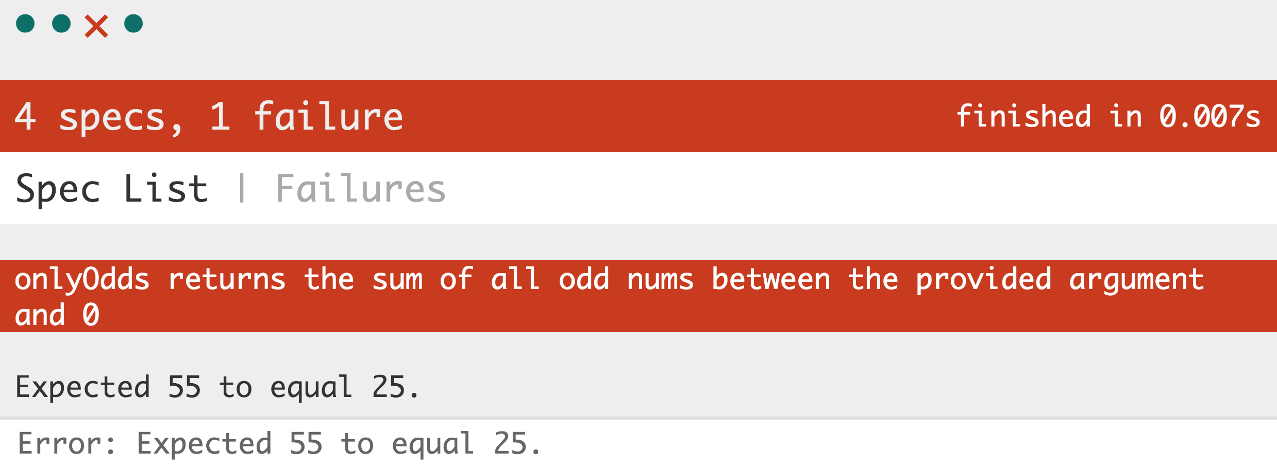
Debugging — failing tests
1
2
3
4
5
6
7
8
9
10
11
12
13
14
/* When your test is failing, you'll get an output that compares the value your function returned against the expected value. */
BOOTCAMP PREP

Slide 21
Debugging — failing tests
1
2
3
4
5
6
7
8
9
10
11
12
13
14
/* Note the plain-english explanation of what the test is looking for; that can help! */
BOOTCAMP PREP

Slide 22
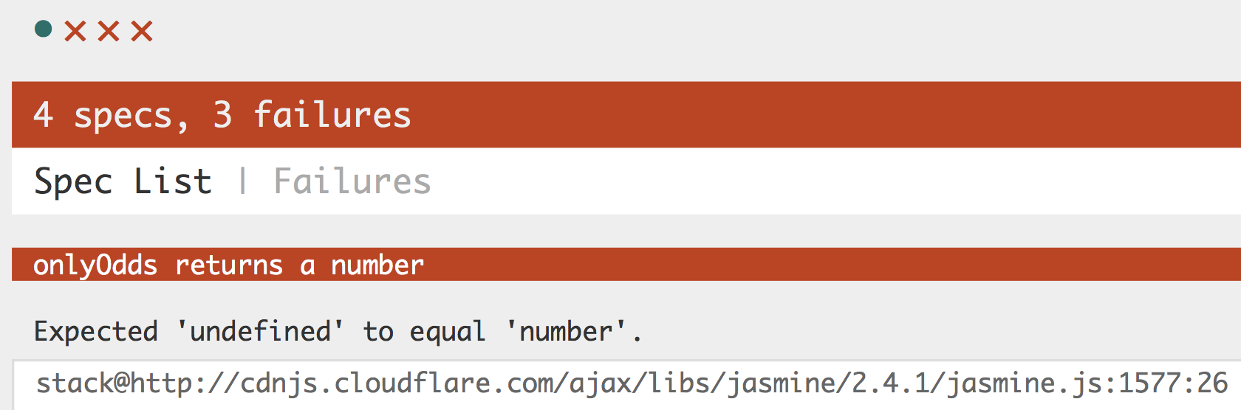
Debugging — failing tests
1
2
3
4
5
6
7
8
9
10
11
12
13
14
/* If your test is failing with "undefined" outputs, makes sure you are returning values from your functions, not console.logging them! */
BOOTCAMP PREP

Slide 23
Debugging — failing tests
1
2
3
4
5
6
7
8
9
10
11
12
13
14
/* It can also help to look directly at the code that defines how the test is supposed to work. Look for a test in the *.spec.js file with the same plain-language explanation, and with the same expect value. */
/* Now you can see that the test is passing in the number 10 to your function. This can help you debug! */
/* All of the code inside of the tests, besides the line that starts with expect, is plain-old JavaScript */
BOOTCAMP PREP

Slide 24
Debugging — debugger
1
2
3
4
5
6
7
8
9
10
11
12
13
14
/* To use debugger:
1. add the debugger keyword in your function in VSCode
2. invoke the function yourself */
function onlyOdds(num) {
debugger; // debugger keyword here
let sum = 0;
for (let i = num; i >= 1; i--) {
if (i % 2 === 1) {
sum += i;
}
}
return sum;
} onlyOdds(3); // invoking the function ourselves here
BOOTCAMP PREP

Slide 25
debugger: Chrome Dev Tools
1
2
3
4
5
6
7
8
9
10
11
12
13
14
/* Open Chrome Dev Tools (right-click > Inspect > Console) */
/* Run your code in CodePen */
/* Your code will pause when it hits the debugger keyword */
/* Note the Scope panel on the right side of the screen. This
continuously updates the values assigned to every relevant variable. */
/* Select the button to move your code forward one line */
/* It's sometimes easier to use debugger when you call the function directly through the console instead of letting tests call your code */
BOOTCAMP PREP

Slide 26

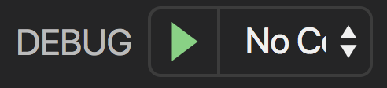


debugger: VSCode
1
2
3
4
5
6
7
8
9
10
11
12
13
14
/* Click the debugging option in VSCode: followed by the green debug arrow at the top-left of the screen: Now, press to see your code run line by line (press to stop) */
/* Note the Variables panel on the left side of the screen. This continuously updates the values assigned to every relevant variable. */
/* Especially helpful to debug control-flow bugs (like loops) */
BOOTCAMP PREP

Slide 27
Recap
1
2
3
4
5
6
7
8
9
10
11
12
13
14
/*
- loops
- while loop
- for loop
- break, continue keywords
- debugging
- interpreting a stack trace/error message
- debugging a failing test
- using debugger
*/
BOOTCAMP PREP

