Slide 1
Solving Tricky Problems
Presto REACTO!
REACTO

Slide 2
Some Facts
The FSA Admissions exam assesses for two things:
Knowledge of fundamental JS
Problem solving ability
How do Engineers solve tricky problems?
REACTO
Notes:
Fellow who does Tuesday problem should slack out pairs for the week. Fellows might want to share problem with interviewers the night before.

Slide 3
Problem solving
Identify the problem
Brainstorm solutions
Implement one
Evaluate it
REACTO

Slide 4

R
E
A
C
T
O
e s t a t e
x a m p l e s
p p r o a c h
o d e
e s t
p t i m i z e
Notice how far down this is
REACTO

Slide 5
Restate
Rephrase in your own words (diagram if useful)
Make sure you fully understand the problem
Leads very naturally into…
REACTO

Slide 6
EXAMPLES
Representative input and output
Consider edge cases
Consider errors
Write them down
REACTO

Slide 7
APpROACH
Come up with at least one conceptual solution
Don’t code yet!
Make some comments in your code file
REACTO

Slide 8
Code
Translate your Approach into working JS
FSA Admissions Team will even give partial credit for a solid approach (even if the code isn’t complete)
Make sure include all those edge cases!
REACTO
Notes:
Notice what’s not on this slide: anything having to do with problem-solving

Slide 9
Test
Use Examples in the test specs to hone your solution
Ensure your Code works for all Examples
Debug as necessary
REACTO

Slide 10
optimize
The final (and least important) step!
Only if your code works and you have plenty of time
Is there a more concise way to write this code?
Are there built-in methods that can help?
Did I document my code so it is easy to understand?
REACTO

Slide 11
Example
“Create a function vowelCount() that takes a string as an argument. The function should return the total number of vowels in the string”
REACTO
Notes:
Sample problems: "Hydronium" (Hello -> H3O); or a harder problem (figure out one).

Slide 12
Restate
“I want to return the total number of vowels in a string argument”.
Do I include ‘y’?
Is it case sensitive?
What if I get an empty string?
REACTO
Notes:
Sample problems: "Hydronium" (Hello -> H3O); or a harder problem (figure out one).

Slide 13
Examples
vowelCount(‘hello’) => 2
vowelCount(‘Yummy Food’) => 5
vowelCount(‘’) => 0
REACTO
Notes:
Sample problems: "Hydronium" (Hello -> H3O); or a harder problem (figure out one).

Slide 14
Approach
I will loop over every character in the string.
For each character, I will convert to Lower Case, and check if it exists in a string of vowels.
If it does, I will increment my vowelCount
After my loop, I will return the total vowelCount
REACTO
Notes:
Sample problems: "Hydronium" (Hello -> H3O); or a harder problem (figure out one).

Slide 15
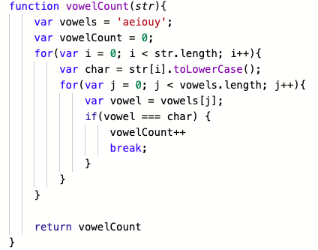
Code / Test
REACTO
Notes:
Sample problems: "Hydronium" (Hello -> H3O); or a harder problem (figure out one).

Slide 16
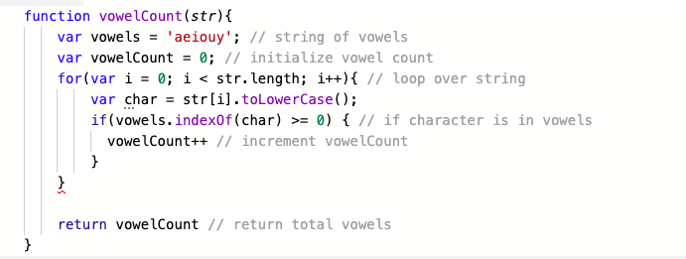
Optimize
REACTO
Notes:
Sample problems: "Hydronium" (Hello -> H3O); or a harder problem (figure out one).

Slide 17
Today’s Problem
Today you will build a Caesar Cypher, an encryption scheme favored by the Ancient Romans
Your function will take a string, and a number of characters. It should shift each character in the string by that number of letters
Example: “dog” shifted by 4 => “hsk”
REACTO

Slide 18
Et Tu ReaCTO?
R
E
A
C
T
O
e s t a t e
x a m p l e s
p p r o a c h
o d e
e s t
p t i m i z e
REACTO

