Slide 1
Arrays II
More methods, and nested arrays
COURSE TITLE GOES HERE

Slide 2
Overview
1
2
3
4
5
6
7
8
9
10
11
12
13
14
/*
- more methods - nested arrays
*/
BOOTCAMP PREP

Slide 3
.splice method
[ George, Thomas ] [ John ]
1
2
3
4
5
6
7
8
9
10
11
12
13
14
/* .splice mutates the original array; it's used to add or remove elements from the middle of an array (instead of adding or removing from either end */
/* its first argument is an index; the second is a count of elements to delete from the element, starting at the provided index */
/* it returns a new array with all of the removed elements */
let names = ['George', 'John', 'Thomas'];
let singleTermPresidents = names.splice(1, 1);
console.log(names);
console.log(singleTermPresidents);
BOOTCAMP PREP

Slide 4
.splice method
[ Paul, Ringo ] [ George, John ]
1
2
3
4
5
6
7
8
9
10
11
12
13
14
let names = ['Paul', 'George', 'John', 'Ringo'];
let acrossTheUniverse = names.splice(1, 2);
console.log(names);
console.log(acrossTheUniverse);
BOOTCAMP PREP

Slide 5
.splice method
[ Paul, George, Ringo, John ] [ Pete ]
/* you can optionally add new elements at the given index */
let names = ['Paul', 'George', 'Pete', 'John'];
let formerMembers = names.splice(2, 1, 'Ringo');
console.log(names);
console.log(formerMembers);
1
2
3
4
5
6
7
8
9
10
11
12
13
14
BOOTCAMP PREP

Slide 6
.splice method
[ Paul, George, Pete, Stuart, Ringo, John ] [ ]
1
2
3
4
5
6
7
8
9
10
11
12
13
14
/* you don't have to remove any elements! */
let names = ['Paul', 'George', 'Ringo', 'John'];
let removedElements = names.splice(2, 0, 'Pete', 'Stuart');
console.log(names);
console.log(removedElements);
BOOTCAMP PREP

Slide 7
.join method
string
Paul,George,John,Ringo
1
2
3
4
5
6
7
8
9
10
11
12
13
14
/* .join concatenates the elements of an array into a string; the original array is not changed
*/
let names = ['Paul', 'George', 'John', 'Ringo'];
let joinedString = names.join();
console.log(typeof joinedString);
console.log(joinedString);
BOOTCAMP PREP

Slide 8
.join method
Paul and George and John and Ringo
1
2
3
4
5
6
7
8
9
10
11
12
13
14
let names = ['Paul', 'George', 'John', 'Ringo'];
let joinedString = names.join(' and '); // add a separator
console.log(joinedString);
BOOTCAMP PREP

Slide 9
.concat method
[ Ringo, John, Paul, George ]
[ Ringo, John ]
1
2
3
4
5
6
7
8
9
10
11
12
13
14
/* concat merges two or more arrays into one */
/* it returns a new array and doesn't change the array on which is was called */
let older = ['Ringo', 'John'];
let younger = ['Paul', 'George'];
let allTogetherNow = older.concat(younger);
console.log(allTogetherNow);
console.log(older);
BOOTCAMP PREP

Slide 10
Nested arrays
[ Windows, MacOS ]
New York
2
1
2
3
4
5
6
7
8
9
10
11
12
13
14
/* arrays can contain any type of value, including other arrays */
let relatedThings = [['Windows', 'MacOS'], ['New York', 'Chicago']];
console.log(relatedThings[0]);
console.log(relatedThings[1][0]);
console.log(relatedThings.length);
BOOTCAMP PREP

Slide 11
Nested arrays: looping
Jane
Mel
Jack
Rohan
David
Meg
1
2
3
4
5
6
7
8
9
10
11
12
13
14
15
let rsvpGroups = [['Jane', 'Mel'], ‘Jack',
['Rohan', 'David', 'Meg']];
for (let i = 0; i < rsvpGroups.length; i++) {
let element = rsvpGroups[i]; // not sure if this is a string or an array
if (Array.isArray(element)) {
for (let j = 0; j < element.length; j++) {
let name = element[j];
console.log(name);
}
} else {
console.log(element)
}
}
BOOTCAMP PREP

Slide 12
Nested arrays: grid
[ 1, 1, 1 ]
1
2
3
4
5
6
7
8
9
10
11
12
13
14
/* use nested arrays to represent a grid in code */
/* inner arrays represent the rows of the grid */
/* each index of the rows represents a column */
let grid = [
[1, 2, 3],
[1, 2, 3],
[1, 2, 3]
];
let firstColumn = [grid[0][0], grid[1][0], grid[2][0]];
console.log(firstColumn);
BOOTCAMP PREP
Notes:
We include this slide so that students are better prepared for the grid-related questions in the workshop.

Slide 13
Recap
1
2
3
4
5
6
7
8
9
10
11
12
13
14
/*
- more methods - nested arrays
*/
BOOTCAMP PREP

Slide 14
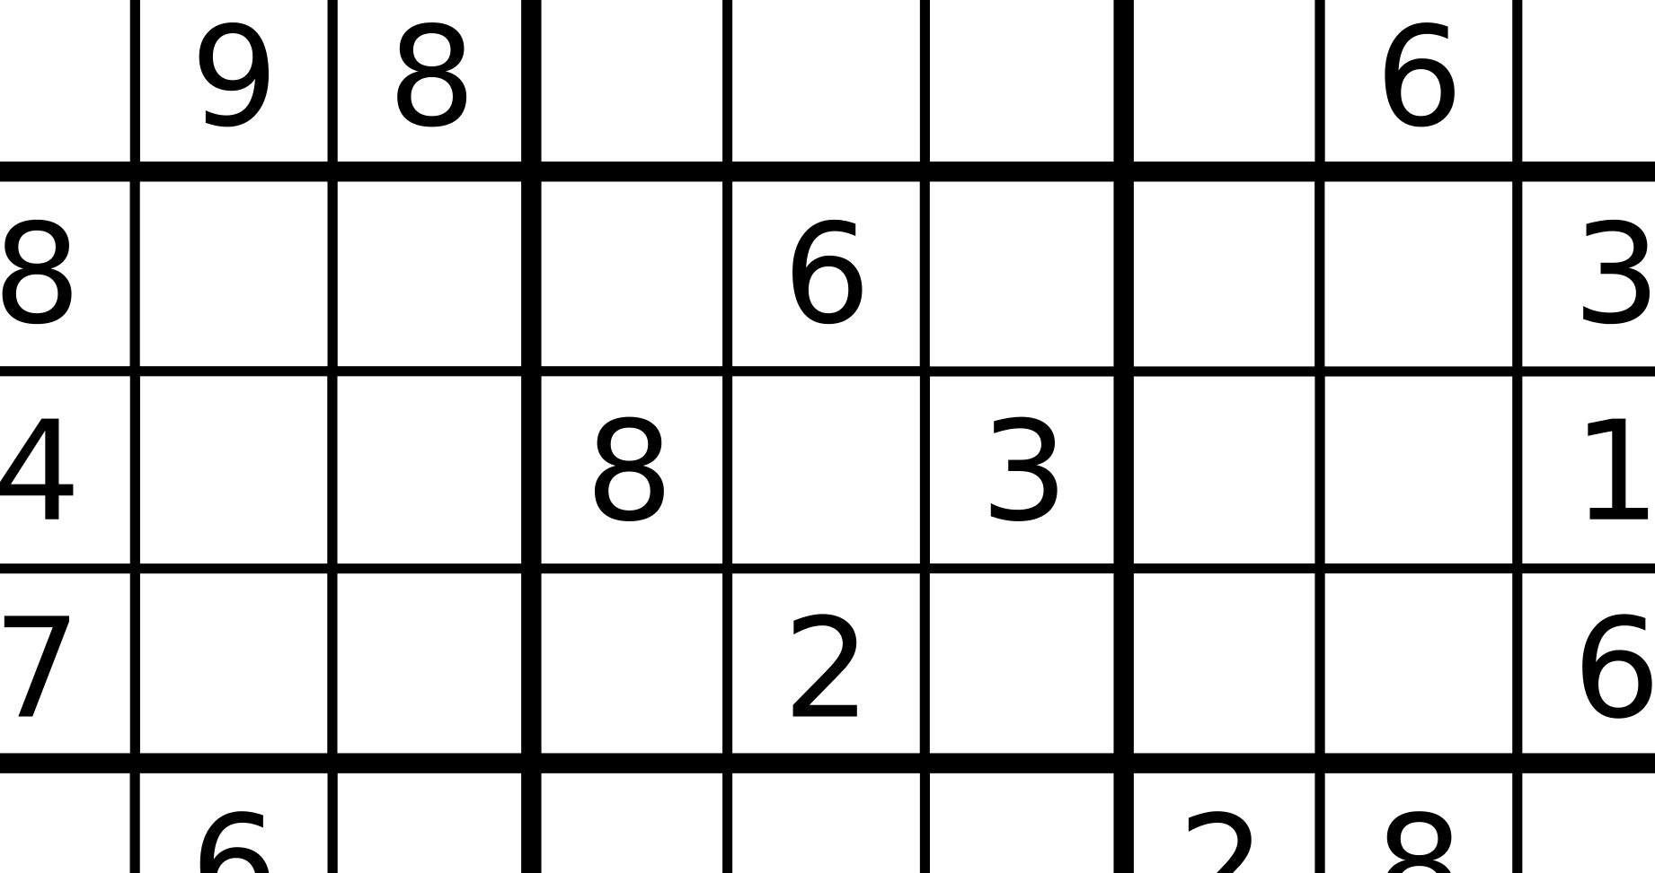
Sudoku Project
100% optional
Good practice building a slightly larger program
Instructions available in extra workshop on LearnDot
Don't forget to write tidy code!
Send your solution to the instructors by the end of class next Thursday if you want feedback!
BOOTCAMP PREP

